Slide 1
DIGITAL COLLECTION DEVELOPMENT
LOCAL AND CONSORTIAL PERSPECTIVES
Chris Palazzolo, Emory University Libraries (Emory University Libraries, Library and IT Services)
Bernard Reilly, Center for Research Libraries (CRL)

Slide 2
CURRENT STATE AND INQUIRIES
Libraries and cultural institutions have been digitizing materials for over 25 years, still significant amounts of materials remain “on tap”
Parallels with past microfilming projects that created local, consortial, and national collections may have provided guidance
How are these collections prioritized? How does one balance collection-building, the need for preservation, and the costs and resource needs associated with digitization and preservation? What is the role of individual libraries, consortia, granting agencies, and commercial vendors?

Slide 3
RATIONALES FOR DIGITIZATION (OR, SELECTIVE RESELECTION)
Rationales abound (CLIR/DLF 2001 “Strategies for Building Digitized Collections”)
Space constraints
Protecting at risk materials (preservation)
Faculty research and teaching
One-offs versus collection building
Digital projects/digital humanities
Enhanced access to restricted materials
Community development/partnerships

Slide 4
CURATION AND CREATION
What is the “collection” under consideration?
Some collections are naturally linked to a print collection(e.g., Yellowbacks, Papers of person X)’ others are curated to establish a new digital collection (e.g., Views of Rome)
Who performs the curation? Faculty, librarians, commercial vendor?
Are collections “open” or “closed” (what is a threshold)
How do you scale collections?
At what level is the collection (library, state, regional, national, international)--how are collections connected to each other (e.g., IIIF, national digital libraries)
Preservation and collection-building need not be mutually exclusive, but they can be!

Slide 5
EMORY—DIGITAL COLLECTIONS POLICY SUITE
Focused on creating and establishing an overall digital collection that supports teaching, learning and research needs of faculty, students and staff
Differentiates between individual patron requests, digital projects, and “collection-building”)
Further establishes preservation, retention, and dissemination policies to govern digital assets
Much digitization had occurred prior to the development of a Emory Repository; collections disseminated in various ways, with varying levels of preservation, some collections, some one-offs, etc.

Slide 6
Collection Digitization Prioritization
Guidelines are here (page 4)
Challenges
Newer collecting areas/focus for Emory’s Special Collections
Metadata and copyright clearances
Open Access mandates, preservation, and restricted access consideration
Donor Expectations
Short-term and long-term digitization and preservation needs (patrons, exhibits, technological obsolescence)

Slide 7
Current Ingest Prioritization
Large backlog of materials under consideration for inclusion in the Emory repository
Ingest process broken into phases for management; short-term, mid-term, and long-term (long-tail)
Necessary collection preparation and validation work for collection “stewards”
First collections as “proof of concept” for technical development
Focus on complete, open collections, mutiple formats, for “opening day”
Medium term--balancing preservation mandate with scholarly need/demand, and institutional priorities, born-digital materials

Slide 8
DIGITAL COLLECTIONS GOVERNANCE
Digital Collections Steering Committee
Focus on policy development, overall digital collection prioritization
Approval of third-party partnerships
Input on grants that involve preservation
Digital Collections Development Committee
Assess digitization or preservation proposals for metadata, technical requirements, preservation, and permissions/copyright considerations
Prioritize collections for digitization (some prioritization occurs at individual library level)
Organize call for proposals and provide “seeds” for potential digitization efforts

Slide 9
Collaborative Approaches to Collection-Building (Emory)
Participation in collective collection-building, e.g., ASERL Civil War Support
Collection-building through members
Support of library crowd-funded approaches, e.g., Reveal Digital (Independent Voices)
Umbrella organization funds metadata enhancement, digitization, preservation, marketing, etc. through libraries, who also curate and develop the collection jointly. Open access
Difficult in terms of sustainability
National scale participation: HathiTrust, Internet Archive
Costs borne out by institution in terms of metadata, technical, rights, etc.
Primarily open access

Slide 10
Commercial Considerations
Currently in process of designating cross-library principles for engagement with commercial vendors
LoC and Fyffe and Warner as starting points
Managing open-access goals with commercial ventures and preservation mandates
Participating in advisory boards with faculty and other stakeholders

Slide 11
CRL – COOPERATIVE APPROACHES TO DIGITAL COLLECTION DEVELOPMENT Background
Global Dimensions of Scholarship (2012)
Aggressively pursue broad digital access to international information resources
Internationalize research library services and perspectives
Broaden and internationalize library collaborations

Slide 13
CRL – COOPERATIVE APPROACHES TO DIGITAL COLLECTION DEVELOPMENT 1: Collective action on the “Long Tail”
Organizing cooperative support to digitize materials.

Slide 14
CRL – COOPERATIVE APPROACHES TO DIGITAL COLLECTION DEVELOPMENT 1: Collective action on the “Long Tail”
Organizing cooperative support to digitize materials.
Direct support for library-based initiatives.
Investment in Open Access

Slide 15
CRL – COOPERATIVE APPROACHES TO DIGITAL COLLECTION DEVELOPMENT 2: Collective dealings with digital publishers and other data providers
Strategic partnerships with commercial publishers and/or non-profit organizations.

Slide 16
CRL – COOPERATIVE APPROACHES TO DIGITAL COLLECTION DEVELOPMENT 2: Collective dealings with digital publishers and other data providers
Strategic partnerships with commercial publishers and/or non-profit organizations.
Direct engagement with content producers
digital media
NGOs
other non-library aggregators of documentation and data

Slide 17
GLOBAL PRESS ARCHIVE – EAST VIEW / CRL “CHARTER ALLIANCE”
3-year initiative, subcomponent of EVIS GPA initiative
Digitization of 4.5 million pages of content
3 million pages Open Access (worldwide)
1.5 million pages Licensed content open to CRL, investing institutions
Collections drawn from Hoover, CRL, other institutions

Slide 18
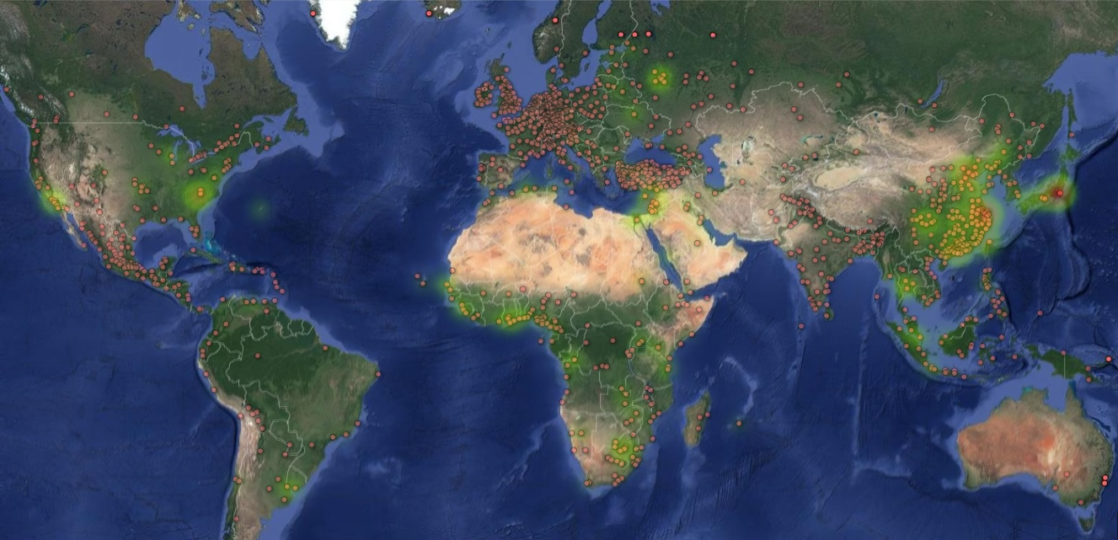
GLOBAL PRESS ARCHIVE – EAST VIEW / CRL “CHARTER ALLIANCE”
Notes:
Coverage Map of CRL International Newspaper titles (US is inaccurate). Overlayed heatmap (green glow) show areas of strength in Hoover/Stanford holdings.

Slide 19
GLOBAL PRESS ARCHIVE – EAST VIEW / CRL “CHARTER ALLIANCE” Content prioritization
Content prioritized by CRL community
9 content packages over three years (6 OA, 3 licensed)
Title preferences recommended by membership (GlobalCollections platform)
Rights cleared by EVIS
Priorities adjudicated by CRL GPA Advisory Committee

Slide 20
GLOBAL PRESS ARCHIVE – EAST VIEW / CRL “CHARTER ALLIANCE” Community benefits
Coordination of content & priorities
Cost control
Wide accessibility
Support for advanced research (DH)
Content persistence

