Slide 1
The gestalt of authority work: making sense of identity management
Violet Fox
@violetbfox
Notes:
I’m unemployed. There are a lot of bad things about that, the whole not-getting-paid thing, but if there’s one advantage, it’s right now, that I’m going to use the fact that I’m not representing an employer to my advantage to be even more political than usual. My goals with this presentation are to be interesting and coherent.
I hope you’ll give me a little leeway for throwing out a bunch of thoughts at you. I didn’t have a lot of chance to get feedback on this presentation, since I’ve got no coworkers and my spouse is real sick of hearing me talk about ethics in cataloging, even though he’s a cataloger too.

Slide 2
oclc.org
Notes:
At first glance I think this is an attractive message to many of us who have spent our careers working to make information accessible to people. But it’s trivially easy to begin picking this apart. I know my Social Security Number, but I don’t want to share it with you. People who work in health care settings don’t want to share much of the information they know about their patients.
More fundamentally, there are cultures, and here I’m thinking, for example, of the Indigenous peoples of the Americas, who have strict cultural traditions about who has access to their traditional knowledge, which can vary quite a bit: some knowledge might be suitable for everyone, some might be only for members of a particular tribe, some knowledge is only for specific genders to know, and some knowledge is only appropriate to tell during certain seasons.
The more you think about it: the idea of a universal right to knowledge is a very Western, Age of Enlightenment way of looking at things.
What I’m getting at is that talking about control over information is fraught with our cultural assumptions about the concepts of privacy and our liberties and rights. There’s no easy answers, but these are the things we need to be aware of when we have these discussions.
I have to say I think this OCLC motto is facile and for an organization that has a very large footprint, I think having this as the sentence that encapsulates their viewpoint is detrimental to our moving to a more nuanced view in identity management.

Slide 3
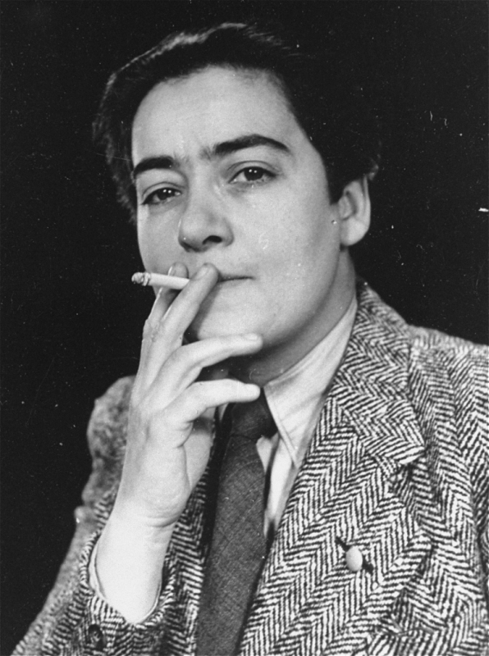
Frieda Belinfante
Notes:
Frieda Belinfante was a Dutch cellist, conductor, a prominent lesbian, and a member of the Dutch Resistance during World War II. I think we can all gather, from her photo alone, that she was pretty much a badass.
She actively contributed to the resistance movement. She forged identity documents for people hiding from the Nazis and their collaborators She was part of a resistance group that organized and executed the bombing of the population registry in Amsterdam on March 27, 1943, which destroyed thousands of files and hindered Nazi attempts to compare forged documents with documents in the registry. She had a number of close escapes from Nazi capture. After the war she emigrated to the United States and became the founding artistic director and conductor of the Orange County Philharmonic.
Why am I talking about someone who gave misinformation in records and destroyed records?
Again, we as catalogers and classifiers have a particular viewpoint, and I want to bring up Belinfante to give ourselves a chance to recalibrate our thoughts about creating and sharing accurate information as being the ultimate good.
Now let’s bring this down to our topic at hand, which is authority records. I promise I haven’t forgotten.

Slide 4
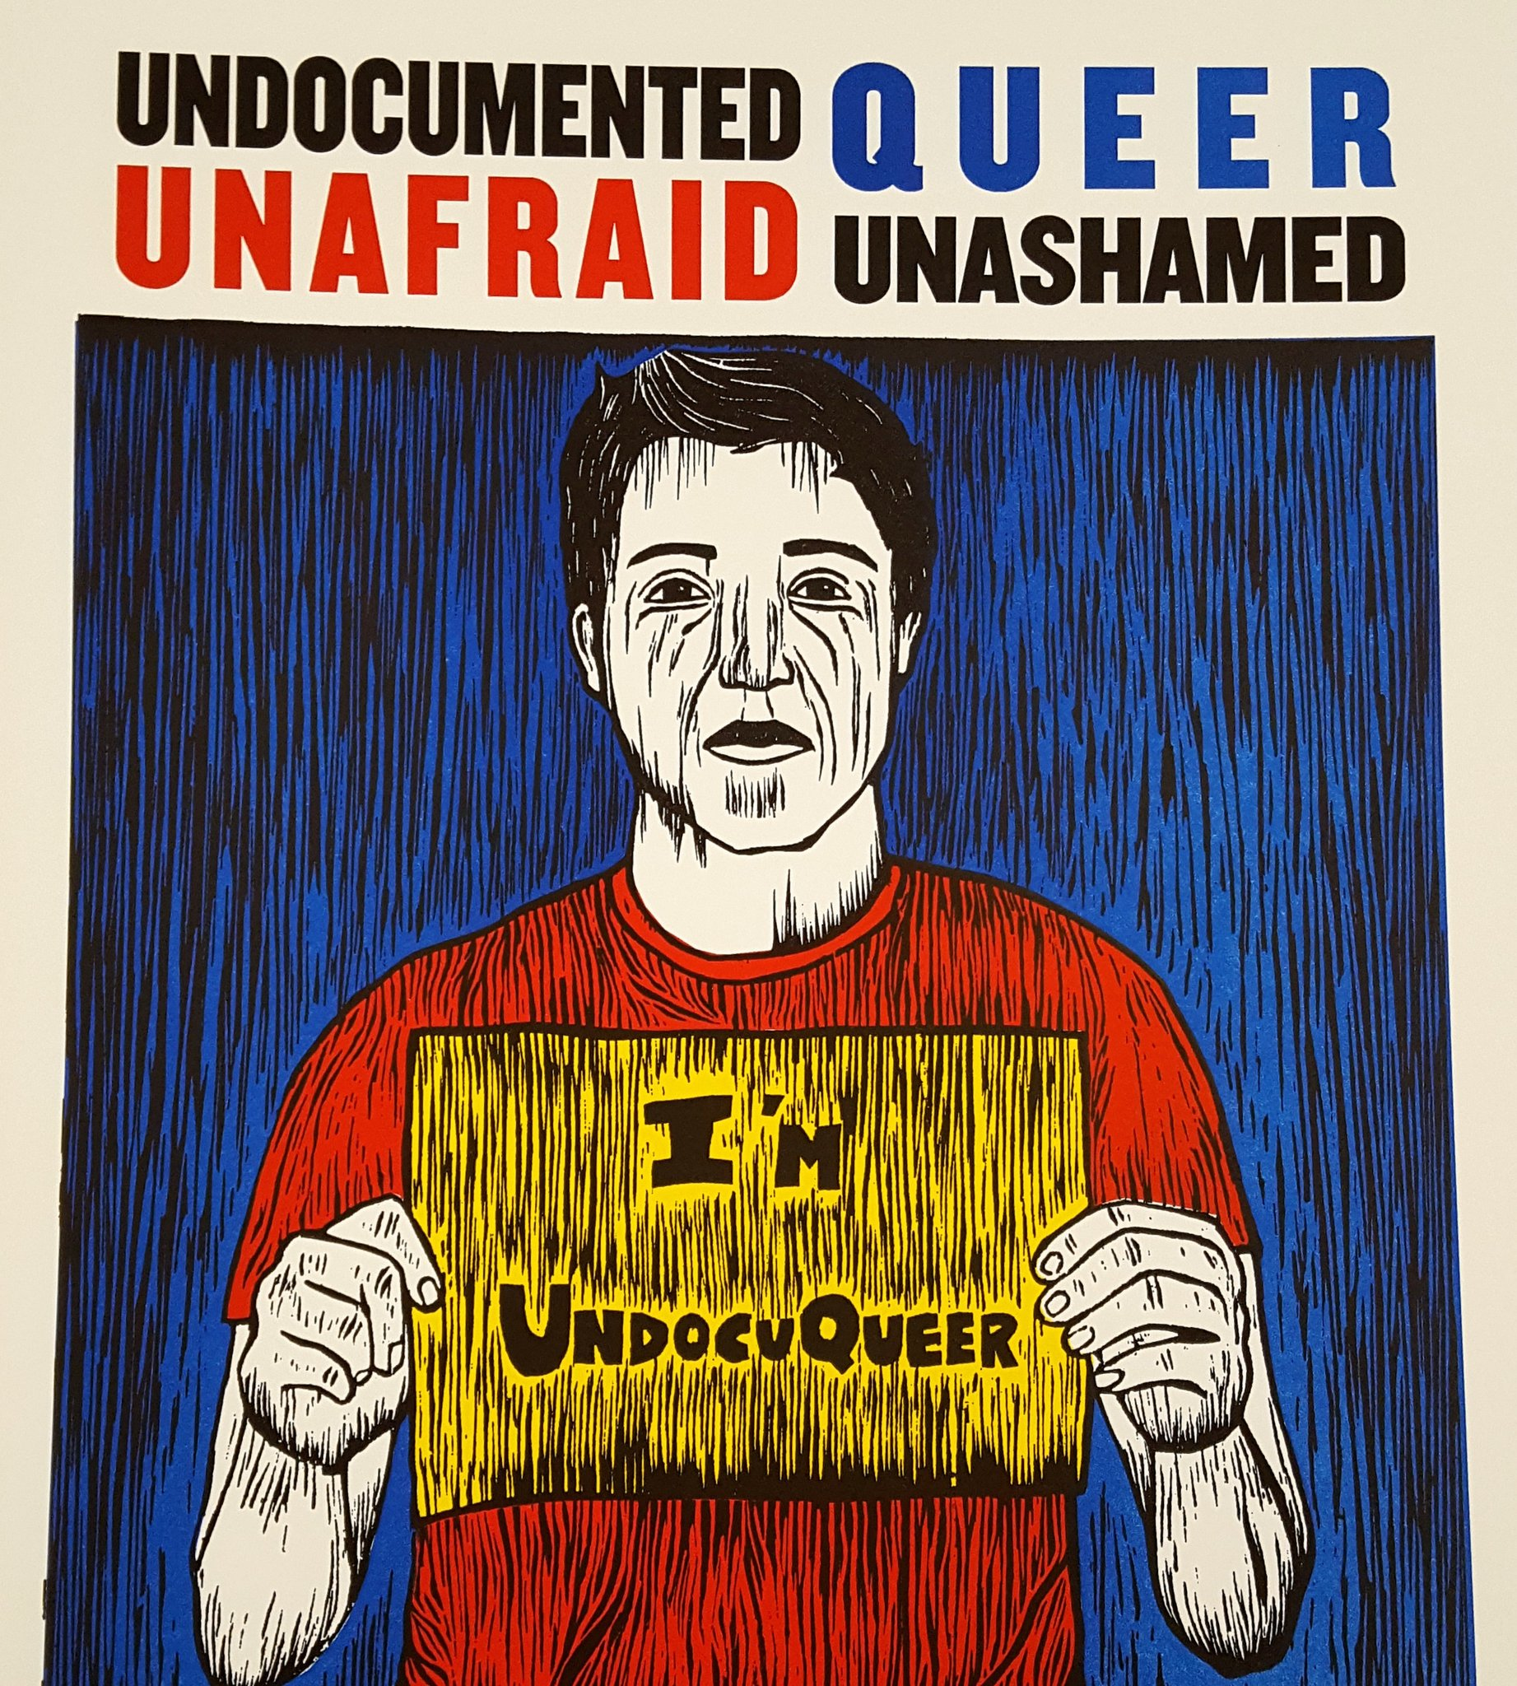
Notes:
I have a real-life cataloging example. This is an image from a portfolio of letterpress and silkscreened artworks around the topic of migration. The portfolio had an introductory sheet that had information about each of the artists who had created these images. My item in hand has this artist’s full name, the year of their birth, the fact that they were born outside the U.S., and from their artists’s statement, I know that they identify as queer and they are an undocumented immigrant to the U.S.
If I’m thinking like a cataloger, I’m thinking, GREAT. I can put in a 046 for their date of birth, 370 for place of birth. Heck maybe I’ll put in a 372 to say they’re a “Political activists” talking about issues of “Illegal aliens” subfield 2 LCSH.
But if I’m thinking like a human being, I think twice about putting that information into the NAF. And this is where I come to the point of all of this: we’re putting information about people into a database that run in a large part by a government agency. And I want us to think about that.
I interned in the Dewey Office at the Library of Congress, and I have good friends who work at LC. But the lesson that I took away from the effort to replace the “Illegal aliens” LCSH is that LC doesn’t have complete control over their own information. Or, at least, for any number of reasons, they can’t or won’t push back when confronted.

Slide 5
we are entering information into a government database
we don’t control who uses that information or for what purposes
Notes:
I bring up our freedom-fighting Dutch friend Frieda Belinfante to remind us that we are entering information into a, at least a semi- governmental database, and that we don’t have control as to who uses that information or for what purposes. Do I know with 100% certainty that the information I add to NAF, like, a birthplace, won’t be used by, for example, ICE (immigration and custom enforcement) to deport people?
As we move from authority control to identity management, we have to ask, who asked us to manage their identity? With authors of traditionally published books, we can assume that authors want us to have their book in our library, and to promote their work on our blogs or our recommended reads shelves. And, generally speaking, that they’ll be okay with librarians entering information about them, their birthdate, their research interests, where they’ve lived, which works they’ve written.
But as we move away from that bibliocentric view, we begin to have things in libraries that people might not expect to have in libraries, or that they created but didn’t necessarily want in a library.

Slide 6
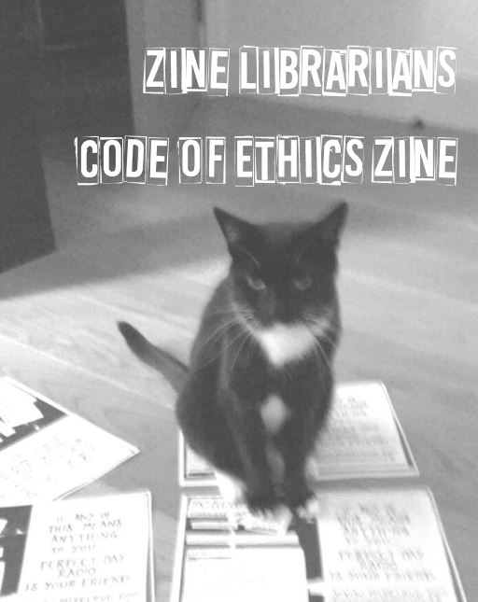
Notes:
Many of my thoughts on the ethics of authority control, especially author privacy concerns, derive from my work with zines. I’m someone who frequently proselytizes about the life-changing possibilities of zines, because they’re small publication where you can write or draw or create anything, and distribute that work cheaply, without any approval or interference from a traditional publisher, or your Internet Service Provider, or a blogging platform, or an Internet hosting site.
That also means that zines are often very personal. Imagine a zine that was created by a fifteen-year-old talking about, for example, their issues with gender confusion, and they distributed ten copies of it to their friends. And say ten years later they discover from a web search on their name that their zine, full of their private thoughts, was donated by someone else to a library halfway across the country.
You can say “well, they ‘published’ it, so tough luck,” but the zine community would disagree with that, and would recognize that as zines are often published by people who are most marginalized in our society, and that librarians have a responsibility NOT JUST to users of the information in our resources but also to the creators.
Let me quote from the Zine Librarians Code of Ethics: “Librarians and archivists should consider that making zines discoverable on the Web or in local catalogs and databases could have impacts on creators – anything from mild embarrassment to the divulging of dangerous personal information. Zine librarians/archivists should strive to make zines as discoverable as possible, while also respecting the safety and privacy of their creators.”

Slide 7
Notes:
Do people know that we’re collecting information on them? Yesterday there was a presentation at the Cataloging Norms Interest Group called “Catalogers Cyberstalking Authors,” by Ilda Cardenas at Mississippi State. I’m sorry to have missed it, but here’s a bit from the abstract: “The preliminary results suggest catalogers are “stalking” authors’ social media profiles for information to include in an authority record. They are using social media instead of contacting authors or publishers directly for this information and it appears to be common practice.”
That’s kinda creepy? We need to stop creeping around on people, and just ask them for their information. Contacting creators takes more time but it ensures accuracy as well as being a type of outreach. Catalogers get precious few chances to do outreach to the public, but the work we do with authorities is important enough to get in touch with creators to say, look, we’re doing this work in a large part to benefit the author, to make sure that you’re the same “Jane Smith” who also wrote a book about flying kites, and to ensure that people can find all your work.
What recourse do people have when they find out they’re in the authority file and they don’t want to be? Do we give people the option to opt out? Or if there is information in their record that they don’t want there, say, a birthdate or a middle name. What recourse do they have when they ask us to remove their information? (As far as I know, there's no way to have a suppressed record in NAF, so if someone asks to be removed, it might technically be possible, but what would stop someone else from creating a record? I honestly don’t know what LC’s policy on that is, if they have one.
We need to think more thoroughly about who controls the information we put into the NAF. If we want to be ethically responsible, we need to give creators control over their personal information, including whether they want to be listed in the NAF at all. And we need to make the process more transparent. Tina Gross of St Cloud State and I are writing a book chapter in the forthcoming “Ethical Questions in Name Authority Control,” and one of the fairly simple suggestions we have for the leadership of PCC is to create a landing page, a page on the PCC site for non-librarians to understand what an authority record is and why we’re collecting information on people. And put info on that landing page about who to contact if there is incorrect information or information they want removed. We think that would go a long way towards giving people autonomy over their information. And hopefully catalogers would stop creeping around on LinkedIn.

Slide 8
an overall philosophy
of authcon
Notes:
As we move forward with Linked Data initiatives, we’re linking our information along with the information about objects, places, and things that exist out in the big world of data. Even if we do take steps to allow individuals to have control over the information in the NAF, they may or may not have control over the information from other sources that libraries link to. That’s not necessarily a problem we can solve, but as librarians we can at least be a good example of good stewardship of people’s personal information.
Finally I want to end with the idea of the gestalt of identity management, or, as my friend Catherine Oliver put it, an overall philosophy of authcon. What I’m arguing is that we no longer have one. Right now we’re moving towards trying to provide information that will work in ways we don’t currently anticipate. When we add RDA fields to records, we’re taking a step of faith that at some point our ILSes, our discovery systems, or whatever comes next, will allow for awesome new ways of discovery, different data mining, digital humanities projects that will allow for ways of thinking about the bibliographic universe, or whatever is beyond “bibliographic”. That makes it hard to anticipate potential harmful uses of the data we are adding today. BUT We’re no longer just categorizing books or maps or CDs, we’re categorizing people. And that greatly increases the chance for harm.

Slide 9
“The scholar may swear to his neutrality on the job, but whether he be physicist, historian, or archivist, his work will tend… to maintain the existing social order by perpetuating its values, by legitimizing its priorities, by justifying its wars, perpetuating its prejudices, contributing to its xenophobia, and apologizing for its class order.”
–Howard Zinn
Notes:
I want to state that I have great trust in my colleagues who are doing the work of the move to identity management. But we, as the community of people who create records, add fields, and shape the authority file ever so incrementally in our daily work, need to be cognizant of our cultural assumptions, both spoken and unspoken, that influence our decisions as to who we describe and how we describe them. And, in the larger sense, who is using the data we create, and for what purposes.
And again I’m gonna be as political as I can and end with a Howard Zinn quote. “The scholar may swear to his neutrality on the job, but whether he be physicist, historian, or archivist, his work will tend… to maintain the existing social order by perpetuating its values, by legitimizing its priorities, by justifying its wars, perpetuating its prejudices, contributing to its xenophobia, and apologizing for its class order.”

Slide 10
Thanks! Violet Fox @violetbfox violetfox@gmail.com
Notes:
And if you’d like to encourage me not to be so political, I’m now accepting job offers.

