Slide 1
LCDGT in Bibliographic and Authority Records
Adam L. Schiff
Principal Cataloger
University of Washington Libraries
aschiff@uw.edu
ABC’s of LCDGT
November 30, 2023

Slide 2
LCDGT in Bibliographic Records
385 Audience Characteristics
386 Creator/Contributor Characteristics
LCDGT was developed specifically for use in 385 and 386 fields
650 Subject Added Entry - Topical Term
656 Index Term - Occupation

Slide 3
MARC 385 – Audience Characteristics
Indicators both blank
Subfields:
$a – Audience term (R)
$b – Audience code (R)
$m – Demographic group term (NR)
$n – Demographic group code (NR)
$0 – Authority record control number or standard number (R)
$2 – Source (NR)
$3 – Materials specified (NR)
Notes:
Field Definition and Scope
A category of persons for which a resource is intended or a category of persons representing the intellectual level for which the content of a resource is considered appropriate.
If a demographic group is not specified then multiple audience characteristics from the same source vocabulary or code list may be recorded in the same field in separate occurrences of subfield $a and subfield $b. If a demographic group is specified then the characteristics in the field must all come from the same group. Terms from different source vocabularies are recorded in separate occurrences of the field.

Slide 4
MARC 386 – Creator/Contributor Characteristics
Indicators both blank
Subfields:
$a – Creator/contributor term (R)
$b – Creator/contributor term code (R)
$i – Relationship information (R)
$m – Demographic group term (NR)
$n – Demographic group code (NR)
$0 – Authority record control number or standard number (R)
$2 – Source (NR)
$3 – Materials specified (NR)
$4 – Relationship (R)
Notes:
Field Definition and Scope
A group category to which the creator(s) of a work or compilation of works, or the contributor(s) to an expression or compilation of expressions, belongs.
If a demographic group is not specified then multiple creator/contributor group categories from the same source vocabulary or code list may be recorded in the same field in separate occurrences of subfield $a and subfield $b. If a demographic group is specified then the categories in the field must all come from the same group. Terms from different source vocabularies are recorded in separate occurrences of the field.

Slide 5
MARC 385/386 $m and $n
$m – Demographic group term (NR)
$n – Demographic group code (NR)
During the development of the 385 and 386 fields, we noted that many class of persons headings belong to broader group categories that users might want to search or limit by. For example, children, tweens, teenagers, young adults, middle-aged persons, and senior citizens are all examples of age groups. Catholics, Baptists, Jews, Buddhists, Mormons, Muslims, Hindus, and Wiccans are all examples of religious groups.
LC maintains the list of group terms and codes: http://www.loc.gov/standards/valuelist/lcdgt.html and https://id.loc.gov/authorities/demographicTerms.html

Slide 6
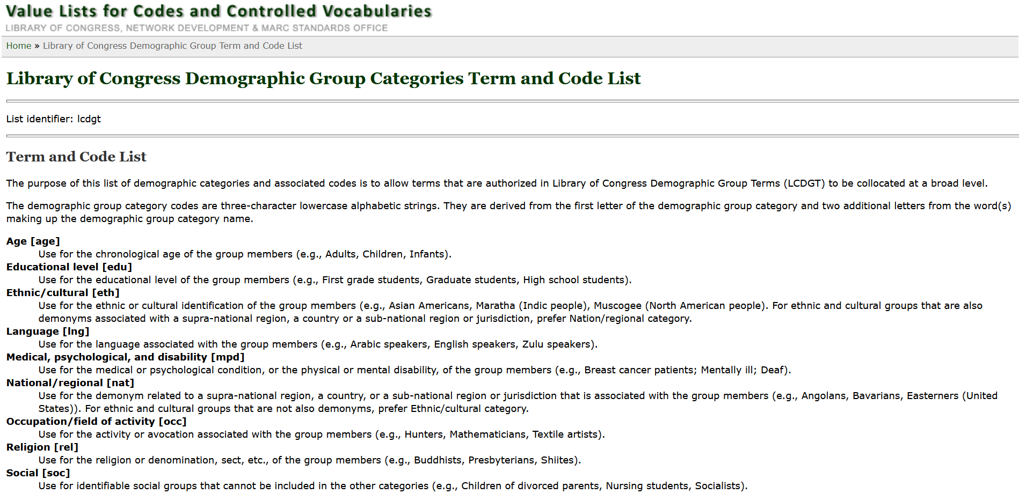
http://www.loc.gov/standards/valuelist/lcdgt.html

Slide 7
385/386 Fields
$m and $n are optional. They are not repeatable. Most catalogers don’t record them. LCDGT manual says not to use $m.
$2 is optional, but should be included if a term is from a controlled vocabulary. Use lcdgt for terms from LCDGT.
May repeat $a when terms are from the same vocabulary:
386 __ Catholics $a Canadians $a Librarians $2 lcdgt
A work or works created by Catholic Canadian librarians
Alternatively, may record each term in a separate field (LCDGT manual best practice):
386 __ Catholics $2 lcdgt
386 __ Canadians $2 lcdgt
386 __ Librarians $2 lcdgt
Notes:
LCDGT Manual L 550 (Audience): Optionally, the field may include an $n subfield containing the three-letter code assigned to the demographic group category. Optionally, it may also include a $0 (zero) subfield for the control number of the record of the authorized term used in the $a subfield.
Best practice is to repeat the field when more than one term is being recorded.
LCDGT Manual L 555 (Creator/Contributor): Optionally, the field may include subfields $i, $n, and $0.
Best practice is to repeat the field when more than one term is being recorded.

Slide 8
385/386 Fields
Must repeat the field if $m or $n is used and terms belong to different demographic categories:
386 __ $n rel $a Catholics $2 lcdgt
386 __ $n nat $a Canadians $2 lcdgt
386 __ $n occ $a Librarians $2 lcdgt
Should repeat the field if including $0 or $1
386 __ Catholics $2 lcdgt $0 http://id.loc.gov/authorities/
demographicTerms/dg2015060259
386 __ Canadians $2 lcdgt $0 http://id.loc.gov/authorities/
demographicTerms/dg2015060002
386 __ Librarians $2 lcdgt $0 http://id.loc.gov/authorities/
demographicTerms/dg2015060192

Slide 9
385/386 Fields
Must repeat field if terms are from different controlled vocabularies:
385 __ $a Teenagers $2 lcdgt
385 __ $a Adolescents $2 ericd
A work or works for teenagers
386 __ $a Indians, North American $2 mesh
386 __ $a American Indians $2 ericd
386 __ $a Indians of North America $2 lcsh
386 __ $a Indigenous people of America $2 lcdgt
A work or works created by Native Americans

Slide 10
Because of the way faceting works in discovery systems, it may sometimes be advisable to record more than one term in a hierarchy, such as demonyms
100 1# Guizzetti, Elizabeth, $e author, $e illustrator.
240 10 Accident among vampires
245 10 Accident among vampires, or, What would Dracula do? : $b a novel
set in the Paper Flower Consortium / $c written by Elizabeth
Guizzetti ; cover and interior illustrations by Elizabeth Guizzetti.
386 ## Americans $a Washingtonians (Washington State) $a Seattleites $a
Women $2 lcdgt
The reason for this: library discovery systems do not provide facets in a hierarchical expandable arrangement the way systems like Amazon and eBay do. We don’t want users to have select demonyms for Americans, for every state and territory, and for every region or city in order to get all works by Americans.

Slide 11
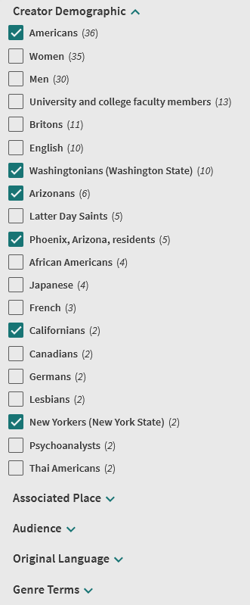
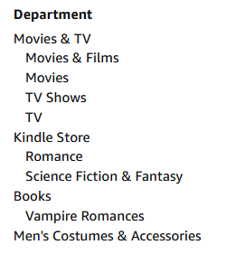
Amazon Facets
eBay Facets
Primo Facets
Notes:
Results of a search for keyword “vampire” in Amazon, eBay, and Primo.
Amazon and eBay present the shopper with hierarchically arranged and indented facets, which in some categories can be expanded to include subcategories. However, Primo does not present the user with a facet for Americans that can be opened up to show facets for each state demonym. If we don’t include Americans in a 386 field, a user wanting all works by Americans has to select Arizonans, Californians, New Yorkers, Washingtonians, etc. By including demonyms at multiple hierarchical levels, we make it easier for users to select what they are looking for.

Slide 12
May use $3 for parts of resource to which the field applies.
245 00 Contemporary African plays / $c edited and introduced by Martin Banham and Jane Plastow.
386 __ Africans $2 lcdgt
386 __ $3 The chattering and the song ; Death and the king’s horseman $a Nigerians $2 lcdgt
386 __ $3 The rise and shine of Comrade Fiasco $a Zimbabweans $2 lcdgt
386 __ $3 Anowa $a Ghanaians $2 lcdgt
386 __ $3 Woza Albert! $a South Africans $2 lcdgt
386 __ $3 The other war $a Eritreans $2 lcdgt
386 __ $3 The chattering and the song ; The rise and shine of Comrade Fiasco ; Woza Albert! ; The
other war ; Death and the king’s horseman $a Men $2 lcdgt
386 __ $3 Anowa $a Women $2 lcdgt
505 0_ The chattering and the song / Femi Osofisan -- The rise and shine of Comrade Fiasco /
Andrew Whaley -- Anowa / Ama Ata Aidoo -- Woza Albert! / Percy Mtwa, Mbongeni Ngema,
and Barney Simon -- The other war / Alemseged Tesfai ; translated by Paul Warwick, Samson
Gebregzhier, and Alemseged Tesfai -- Death and the king's horseman / Wole Soyinka.
650 _0 African drama (English) $y 20th century.
655 _7 Drama. $2 lcgft
Notes:
$3 - Materials specified
Part of the described materials to which the field applies.
The first 386 applies to all of the works in this collection, so no $3 is necessary.

Slide 13
May use $i and/or $4 to record relationship between the term(s) recorded and the resource being described.
100 1_ Rylant, Cynthia, $e author.
245 10 Herbert's first Halloween / $c by Cynthia Rylant ; illustrated by Steven Henry.
386 __ $i Author: $a Oregonians $a Women $2 lcdgt
386 __ $i Illustrator: $a Washingtonians (Washington State) $a Men $2 lcdgt
650 _0 Halloween $v Juvenile fiction.
650 _0 Father and child $v Juvenile fiction.
650 _0 Costume $v Juvenile fiction.
650 _1 Halloween $v Fiction.
650 _1 Father and child $v Fiction.
655 _7 Fiction. $2 lcgft
655 _7 Picture books. $2 lcgft
700 1_ Henry, Steven, $d 1962- $e illustrator.
Notes:
$i - Relationship information (R)
Designation of a relationship between one or more members of the demographic group recorded in the 386 field and the resource described in the 1XX/245 of the record. This may be an uncontrolled textual phrase or a controlled textual value from a list of relationships between bibliographic resources.
$4 - Relationship
Code or URI that specifies the relationship from the entity described in the record to the entity referenced in the field.
LCDGT Manual L 555: Capitalize the first letter of a relationship term and record it in the singular. Follow the relationship term with a colon. For further guidance, see DCM Z1 386 Creator-Contributor Characteristics.

Slide 14
$i and $4 are repeatable, but LCDGT manual says $i should not be repeated
100 1_ Bizet, Georges, $d 1838-1875, $e composer.
245 10 Carmen / $c Georges Bizet.
386 __ $i Composer: $a French $2 lcdgt $4 cmp
386 __ $i Librettist: $a French $2 lcdgt $4 lbt
386 __ $i Composer: $a Men $2 lcdgt $4 cmp
386 __ $i Librettist: $a Men $2 lcdgt $4 lbt
386 __ $i Conductor: $a Americans $2 lcdgt $4 cnd
386 __ $i Conductor: $a Men $2 lcdgt $4 cnd
500 __ Libretto by Henri Meilhac and Ludovic Halévy, based on the novella by Prosper Mérimée.
511 0_ Adriana Maliponte, soprano ; Marilyn Horne, mezzo-soprano ; James McCracken,
tenor ; Tom Krause, baritone ; Donald Gramm, bass ; Colette Boky, Marcia Baldwin,
Russell Christopher, Andrea Velis, Raymond Gibbs, supporting soloists ; Manhattan
Opera Chorus ; Metropolitan Opera Orchestra and Children's Chorus ; Leonard Bernstein,
conductor.
700 1_ Meilhac, Henri, $d 1831-1897, $e librettist.
700 1_ Halévy, Ludovic, $d 1834-1908, $e librettist.
Notes:
$i - Relationship information (R)
Designation of a relationship between one or more members of the demographic group recorded in the 386 field and the resource described in the 1XX/245 of the record. This may be an uncontrolled textual phrase or a controlled textual value from a list of relationships between bibliographic resources.
$4 - Relationship
Code or URI that specifies the relationship from the entity described in the record to the entity referenced in the field.
According to the PCC Task Group on Linked Data Best Practices: final report (https://www.loc.gov/aba/pcc/taskgroup/linked-data-best-practices-final-report.pdf), the preferred order of subfields is $2 $4 $0 $1.

Slide 15
386 Field
$4 can hold a code and/or URI for the relationship
130 0_ Gravity (Motion picture : 2013)
245 10 Gravity / $c directed by Alfonso Cuarón ; written by Alfonso
Cuarón & Jonás Cuarón ; produced by Alfonso Cuarón ; produced
by David Heyman ; executive producers, Nikki Penny, Chris
DeFaria, Stephen Jones ; a Warner Bros. Pictures presentation ; an
Esperanto Filmoj produktado ; a Heyday Films production ; an
Alfonso Cuarón film.
257 __ United States $a Great Britain $2 naf
386 __ $i Film director: $a Mexicans $a Men $2 lcdgt $4
http://id.loc.gov/vocabulary/relators/fmd
Notes:
$4 - Relationship
Code or URI that specifies the relationship from the entity described in the record to the entity referenced in the field.
According to the PCC Task Group on Linked Data Best Practices: final report (https://www.loc.gov/aba/pcc/taskgroup/linked-data-best-practices-final-report.pdf), the preferred order of subfields is $2 $4 $0 $1.

Slide 16
386 Field
Example showing both $3 and $i
245 00 Three contemporary European plays.
386 __ $i Author: $a Europeans $2 lcdgt
386 __ $3 Escalation: obscene $i Author: $a Austrians $a Men $2 lcdgt
386 __ $3 The propsmaster $i Author: $a Serbs $a Men $2 lcdgt
386 __ $3 Hand in hand $i Author: $a Swedes $a Women $2 lcdgt
505 0_ Escalation: obscene / by Werner Schwab ; translated by David
Barnett -- The propsmaster / by Uglješa Šajtinac ; translated by
Duška Radosavljević Heaney -- Hand in hand / by Sofia Fredén ;
translated by Mark Batty.
655 _7 Drama. $2 lcgft
Notes:
$3 - Materials specified
Part of the described materials to which the field applies.
There are other ways to record the gender. For example (shown on the next slide):
386 __ $3 Escalation: obscene $i Author: $a Austrians $2 lcdgt
386 __ $3 The propsmaster $i Author: $a Serbs $2 lcdgt
386 __ $3 Hand in hand $i Author: $a Swedes $2 lcdgt
386 __ $3 Escalation: obscene ; The propsmaster $i Author: $a Men $2 lcdgt
386 __ $3 Hand in hand $i Author: $a Women $2 lcdgt
$i is used here because statements are only being made about the authors of the plays, not the translators.

Slide 17
386 Field
Example showing both $3 and $i
Alternative to the previous slide (LCDGT best practice):
386 __ $i Author: $a Europeans $2 lcdgt
386 __ $3 Escalation: obscene $i Author: $a Austrians $2 lcdgt
386 __ $3 The propsmaster $i Author: $a Serbs $2 lcdgt
386 __ $3 Hand in hand $i Author: $a Swedes $2 lcdgt
386 __ $3 Escalation: obscene ; The propsmaster $i Author: $a Men $2 lcdgt
386 __ $3 Hand in hand $i Author: $a Women $2 lcdgt
Notes:
An alternative way to record the same characteristics. There is no one correct way, and there is presently no best practice, although LC practice is to use only one demographic group term per field.
$i is used here because statements are only being made about the authors of the plays, not the translators.

Slide 18
386 Field
$3 will commonly be used for sound recordings of works by various composers
245 00 Cello sonata ; $b Polonaise brillante / $c Chopin. Variations
concertantes / Mendelssohn. Variations on a theme of Rossini /
Martinů. Cello sonata / Debussy. Rhapsody no. 1 / Bartók.
Hungarian wedding dance / Weiner.
386 __ $3 Cello sonata (Chopin) ; Polonaise brillante $i Composer: $a Poles $2 lcdgt
386 __ $3 Variations concertantes $i Composer: $a Germans $2 lcdgt
386 __ $3 Variations on a theme of Rossini $i Composer: $a Czechs $2 lcdgt
386 __ $3 Cello sonata (Debussy) $i Composer: $a French $2 lcdgt
386 __ $3 Rhapsody no. 1 ; Hungarian wedding dance $i Composer: $a Hungarians $2
lcdgt
386 __ $i Composer: Men $2 lcdgt
Notes:
$3 - Materials specified
Part of the described materials to which the field applies.
Will commonly be used for music by composers with different characteristics.
No subfield $3 necessary for the final 386, because all of the compositions are by men.
$i is used here because statements are only being made about the composers of the music on the sound recording, not the performers or others involved.

Slide 19
LCDGT in Other Fields: 650 and 656
Because LCDGT is listed on the Subject Heading and Term Source Codes list, it may also be used in subject fields
Reasons for using LCDGT as subject:
Equivalent class of persons term not available in LCSH or FAST or other controlled vocabularies
Examples: Fire ecologists; Labor historians; Analytical chemists; Applied mathematicians; Food studies scholars; Atmospheric scientists; Crime writers; Booker Prize winners; Reform Jews; People of color; Indigiqueer people; Fifth grade teachers; Oboe teachers; Eighth grade students; Ecology students
LCSH expresses the same concept differently
Examples: Celiac disease--Patients (LCSH) vs. Celiac disease, People with (LCDGT)
Japanese--Canada (LCSH) vs. Japanese Canadians (LCDGT)
Hotels--Employees (LCSH) vs. Hotel employees (LCDGT)
Seattle (Wash.)--[subdivision, e.g. Biography] (LCSH] vs. Seattleites (LCDGT)
Iroquois Indians (LCSH) vs. Haudenosaunee (North American people) (LCDGT)
Library does not participate in SACO to propose an LCSH term
LCSH does not allow certain kinds of terms that are allowed in LCDGT
Examples: French speakers; Japanese Canadians; Somali Finns; Wisconsinites; Berliners; Upstate New Yorkers; Church of Scotland members; Selkirk First Nation citizens; Parti québécois members (Québec)
LCSH uses a same or similar term in a different way
Examples: Australians (LCSH) vs. Australians (LCDGT)
German students (LCSH) vs. German, Students of (LCDGT)

Slide 20
LCDGT in Other Fields: 650 and 656
245 00 Two monographs on Japanese Canadians / $c edited by Roger Daniels.
500 ## Reprint of the 1958 ed. of K. Adachi's A history of the Japanese Canadians
in British Columbia, 1877-1958, and of the 1972 ed. of D. Iwaasa’s
Canadian Japanese in southern Alberta, 1905-1945, which was published
by the University of Lethbridge, Lethbridge, Alta., in series: University of
Lethbridge research paper.
650 #0 Japanese $z British Columbia $x History.
650 #0 Japanese $z Alberta $x History.
651 #0 British Columbia $x History.
651 #0 Alberta $x History.
650 #7 Japanese Canadians. $2 lcdgt
650 #7 British Columbians. $2 lcdgt
650 #7 Albertans. $2 lcdgt

Slide 21
LCDGT in Other Fields: 650 and 656
100 1# Desjardins, Michel, $e author.
245 10 Vitality indicators for official language minority communities 1 : $b francophones in urban settings : the Halifax francophone community.
650 #0 Linguistic minorities $z Nova Scotia $z Halifax.
650 #0 French-Canadians $z Nova Scotia $z Halifax.
651 #0 Halifax (N.S.) $x Languages.
650 #7 French Canadians. $2 lcdgt
650 #7 French speakers. $2 lcdgt
650 #7 Haligonians. $2 lcdgt
110 2# National Union of Marine Cooks and Stewards, $e creator.
245 10 Marine Cooks and Stewards Union records.
610 20 National Union of Marine Cooks and Stewards $v Archives.
610 20 Alaska Steamship Co. $x History $v Sources.
650 #0 Contracts for work and labor $z Washington (State) $z Seattle $x History $v Sources.
650 #0 Cooks $x Labor unions $x History $v Sources.
650 #0 Stewards $x Labor unions $x History $v Sources.
656 #7 Marine cooks. $2 lcdgt
656 #7 Marine stewards. $2 lcdgt
Notes:
NOTE: The two LCDGT terms are not yet approved. They have been submitted through SACO.

Slide 22
LCDGT in Authority Records
Works and Expressions
385 Audience Characteristics
386 Creator/Contributor Characteristics
LCDGT was developed specifically for use in 385 and 386 fields
Persons and Families
368 $c Other Attributes of Person or Corporate Body
372 Field of Activity
374 Occupation
375 Gender [no longer used in NACO records]
376 $a Type of Family
376 $d Other Designation
Notes:
Note: MARC Proposal No. 2023-05 was approved earlier this year and expands the scope of fields 372 and 374 to families. Also approved was a new subfield $d in field 376 for Other Designation. These changes have not yet been published or implemented by NACO.

Slide 23
385/386 Fields
Same guidelines as for bibliographic records
100 1# Bulkin, Carleton. $t Dari-English/English-Dari practical dictionary
380 ## Multilingual dictionaries $2 lcgft $0 http://id.loc.gov/authorities/
genreForms/gf2017026117
385 ## Dari speakers $2 lcdgt $0 http://id.loc.gov/authorities/
demographicTerms/dg2022060130
385 ## English speakers $2 lcdgt $0 http://id.loc.gov/authorities/
demographicTerms/dg2015060276
400 1# Bulkin, Carleton. $t Dari practical dictionary
Notes:
LCDGT Manual L 550 (Audience): Optionally, the field may include an $n subfield containing the three-letter code assigned to the demographic group category. Optionally, it may also include a $0 (zero) subfield for the control number of the record of the authorized term used in the $a subfield.
Best practice is to repeat the field when more than one term is being recorded.
LCDGT Manual L 555 (Creator/Contributor): Optionally, the field may include subfields $i, $n, and $0.
Best practice is to repeat the field when more than one term is being recorded.

Slide 24
385/386 Fields
Same guidelines as for bibliographic records
100 1# Collins, Suzanne. $t Hunger Games (Novel)
370 ## $g United States $2 naf
380 ## Novels $a Dystopian fiction $a Apocalyptic fiction
$a Science fiction $a Action and adventure fiction
$2 lcgft
380 ## Young adult fiction $2 lcsh
385 ## Teenagers $2 lcdgt
386 ## Americans $2 lcdgt
386 ## Women $2 lcdgt
Notes:
LCDGT Manual L 550 (Audience): Optionally, the field may include an $n subfield containing the three-letter code assigned to the demographic group category. Optionally, it may also include a $0 (zero) subfield for the control number of the record of the authorized term used in the $a subfield.
Best practice is to repeat the field when more than one term is being recorded.
LCDGT Manual L 555 (Creator/Contributor): Optionally, the field may include subfields $i, $n, and $0.
Best practice is to repeat the field when more than one term is being recorded.

Slide 25
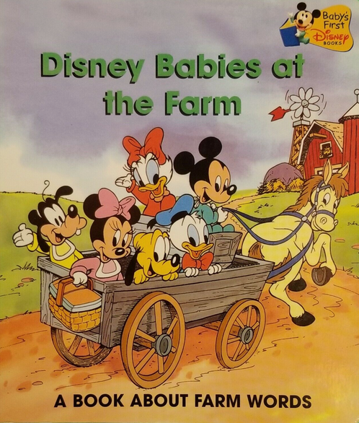
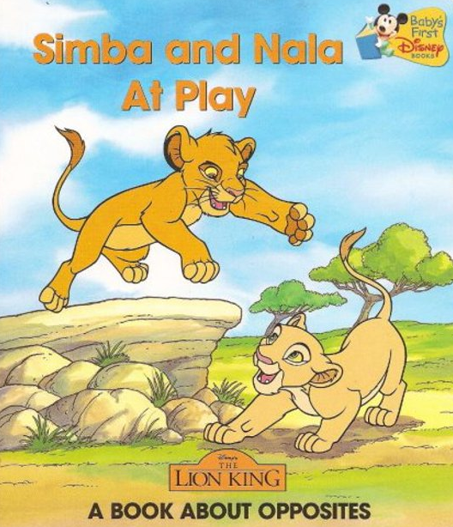
385/386 Fields
Same guidelines as for bibliographic records
130 #0 Baby's first Disney books
380 ## Series (Publications) $a Monographic series $2 lcsh
385 ## Infants $a Toddlers $2 lcdgt
Notes:
LCDGT Manual L 550 (Audience): Optionally, the field may include an $n subfield containing the three-letter code assigned to the demographic group category. Optionally, it may also include a $0 (zero) subfield for the control number of the record of the authorized term used in the $a subfield.
Best practice is to repeat the field when more than one term is being recorded.
LCDGT Manual L 555 (Creator/Contributor): Optionally, the field may include subfields $i, $n, and $0.
Best practice is to repeat the field when more than one term is being recorded.

Slide 26
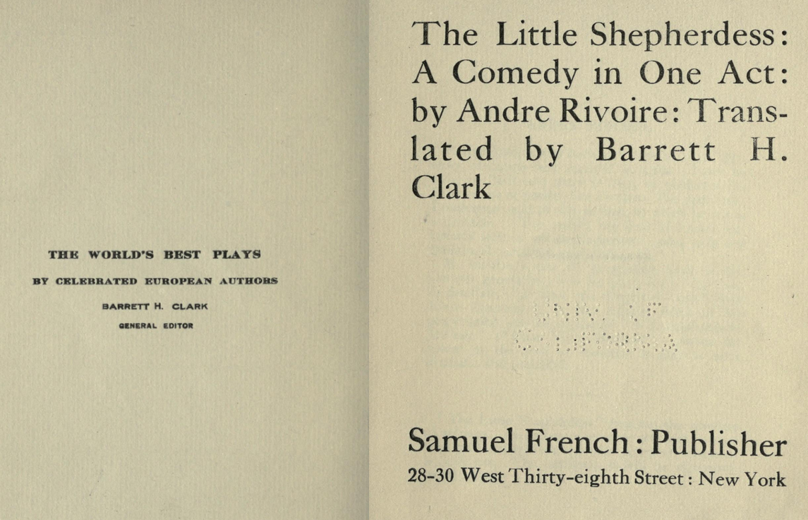
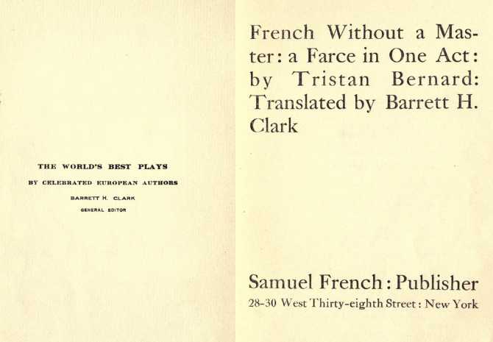
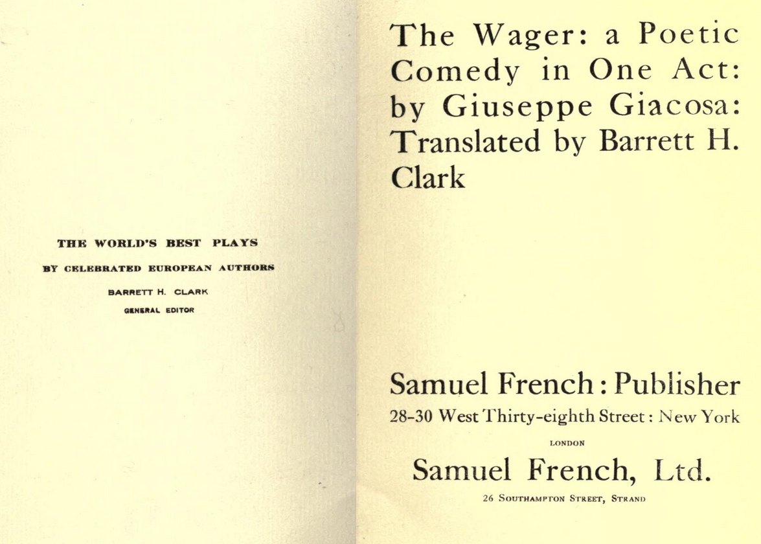
385/386 Fields
Same guidelines as for bibliographic records
130 #0 World's best plays by celebrated European authors
370 ## $g New York (N.Y.) $2 naf
380 ## Series (Publications) $a Monographic series $2 lcsh
380 ## Drama $2 lcgft
386 ## Europeans $2 lcdgt
Notes:
LCDGT Manual L 550 (Audience): Optionally, the field may include an $n subfield containing the three-letter code assigned to the demographic group category. Optionally, it may also include a $0 (zero) subfield for the control number of the record of the authorized term used in the $a subfield.
Best practice is to repeat the field when more than one term is being recorded.
LCDGT Manual L 555 (Creator/Contributor): Optionally, the field may include subfields $i, $n, and $0.
Best practice is to repeat the field when more than one term is being recorded.

Slide 27
385/386 Fields
Same encoding guidelines as for bibliographic records
046 ## $k 1790 $2 edtf
100 1# Austen, Jane, $d 1775-1817. $t Love and freindship
386 ## Girls $a Teenagers $a English $2 lcdgt
046 ## $k 1822 $l 1824 $2 edtf
100 1# Beethoven, Ludwig van, $d 1770-1827. $t Symphonies, $n no. 9, op.
125, $r D minor
386 ## Germans $2 lcdgt $0 http://id.loc.gov/authorities/demographicTerms/
dg2015060340
386 ## Men $2 lcdgt $0 http://id.loc.gov/authorities/demographicTerms/
dg2015060359
386 ## Hearing impaired $2 lcdgt $0 http://id.loc.gov/authorities/
demographicTerms/dg20150
Notes:
LCDGT Manual L 550 (Audience): Optionally, the field may include an $n subfield containing the three-letter code assigned to the demographic group category. Optionally, it may also include a $0 (zero) subfield for the control number of the record of the authorized term used in the $a subfield.
Best practice is to repeat the field when more than one term is being recorded.
LCDGT Manual L 555 (Creator/Contributor): Optionally, the field may include subfields $i, $n, and $0.
Best practice is to repeat the field when more than one term is being recorded.

Slide 28
368 $c
Use for attributes of persons not covered by any other MARC field
100 1# Dawson, Daisy Tibbs, $d 1924-2013
368 ## $c Americans $2 lcdgt
368 ## $c Washingtonians (Washington State) $2 lcdgt
368 ## $c Seattleites $2 lcdgt
368 ## $c African Americans $2 lcdgt
368 ## $c Pacifists $2 lcdgt
368 ## $c Presbyterians $2 lcdgt
670 ## BlackPast.org, viewed October 10, 2018 $b (Daisy Tibbs Dawson, a Seattle,
Washington peace activist and educator, is the only African American to be
memorialized in the Hiroshima Peace Memorial Museum in Hiroshima, Japan)
670 ## Copeland, Joe. Seattle-led team's work remembered in Hiroshima, via
Hiroshima stories website, October 25, 2012, viewed on October 10, 2018 $b
(Daisy Tibbs Dawson; former executive in Seattle Public Schools' Head Start
program and a longtime leader in Presbyterian church affairs in the
Northwest)

Slide 29
368 $c
Use for attributes of persons not covered by any other MARC field
100 1# Archibald-Barber, Jesse Rae, $d 1972-
368 ## $c Métis (North American people) $2 lcdgt $0 http://id.loc.gov/authorities/
demographicTerms/dg2017060218
368 ## $c Cree (North American people) $2 lcdgt $0 http://id.loc.gov/authorities/
demographicTerms/dg2015060243
368 ## $c Canadians $2 lcdgt $0 http://id.loc.gov/authorities/demographicTerms/
dg2015060002
368 ## $c Saskatchewanians $2 lcdgt $0 http://id.loc.gov/authorities/
demographicTerms/dg2015060226
368 ## $c Reginans $2 lcdgt $0 http://id.loc.gov/authorities/demographicTerms/
dg2022060145
670 ## Kisiskâciwan, 2018: $b title page (Jesse Rae Archibald-Barber) back cover
(Métis-Cree; associate professor of Indigenous literatures at First Nations
University of Canada; lives in Treaty 4 territory in Regina, Saskatchewan)

Slide 30
368 $c
Use for attributes of corporate bodies not covered by any other MARC field or subfield
110 2# Washington National Cathedral (Washington, D.C.)
368 ## Cathedrals $2 lcsh
368 ## $c Episcopalians $2 lcdgt
373 ## Episcopal Church. Diocese of Washington $2 naf
110 2# American Society for Microbiology
368 ## Professional associations $2 lcsh
368 ## $c Microbiologists $2 lcdgt
372 ## Microbiology $2 lcsh

Slide 31
372
Field of Activity
100 1# Erzin, Jeff, $d 1961-
372 ## United States--History--Civil War, 1861-1865--Veterans--Biography $2
lcsh
372 ## Veterans--Confederate States of America--Biography $2 lcsh
372 ## Confederates $2 lcdgt
372 ## Civil War veterans (United States) $2 lcdgt
372 ## Californians $2 lcdgt
670 ## Confederate veterans in Northern California, 2020: $b ECIP title page
(Jeff Erzin) data view (born 1961)

Slide 32
374
Occupation
100 1# El-Azazy, Marwa
374 ## Analytical chemists $2 lcdgt $0 http://id.loc.gov/authorities/demographicTerms/
dg2017060099
374 ## Chemometricians $2 lcdgt $0 http://id.loc.gov/authorities/demographicTerms/
dg2022060103
374 ## Spectroscopists $2 lcdgt $0 http://id.loc.gov/authorities/demographicTerms/
dg2017060067
670 ## Infrared spectroscopy : principles, advances, and applications, 2019: $b t.p. (Marwa
El-Azazy)
670 ## IntechOpen website, viewed 18 September 2019 $b (Dr. Marwa El-Azazy is an
analytical chemist; her main research interest is construction of sensors (using
microfluidic platforms for point-of-care-testing of drugs and bio-analytes and ion-
selective electrodes), chemometrics and analytical method development,
spectroscopic analyses of drugs and pharmaceuticals, synthesis of nanomaterials,
and development of green chemistry approaches for wastewater treatment)

Slide 33
376
Type of Family ($a) and Other Designation ($d) [$d not yet implemented]
100 3# Denney (Family : $g Denny, Anthony, 1501-1549)
376 ## Families $2 lcdgt
376 ## $b Denny, Anthony, 1501-1549 $2 naf 376 ## $d Britons $2 lcdgt
100 3# Kamehameha (Royal house : $d 1810-1872 : $c Hawaii)
376 ## Royal houses $2 lcsh $0 http://id.loc.gov/authorities/subjects/sh85115587
376 ## Dynasties $2 aat $0 http://vocab.getty.edu/aat/300386176
376 ## $b Kamehameha I, the Great, King of the Hawaiian Islands, -1819 $2 naf $0
http://id.loc.gov/authorities/names/n93094275 $1 http://id.loc.gov/rwo/
agents/n93094275
376 ## $d Hawaiians (Polynesian people) $2 lcdgt $0 http://id.loc.gov/authorities/
demographicTerms/dg2015060376

Slide 34
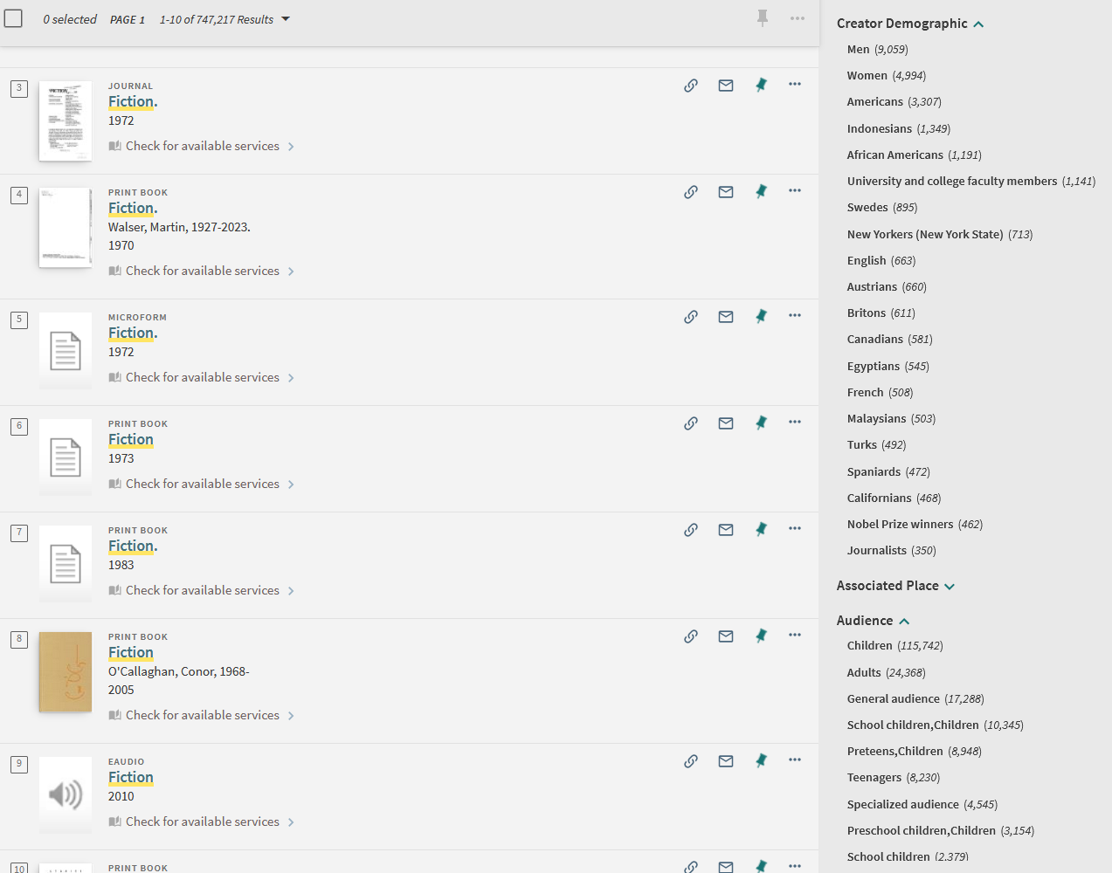
Faceting in Action
To see how facets work in a discovery system (Orbis-Cascade Primo): https://tinyurl.com/2tzc4aee
Try a keyword search on “novels”, “fiction”, “music”, “poetry”, etc.

Slide 35
