Slide 1
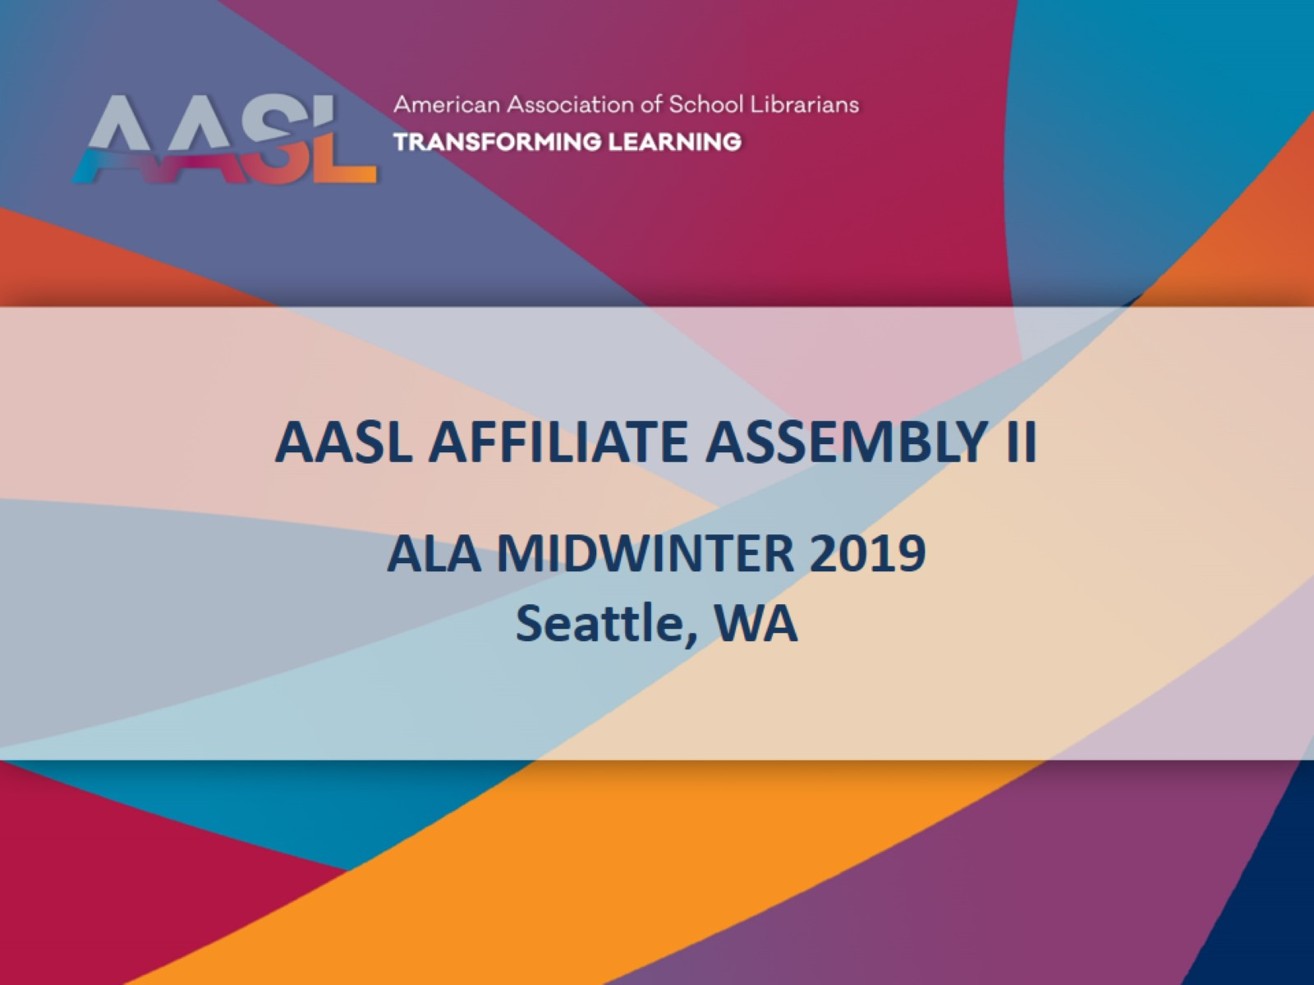
AASL AFFILIATE ASSEMBLY II

Slide 2
Welcome

Slide 3
AASL ANNOUNCEMENTS AND UPDATES

Slide 4
2018-2019 Affiliate Assembly Coordinating Team

Slide 5
2018-2019 Affiliate Assembly Coordinating Team

Slide 6
AASL Board of directors 2018-2019

Slide 7
2018-2019 Board of Directors

Slide 8
2018-2019 Board of Directors

Slide 9
concerns MOVED FORWARD BY AFFILIATE ASSEMBLY 2018

Slide 10
Review of Concerns

Slide 11
Regional Director Concern Cont.

Slide 12
Review of Concerns

Slide 13
Chapter Communications Cont.

Slide 14
Review of 2018 commendations

Slide 15
Review of Commendations

Slide 16
Review of Commendations

Slide 17
Review of Commendations

Slide 18
AASL in 2018-2019

Slide 19
National school library standards

Slide 20
National School Library Standards

Slide 21
Standards

Slide 22
Presidential Initiative

Slide 23
Focus & Purpose of Presidential Initiative

Slide 24
What’s Coming?

Slide 25
Strategic Planning

Slide 26
ADVOCACY

Slide 27
AASL 2019 NATIONAL Conference Louisville, KY November 14-16,2019

Slide 28
Programming

Slide 29
Networking

Slide 30
Exciting Speakers

Slide 31
BYA (Bring Your Administrator)

Slide 33
First Time at an AASL National Conference?

Slide 36
ALA Annual hot off the Presses!

Slide 37
ALA Annual Programming Changes

Slide 39
Concerns

Slide 40
Commendations

Slide 41
Regional caucus

Slide 42
Chair elect nominees

Slide 43
Concerns & Commendations Deadline

Slide 44
ALA Annual Affiliate Meetings

