Slide 2
2019 AASL Candidates Forum
ALA Midwinter Meeting Saturday, January 26, 2019

Slide 3
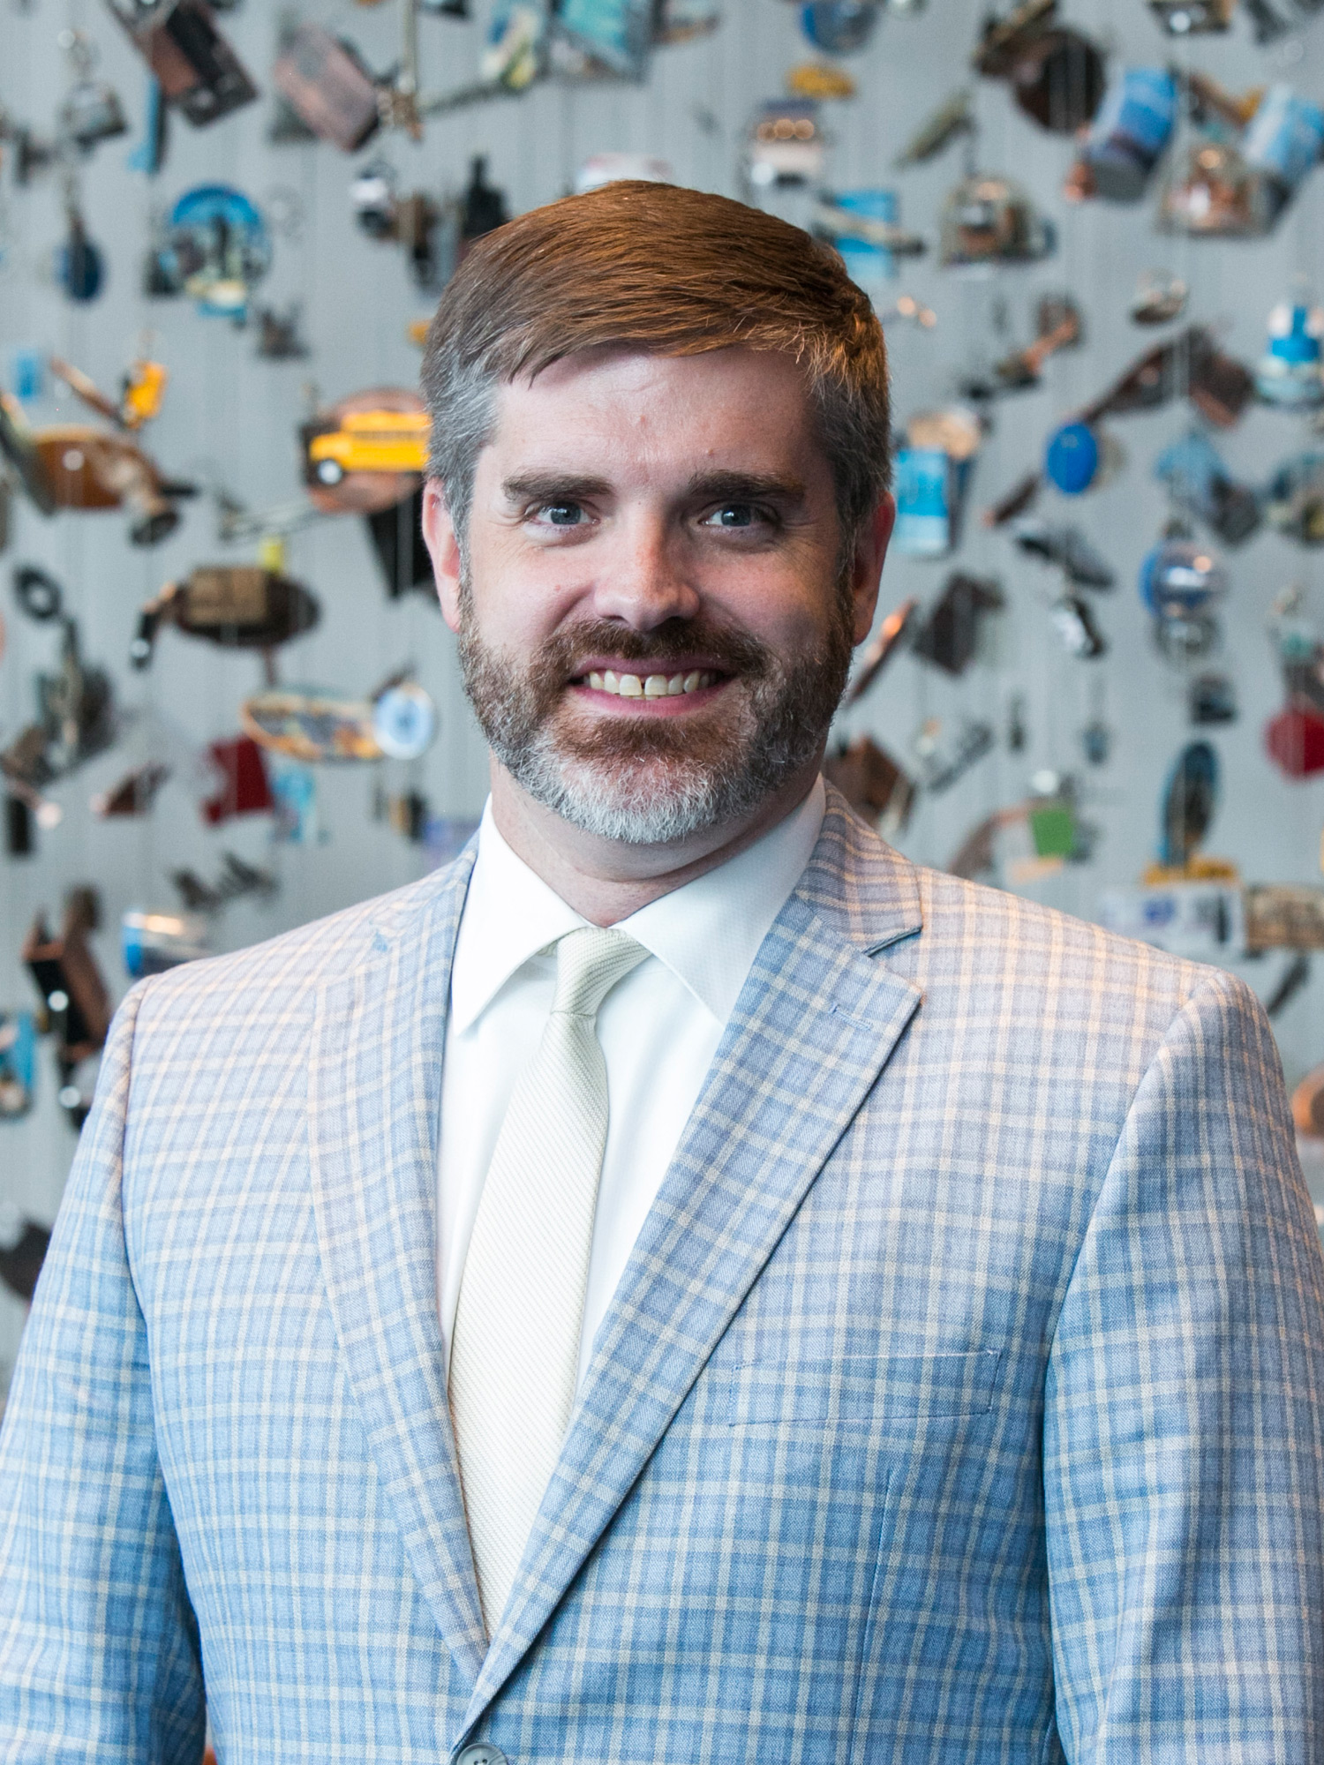
Welcome
Steven Yates AASL Past President, 2018-2019

Slide 4
2018-2019 AASL Leadership Development Committee
Steven Yates, Chair
Stephanie Ham
Dorcas Hand
Carl A. Harvey, II
Robert Hilliker
Stephanie A. Jones
Courtney Lewis
Kelly Miller
Heather Moorefield-Lang

Slide 5
AASL Candidates for ELECTION

Slide 6
AASL Candidates
President-Elect
Lisa Brakel
Kathy Carroll
AASL Division Councilor
Diane Chen
Shannon DeSantis
Member-at-Large
Laura Hicks
Chiquita Toure
Region 2 Director Emmanuel Faulkner
Allison Mackley
Region 4 Director
Courtney Lewis
Erika Long
Region 5 Director
Jennifer Anders
Cathy Smith
Region 9 Director
Jennisen Lucas
Betty Meyer

Slide 7
AASL Candidates
Educators of School Librarians Section Chair-Elect
Melanie Lewis
Daniella L. Smith
Educators of School Librarians Section Secretary
Angie Branyon
Aaron Elkins
Independent Schools Section Chair-Elect
Tad Andracki
Bianca Spurlock
Supervisors Section Chair-Elect
Mary Jo Richmond
Christina Norman
Supervisors Section Secretary
Marian Royal
Jenny Takeda
Supervisors Section Representative to the Board Kelly Miller
Suzanna Panter

Slide 8
Angie Branyon
Educators of School Librarians Section (ESLS) Secretary

Slide 9
Melanie lewis
Educators of School Librarians Section (ESLS) Chair-Elect

Slide 10
Daniella l. Smith
Educators of School Librarians Section (ESLS) Chair-Elect

Slide 11
Marian Royal
Supervisors Section Secretary

Slide 12
Kelly miller
Supervisors Section Representative to the Board

Slide 13
Suzanna panter
Supervisors Section Representative to the Board

Slide 14
Christina norman
Supervisors Section Chair-Elect

Slide 15
Jennisen lucas
Region 9 Director

Slide 16
Betty Meyer
Region 9 Director

Slide 17
Jennifer anders
Region 5 Director

Slide 18
Cathy smith
Region 5 Director

Slide 19
Courtney lewis
Region 4 Director

Slide 20
Erika long
Region 4 Director

Slide 21
Emmanuel faulkner
Region 2 Director

Slide 22
Allison mackley
Region 2 Director

Slide 23
Laura hicks
Member-at-Large

Slide 24
Diane chen
AASL Division Councilor

Slide 25
Shannon desantis
AASL Division Councilor

Slide 26
Lisa brakel
President-Elect

Slide 27
Kathy carroll
President-Elect

Slide 28
Candidates for ala council

Slide 29
Candidates for ALA Council
John Eric Byrnes
Kathy Carroll
Bitsy Griffin
Carl A. Harvey, II
Andrea Q. Jamison
Sara Kelly Johns
Maricar Laudato
Christine H. Lopez
James (Jim) G. Neal
Brenda Pruitt-Annisette
Deborah Rinio
Brenda S. Sprinkle
Ann K. Symons
Joyce Valenza

Slide 31
THANK YOU FOR ATTENDING

