Slide 1
Notes:
Welcome and thank you all for coming to ALA’s Pre-conference session, “Librarians and Social Workers: Partnerships for Connecting people in need”. My name is Justine and I work for a AMITA Health and am the social worker at Chicago Public Library. Today we are have an amazing panel of of library social workers across the country who will be talking about the innovative partnerships that they have established to help library patrons. Some general housekeeping items: Please put phones on silent or vibrate. We will also be taking a 10-15 min break about halfway through the presentation. If you have any questions during the presentation please write them down and we will take questions at the end.
So I want to start us off by reading this quote that I think really sums up the the role libraries play in their communities: I got this from a NYT article titled: “To restore Civil Society, Start with the Library”
“Libraries don’t just provide free access to books and other cultural materials, they also offer things like companionship for older adults, de facto child care for busy parents, language instruction for immigrants and welcoming public spaces for the poor, the homeless and young people.”
Eric Klinenberg, “To Restore Civil Society, Start with the Library”, The New York Times, Sept. 8th, 2018
I love this quote because it just shows the tremendous amount of service libraries are providing to their communities. It’s not just about books, it’s about people and the communities we serve.

Slide 2
Notes:
Libraries serve everyone! Regardless of race, SES, immigration status, you all provide service to the entirety of your community. At times library staff are asked for assistance in areas that are not experts in or even trained to deal with. Some libraries have turned to social workers, to help their patrons and library staff.

Slide 3
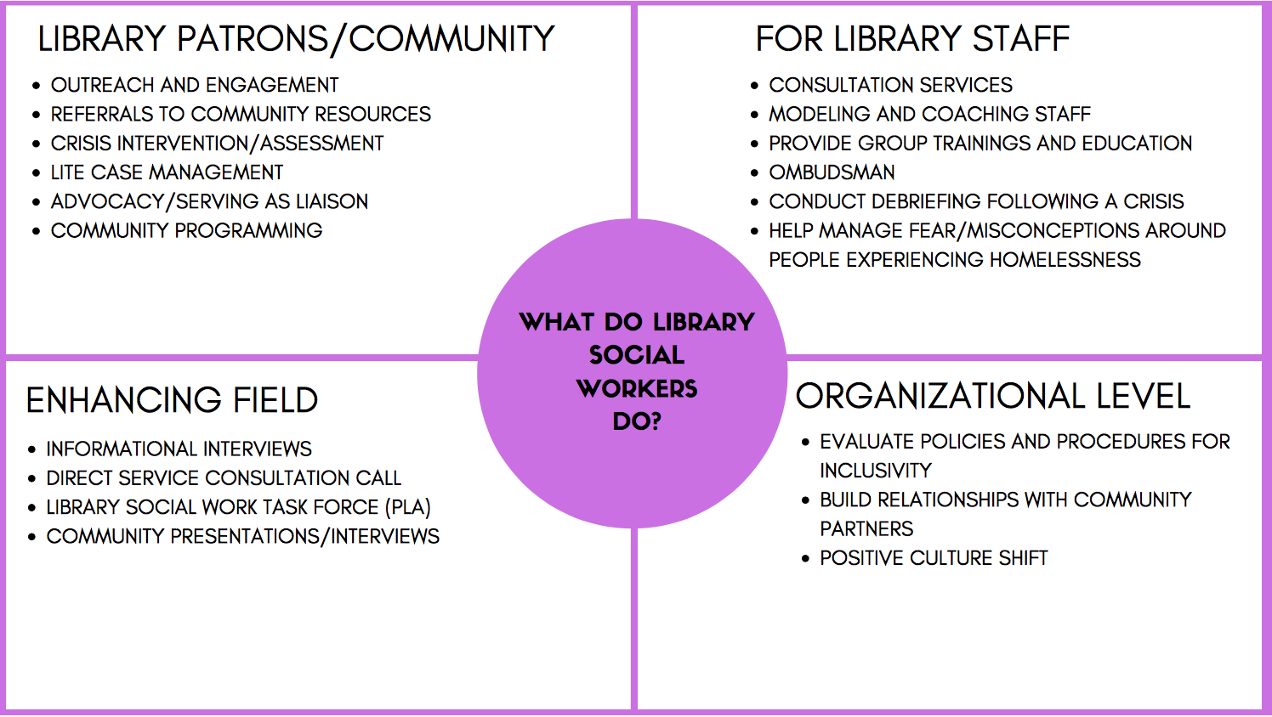

Slide 4
Notes:
I think it’s important to review some tenants of social work practice because these approaches we utilize are what make the programs successful. You might hear some of these concepts talked about throughout the presentation so we’ll take a minute to cover them.
We can interpret this both literally and figuratively. If someone is not ready for therapy or casemanagement that is OKAY! Whatever the patron sees as the goal, we also see as the goal. From a literal perspective we want to make it easy for patrons. Many of the communities we serve have multiple barriers to accessing care. If we can bring the services to the library it just makes it easier leads to more successful outcomes.

Slide 5
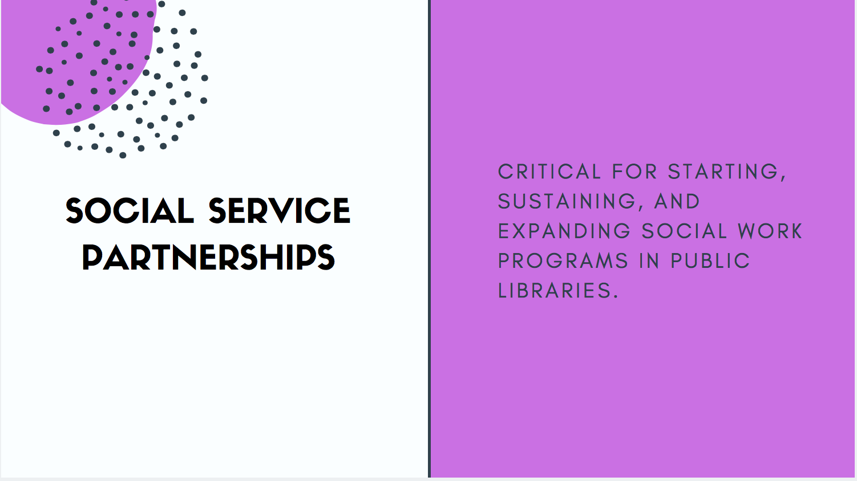
Notes:
All of us sitting here today are engaged with key community partners. Justine and Leah are actually employed by other organizations or government agencies that have partnered with their library systems to bring outreach and social work services into the library on a full time basis. There are so many ways partnerships can work we wanted to highlight the importance of the role developing community partnerships plays in our work as social workers in the public library and how partnerships can

Slide 6
Notes:
Creating effective partnerships to address library challenges in the social work/social service realm can be time consuming and requires clear and open communication with partner agencies.
Partnership is a 2 way street- there has to be a relationship between both parties. When i’ve talked to library staff about when they had partnered in the past with a different social service agency there was no established relationship. A provider wants to come and do outreach at the library and then the worker comes and doesn’t say hi to anyone or check in with any library staff member and just sits at a desk waiting for people...Soon they stop coming and the library doesn’t even notice. CPD example.... Thank the group for coming!
These are important questions to keep in mind as we go through the presentation.

Slide 7
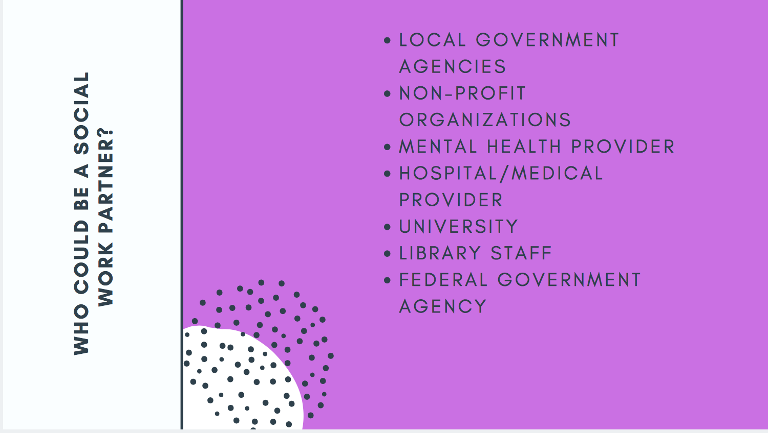
Notes:
So the first partnership we’re going to cover today is talking about the role the social worker embedded in the library plays.

Slide 8
Notes:
Specifically for my role AMITA health has partnered with 3 different library systems to provide medical/behavioral health care to library patrons. Part of how this started was from the Community health Needs assessment. Most hospital systems are required to do this. In Chicago...
CHNA identified four priority issues. The Social Worker in the Library (SWIL) directly addresses three:
Improving Mental Health and Decreasing Substance Abuse
Increasing Access to Care and Community Resources
Addressing Social Determinants of Health
Preventing and Reducing Chronic Disease
What existing partnerships does the city have in place?

Slide 9
Notes:
In our program at Evanston and Chicago we host 1st year MSW interns & 2nd year MSW interns. This is a great way to find a way to bring in a social service provider. David actually started as an MSW intern and that has brought about the full time SW position. While there are many positives about having interns, I also want to provide some guidance and thoughtful considerations if you decide to go this route.
-importance of clinical supervision in SW degrees
-strongly advise against BSW interns or interns in other areas to do the kind of work that we do.

Slide 11
Notes:
These are some of the partnerships developed over the past five years. All look a little different . Some are on auto-pilot like Neighborhood legal services, others very informal, others are time limited and specific like Library Safety trainings, and others are more formal and require care and attention, like the DC Department of Behavioral Health partnership.

Slide 13
Notes:
Creating partnerships that work can take time and sometimes the stars have to align to make it happen.
In 2016 the DC Department of Behavioral Health received a federal grant from Substance Abuse and Mental Health Services Administration.
The grant, CABHI, Collective Action to Benefit Homeless Individuals

Slide 18
Notes:
Libraries and the Opioid Epidemic: Community-based Responses
Monday, June 24
2:30 PM - 3:30 PM
Location: Washington Convention Center, 149A-B

Slide 20
Notes:
40 part-time staff
20 active volunteers.
We are working on ways to better incorporate more volunteers into our program.
We aren't looking to increase the amount of staff at the moment - just to stay fully staffed, which can be difficult with the higher turnover of a part-time job. I would like to find ways to offer more hours to the staff we have, as well as opportunities for growth, training and professional development. I would love to expand the program to more branches, which then would involve hiring more staff.
Nicanor is providing a networking uncommons session from 9:30am to 10:30am on Sunday

Slide 22
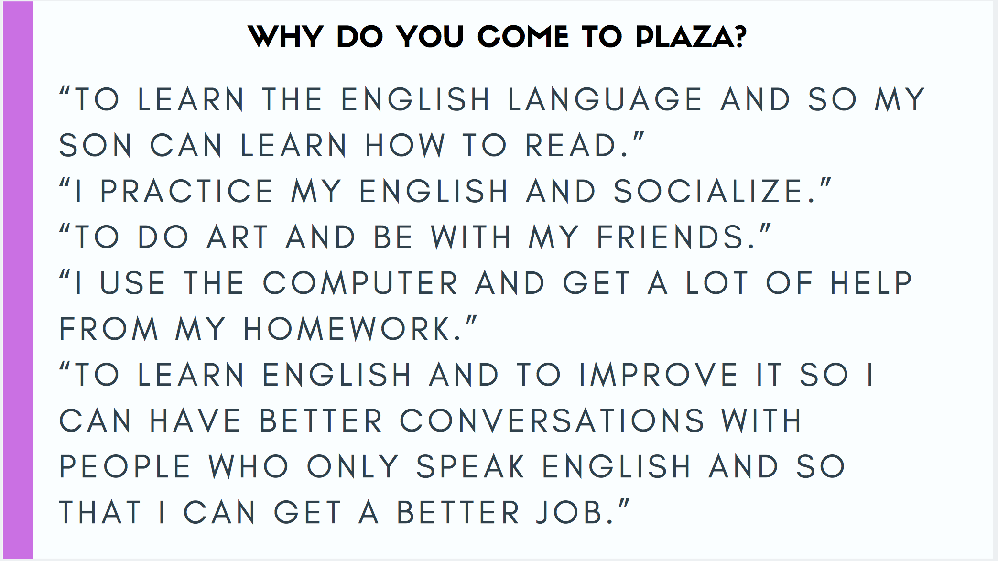
Notes:
“It’s a support for them to be in these classes with each other”-Jaime
People have been taken advantage of
Get to know the culture - how bills get late fees “why is it going up?”
Housing, social security, job searches, citizenship (tricky applications), resources in general: legal, immigration, working 2-3 jobs and still coming to class,

Slide 23
Notes:
CCD immigration interest group, Equity and Diversity metro area library group, CPIN, Southwest Denver Coalition
•Drop in hours before plaza programs
•Social worker is first generation American; peer navigator is immigrant
Where are the needs?
People who are undocumented or lack certain statuses have limited access to an already very limited pool of resources.
Transportation is a big barrier for many people.
People need connection to housing
We often struggle to find resources in general for undocumented immigrants, asylum seekers, refugees who have been here longer than five years, or others who come with limited support systems (e.g. diversity visa recipients, those with temporary protected status, people who have recently been released from immigration detention, etc...).
Some organizations in the area are limited in whom they can serve depending on their funding sources.
Know Your Rights
Teachers United for Immigrant Rights
Your constitutional rights
What to say if you are in contact with the
police or immigration
Rights in case of arrest
An emergency plan for the family

Slide 24
Jaime Rico, MSW and Karim Lopez, Peer Navigator.
Notes:
How have you seen the collaboration work?
The collaboration has helped us make more responsible connections and smarter referrals without sending people on a wild goose chase for resources that won't be helpful. Also, it helps to have someone from CRS pointing out areas of improvement. For example, it was important to have phone interpretation services for CRS to offer assistance in an ethical way.

Slide 25
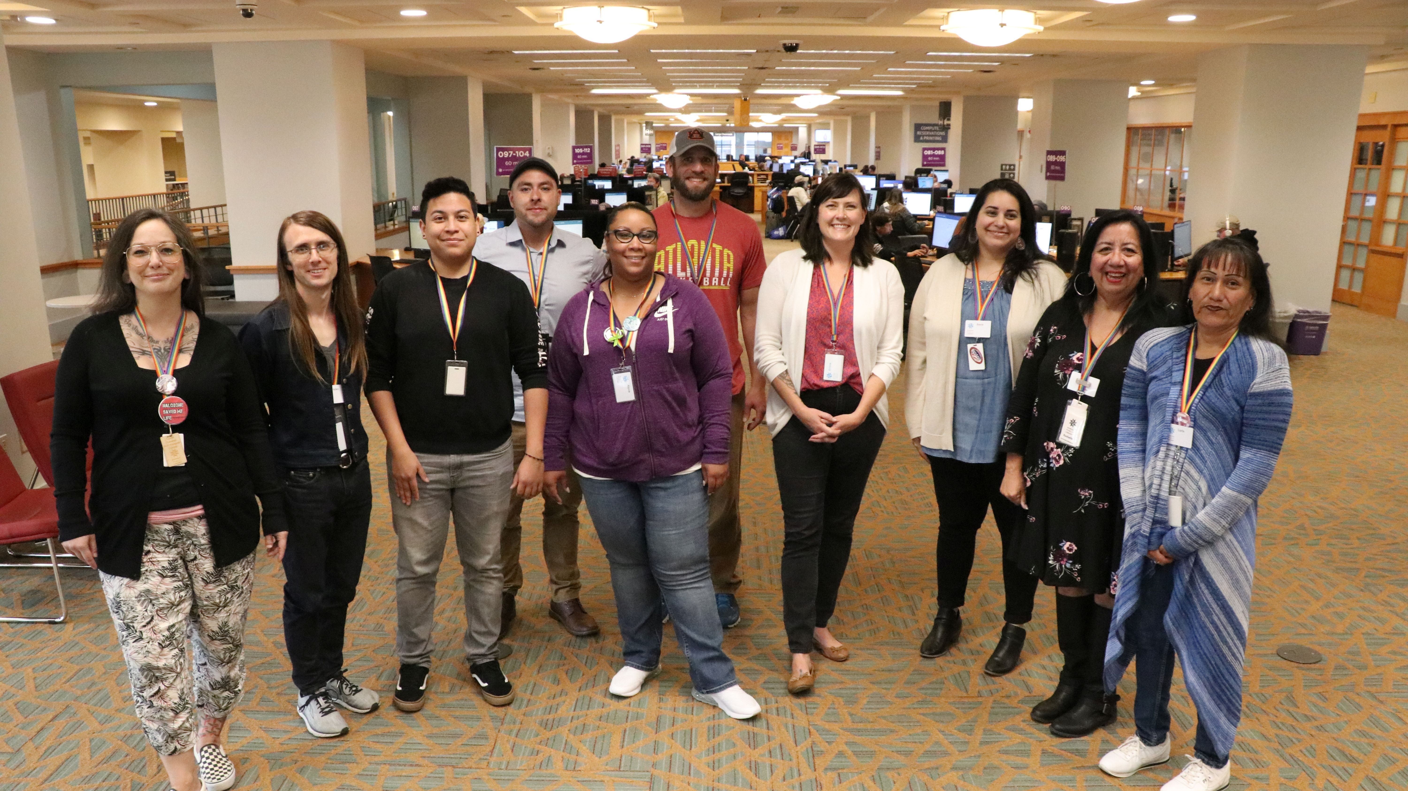

Slide 32
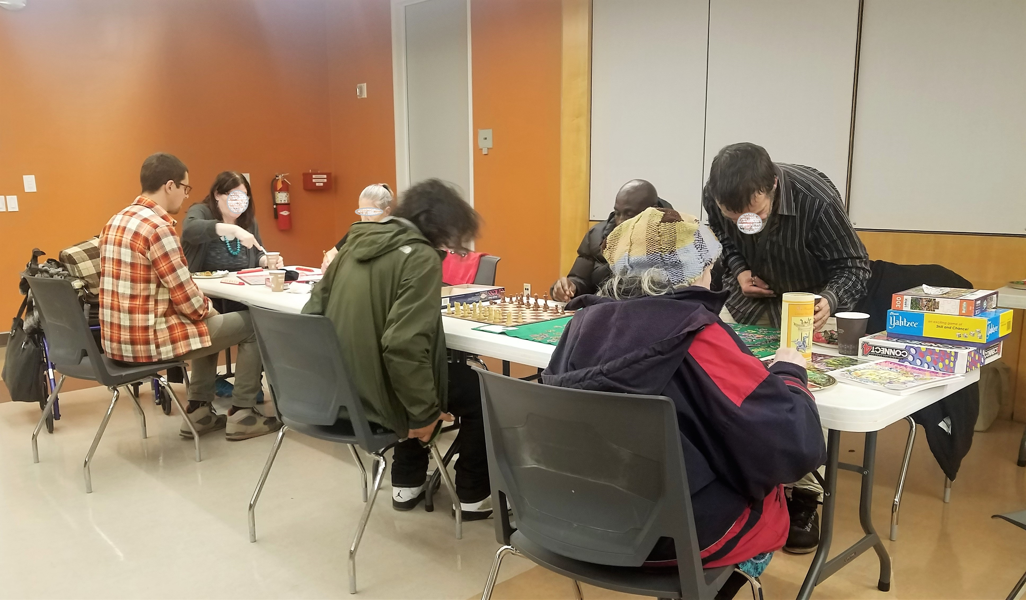

Slide 34
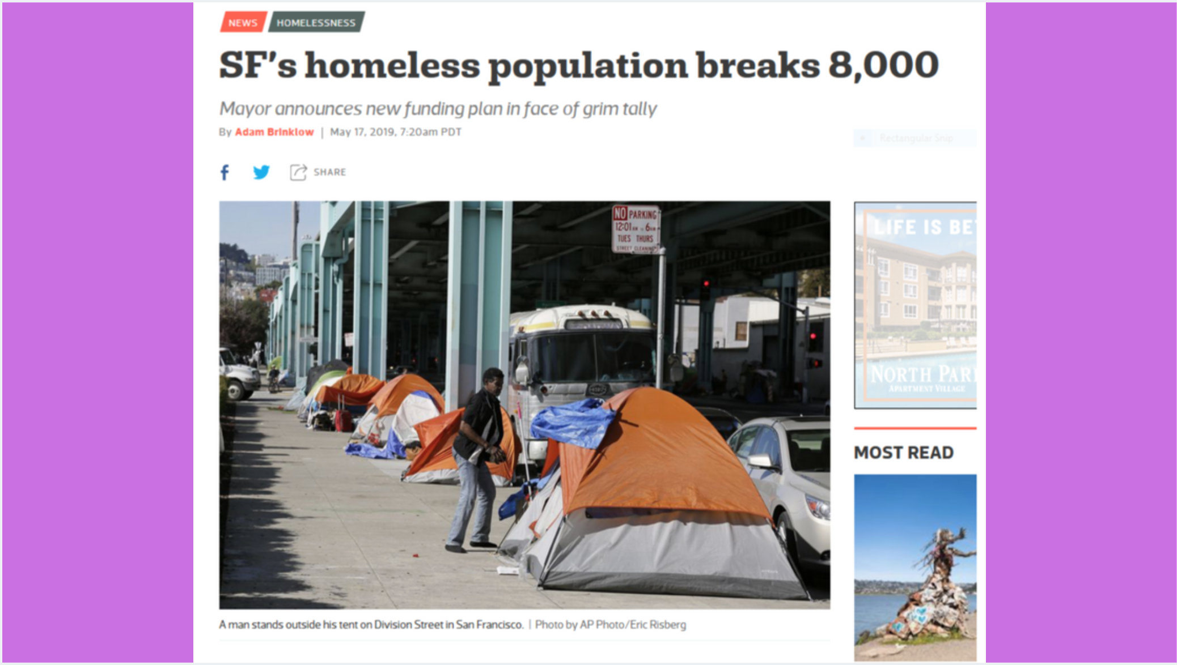

Slide 37
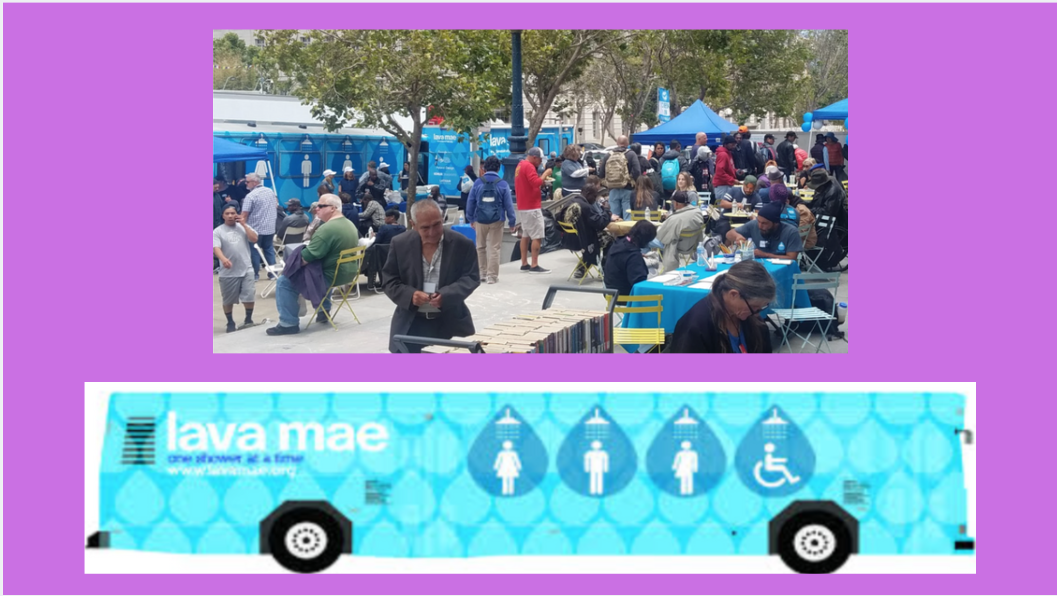

Slide 38
