Slide 1
Subtle Outreach: Engaging Students and Faculty with DH through Remote Learning
Laura Braunstein (she/her), Digital Humanities Librarian
& Co-Lead, Digital by Dartmouth Library, @laurabrarian
Dartmouth College
ACRL-DSS Digital Humanities Discussion Group Online Symposium
March 29, 2021
Notes:
Introduce me
Based on a presentation from NERCOMP 2020
The "pivot to remote" last spring tossed many faculty into the deep end of digital teaching and learning without much preparation. Requests to librarians to facilitate research assignments "like we usually do, but digital" present an opportunity for "subtle outreach"; that is, to engage communities in digital pedagogy that is mindful and deliberate rather than just a crisis response. In this presentation, I'll talk about several digital exhibit assignments using Omeka-S and digitized archival materials that students have completed in the last year. The assignments were framed in the context of a longer-term project between the Library and Dartmouth's Learning Design team to develop a collaborative infrastructure for supporting digital assignments.

Slide 2
yes, please tweet!
I am @laurabrarian
link to these slides: https://dartgo.org/lrb321

Slide 3
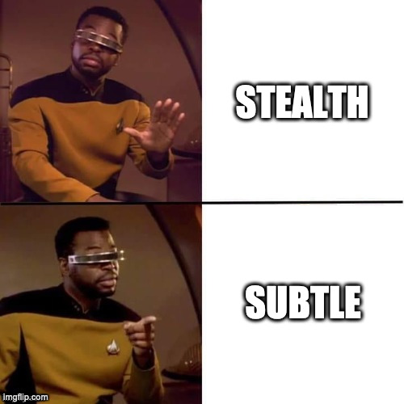
[Hey Laura, did the title of your presentation change?]
Notes:
Geordie/Drake meme, made on https://imgflip.com/memegenerator

Slide 4
“Before Times”
Remote Learning
“Hey! I want my students to do a cool digital project.”
“Help! I need to make this in-person assignment into a digital project.”
Notes:
Laura
Pivot to remote at a time when intake process for digital projects was already being reviewed -- how to make a collaborative, learning focused project?
What had been an extra, “fun” project now was central and a necessity
Image: Wikimedia Commons CC-0

Slide 5
What does it mean to be digital?
How do we mean when we are digital?
What changes when we are digital?
Who gets to be digital?
Where are digital things?
Notes:
Yet the questions we need to ask to “make it digital” -- these are the central questions, for me, of digital humanities

Slide 6
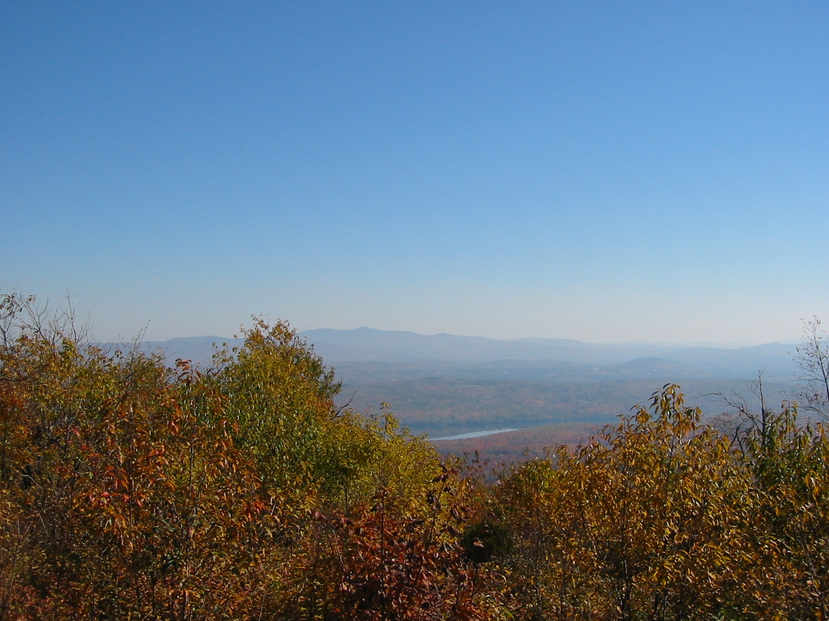
Looking
at the landscape
Digital resources:
Platforms
Digital “things”
Processes
Human resources:
Time
Trust
Resilience
Notes:
What is available to us -- faculty, librarians, students -- to make something digital. Skeptical of “resilience” as a concept that is supposed to make up for deficits in the other things
Image of Moose Mountain summit, Hanover, NH. CC-BY-NC: Credit: Laura Braunstein

Slide 7
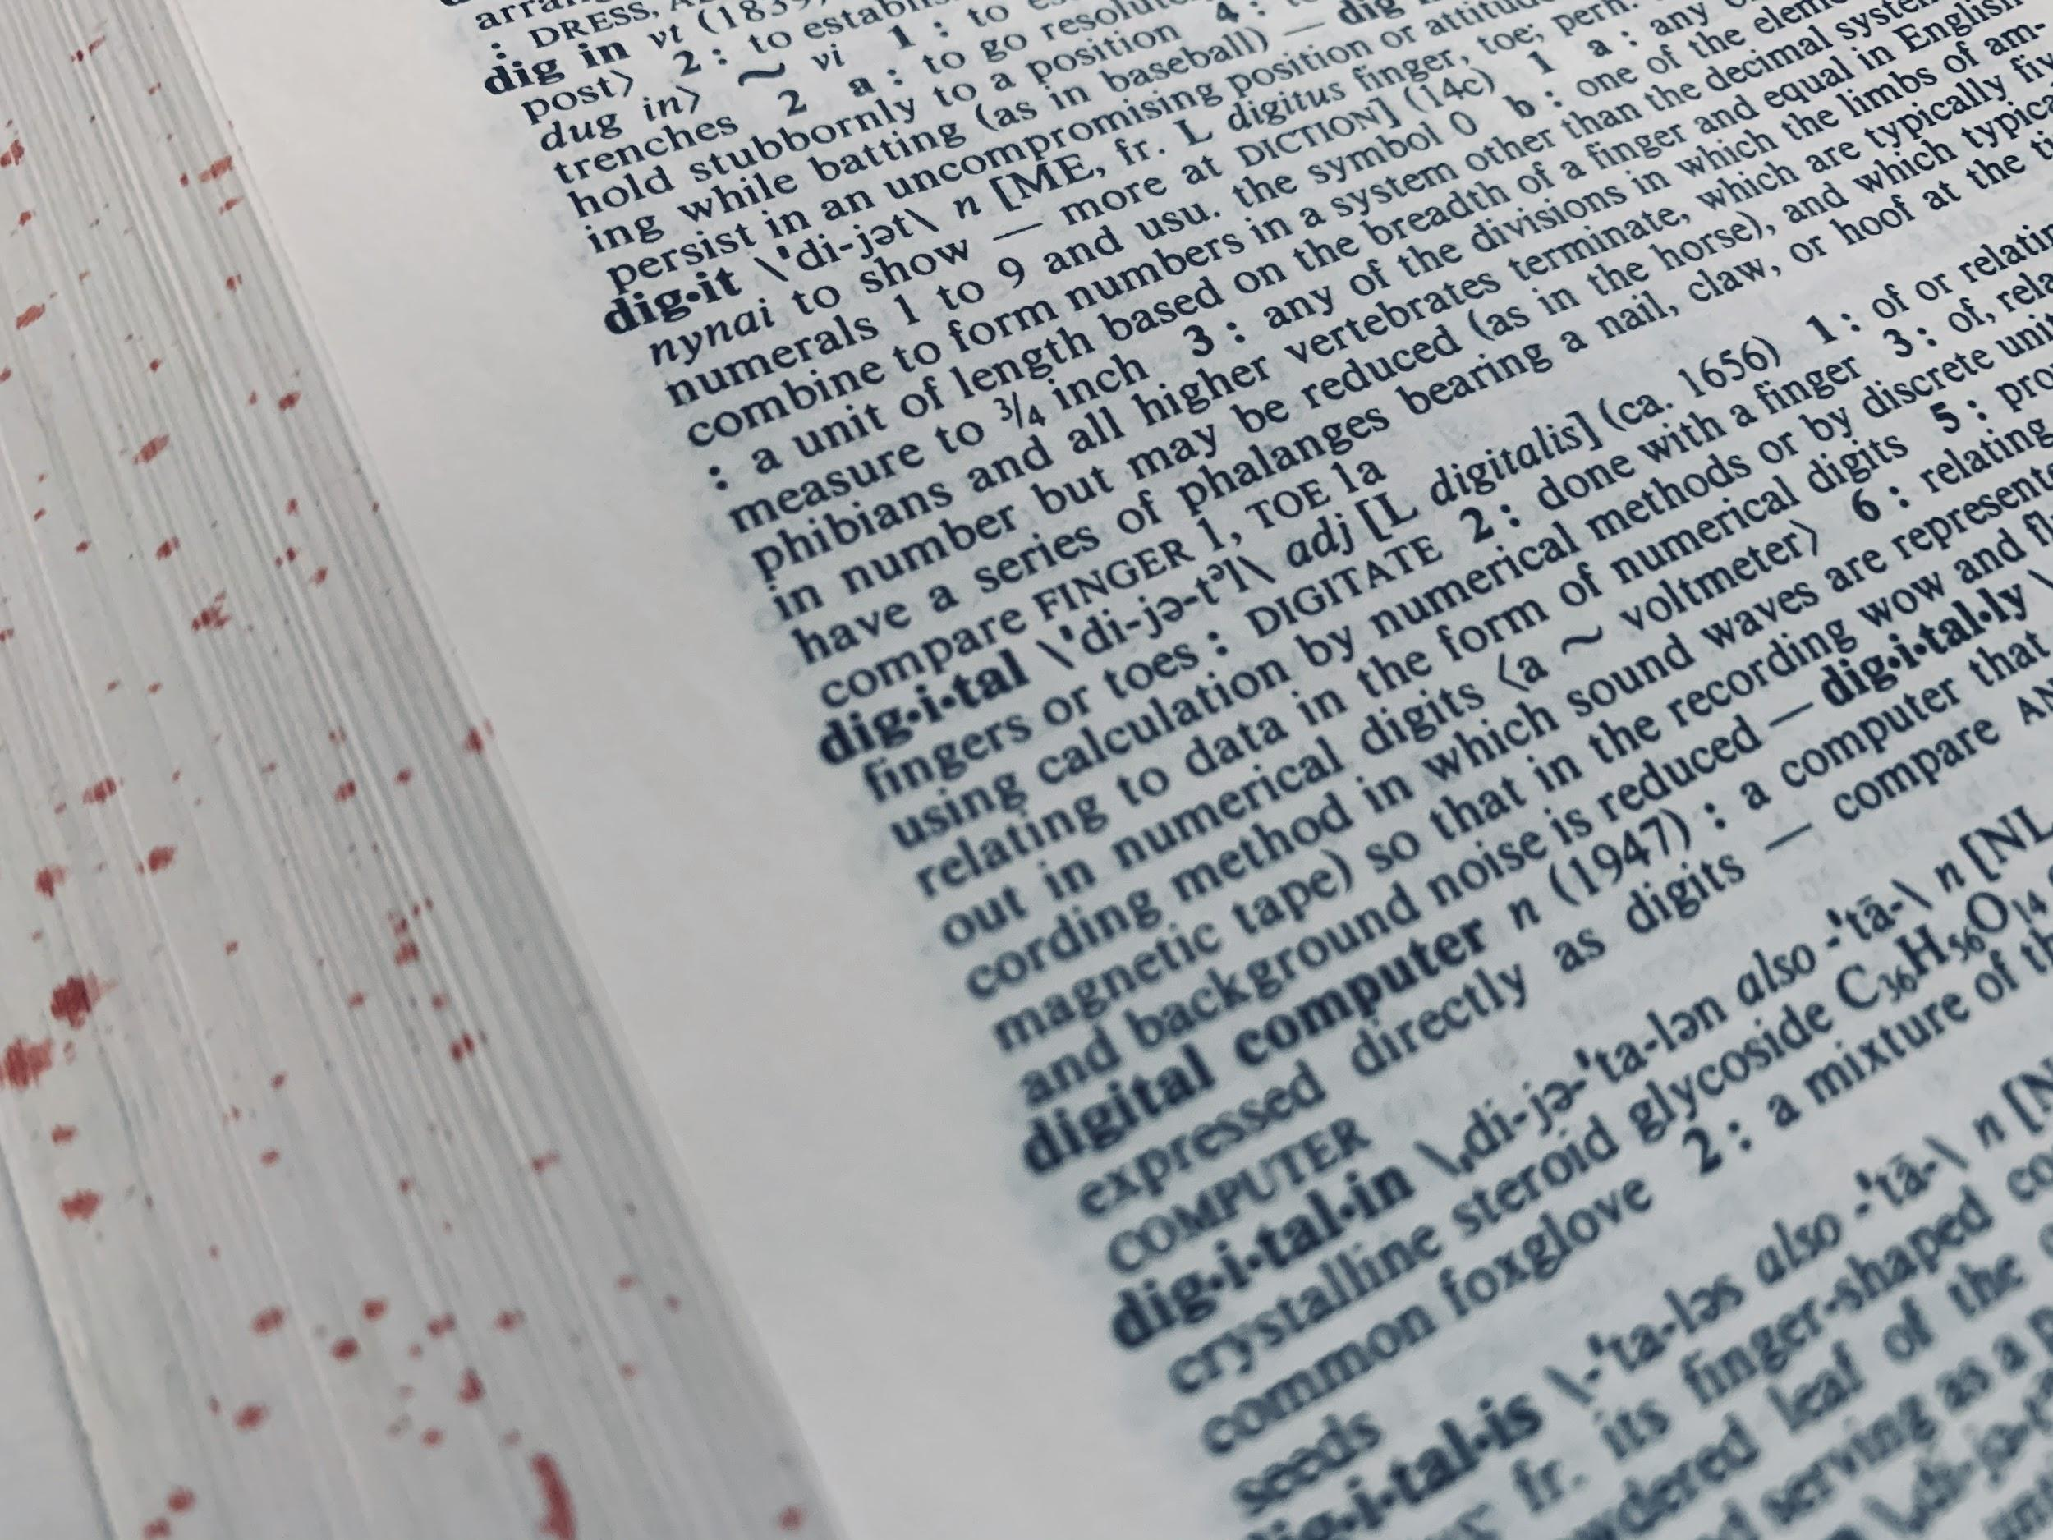
Consultation Questions
Initial Questions
Assignment Design
End Product
Resources needed
Define a
“digital project”
Notes:
LAURA
(Ask the question FIRST!)
Questions are set up to try and steer the faculty member, reframe from the technology to the learning goals.
[Slides are shared -- see end for full questions]
Initial questions category - We need some introduction questions to help set expectations. Faculty had varied hopes - from “you’ll do everything” to “you’ll give me an account”. We also found huge variation in the definition of “digital projects”, from digital storytelling to a powerpoint slide. We trust that the faculty are asking in good faith to work with them, but we also have faculty who are coming to this project from a place of deficit (as in, I had a week to fill). Spoiler that these projects don’t work very well.
Image of Merriam-Webster’s 9th New Collegiate Dictionary CC-BY-NC Credit: Laura Braunstein

Slide 8
Consultation Questions
Initial Questions
Assignment Design
End Product
Resources needed
Notes:
Assignment design questions might seem straightforward - they are! They are universal course design questions. We start with learning objectives, discuss the logistics of how students will work together, or alone, milestones that will be documented, implicit vs. explicit expectations, how the assignment fits into the course, and (especially now) timeline markers.
Image by Philipp Marquetand from Pixabay
What are your learning outcomes? Why are you doing this?
How will students work: individually, groups, as a whole class?
Is this assignment ongoing or a culminating project?
What kind of teaching will best support students? (e.g. training sessions, demonstrations, tutorials, individual consultations)
How will students in future classes interact with this work? Namely, will other courses continue the project?
Will this assignment fit in the scope of a ten-week term? If not, can you chunk it into smaller parts?
How will you scaffold the assignment to keep students on track?

Slide 9
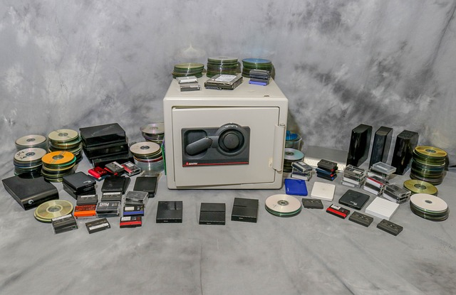
Consultation Questions
Initial Questions
Assignment Design
End Product
Resources needed
Notes:
End Product - People have different expectations for the long life of “Digital things”, which could potentially be open to the whole world. We have to talk about Privacy, Access, Persistence, and Preservation. We have to make sure that these decisions are deliberate and not default. I’m sure we’ve all had experiences where a project “fell into the wrong hands” because students were outside of the protected classroom space. There could be situations where a student shares personal information or uses copyrighted information, and these restrict how their products should be shared. Additionally, many of these projects are built on internal enterprise systems and if students want them after they graduate, they could be restricted. It’s important to know who owns the platforms and is responsible for updates and migration should it be needed.
Image by Greg Reese from Pixabay.

Slide 10
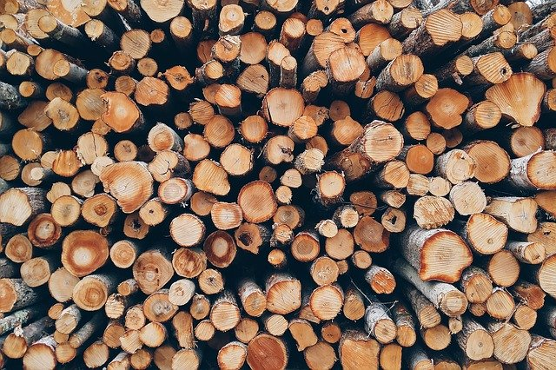
Consultation Questions
Initial Questions
Assignment Design
End Product
Resources needed
Notes:
This is the category where things are the MOST DIFFERENT from Before Times -- everything is bespoke
We leave these questions up to the “class environment”, including the previous ones. We don’t have a universal policy on who gets what, but we need hosting, updates, etc. Some of the things we’ve discussed are project management and account management. Some need assistance with content. Others need training - especially on the creation of accessible materials and the use of metadata.
Image by Pexels from Pixabay

Slide 11
Project Example: Digital Exhibit

Slide 12
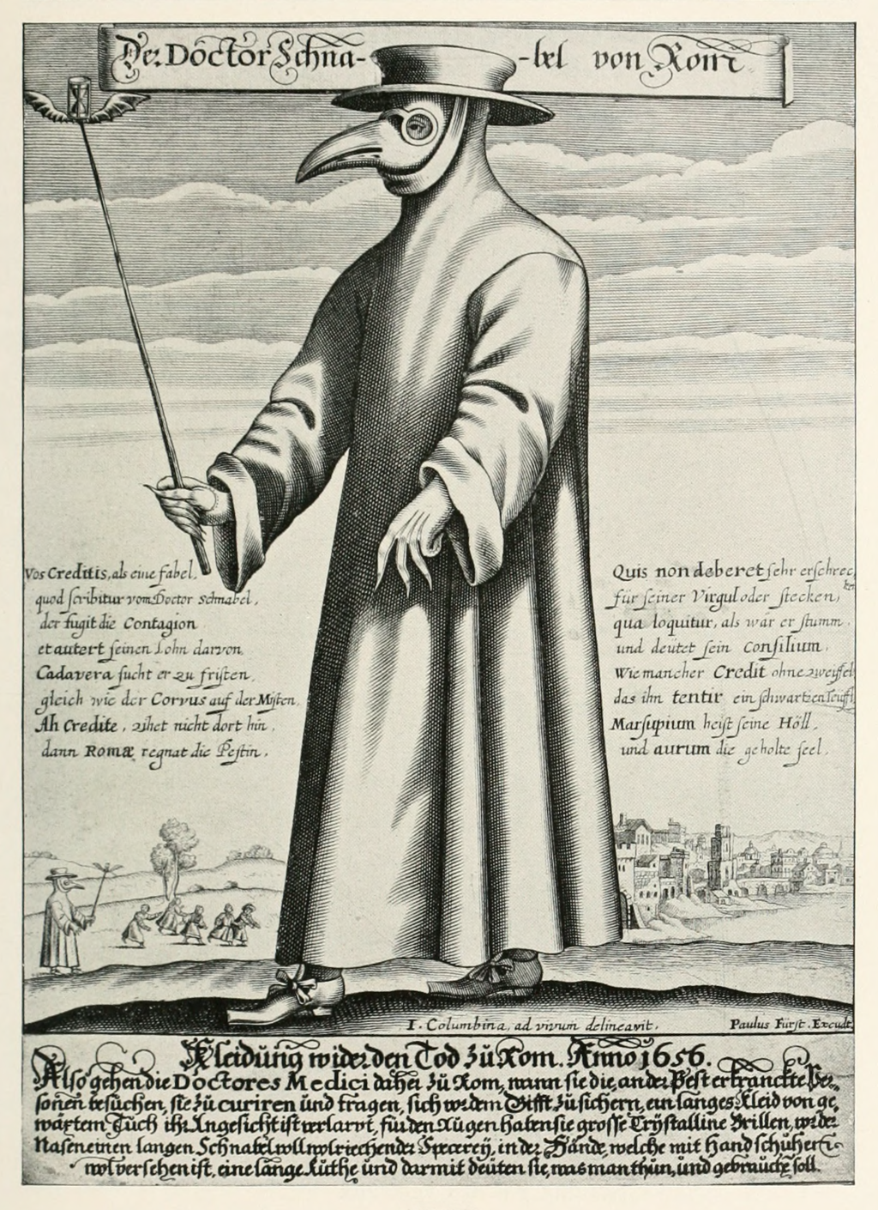
The Course:
Anthropology 7: The Values of Medicine Professor Sienna Craig
First-year seminar
16 students, all remote
Introduction to academic writing
Ethnographic approach to history of medicine
Focus on pandemics through history
Focus on primary sources in special collections
Notes:
Image: Eugen Holländer, Die Karikatur und Satire in der Medizin: Medico-Kunsthistorische Studie von Professor Dr. Eugen Holländer, 2nd edn (Stuttgart:Ferdinand Enke, 1921), fig. 79 (p. 171). Internet Archive via Wikimedia Commons

Slide 13
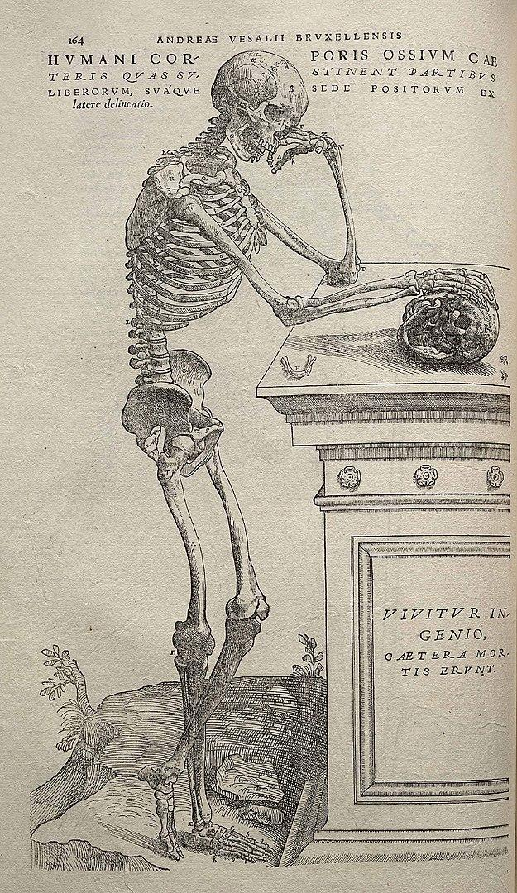
The Assignment:
Curate a digital exhibit focusing on epidemic disease at previous moments in history
Learning outcomes for the digital exhibit:
Write for a public audience
Write for a digital audience
Curate digital items
Create metadata
Work collaboratively
Tell a compelling story
Use a digital exhibit platform
Notes:
Image from Andreas Vesalius's De humani corporis fabrica (1543), page 164. Wikimedia Commons

Slide 14
The Process
The Materials
Items “pre-curated” in special collections
Items digitized via iPad
Metadata created
Items sideloaded into Omeka-S
Organized into item sets
The Teaching
Introductory workshop
Sessions with individual teams
Follow-up sessions
Individual consultations
Peer review
Final presentations
Notes:
Process is HUGELY front-loaded

Slide 15
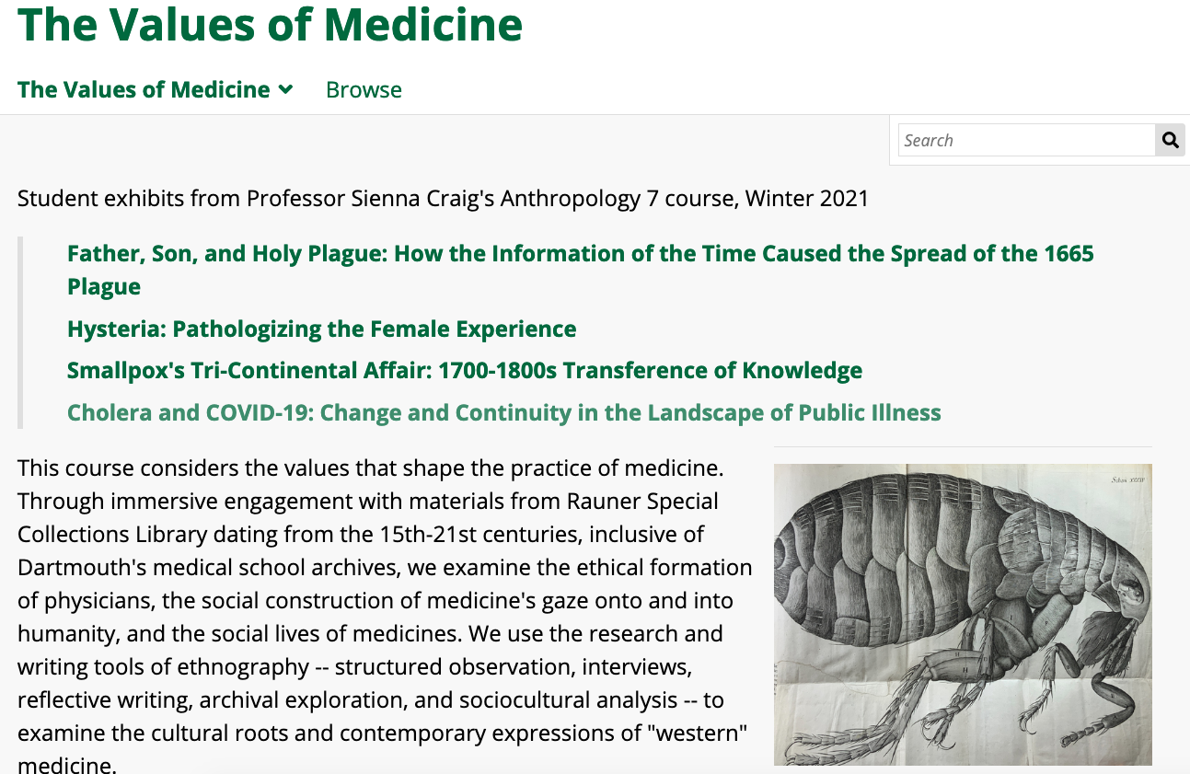
The Final Exhibit! https://dartgo.org/anthro7

Slide 16
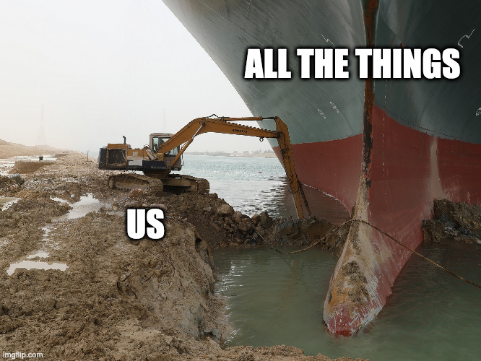
What’s next:
Community of practice
Documentation
Outreach to faculty
Sustainability plan
What do we keep? What do we leave behind? How has this changed us?
Notes:
Ever Given meme, made on https://imgflip.com/memegenerator

Slide 17
Questions?
Laura Braunstein
lrb@dartmouth.edu
@laurabrarian
Thank you to:
Erin DeSilva
Sienna Craig
Jay Satterfield
Betty Kim
Anthro 7 Students

Slide 18
Appendix:
Consultation Questions
For Faculty

Slide 19
Consultation Questions
Initial Questions
Assignment Design
End Product
Resources needed
Define a “digital project”
Why make it digital?
How “techy” are you?
Overall learning goals?
Notes:
LAURA
Questions are set up to try and steer the faculty member, reframe from the technology to the learning goals.
Slides are shared.
Initial questions category - We need some introduction questions to help set expectations. Faculty had varied hopes - from “you’ll do everything” to “you’ll give me an account”. We also found huge variation in the definition of “digital projects”, from digital storytelling to a powerpoint slide. We trust that the faculty are asking in good faith to work with them, but we also have faculty who are coming to this project from a place of deficit (as in, I had a week to fill). Spoiler that these projects don’t work very well.

Slide 20
Consultation Questions
What are your learning outcomes? Why are you doing this?
How will students work: individually, groups, as a whole class?
Is this assignment ongoing or a culminating project?
What kind of teaching will best support students? (e.g. training sessions, demonstrations, tutorials, individual consultations)
How will students in future classes interact with this work? Namely, will other courses continue the project?
Will this assignment fit in the scope of a ten-week term? If not, can you chunk it into smaller parts?
How will you scaffold the assignment to keep students on track?
Initial Questions
Assignment Design
End Product
Resources needed
Notes:
ERIN
Assignment design questions might seem straightforward - they are! They are universal course design questions.

Slide 21
Consultation
Questions
Who is the intended audience? (e.g. professor, students, campus, general public)
Will the project be findable on the open internet? (“google-able”)
Who creates and organizes the content?
Students create their own content
Students curate content created by others
Is it already available for use or will it need to be curated first? Is student curation part of the assignment?
Will they need permission to use this material in a digital project?
How will students give attribution?
Will they embed/host content or link to content hosted elsewhere?
Will the students create metadata?
How long will projects persist?
Will students need access after they graduate?
How long should it be accessible to its audience?
Should it be archived?
Will they need to export content?
Is this a potential candidate for web archiving?
Will this product need to interact with any other technology? (i.e. single sign-on)
Initial Questions
Assignment Design
End Product
Resources needed
Notes:
LAURA
End Product - People have different expectations for the long life of “Digital things”, which could potentially be open to the whole world. We have to talk about Privacy, Access, Persistence, and Preservation. We have to make sure that these decisions are deliberate and not default. I’m sure we’ve all had experiences where a project “fell into the wrong hands” because students were outside of the protected classroom space. There could be situations where a student shares personal information or uses copyrighted information, and these restrict how their products should be shared. Additionally, many of these projects are built on internal enterprise systems and if students want them after they graduate, they could be restricted. It’s important to know who owns the platforms and is responsible for updates and migration should it be needed.

Slide 22
Consultation Questions
Tech Support -- hosting, installation, updates
Project Management -- accounts, content, afterlife/preservation
Training -- on platform, accessibility, metadata
Course Design -- learning outcomes, scaffolding assignments
Initial Questions
Assignment Design
End Product
Resources needed
Notes:
ERIN
We leave these questions up to the “class environment”, including the previous ones. We don’t have a universal policy on who gets what, but we need hosting, updates, etc. Some of the things we’ve discussed are project management and account management. Some need assistance with content. Others need training - especially on the creation of accessible materials and the use of metadata.

Slide 23
Thank You!

