Slide 1
OpenLink Data explorer
By Rhonda Super
Continuing Resources Work Group
April 4, 2017

Slide 2
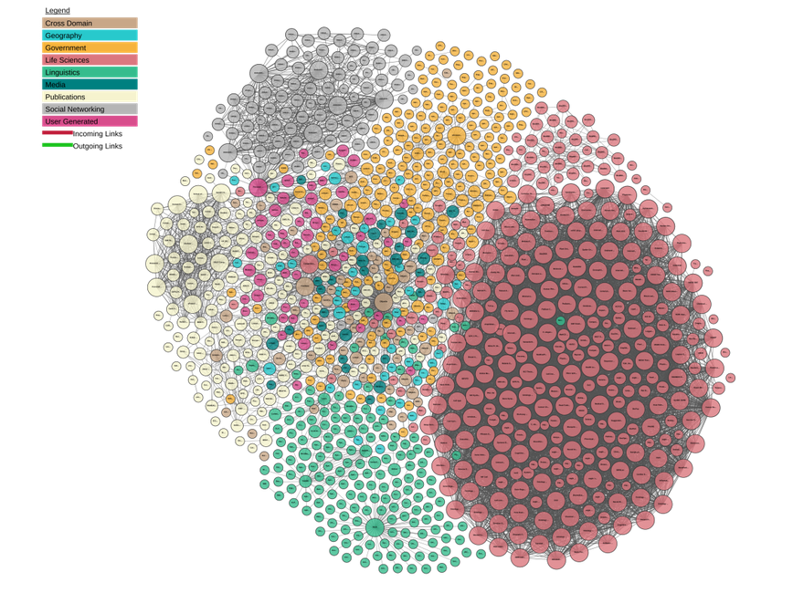
LINKing open DATA CLOUD
"Linking Open Data cloud diagram 2017, by Andrejs Abele, John P. McCrae, Paul Buitelaar, Anja Jentzsch and Richard Cyganiak. http://lod-cloud.net/"
Notes:
The latest published diagram of the Linking Open Data Cloud looks like this.

Slide 3
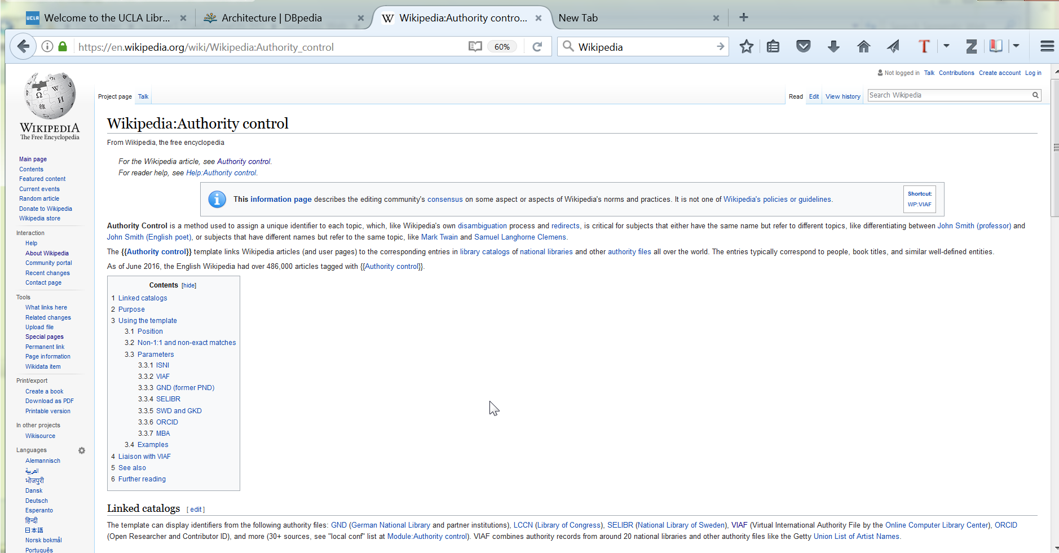
Wikipedia: authority control
Notes:
The key element to linked data is AUTHORITY CONTROL!

Slide 4
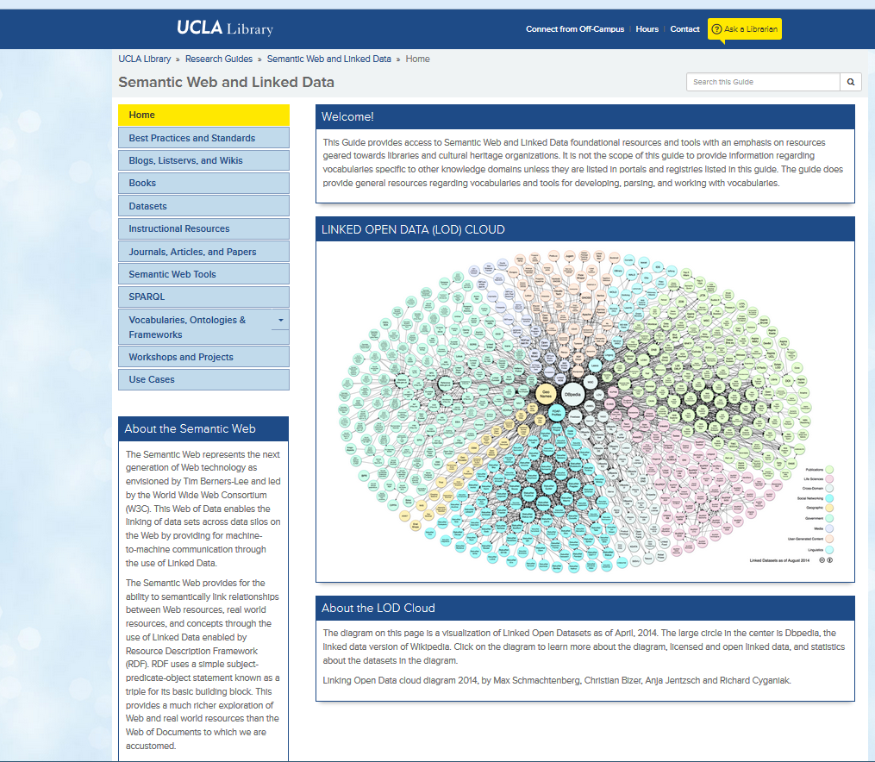
Semantic web and Linked data lib guide
Notes:
This LibGuide provides an extensive list of Semantic Web resources.

Slide 5
Openlink data explorer
http://translate.google.com/translate?hl=en&sl=auto&tl=en&u=http%3A%2F%2Fwww.bauwerk-parkett.de%2Fde%2Fdownload%2Fbroschueren.html
Notes:
Once you have installed the OpenLink Data Explorer add-on to your web browser, open a page you would like to explore using linked data.

Slide 6
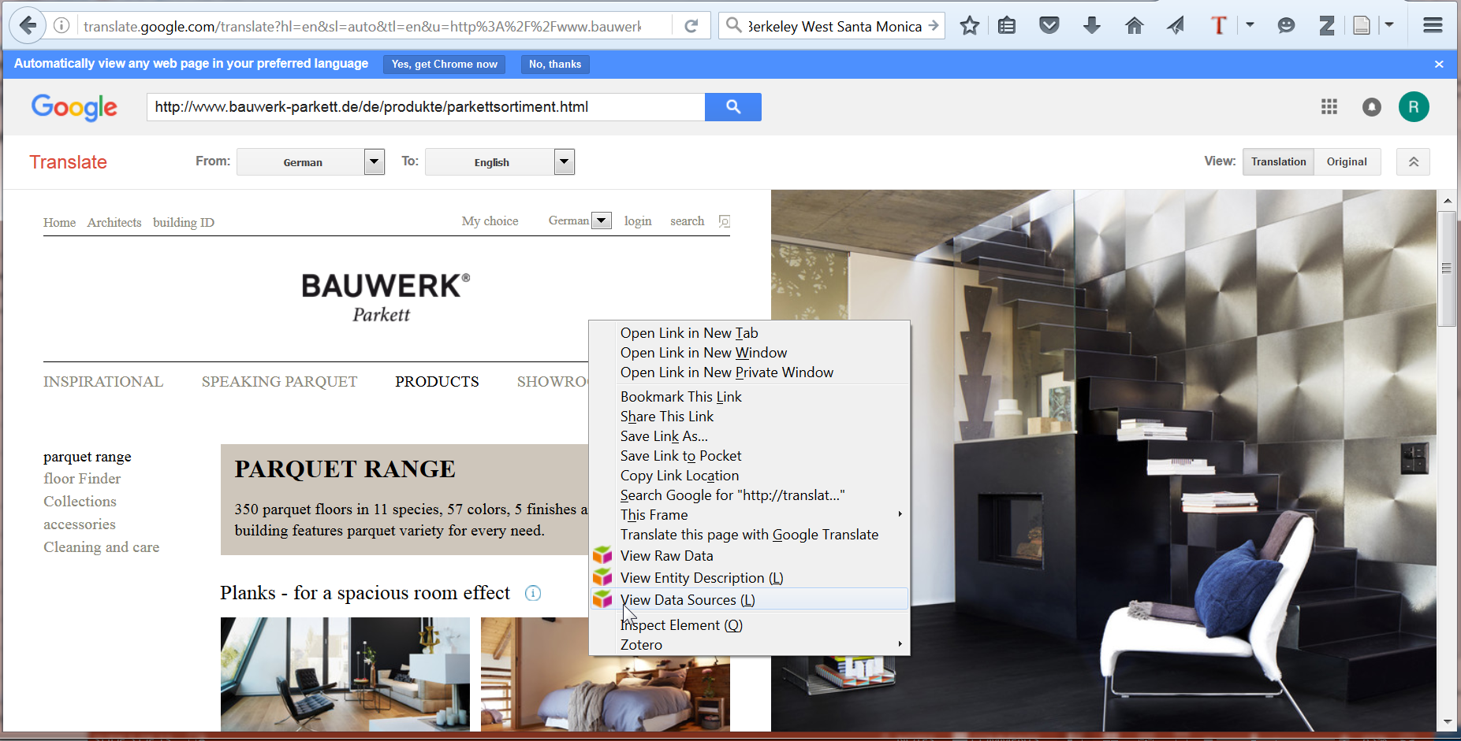
Openlink data explorer
Right Click on mouse. Then, click on “View Data Sources (L).”
Notes:
Right click on your mouse. Then, click on View Data Sources (L).

Slide 7
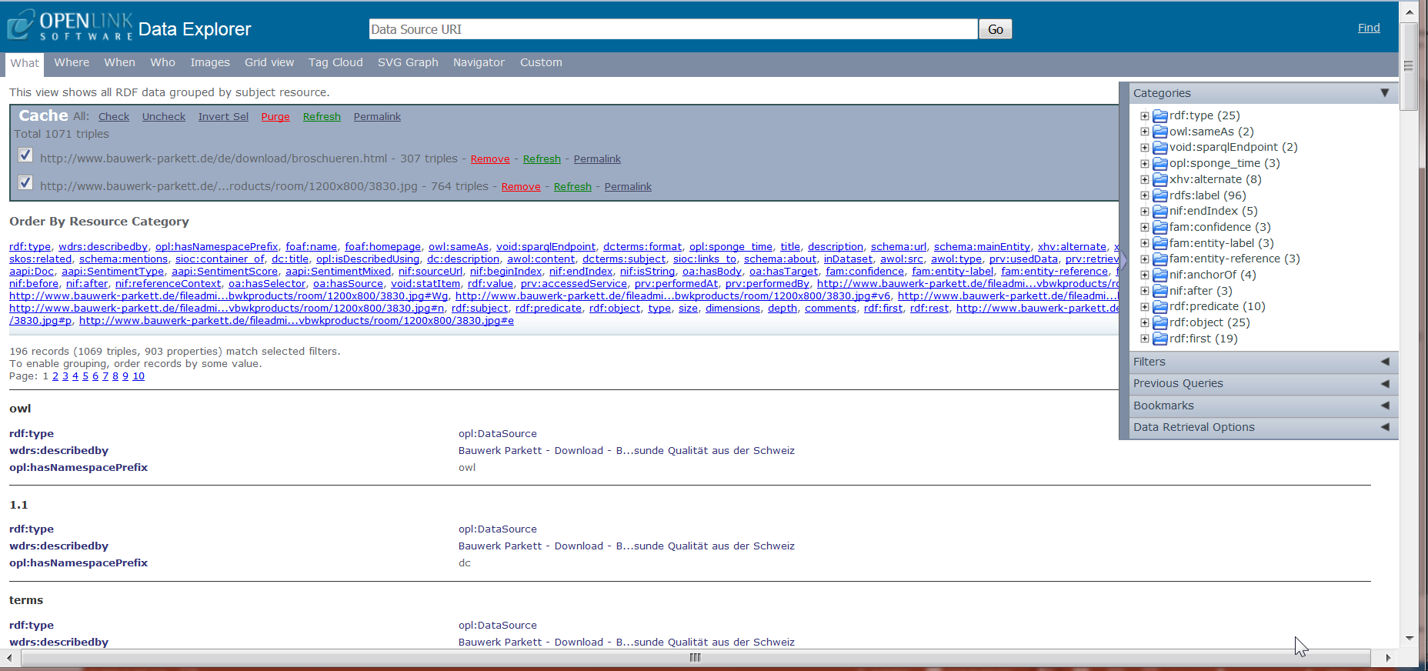
Openlink data explorer
Notes:
OpenLink Data Explorer deploys, giving you a screen that looks like this.

Slide 8
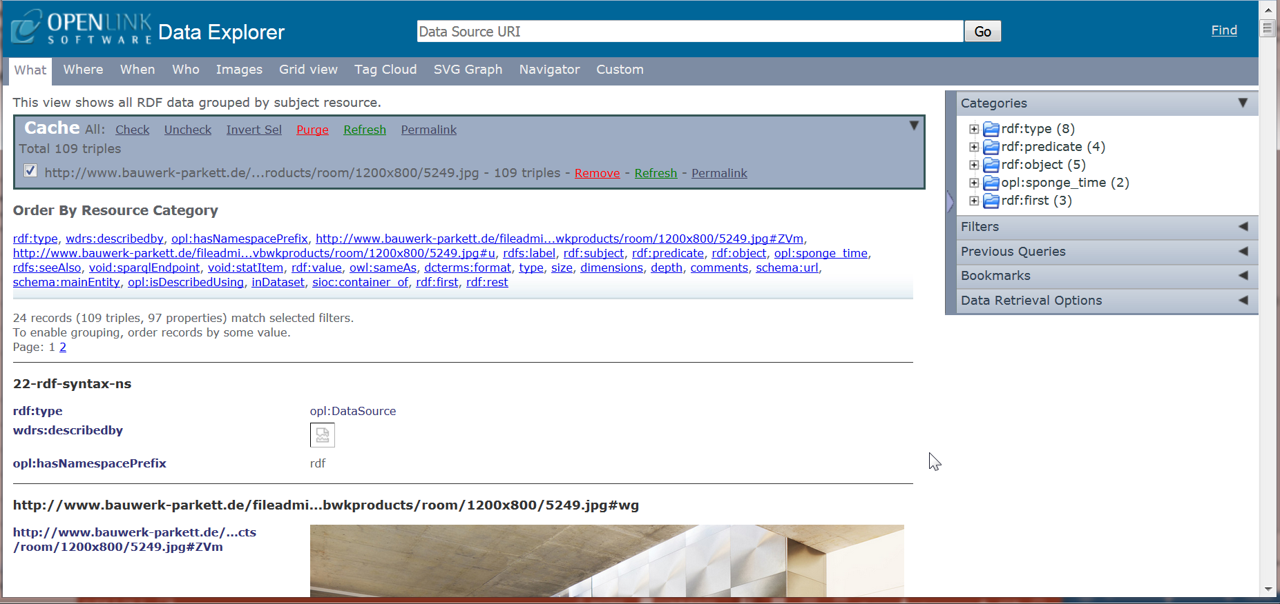
What tab
Notes:
The first tab on the left is the What tab, and will give you a break-down the information on the page. There is a Categories box on the upper right of your screen. You can use the categories to find out what namespaces are being used and to limit the information by using filters.

Slide 9
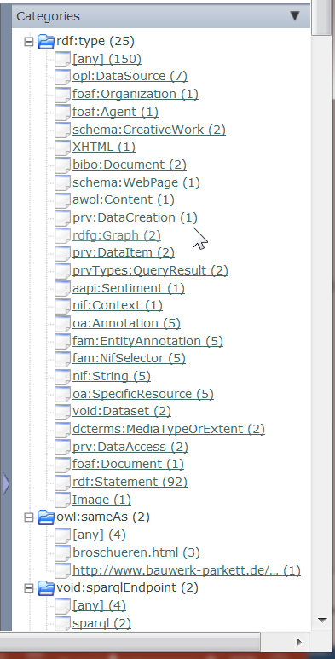
categories
If you expand the rdf:type (25) Category, you will get a good idea of the number of vocabularies used to provide the linked data on this page.
Notes:
If you see a namespace prefix with which you are unfamiliar, and want to find it’s namespace URI, use the prefix.cc tool.

Slide 10
Prefix.cc
Use prefix.cc to find namespace information. You will find a link to prefix.cc on the Semantic Web LibGuide.

Slide 11
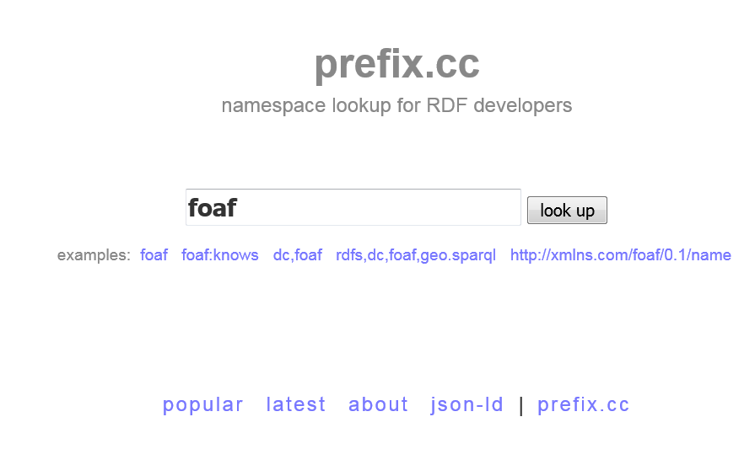
Prefix.cc

Slide 12
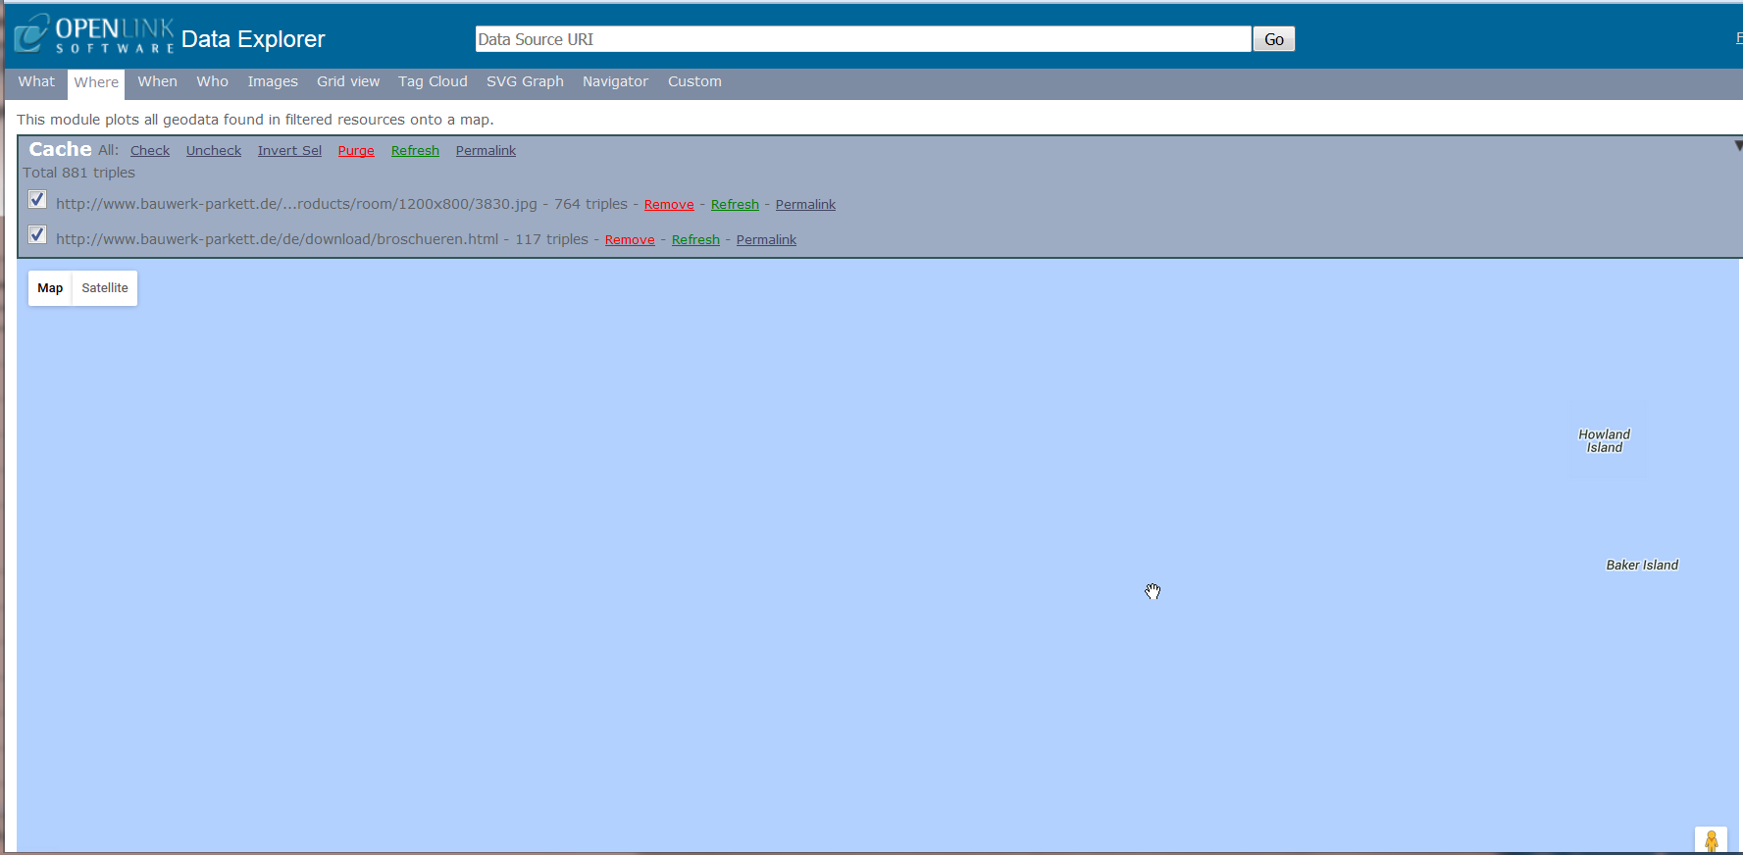
Where tab
The “Where” tab will bring up an ocean view in Google maps.

Slide 13
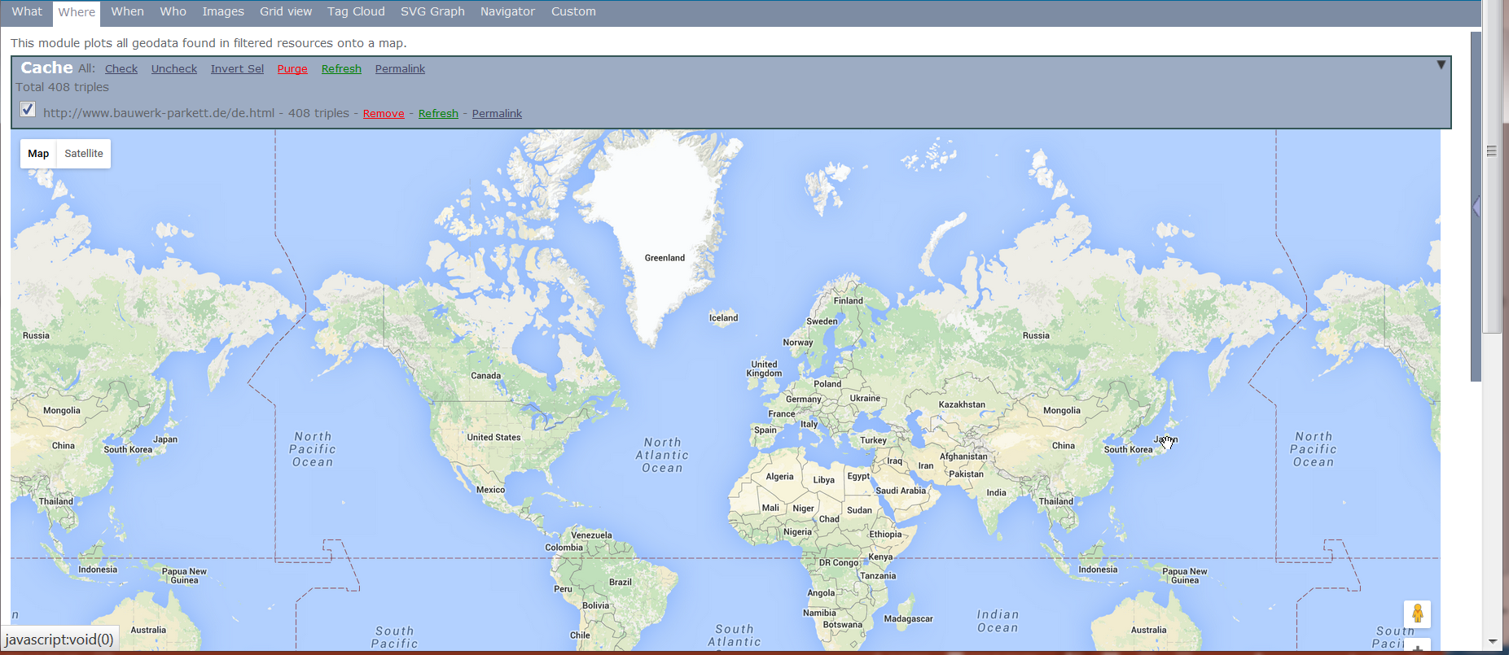
Where tab
Notes:
Scroll into the Pacific Ocean to bring up a full view of the map.

Slide 14
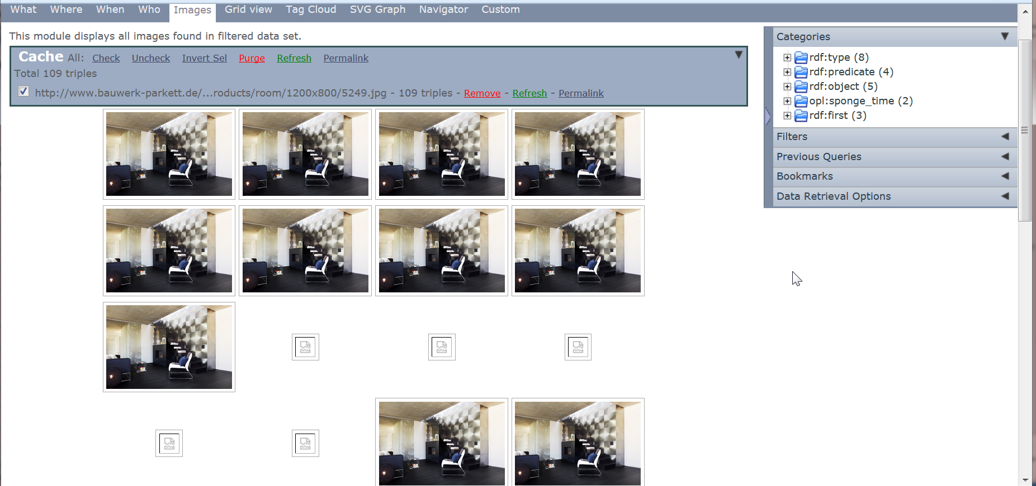
Images tab
Notes:
The images tab will bring up images found in triples on the page.

Slide 15
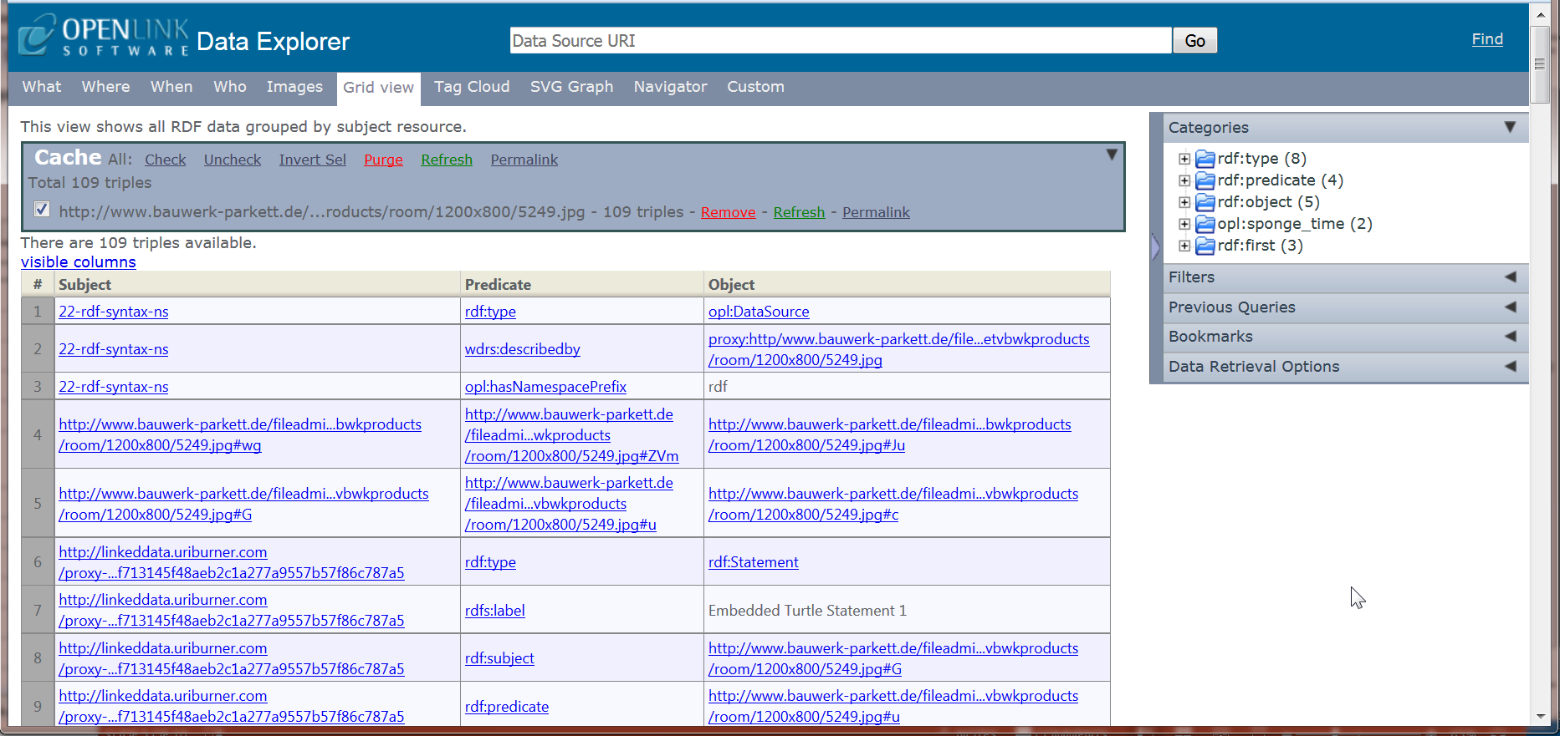
Grid view tab
Notes:
The Grid View displays the subjects, predicates, and objects of the triples.

Slide 16
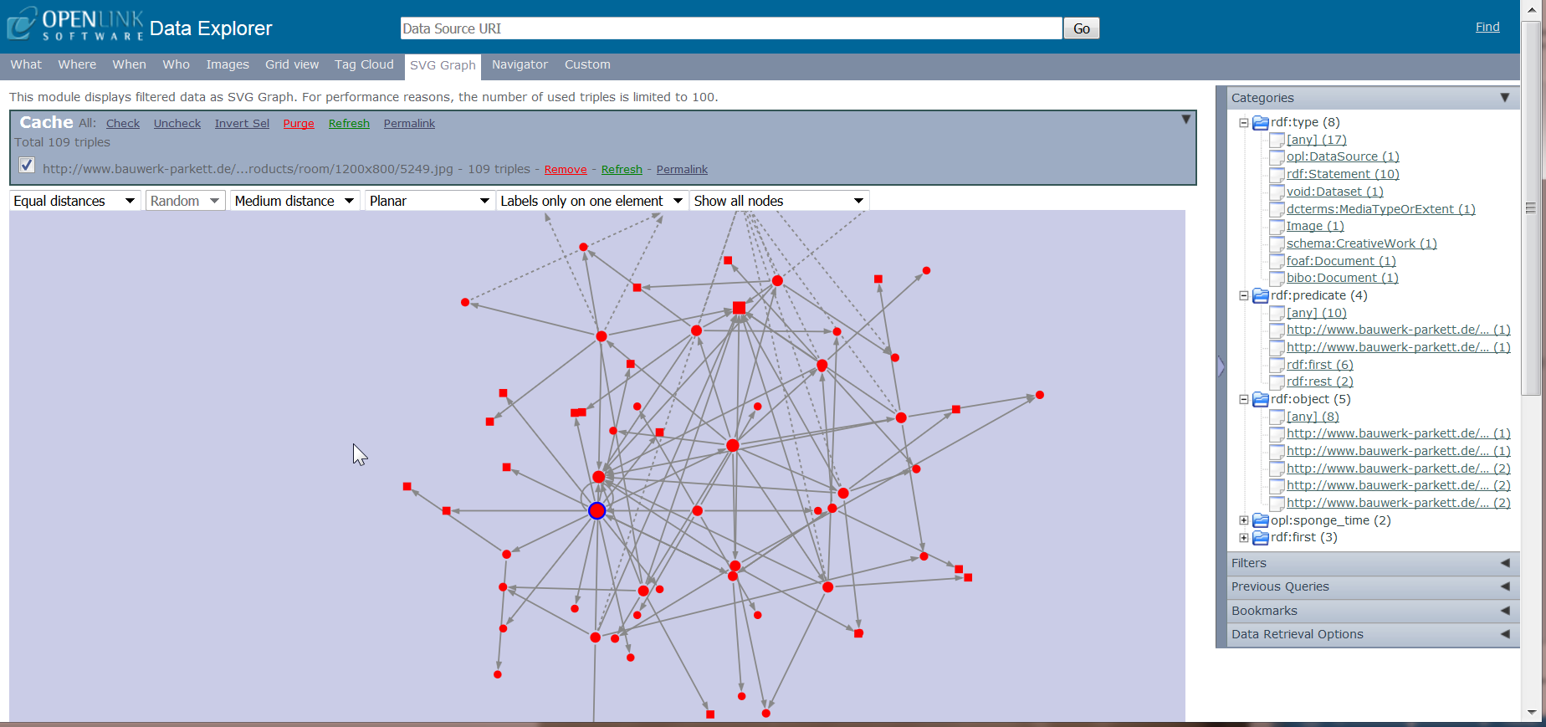
SVG GRAPH Tab & Categories
Notes:
The SVG Graph displays the RDF graph.

Slide 17
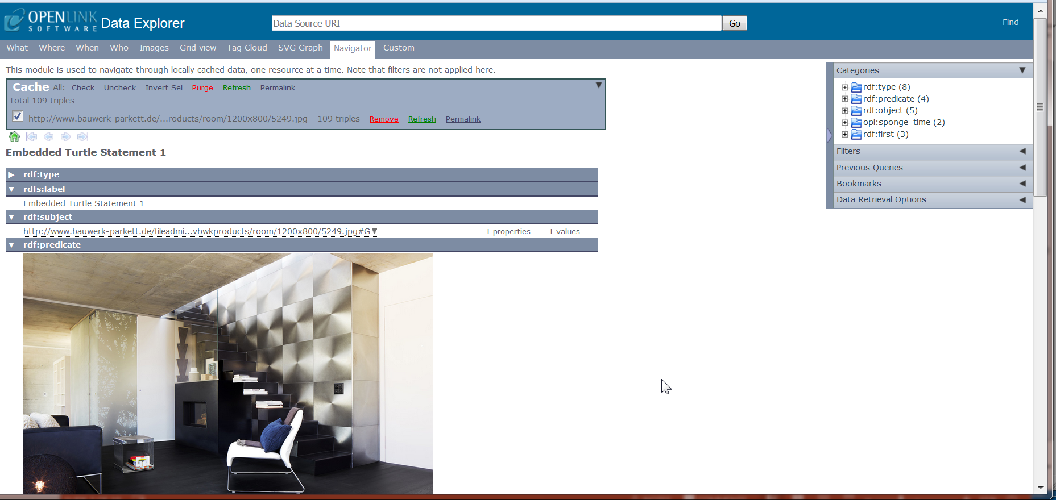
Navigator tab
Notes:
The Navigator tab provides additional information.

Slide 18
Openlink data explorer
http://ode.openlinksw.com/
Notes:
You can access the add-in on this page by right clicking on the slide, then clicking on “Open Hyperlink” in the drop-down menu.

Slide 19
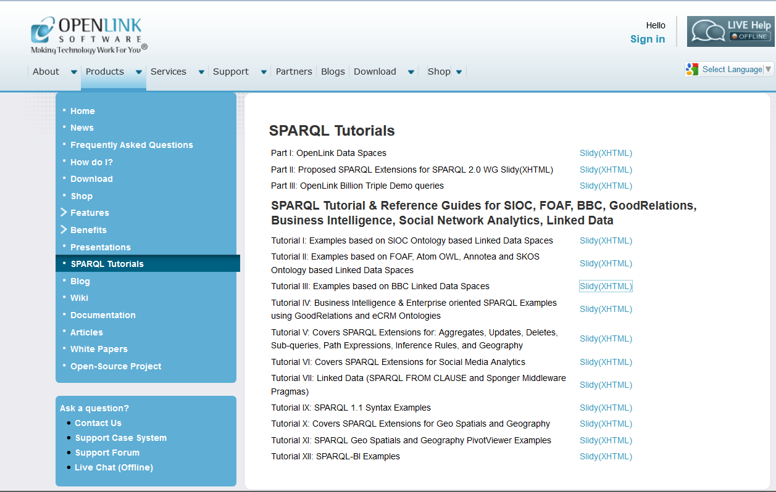
Openlink Software - SPARQL Tutorials
http://virtuoso.openlinksw.com/sparql-tutorials/
Notes:
OpenLink Software is the company that developed the add-in. Their site offers much semantic web related information, including this page with links to SPARQL tutorias.

Slide 20
references
Abele, Andrejs, McCrae, John P., Buitelaar, Paul, Jentzsch, Anja, and Cyganiak, Richard. Downloaded April 4, 2017 from: http://lod-cloud.net/.
Bauwerk Parkett (2016). Bauwerk-Parkett. Downloaded June 1, 2016 from: chrome://ode/content/ode/index.html?uri[]=http%3A%2F%2Fwww.bauwerk-parkett.de%2Ffileadmin%2Fcontent%2Fnetvbwkproducts%2Froom%2F1200x800%2F5249.jpg.
OpenLink Software. The OpenLink Data Explorer Extension. Downloaded June 2, 2016 from: http://ode.openlinksw.com/.
OpenLink Software. SPARQL Tutorials. Downloaded June 1, 2016 from: http://virtuoso.openlinksw.com/sparql-tutorials/.

