Slide 1
Managing during a crisis

Slide 2
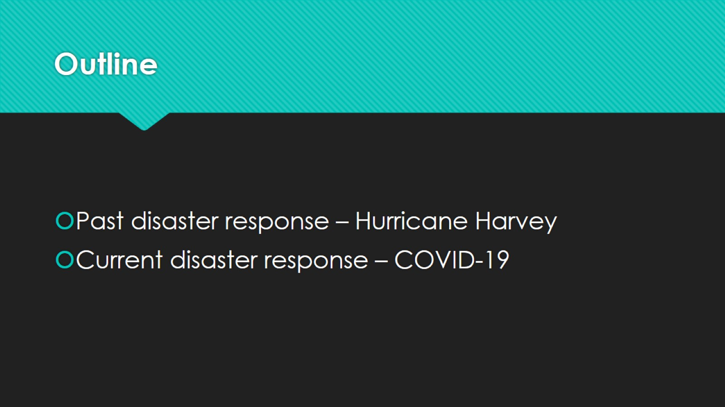
Outline

Slide 3
Harris County Public Library: Who we are

Slide 4
Hurricane Harvey 2017

Slide 5
Four branches flooded

Slide 6
While at home – immediate disaster

Slide 7
Back in the office – long term recovery

Slide 8
Three branches reopen within 9 months

Slide 9
Facts & Figures: Opening Day Collections

Slide 10
Missed opportunities

Slide 11
COVID-19 Response 2020

Slide 12
Curbside Service in March 2020

Slide 13
Cataloging and Processing Team

Slide 14
Challenges Faced

Slide 15
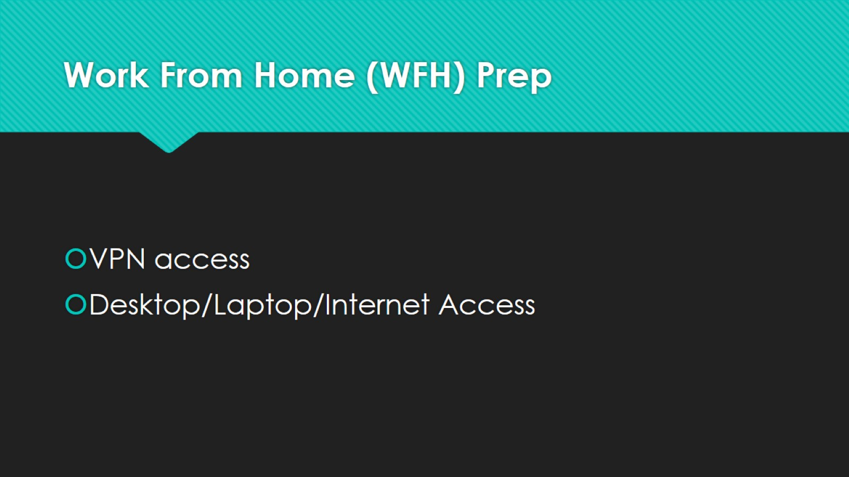
Work From Home (WFH) Prep

Slide 16
Expectations vs Reality

Slide 17
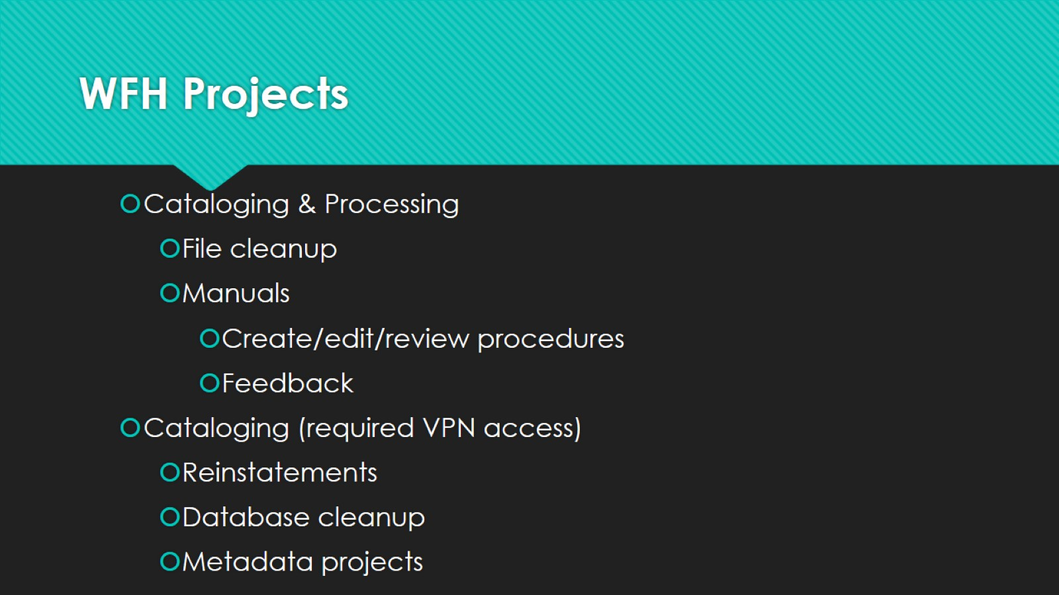
WFH Projects

Slide 18
Curveballs

Slide 19
Workflow Efficiency

Slide 20
Recommendations

Slide 21
Phased Re-opening

Slide 22
This is an on-going crisis

Slide 23
THANK YOU!

