Slide 1
Getty Vocabularies:
Linked Open Data, Troubleshooting and Maintenance
Jonathan Ward
Sr Editor – Getty Vocabulary Program
Getty Research Institute
February 1, 2021

Slide 2
The Getty Vocabularies and Linked Open Data
Open Content Initiative and the GRI Portal
Concepts are from scholarly and trusted sources
All concepts and terms have unique identifiers
Vocabularies share a core data structure
Vocabularies are linked to each other through core fields
February 1, 2021

Slide 3
The Getty Vocabularies and Linked Open Data
Key analysis by Dr. Marcia Zeng (Kent State University)
Outside vendor hired (Ontotext); funding provided
AAT released in 2014
First implementation was SKOS-based and used numerous ontologies:
February 1, 2021

Slide 4
The Getty Vocabularies and Linked Open Data
Ontologies used:
Thesaurus information: SKOS, SKOSXL, ISO 25964
Common properties: Dublin Core (DC), Dublin Core Terms (DCT)
Sources and contributors: Bibliographic Ontology (BIBO), Friends of a Friend (FOAF)
Geographic information: W3C Geo Ontology (WGS)
Revision History: Provenance (PROV)
System properties: Resource Description Framework (RDF), RDF Schema (RDFS), Web Ontology Language (OWL), and XML Schema Definition (XSD)
Implementation of the conversion: RDB to RDF Mapping Language (R2RML)
Future changes: CIDOC-CRM
February 1, 2021

Slide 5
Vocabulary Program Process
LOD &
SPARQL
XML WEB
SERVICES
Contributing Institution
Vocabulary Editors
February 1, 2021

Slide 6
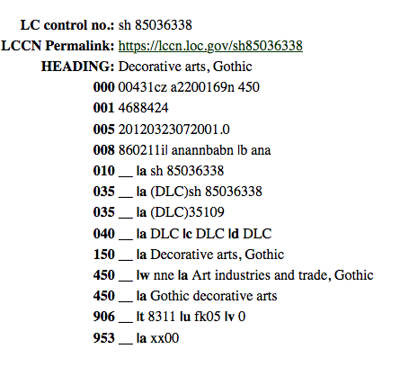
Thesauri & Subject Headings
AAT:
February 1, 2021

Slide 7
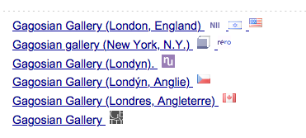
Thesauri & Subject Headings: Many-to-one example
ULAN:
February 1, 2021

Slide 8
Troubleshooting and Error Reporting
Contact: vocab@getty.edu
February 1, 2021

Slide 9
Troubleshooting and Error Reporting
ULAN and TGN errors
Typos and grammar
Name changes (“Macedonia” = “North Macedonia”)
Name changes (Perferred “Akagi Yasunobu” not “Akagi, Yasunobu”
Data errors: wrong coordinates (TGN), wrong culture/nationality (ULAN
Data errors: incorrect life dates (ULAN), wrong hier placement (TGN)
Contact: vocab@getty.edu
February 1, 2021

Slide 10
Troubleshooting and Error Reporting : Duplicates
Contact: vocab@getty.edu
February 1, 2021

Slide 11
Troubleshooting and Error Reporting: AAT-specific
AAT errors and fixes:
Non-synonymous “used-for” terms
De-coordination
Hierarchical repositioning
Correcting or removing ”guide terms”
Scope note revision, expansion, correction
Contact: vocab@getty.edu
February 1, 2021

Slide 12
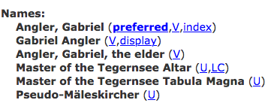
Troubleshooting and Error Reporting: Ambiguity
Contact: vocab@getty.edu
February 1, 2021

Slide 13
Contributing to the Getty Vocabularies
OpenRefine Reconciliation Service
Align data; prepare data for contribution
Online contribution webform
New click-through license agreement
Spreadsheet for contributors in development
February 1, 2021

Slide 14
Thank you.
Jonathan Ward
Sr Editor – Getty Vocabulary Program
Getty Research Institute
jward@getty.edu

