Slide 1
The Cataloging Lab: Encouraging Collaboration for a More Effective & Inclusive LCSH Proposal Process
Violet Fox
@violetbfox
#metadataIG #alctsac18 #CatalogingLab
Metadata Interest Group, ALA Annual, June 24 2018

Slide 2
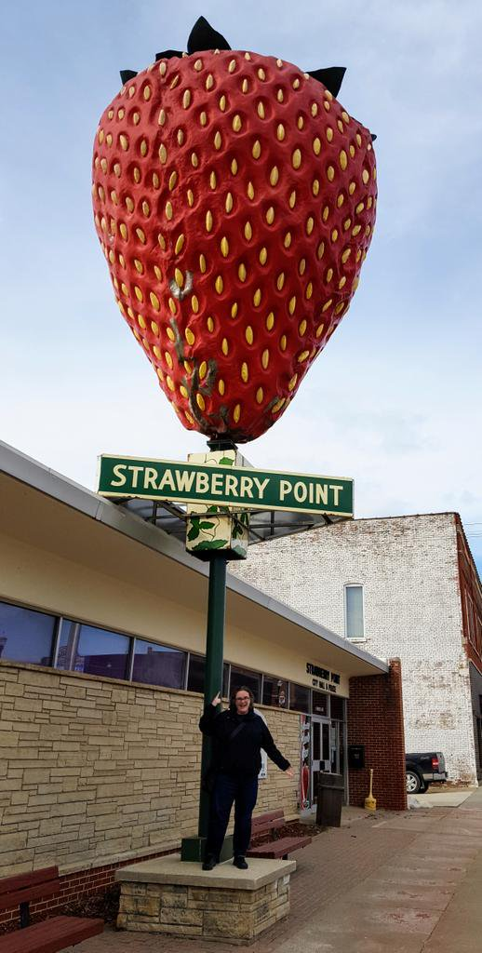
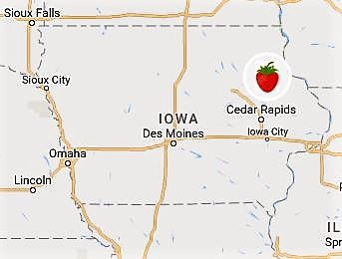
About me
Notes:
To start off with thanks to the Metadata Interest Group for having me, and to Chair Liz and Vice Chair Anna for inviting me to be a part of today’s program.
This is a photo of the world’s largest strawberry, I write a zine that talks about my travels to visit roadside attractions across the U.S.
I previously worked in cataloging and metadata at the University of Illinois at Chicago and St. John’s University in Collegeville, Minnesota. I received my MLIS from the University of Washington in 2013.
I recently began working for OCLC in my new position as one of the Editors of the Dewey Decimal Classification. I would like to be clear that this is my personal project started before I interviewed with them. The Cataloging Lab is not an OCLC product and I’m not representing OCLC this morning.
I will also say that I don’t work for LC (the Library of Congress), and I’m not a part of PCC (the Program for Cooperative Cataloging), so I’m not anyone who’s affiliated with anyone in charge of anything! I am entirely self-taught, and I’m still learning how the process works, ensuring that all my Is are dotted and my Ts are crossed. I say all this with somewhat of a fear that you the attendees will be like, well, who the heck are you to be talking to us today? And that’s a legitimate point! But I also add those disclaimers to say, look, anybody can do this. Training is great if you can get it, if you have that sort of support in your department, but as more and more catalogers work alone, or don’t have professional development support, we all need to be able to step up and to not let that stop us from educating ourselves, and being an active part of the metadata community.

Slide 3
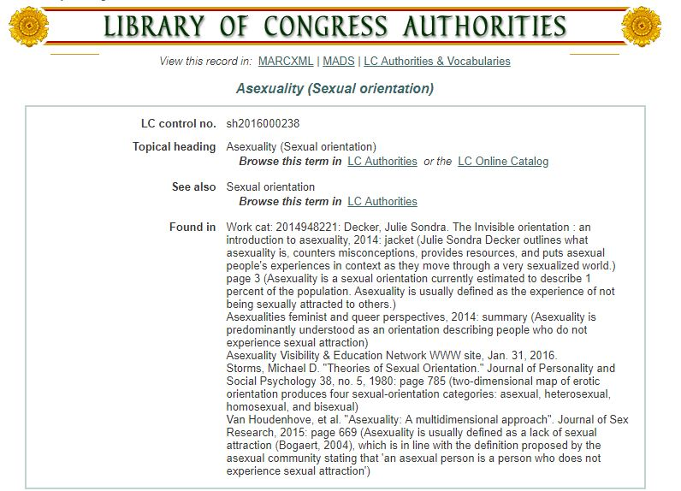
Thanks to:
Catherine Oliver, Northern Michigan University
Jessica Schomberg, Minnesota State University Mankato
Netanel Ganin, Library of Congress National Audio-Visual Conservation Center
Notes:
Since I mentioned how I’m not a part of a SACO library or a part of LC, let me briefly talk about how I came to start working on subject heading proposals. My story starts with library twitter and more specifically cataloging twitter, which is always entertaining and sometimes even informative. Some of my Twitter colleagues, Catherine Oliver and Netanel Ganin were frustrated that there was no LCSH for Asexuality. Netanel submitted a proposal, which was not accepted, because PSD had questions about the proposal. So a few of us worked together on a shared Google doc to address their concerns and shore up the proposal, adding new resources that clarified that Asexuality is a sexual orientation. And then we resubmitted that proposal and it was accepted, and that’s the accepted authority record that you see there. That was really exciting!
It really worked out well to be able to share information. We built a better proposal because we collaborated. But instead of a Google doc, we can do better than that. So I built a wiki platform where people could work together on proposals and learn from previous submissions about what worked and what didn’t.
So just a quick thank you to my collaborators who have helped make the Cataloging Lab possible.

Slide 4
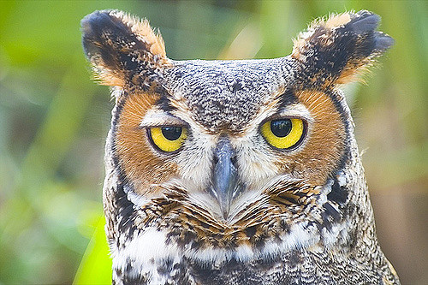
Who
are
you?
“Owl” by allspice1 is licensed under CC BY-ND 2.0
Notes:
I’d like to know who is here in the audience today. To do that, I’m going to ask just one question and have people answer on a two point scale. What would you do if someone in your library came to you and said, “Hey, why isn’t [such-and-such] an LC subject heading yet? Can you make that happen?” Would you be more likely to say, “Sure, I do that all the time,” or to throw down a smoke bomb and quit your job?

Slide 5
Who
makes the decisions?
“Browl Fish Owl” by challiyan is licensed under CC BY-SA 2.0
Notes:
Let’s talk about who makes the decisions in the LCSH process.

Slide 6
SACO: Subject Authority Cooperative program (is a part of PCC)
PCC: Program for Cooperative Cataloging
PSD: Policy and Standards Division of the Library of Congress
Notes:
acronyms slide
LC = Library of Congress
LCSH = Library of Congress Subject Headings
SACO has been around since the 1990s. SACO program was designed so that institutions outside of LC could submit proposals for additions and revisions to LCSH and LCC. There are two ways to be a part of SACO. The first is that your institution can be an individual contributor. In practice that’s usually limited to larger academic institutions, because librarians have to have the institutional support to take the time to learn the rules and do the kind of research that’s required for proposals. You can also join as part of SACO funnel. That’s when catalogers form cooperative groups called funnels to participate in creating proposals. Funnels are organized by either subject area or geographic location, but many libraries exist outside the areas covered by funnels.
PSD are the gatekeepers of LCSH and LCC. And that’s both a good and bad thing. It maintains a relatively high quality, relatively consistent vocabulary that is capable of describing a huge variety of resources. That’s undoubtably valuable. On the other hand, while people tend to think of LC as our national library, and in some ways it is, it many others it’s not, and that includes staffing.
And it’s not an acronym, but I will briefly mention the concept of “literary warrant”, which is an important concept to understand. It’s the idea that in order to be justified for inclusion in LCSH, there has to be something published about that topic. We should remember that literary warrant isn’t the only way that you could organize a vocabulary, but it is the way that headings in LCSH are justified, which means that much of the proposal process relies on proving that the heading is necessary and useful by showing that there are published works that would be assigned that heading by catalogers.

Slide 7
The submission process
Identify need
Research topic
Formulate record
Submit proposal

Slide 8
The review process
6-10 weeks
Receive proposal
Evaluate proposal
Publish decisions

Slide 9
What do you need to know to research and formulate an LCSH proposal?
SACO Participants’ Manual (300 pages)
SHM = Subject Heading Manual
MARC (for authority records)
subject expertise

Slide 10
“Don’t Panic” via TeeTurtle.com

Slide 11
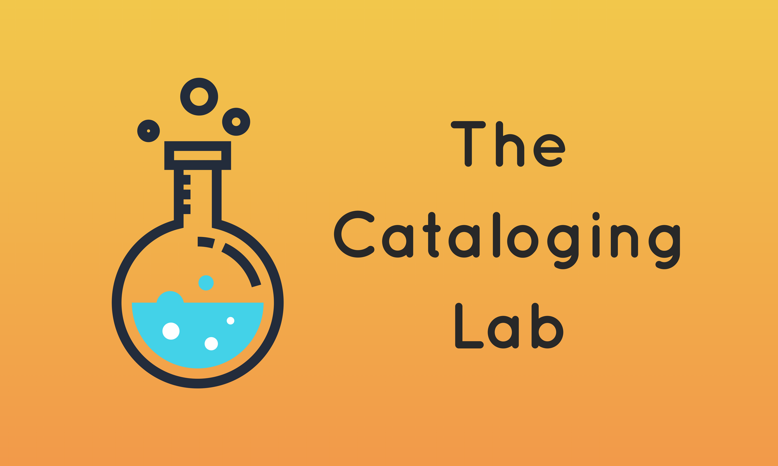
cataloginglab.org
Notes:
This is where the Cataloging Lab can be helpful. It’s a simple wiki that allows people to work together to identify inadequate or inappropriate headings, to gather resources that would justify the new heading or a modification, and then to shape that proposal into MARC format, according to the rules set forth by the SACO proposal process. No one person has to be an expert in any of the topics; people can work together providing the expertise they are familiar with to help craft a proposal which is stronger than any one person could submit.

Slide 12
The submission process
Identify need
Research topic
Formulate record
Submit proposal
Notes:
Let me give you an example of how the process works. This spring I worked with two great groups of students from my alma mater, the University of Washington iSchool. These were students who were not catalogers, didn’t know MARC, weren’t subject matter experts, but they were willing to work with me to learn more about how this whole process works. One of the groups I worked with, students Chris Lu and Katharine Roche-Sudar, they identified “Cultural appropriation” as a subject heading which is not yet in LCSH. Instead, works on cultural appropriation, and there are a good amount of them out there, are currently given the heading “Cultural property”, which seems inadequate because it doesn’t address the idea of a majority culture taking from a minority culture.
They identified the need, they researched literary warrant for the term as well as definitions in sociological resources, then I helped them format the proposal into MARC format and posted it to the Cataloging Lab. After asking Twitter for feedback, the students emailed LC with the proposal, where it is currently being evaluated.

Slide 13
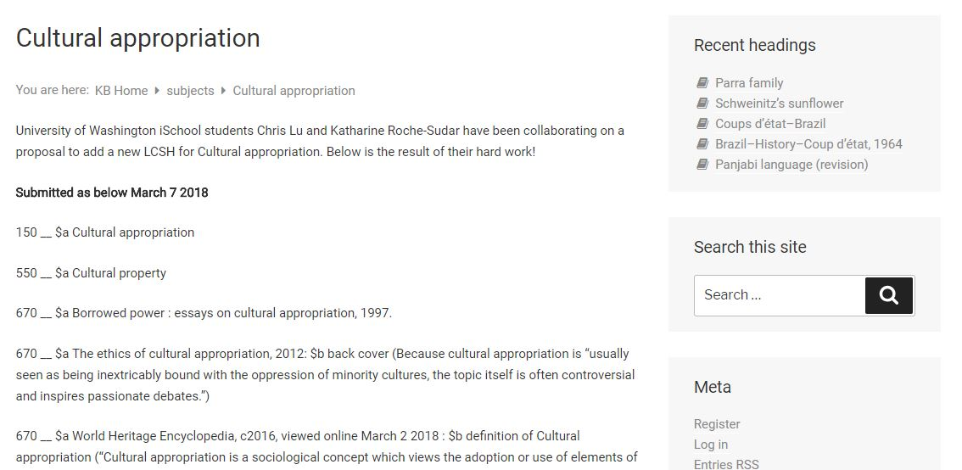
Notes:
This is what the proposal looks like after being formatted into MARC according to SACO rules.

Slide 14
Almost all of the information you need to propose a heading is available on the LC site!
Process for Adding and Revising LCSH: https://www.loc.gov/aba/cataloging/subject/lcsh-process.html
LCSH home: https://www.loc.gov/aba/cataloging/subject/
Find the pdf form to propose or revise a heading!
Check out the summary of decisions!
See the lists of the most recently approved headings!
Find the most relevant Subject Heading Manuals!
SACO home: https://www.loc.gov/aba/pcc/saco/index.html
Thrill to all 300 pages of the SACO Participants’ Manual!
Be inspired by all the SACO funnel groups & consider joining one!

Slide 15
LC can’t do it alone
All of us are responsible for the vocabulary we use
The more people involved, the more diversity of thought is introduced to headings
Because it’s fun!
To better understand controlled vocabs
Why?
Notes:
So let’s talk about why we should do this. We have to be able to justify why this work is important and why we can’t just leave it to LC to figure out. LC doesn’t have the staffing to adequately maintain headings; they’ve set up the SACO program entirely to request community input. They want our help!

Slide 16
Why not?
Notes:
why not just create local headings if LCSH isn’t working for your library? Which is a great question, and I’m a huge fan of local vocabularies, and if you have the resources to maintain a local vocabulary and it works better for your users, that is great, you have my resolute endorsement on that. But there’s a few reasons why that doesn’t work for everyone: cataloging departments are getting smaller, and local vocabs require maintenance. And as we move towards more consortial environments, individual libraries often don’t have the power to change headings. If you’re in a next gen ILS environment like OCLC’s WMS, you’re forced to use master records, and you can certainly add local headings, but you can’t change subject headings that don’t work for your users. For example, my previous position was at a WMS library, and if I didn’t want to use the offensive “Illegal aliens” heading, I could add alternatives, but I couldn’t remove that heading from the records we had holdings on.
There’s a lot of good reasons why it’s beneficial for your library’s users, and for ALL the users of libraries who use LCSH around the world, to work together to make LCSH better. It’s never going to be perfect, but it can be better than it is.
We know that no one controlled vocabulary, no matter how large, can equitably represent the diversity of human thought.
Because my core motive with all this is to get library folks comfortable with controlled vocabularies. To be thinking about the scale and scope of the terms that we use, and the often limited viewpoints that are represented by a particular vocabulary. Let’s tussle with these questions now, let’s reclaim this process. Honestly I hope that some day we’ll move past the point of being so reliant on LCSH, and that we’ll be able to collaborate on more specialized, localized vocabulary that center our own users’ needs. The Cataloging Lab is one tiny baby step in making that future happen.

Slide 17
Questions? Comments?
violetfox@gmail.com
@violetbfox
Notes:
Please get in touch with any questions or comments! I’m glad for your feedback.

