Slide 1
More than LCSH: Enhancing the Discovery of Archival Resources
Whitney Buccicone, Special Collections Cataloging Librarian Charlene Chou, Coordinator for Distinctive Collections Technical Services
University of Washington Libraries

Slide 2
Agenda
Introduction
Controlled vocabularies
Software being used
Ex Libris Primo & ArchivesWest
Comparisons
ArchivesWest, SNAC, Primo, ContentDM & WikiMedia Commons
Recommendations

Slide 3
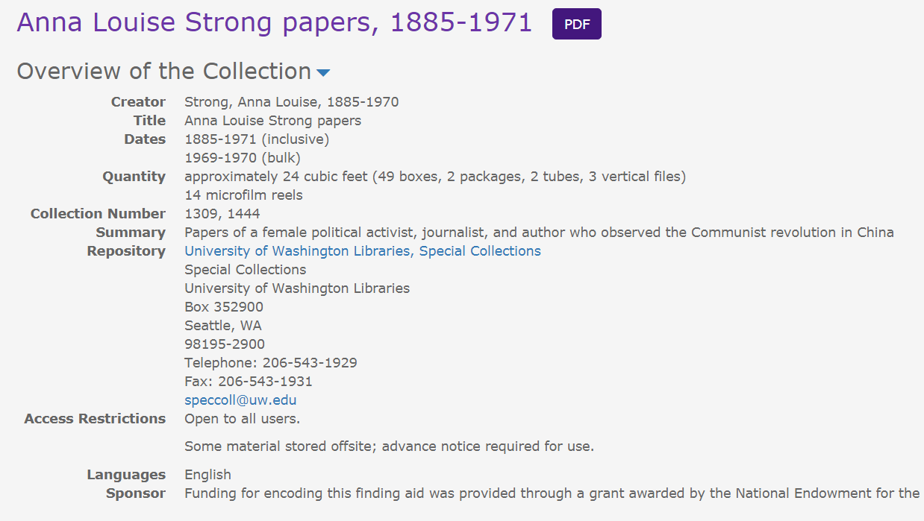
What is an archival collection?
From AAT: Collections of historical records and primary source documents that have accumulated over the course of an individual's or organization's lifetime, and are kept to show the function or history of the person or an organization. Documents may be tangible or digital.
From SAA: n. ~ 1. A group of materials with some unifying characteristic. - 2. Materials assembled by a person, organization, or repository from a variety of sources; an artificial collection.

Slide 4
Controlled Vocabularies
Art & Architecture Thesaurus (AAT)
“…used as a controlled vocabulary or authority by the cataloger or indexer; they provide preferred names/terms and synonyms for people, places, and things. They also provide structure and classification schemes that can aid in documentation”
Library of Congress Genre Terms
“In 2007 the Library of Congress began a project to develop genre/form terms, which describe what a resource is, rather than what it is about, as most subject headings do”
Thesaurus of Graphic Materials
“…tool for indexing visual materials by subject and by genre/format”
RBMS Genre Terms
“[To] provide standardized vocabulary for retrieving special collections materials by form, genre, or by various physical characteristics that are typically of interest to researchers and special collections librarians”

Slide 5
Orbis Cascade Alliance & ArchivesWest
Orbis Cascade Alliance (OCA)
Nonprofit consortium of 39 colleges and universities in Oregon, Washington, and Idaho
Founded in 1993
Archives West
Formally known is the Northwest Digital Archives
Became a program offering by Orbis Cascade Alliance in 2007
Funding is provided by all OCA’s participating institutions with additional funding from different national institutions (IMLS, NEH, etc)
Guides to archival collections: 23,000
From: https://www.orbiscascade.org/about

Slide 6
Who controls the data?
Unique & Local Content Team at the Alliance
Charge: “investigates and implements solutions for unique content needs, recommends consortium-wide practices, and supports an integrated approach for publishing, storing, discovering and preserving resources in our special collections, archives, and digital repositories”
Unique Materials in the SILS Standing Group
Overview: “This group plays a key role in supporting the ULC’s charge to provide broad oversight and leadership for the development, stewardship, and dissemination of unique and local content, by its study of and response to issues affecting unique materials represented in the Alliance’s Shared ILS (SILS). Its approach to problem resolution will include examination and potential revision of both consortial and institutional practices. Issues of system limitations, effects on other materials, and institutional resources will be considered”
Metadata-focused library workers at individual institutions
Challenges:
Not every institution has dedicated metadata-focused library workers
What does this mean? Not all who input metadata into ArchivesWest are trained or knowledgeable in controlled vocabularies

Slide 7
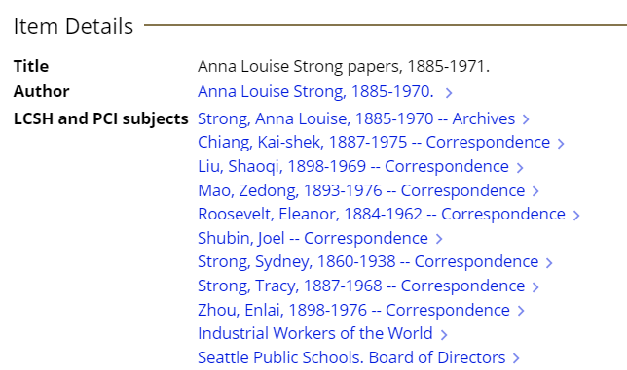
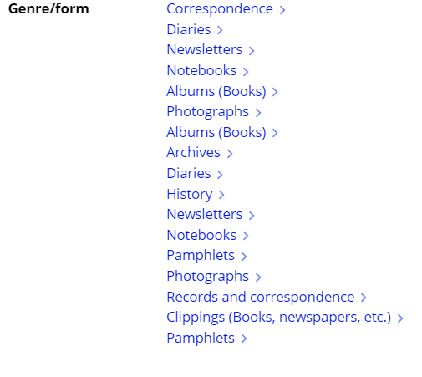
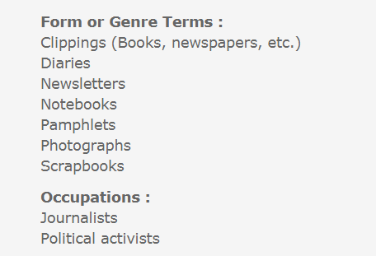
Primo
ArchivesWest
Notes:
Primo – access points controlled and linkable; Archives West – not controlled, not linkable; at UW, taken directly from catalog record while at other institution catalogers not always involved

Slide 8
Comparisons: Primo vs. ArchivesWest ArchivesWest vs. SNAC ArchivesWest vs. Wikimedia Commons
Analysis & Discussion

Slide 9
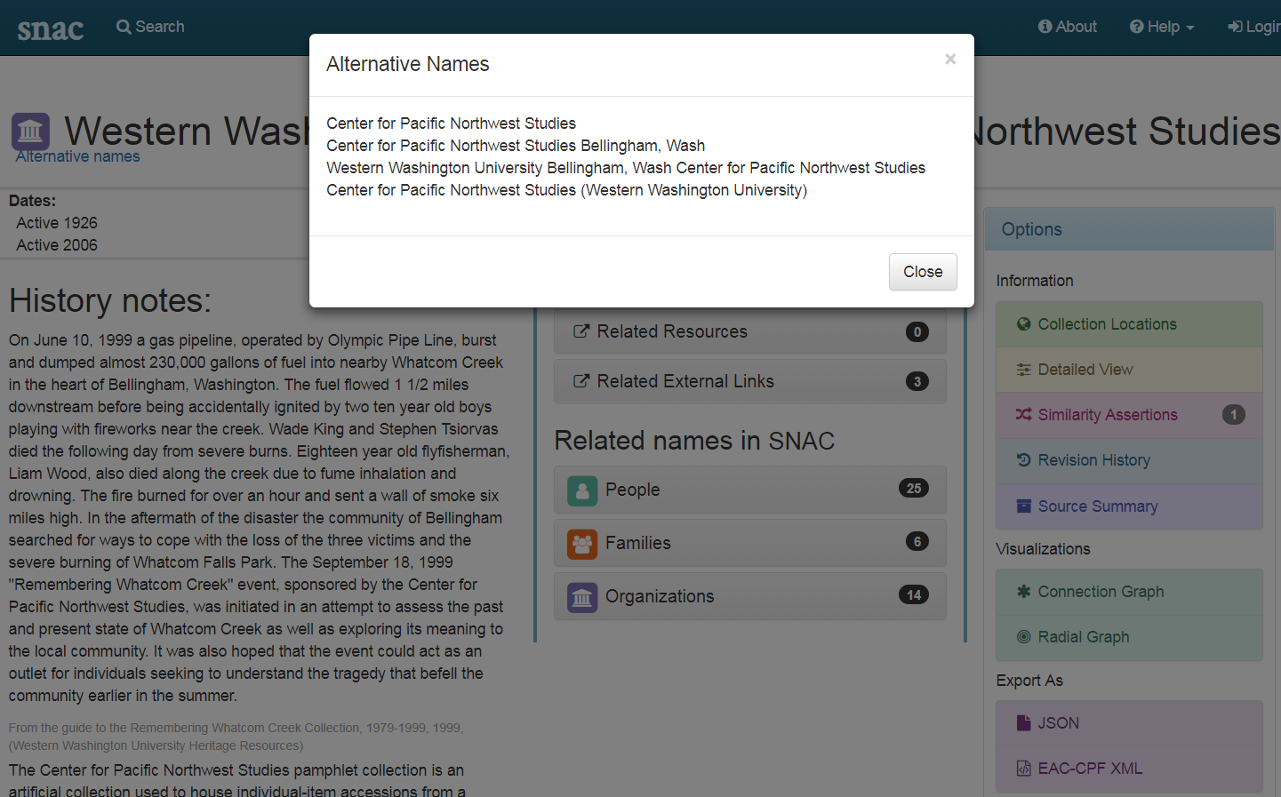
Search Western Washington University. Center for Pacific Northwest Studies (SNAC)
Notes:
SNAC provides the information of alternative names for this corporate body.

Slide 10
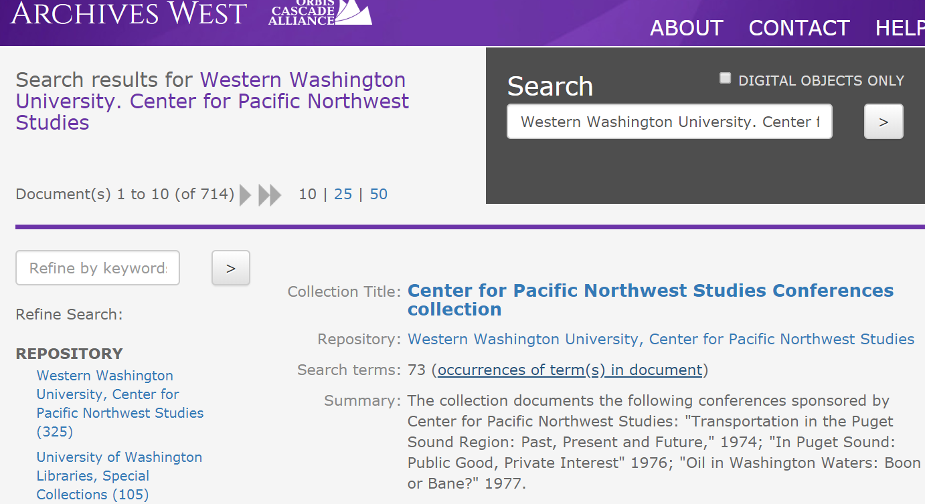
Search Western Washington University. Center for Pacific Northwest Studies (ArchivesWest)

Slide 11
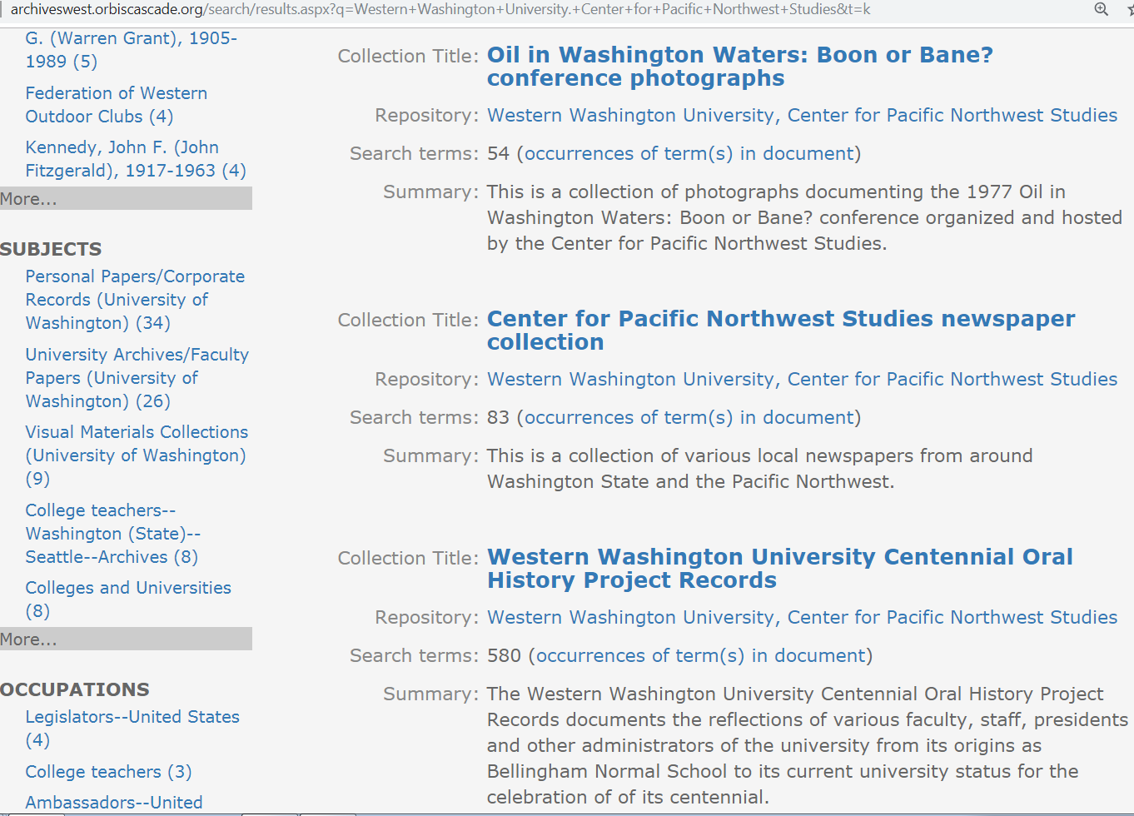
Search Western Washington University. Center for Pacific Northwest Studies (ArchivesWest—Subjects)

Slide 12
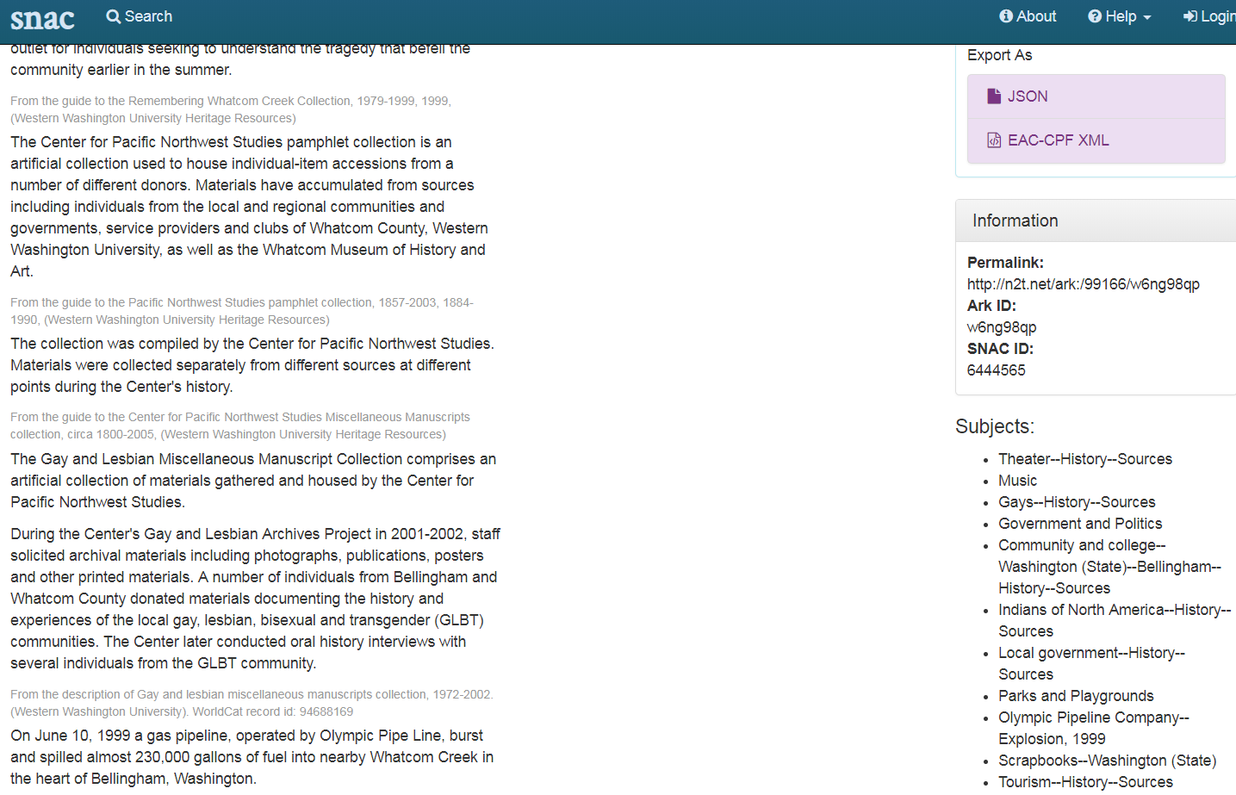
Search Western Washington University. Center for Pacific Northwest Studies (SNAC—Subjects)

Slide 13
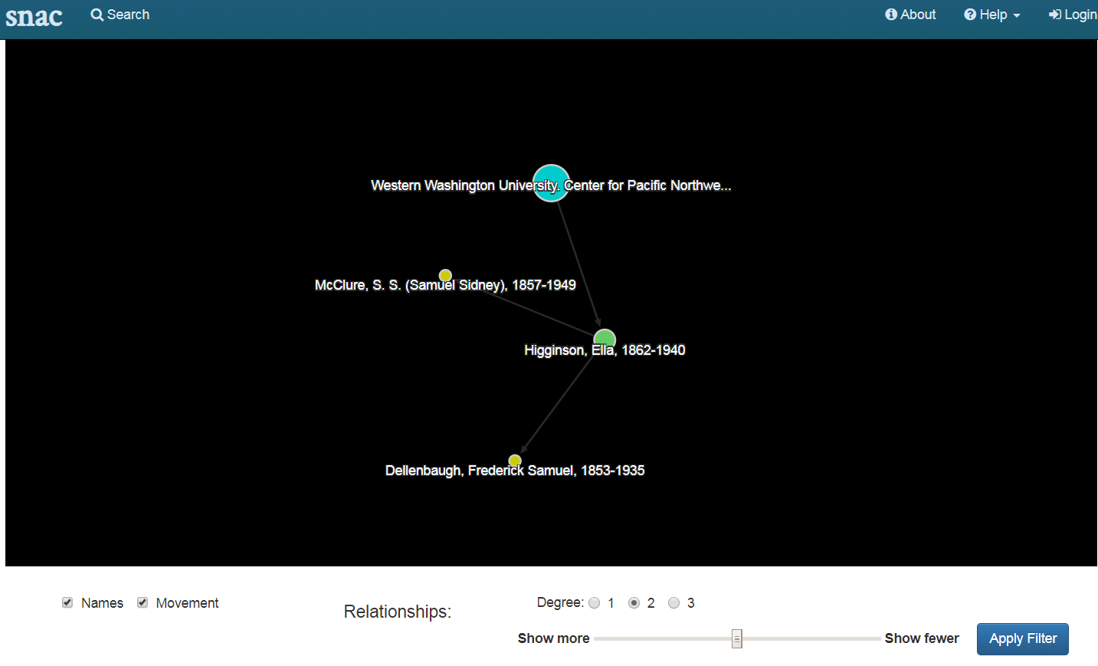
Search Western Washington University. Center for Pacific Northwest Studies (SNAC—Visualizations—Connection Graph)
Notes:
The most important feature → showing relationships

Slide 14
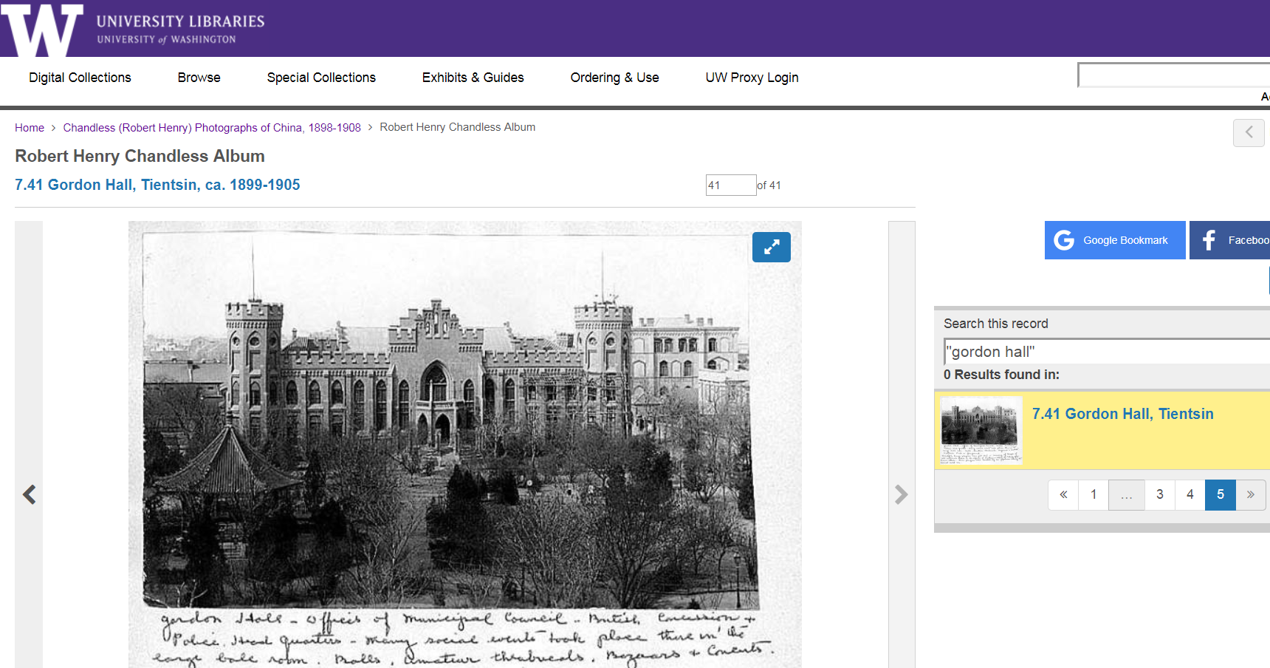
Search “Gordon Hall” in the UW Digital Collections (ContentDM)

Slide 15
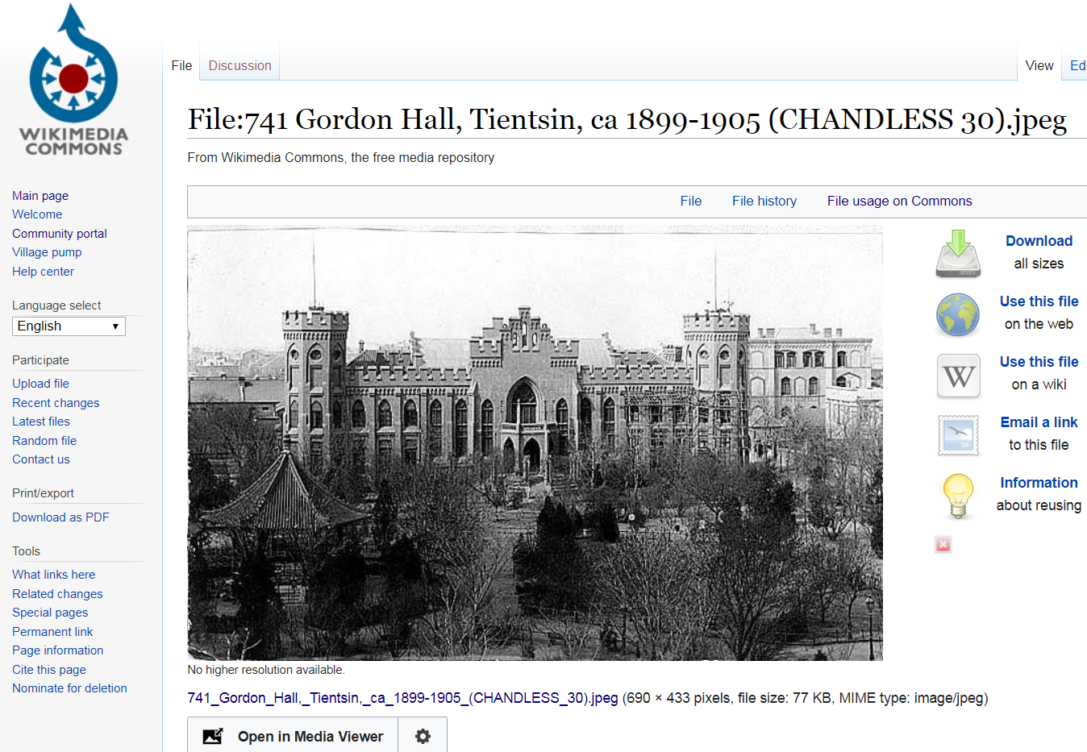
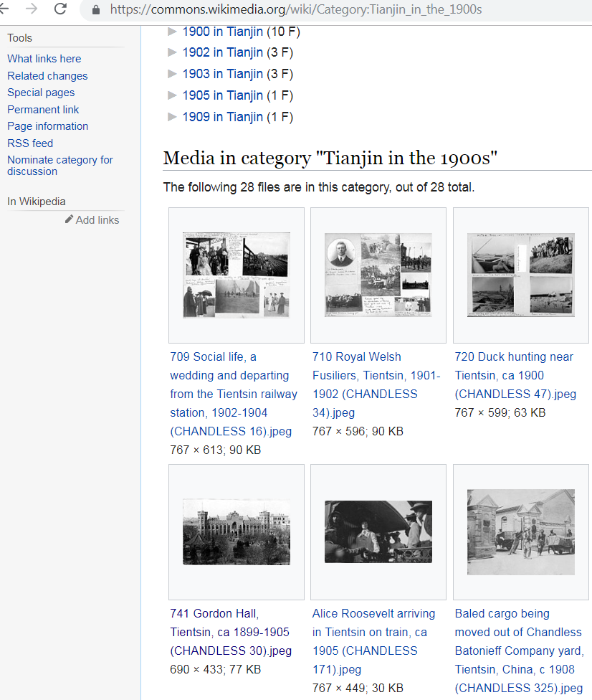
The same photo in the Wikimedia Commons

Slide 16
Recommendations
PCC Model to consider to enhance the discovery of archival resources
Controlled vocabularies are crucial for the implementation of linked data or a more powerful platform for finding resources with relationships
Archivists need training in controlled vocabulary to increase access to materials
Consistency in terminology across institutions (especially in consortium environments) benefits users and library workers
Consortiums should have training manual and guidelines for best practices on inputting metadata
Further benefits institutions without catalogers dedicated to special collections and archival materials
Further increases communication and collaboration between different organizations such as libraries, museums, archives, and cultural heritage institutions

Slide 17
Thank you!
Questions? Comments?
Charlene Chou
cc83@uw.edu
Whitney Buccicone
bucciw@uw.edu

