Slide 1
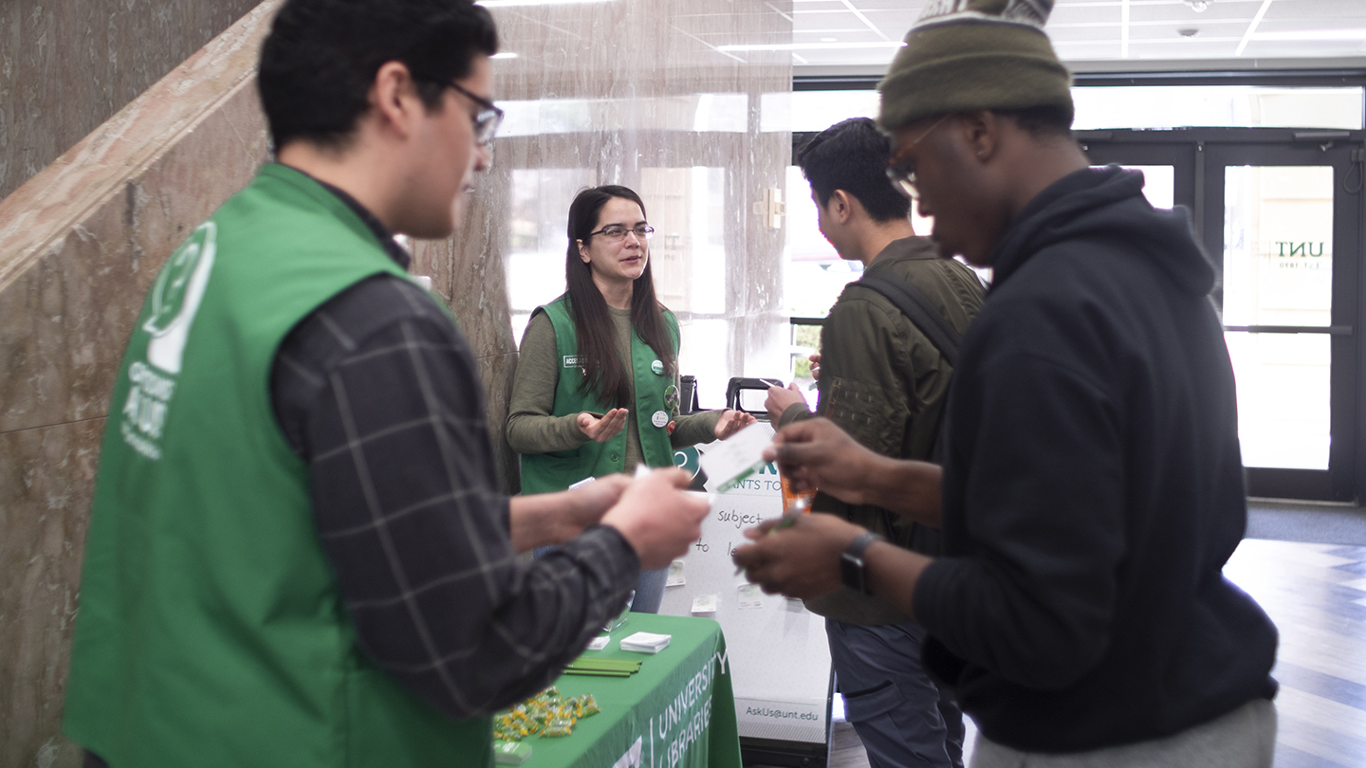
Empowering Student Workers
Using Flipped and Agile Project Management
Jenn Stayton ​
Student Engagement Librarian, UNT Libraries​
jennifer.stayton@unt.edu

Slide 2
Working with Students at UNT
260 Student Assistants
13 Graduate Student Assistants
6 Graduate Student Assistants (GSA)
Access Services, Research & Engagement Unit
Ask Us Reference Services
Tiered Service Desk and Virtual Service Support
Outreach and Instruction
Embedded Peer Tutoring and Research Support
Scholar Speak Blog
Student Assistant Training
Staff Development and "Internal Engagement"
Data Management and Visualization
Service and Department Planning

Slide 3
Ideas for Empowerment
Students workers are valued library employees.
Students are individuals.
Engagement energizes projects.
Leadership is learned.
We must earn and keep their trust.

Slide 4
Students as Collaborators
UCLA DH created some basic principles for student work in their blog post "A Student Collaborators’ Bill of Rights".
Student work is paid, and their roles have value.
Students have the right to claim their work and use their work.
A "high level of mentorship" is expected for internships.
Student collaboration is a mutually beneficial process that enables the student and the "seasoned scholar" to learn from each other.

Slide 5
Flipping for Students in Class
Much is the Same
You do, then we do, then I do. (Schmidt & Ralph, 2016)
Flipped assignments contain elements of hands-on learning through "content inquiry and analysis" that flipped classes use. (Song & Kapur, 2017)
Productive Failure for targeted knowledge assembly through problem solving. (Song & Kapur, 2017)
Engaged learning is widely cited as a positive outcome of this method.

Slide 6
Flipping for Students at Work
Much is Different
No Homework! Doing "You Do" on-the-clock means pairing project goals with learning objectives.
"We Do" must first create and maintain a safe space for failure in the workplace.
"I Do" may happen spontaneously as needs arise and projects change.
Instructor = Mentor > Supervisor.
Expertise and engagement through collaboration.

Slide 7
Agile in Developer Teams
The Agile Manifesto
We are uncovering better ways of developing software by doing it and helping others do it. Through this work we have come to value:
Individuals and interactions over processes and tools
Working software over comprehensive documentation
Customer collaboration over contract negotiation
Responding to change over following a plan
That is, while there is value in the items on the right, we value the items on the left more.

Slide 8
Agile in Libraries?
Agile is not a structure or formal methodology.
Agile is a set of practices that organizes people and prioritizes communication.
Agile methodologies work in Lib and Dev communities because they thrive on the diversity in roles.
Agile translates easily in the library environment because our projects are often interdisciplinary. (Stoddard, Gillis & Cohn, 2019)
Library change is a constant. Agile helps us adapt and keep moving forward.

Slide 9
Agile in Library Teams
Library Agile Values:
Individuals and interactions over processes and tools.
Knowledge acquisition and collaboration over success.
Student centered design over organizational structures.
Responding to change over following a plan.
That is, while there is value in the items on the right, we value the items on the left more.

Slide 10
Adding Agile to the Mix
Roles
Structure
Activities are self-organized and adjusted at any time to meet the project needs. Communication and problem solving are required every time.
Sustainability
Good projects grow, good projects get momentum and keep going. We value the projects we let go and we invest in the work that works.
Match expertise, interest, and availability to the needs of the project and change when needed with the consent of the student.
Success
Providing measurable outcomes and time for reflection helps students to articulate successes and failures honestly.
Fewer deadlines and more emphasis on communication with firm progress as the goal. Time is a valuable resource that is negotiated differently for every project.
Time Management

Slide 11
Controlling Chaos
Structured enough to succeed.
Free enough to fully engage through discovery.
Round 1 Systematic investigation, role discovery, and pursuing achievable goals
Round 2 Reflection, role mastery, refinement, and/or expansion
Round 3 Sustainability, goals, and ownership

Slide 12
Controlling Chaos
Time Management & Communication
Set aside time for communication.
Build reporting and time management into roles.
Hold team members accountable for communication.
Establish timelines, even if they change.

Slide 13
Controlling Chaos
Advocating for Empowerment
Create projects that utilize their skills and interests.
Engage leaders with honesty and set clear expectations for each role.
Get out of the way! Instructors in flipped and Scrum Masters in agile move forward by stepping aside.

Slide 14
Let's talk projects. What is your team like? Have you used flipped or agile techniques before?

Slide 15
Let's talk students. What does your library do to encourage student professional development? What life or library skills can we impart through projects?

Slide 16
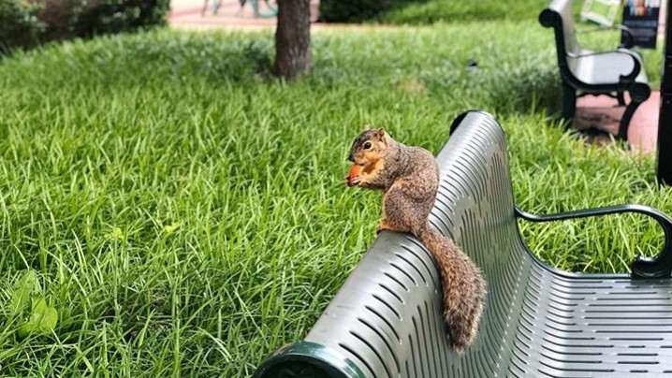
Questions? & Thanks
Jenn Stayton
jennifer.stayton@unt.edu

Slide 17
Sources
Agile Alliance. (2001). Manifesto for Agile Software Development. https://www.agilealliance.org/agile101/the-agile-manifesto/
Di Pressi, H. et al. “A Student Collaborators’ Bill of Rights.” UCLA Digital Humanities. http://www.cdh.ucla.edu/news-events/a-student-collaborators-bill-of-rights/
Schmidt, S. M.,P., & Ralph, D. L. (2016). The flipped classroom: A twist on teaching. Contemporary Issues in Education Research (Online), 9(1), 1.
Song, Y., & Kapur, M. (2017). How to flip the classroom - "productive failure or traditional flipped classroom" pedagogical design? Journal of Educational Technology & Society, 20(1), 292-305.
Stoddard, M., Gillis, B. and Cohn, P. (2019) Agile Project Management in Libraries: Creating Collaborative, Resilient, Responsive Organizations, Journal of Library Administration. https://doi.org/10.1080/01930826.2019.1616971
UNT Libraries. (2019). Statistics for the UNT Libraries, Fiscal Year 2018. https://institutionalresearch.unt.edu/sites/default/files/xh-1alternative_maryann_venner_2018-2019.pdf

Slide 18
Images
GSA outreach. Photo by Megan Gellner. UNT Libraries, 2018.
Walkways in front of Willis. UNT Digital Library, c. 1996. https://digital.library.unt.edu/ark:/67531/metadc850248/
Library card catalog. UNT Digital Library, c. 1972. https://digital.library.unt.edu/ark:/67531/metadc945085
Unt_Libraries. UNT Libraries on Instagram, 2019. https://www.instagram.com/p/B0YkruaHa7Z/?utm_source=ig_web_button_share_sheet

