Slide 1
OCLC authorities activities
CORE Authority Interest Group lightning round and discussion
16 February 2021
Nathan B. Putnam
Director, Metadata Quality OCLC
Notes:
Session Title: Troubleshooting Linked Data Authority Records
Time: Monday, Feb 1, 2021, 9:00 am-10:00 am PST / 11:00 am-12:00 pm CST/ 12:00 pm-1:00 pm EST
When accessing or referencing linked data resources, catalogers or metadata librarians may encounter statements that seem incorrect. Sometimes linked data authorities for entities, particularly individuals and organizations, contain factual errors. How can these potential issues be assessed? Can individuals provide constructive feedback to the organization that hosts the authority record(s)? This session will discuss these issues, and how best practices may differ for different platforms and data sources.

Slide 2
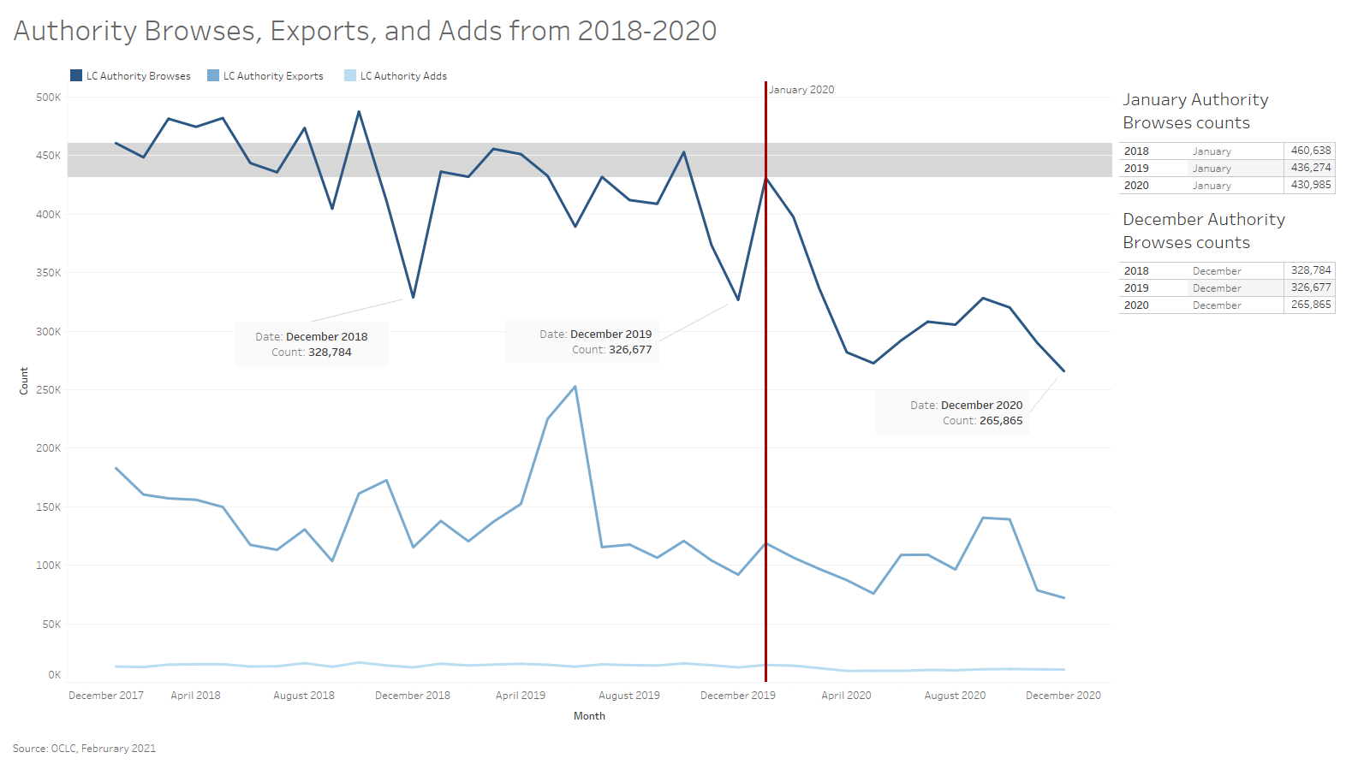

Slide 3
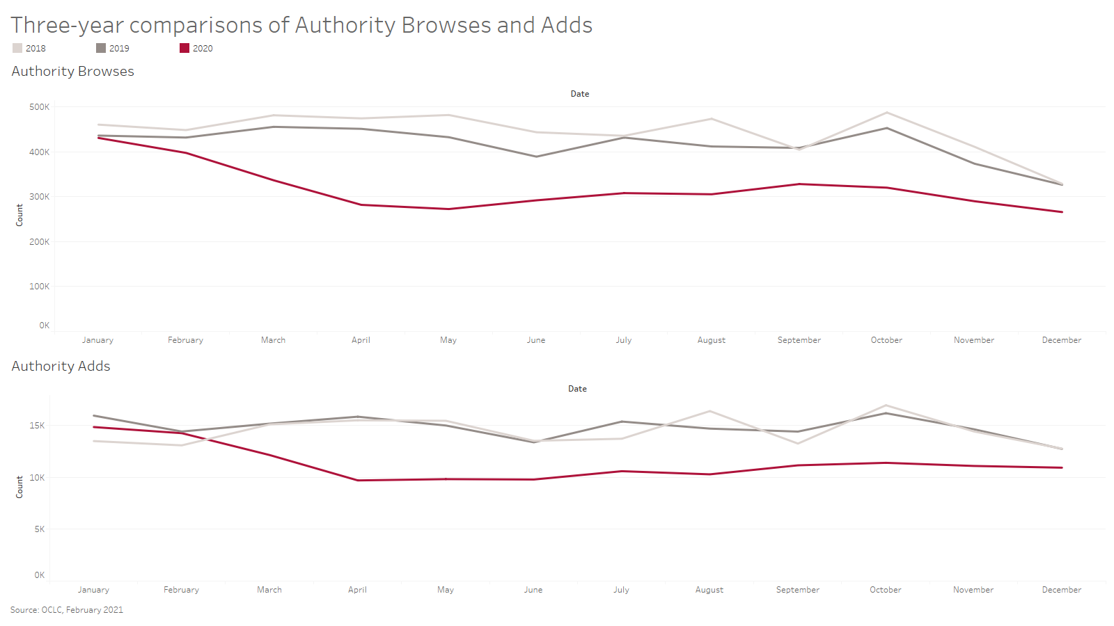

Slide 4
