Slide 1
A
platform that
significantly
reduces the cost
& complexity of
cataloging...
predictivebib.org
Tris Shores

Slide 2
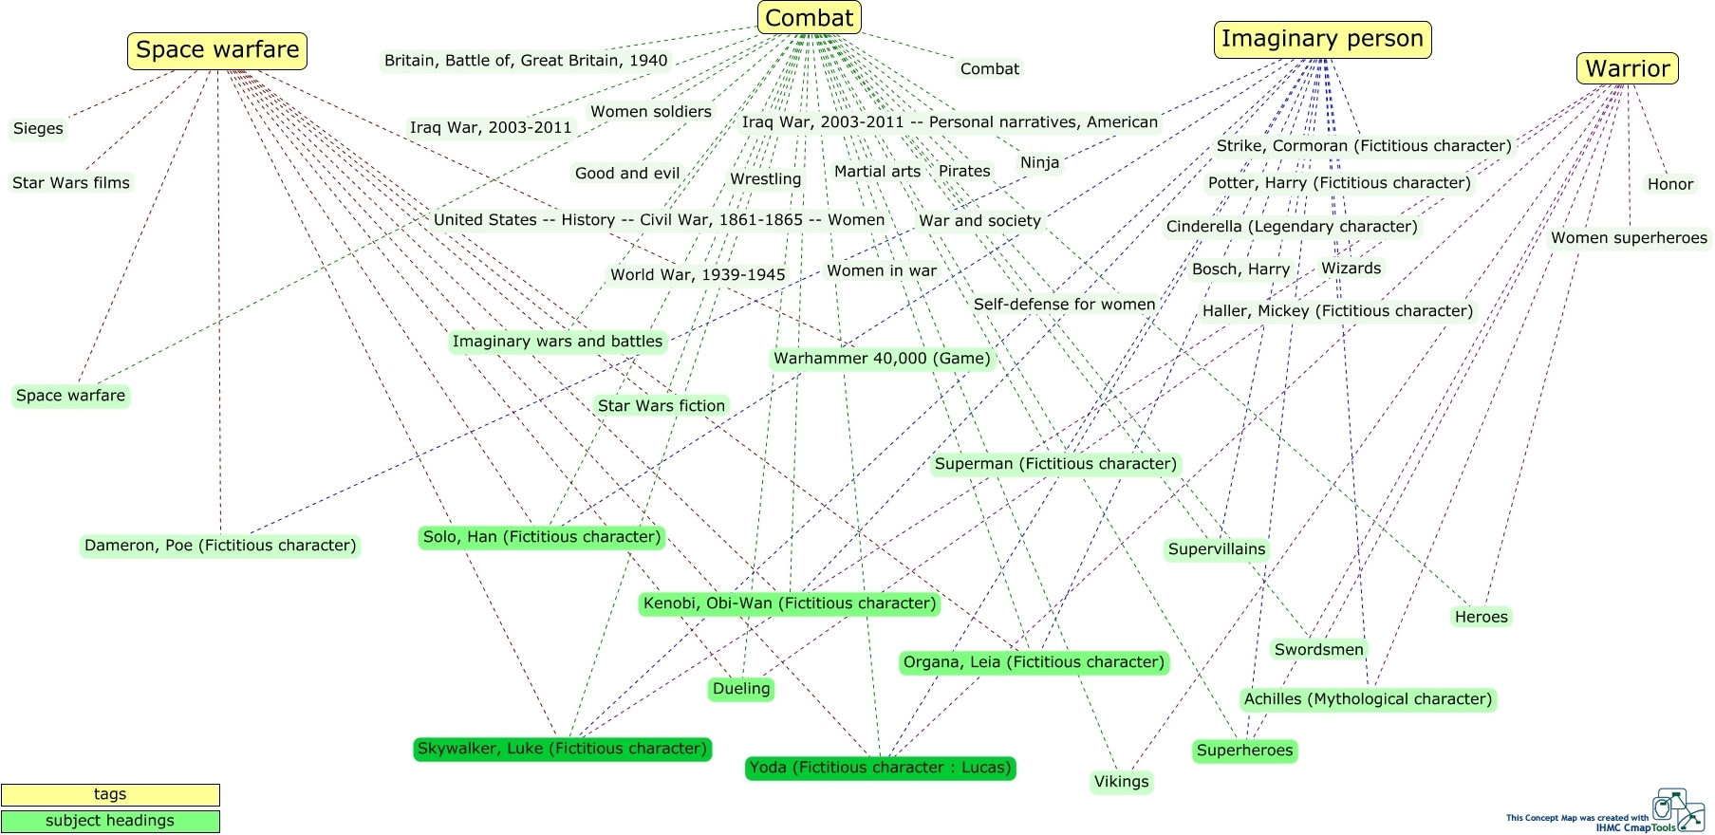
in a galaxy far far away...

Slide 3
Generate Records
Predictive Algorithms / Data
On-demand predictions
for LCSH, name authorities, title authorities, publishers, and DDC.
Cataloger A desktop app
Cataloger B
desktop app
Predictive
Algorithms &
Crowdsourced
Metadata

Slide 4
software-generated: 57%
auto-suggested: 8%
predefined option: 5%
manual data entry: 30%
LDR 02273nam a2200553 i 4500
001 BIB-0000-0000-0247
003 ObibOrg
005 20201001000000.0
008 201001s2013 caua d 6 000 1 eng d
020 __ ǂa 9781421551388 ǂq (paperback ; ǂq v. 54)
020 __ ǂa 1421551381 ǂq (paperback ; ǂq v. 54)
035 __ ǂa (ObibOrg)BIB-0000-0000-0247
040 __ ǂa ObibOrg ǂb eng ǂe rda ǂc ObibOrg
041 1_ ǂa eng ǂh jpn
043 __ ǂa a-ja---
082 04 ǂa 741.5/952 ǂ2 23
100 1_ ǂa Kubo, Tite, ǂe author, ǂe artist.
240 10 ǂa Bleach. ǂl English
245 10 ǂa Bleach. ǂn Vol. 54, ǂp Goodbye to our xcution / ǂc story and art by Tite Kubo ; translation, Joe Yamazaki.
246 3_ ǂa Goodbye to our xcution
250 __ ǂa Shonen Jump Manga edition.
264 _1 ǂa San Francisco, California : ǂb VIZ Media, LLC, ǂc [2013]+
300 __ ǂa 204 pages : ǂb chiefly illustrations ; ǂc 19 cm.
336 __ ǂa text ǂb txt ǂ2 rdacontent
336 __ ǂa still image ǂb sti ǂ2 rdacontent
337 __ ǂa unmediated ǂb n ǂ2 rdamedia
338 __ ǂa volume ǂb nc ǂ2 rdacarrier
490 0_ ǂa Bleach ; ǂv vol. 54
490 1_ ǂa Shonen Jump manga
500 __ ǂa Reads from right to left.
500 __ ǂa Translated from the Japanese.
500 __ ǂa First published in Japan in 2001 by Shueisha Inc.
520 0_ ǂa Ichigo struggles to revive his soul reaper powers. During his escalating battle with Kugo Ginjo, Ichigo uncovers the truth behind his role as Deputy Soul Reaper and has to make a difficult choice.
521 8_ ǂa Rated T for teen.
521 8_ ǂa Recommended for ages 13 and up.
521 8_ ǂa Contains fantasy violence.
588 __ ǂa This bibliographic record is licensed under Creative Commons CC0 1.0.
650 _0 ǂa Spirits ǂv Comic books, strips, etc.
650 _0 ǂa Good and evil ǂv Comic books, strips, etc.
650 _0 ǂa Ghosts ǂv Comic books, strips, etc.
650 _0 ǂa Comic books, strips, etc. ǂz Japan ǂv Translations into English.
650 _0 ǂa Graphic novels ǂz Japan ǂv Translations into English.
655 _7 ǂa Comics (Graphic works) ǂ2 lcgft
655 _7 ǂa Graphic novels. ǂ2 lcgft
655 _7 ǂa Paranormal comics. ǂ2 lcgft
655 _7 ǂa Fantasy comics. ǂ2 lcgft
700 1_ ǂa Yamazaki, Joe, ǂe translator.
830 _0 ǂa Shonen Jump manga.
MANGA

Slide 5
LDR 02605nam a2200541 i 4500
001 BIB-0000-0000-0291
003 ObibOrg
005 20201001000000.0
008 201001t20162015miu d 000 f eng d
010 __ ǂa 2016000435
020 __ ǂa 9781410488091 ǂq (large print ; ǂq hardcover)
020 __ ǂa 1410488098 ǂq (large print ; ǂq hardcover)
035 __ ǂa (ObibOrg)BIB-0000-0000-0291
040 __ ǂa ObibOrg ǂb eng ǂe rda ǂc ObibOrg
041 1_ ǂa eng ǂh ice
043 __ ǂa e-ic---
050 _4 ǂa PT7511.A67 ǂb K3616 2016b
082 04 ǂa 839/.6935 ǂ2 23
100 0_ ǂa Arnaldur Indriðason, ǂd 1961- ǂe author.
240 10 ǂa Kamp Knox. ǂl English
245 10 ǂa Into oblivion : ǂb an Icelandic thriller / ǂc Arnaldur Indridason ; translated from the Icelandic by Victoria Cribb.
250 __ ǂa Large print edition.
264 _1 ǂa Farmington Hills, Michigan : ǂb Thorndike Press, a part of Gale, Cengage Learning, ǂc 2016.
264 _4 ǂc ©2015
300 __ ǂa 459 pages (large print) ; ǂc 23 cm.
336 __ ǂa text ǂb txt ǂ2 rdacontent
337 __ ǂa unmediated ǂb n ǂ2 rdamedia
338 __ ǂa volume ǂb nc ǂ2 rdacarrier
340 __ ǂn large print ǂ2 rdafs
490 1_ ǂa Inspector Erlendur novel
software-generated: 44%
auto-suggested: 15%
predefined option: 2%
manual data entry: 39%
490 1_ ǂa Thorndike Press large print thriller
500 __ ǂa Translated from the Icelandic.
500 __ ǂa First published in Iceland in 2014 by Vaka-Helgafell.
520 0_ ǂa In the late 1970s, Erlendur a young detective, investigates a homicide in cooperation with an African American military police officer at the U.S. Air Force base in Keflavík, the presence of which is viewed with mixed feelings by the locals. At the same time, Erlendur is tasked with a cold case involving a missing girl from the 1950s.
588 __ ǂa This bibliographic record is licensed under Creative Commons CC0 1.0.
650 _0 ǂa Erlendur Sveinsson (Fictitious character) ǂv Fiction.
650 _0 ǂa Police ǂz Iceland ǂz Reykjavík ǂx History ǂy 1970s ǂv Fiction.
610 10 ǂa United States. ǂb Air Force ǂx Air police ǂx Minorities ǂx History ǂy 1970s ǂv Fiction.
651 _0 ǂa Reykjavík (Iceland) ǂx Social conditions ǂy 1970s ǂv Fiction.
650 _0 ǂa Murder ǂx Investigation ǂv Fiction.
655 _0 ǂa Large type books.
655 _7 ǂa Detective and mystery fiction. ǂ2 lcgft
655 _7 ǂa Historical fiction. ǂ2 lcgft
655 _7 ǂa Thrillers (Fiction) ǂ2 lcgft
700 1_ ǂa Cribb, Victoria, ǂe translator.
800 0_ ǂa Arnaldur Indriðason, ǂd 1961- ǂt Inspector Erlendur novel.
830 _0 ǂa Thorndike Press large print thriller.
LARGE-PRINT

Slide 6
001 BIB-0000-0000-0218a
003 ObibOrga
005 20201001000000.0
008 201001t20112011maua j 000 1 eng d
020 __ ǂa 9780547556208 ǂq (paperback)
020 __ ǂa 0547556209 ǂq (paperback)
035 __ ǂa (ObibOrg)BIB-0000-0000-0218
040 __ ǂa ObibOrg ǂb eng ǂe rda ǂc ObibOrg
041 1_ ǂa eng ǂa spa
082 04 ǂa [E] ǂ2 23
100 1_ ǂa Barss, Karen, ǂe author.
245 10 ǂa Fireworks for all = ǂb Fuegos artificiales para todos / ǂc adaptation by Karen Barss ; based on a TV series teleplay written by Dietrich Smith ; adaptado por Karen Barss ; basasdo en un guión para televisión escrito por Dietrich Smith ; based on the characters created by Susan Meddaugh, basado en los personajes creados por Susan Meddaugh.
246 31 ǂa Fuegos artificiales para todos
264 _1 ǂa Boston : ǂb Houghton Mifflin Harcourt, ǂc 2011.
264 _4 ǂc ©2011
300 __ ǂa 17 pages : ǂb chiefly color illustrations ; ǂc 23 cm.
336 __ ǂa text ǂb txt ǂ2 rdacontent
336 __ ǂa still image ǂb sti ǂ2 rdacontent
337 __ ǂa unmediated ǂb n ǂ2 rdamedia
338 __ ǂa volume ǂb nc ǂ2 rdacarrier
490 1_ ǂa Martha speaks = ǂa Martha habla
490 1_ ǂa Green Light readers. Level 1 = ǂa Colección Luz Verde. Nivel 1
500 __ ǂa Includes a word activity.
500 __ ǂa "A Spanish bilingual book"--Front cover.
520 0_ ǂa Martha is not happy that summer will bring noisy weekly fireworks shows that will hurt her sensitive ears, so she organizes the local dogs to help Mrs. Demson's petition drive to get them banned, only to realize how unhappy that will make Helen. ǂc Open Library.
521 1_ ǂa 005-007.
521 8_ ǂa Grade 2.
521 8_ ǂa Guided reading level: J.
521 8_ ǂa Reading recovery level: 17.
546 __ ǂa Text in English and Spanish.
588 __ ǂa This bibliographic record is licensed under Creative Commons CC0 1.0.
650 _0 ǂa Martha (Fictitious character : Meddaugh) ǂv Juvenile fiction.
650 _0 ǂa Dogs ǂv Juvenile fiction.
650 _0 ǂa Fireworks ǂv Juvenile fiction.
650 _0 ǂa Petition, Right of ǂv Juvenile fiction.
650 _0 ǂa Petitions ǂv Juvenile fiction.
650 _1 ǂa Spanish language materials ǂx Bilingual.
655 _0 ǂa Bilingual books.
655 _7 ǂa Adaptations. ǂ2 lcgft
655 _7 ǂa Readers (Publications) ǂ2 lcgft
700 1_ ǂa Smith, Dietrich, ǂe screenwriter.
700 1_ ǂa Meddaugh, Susan, ǂe creator.
830 _0 ǂa Martha speaks (Spanish and English).
830 _0 ǂa Green Light readers. ǂn Level 1.
software-generated: 44%
auto-suggested: 7%
predefined option: 5%
manual data entry: 44%
BILINGUAL READER

Slide 7
software-generated: 49%
auto-suggested: 6%
predefined option: 6%
manual data entry: 39%
LDR 02059nam a2200493 i 4500
001 BIB-0000-0000-0019
003 ObibOrg
005 20201001000000.0
006 j
007 sd f|ngnnmmn|d
008 201001t20011986nyua j 000 0 eng d
010 __ ǂa 2001089899
020 __ ǂa 9780689846939 ǂq (hardcover)
020 __ ǂa 0689846932 ǂq (hardcover)
035 __ ǂa (ObibOrg)BIB-0000-0000-0019
040 __ ǂa ObibOrg ǂb eng ǂe rda ǂc ObibOrg
043 __ ǂa f-sa---
082 04 ǂa 398.210968 ǂ2 23
100 1_ ǂa Seeger, Pete, ǂd 1919-2014, ǂe author.
245 10 ǂa Abiyoyo : ǂb based on a South African lullaby and folk song / ǂc text by Pete Seeger ; illustrations by Michael Hays.
246 1_ ǂi At head of cover title: ǂa Pete Seeger's storysong
250 __ ǂa First Simon & Schuster book-and-CD edition.
264 _1 ǂa New York, New York : ǂb Simon & Schuster Books for Young Readers, ǂc 2001.
264 _4 ǂc ©1986
300 __ ǂa 1 volume (unpaged) : ǂb color illustrations ; ǂc 27 cm + ǂe 1 CD
336 __ ǂa text ǂb txt ǂ2 rdacontent
336 __ ǂa still image ǂb sti ǂ2 rdacontent
336 __ ǂa performed music ǂb prm ǂ2 rdacontent
337 __ ǂa unmediated ǂb n ǂ2 rdamedia
337 __ ǂa audio ǂb s ǂ2 rdamedia
338 __ ǂa volume ǂb nc ǂ2 rdacarrier
338 __ ǂa audio disc ǂb sd ǂ2 rdacarrier
500 __ ǂa Based on an ancient lullaby of the Xhosa people of South Africa.
500 __ ǂa A retelling of Abiyoyo.
500 __ ǂa Includes CD of Pete Seeger performing two different versions of Abiyoyo.
520 0_ ǂa An adaptation of a South African lullaby and folk story. A magician and his musical son are cast out of the village for disturbing the peace, but return to vanquish the giant Abiyoyo when he attacks the village folk.
521 1_ ǂa 004-008.
586 __ ǂa Reading Rainbow selection, 1986
588 __ ǂa This bibliographic record is licensed under Creative Commons CC0 1.0.
650 _0 ǂa Folklore ǂz South Africa.
655 _7 ǂa Folk tales. ǂ2 lcgft
655 _7 ǂa Picture books. ǂ2 lcgft
700 1_ ǂa Hays, Michael, ǂe illustrator.
BOOK WITH
ACCOMPANYING MATERIAL

Slide 8
Questions?
tris@obib.org
tris@predictivebib.org
predictivebib.org
Tris Shores

Slide 9
Resources
Altmann, Gerd. First slide image from Pixabay. https://pixabay.com/users/geralt-9301/
Buccellato, Brian (2017). Injustice: gods among us year five. DC Comics.
Florida Institute for Human & Machine Cognition, Concept Maps.
Lang, Ruth Emmie (2017). Beasts of extraordinary circumstance. St. Martin's Press.
PredictiveBIB acknowledgments. https://predictivebib.org/#acknowledgment_id
Silvey, Anita (2008). I'll Pass For Your Comrade: Women Soldiers in the Civil War. Clarion Books.

