Slide 1
Decolonizing Social Work – and the Library
Academic Library Services For Graduate Students IG
ALA Midwinter, January 26, 2019
Susan Edwards, seedwards@berkeley.edu

Slide 2
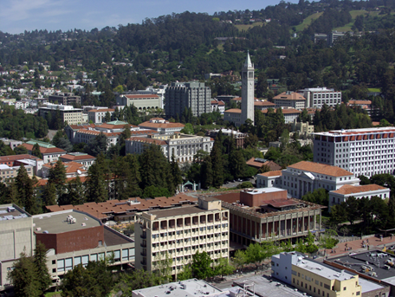
Alan Nyiri, courtesy of the Atkinson Photographic Archive
Context: UC Berkeley is located on the traditional, ancestral, and unceded land of the Ohlone people.
Notes:
The University of California was created in 1868, during the era of settler colonialism. State policies and actions between 1846 and 1873, reduced
the California Indian population from about 150,000 to about 30,000.

Slide 3
School’s Mission
“Social Welfare strives to transform the systems that perpetuate poverty and social disadvantage… and prepares the next generation of culturally competent social workers.”
Notes:
The School of Social Welfare was founded in 1944. It has a strong commitment to social justice,and is committed to improving the lives of vulnerable individuals, families and communities.

Slide 4
“As a direct result of colonization, the vast majority of Indigenous people have lived, or are living, in trauma; in most cases, this trauma is multigenerational…
“It is widely recognized that Indigenous peoples are often not well served by Western treatment … and those seeking help are often confronted with more alienation and traumatization.”
Linklater, R. (2014). Decolonizing trauma work: Indigenous stories and strategies. Halifax: Fernwood Publishing.
Notes:
The legacy of genocide and colonization has led to multigenerational trauma and an array of trauma related conditions such as higher rates of suicide, alcoholism and addiction.

Slide 5
59 of 11,666 Grad Students at Berkeley Are Native American
Notes:
There are very few graduate students at Berkeley who are Native American or Indigenous (other countries.)

Slide 6
3 of 214 Social Welfare Grad Students Are Native American
Notes:
The School has a slightly higher percentage, but there still might be only one in an MSW class.

Slide 7
(RE)generation: Indigenous Social Welfare Caucus
Supports the personal, interpersonal, educational, and professional success of Indigenous students in the Berkeley School of Social Welfare, and advocates for the needs and interests of all Indigenous students at Berkeley.
Notes:
(RE)generation was created to provide support for all Indigenous students at Berkeley.

Slide 8
Nothing About Us Without Us
“We are tired of researchers coming in and documenting all the things wrong with our communities…
You would think people would want to figure out how we survived white people for so many hundred of years…
How about some research on what’s right with us? About what makes us resilient?”
Brown, L. A., & Strega, S. (2015). Research as resistance: revisiting critical, indigenous, and anti-oppressive approaches.
Notes:
Students in (RE)generation wanted to make it easier to find culturally appropriate material – they felt many of the material used, including by some faculty, didn’t address Indigenous issues through a decolonization lens.

Slide 9
(RE)generation and the Library
Created a collection of culturally appropriate material in one place (BF, E, GN, HV, HQ, KF, L, PS, RC)
Welcomed Indigenous students, staff, faculty, community elders and allies into the Library
Formed a Talking Circle to share:
Experiences of research/education in this context
Strategies for resistance
Food!
Co-created an online guide to resources, especially free ones
Notes:
The students in (RE)generation approached the Library with some great strategies to address the problems.

Slide 10
Notes:
They organized an event, the Library just provided funding for food and a space to discuss social work with Indigenous communities.

Slide 11
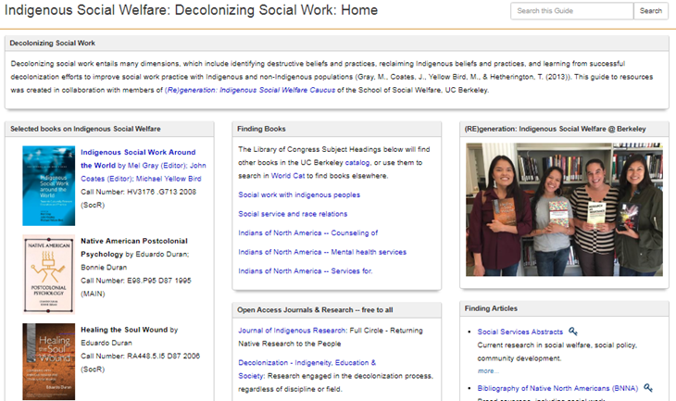
https://guides.lib.berkeley.edu/IndigenousSocialWelfare
Notes:
The students and the librarian collaboratively created a physical collection of material AND an online guide – with a focus on free/OA materials for those outside the academy.

Slide 12
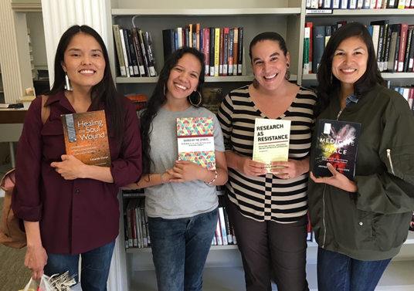

Slide 13
“If you have come here to help me, you are wasting your time. But if you have come because your liberation is bound up with mine, then let us work together.”
Lila Watson

