Slide 1
Visualizing Agriculture Research
Jesse Sigman
Reference Services Coordinator and Chemical & Toxics Librarian
Headquarters – US Environmental Protection Agency
Contractor – ASMS
sigman.jessica@epa.gov

Slide 2
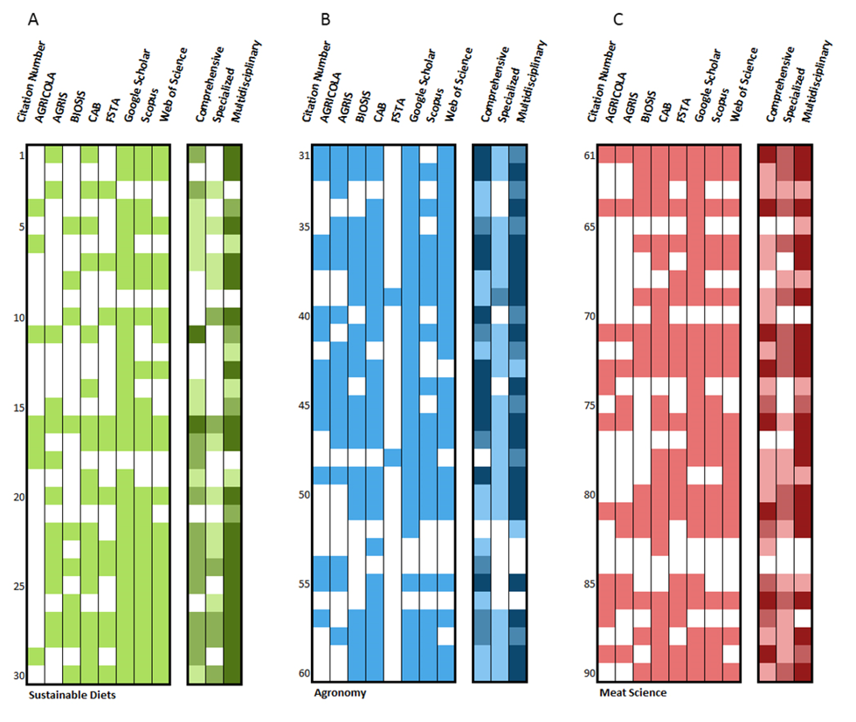
Research
90 articles spanning Meat Science, Sustainable Diets, and Agronomy
Articles searched in 8 indexing and abstracting services
Purpose: Identify which service offered the most coverage of the sample

Slide 3
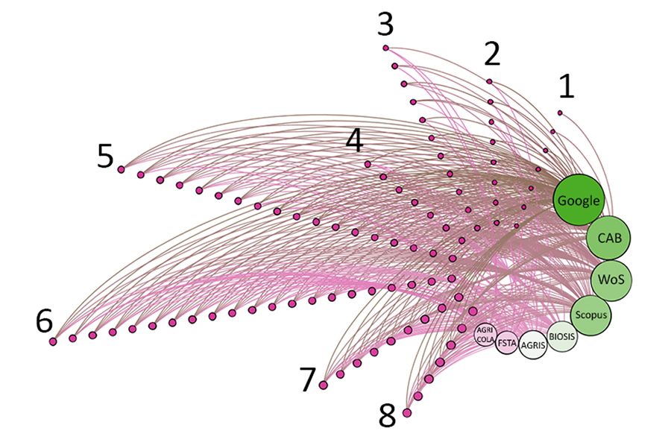
The Visualizations
Excel
Gephi
Cytoscape

Slide 4
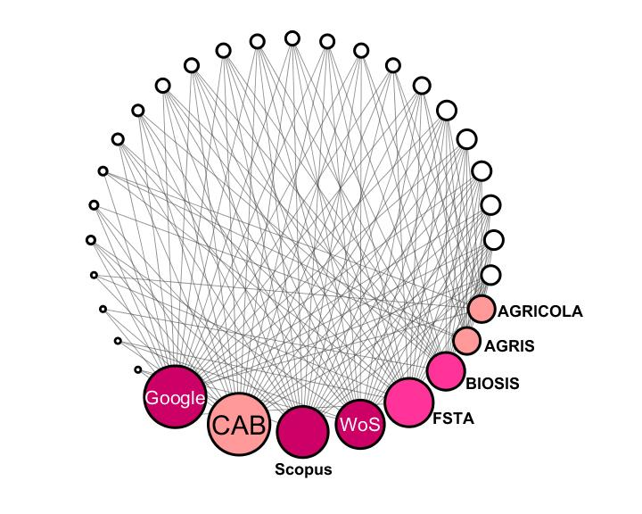
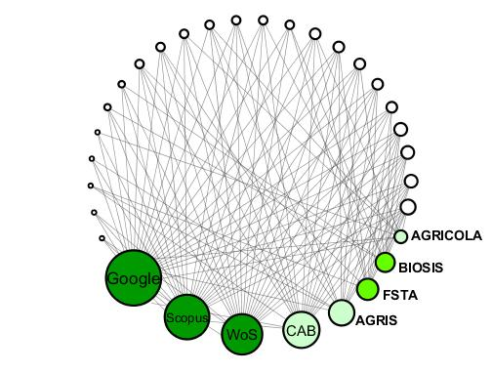
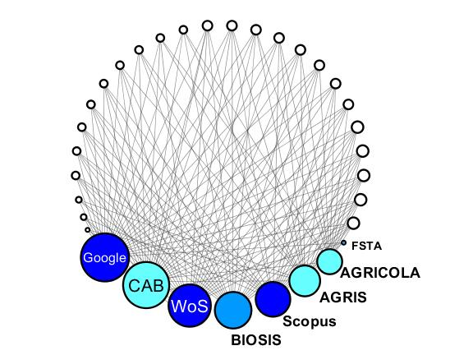
The Rejections ☹
Your opinion as a visualization producer may not always match that of a publication editor

Slide 5
Lessons Learned
Patience with emerging trends
Surprising uses of softwares
Patience with the process

Slide 6
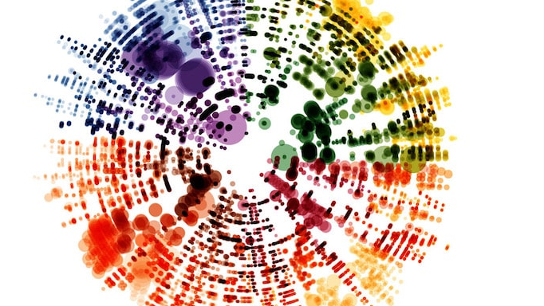
Free (or cheap) Resources

Slide 7
Learn
Tableau 10 A-Z ($10)
Data Camp ($25/mo)
edX (FREE!!!!)
Udacity (FREE!!!!)
Coursera (Varies)
Mike Bostock (FREE!!!!)
Skillshare (One month free, $15/mo after)

Slide 8
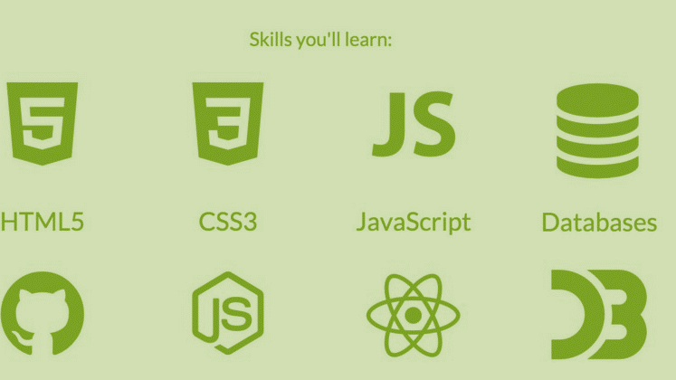
freeCodeCamp

Slide 9
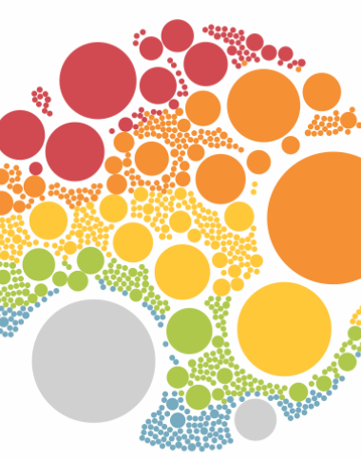
Do
D3
Google Charts
myheatmap
Gephi
R
Github
Gitlab, SourceForge
Vizualize
Open Refine
Gliffy
Policy Map

Slide 10
Data Visualizations From:
My Modern Met – Visualizing Classical Music Scores
The D3 Library
ISTL Spring 2018

Slide 11
Questions?

Slide 12
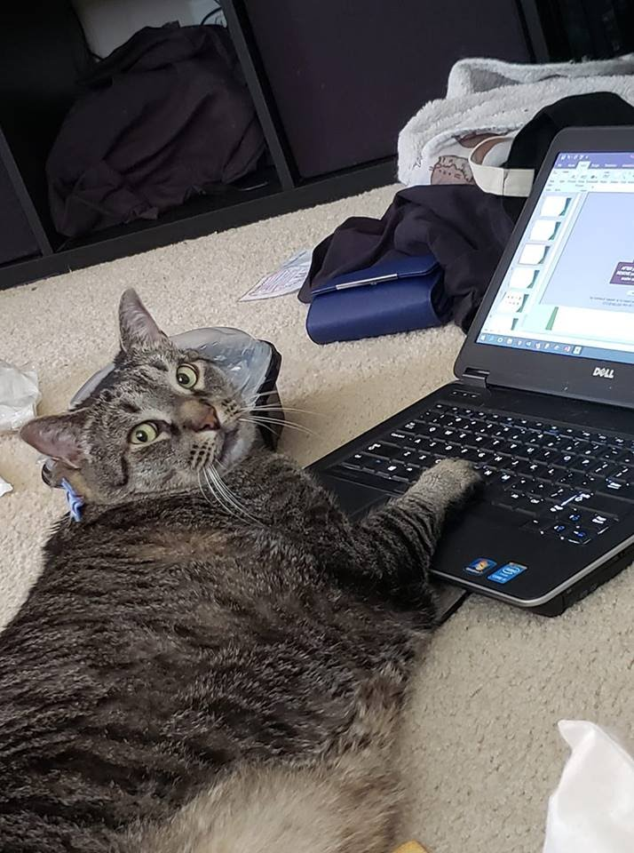
Jesse Sigman sigman.jessica@epa.gov www.linkedin.com/in/jesse-sigman

