Slide 1
Purchasing eBooks from the textbook adoption list. Are we making a difference?
Beth Bernhardt
Assistant Dean for Collection Management and Scholarly Communications

Slide 2
UNC Greensboro
Carnegie Classification – Doctoral
Intensive Univ. I
FTE is 19,500
Collection
2.8 million items (books, gov docs & microforms)
400+ electronic databases
90,000+ ejournals available

Slide 3
Two Approaches
Identify and purchase eBooks from the Course Adoption Textbook list with no restrictions
Provide Mini Grants for Faculty to change their course from using an expensive textbook to using OER, lower cost option or library resources.

Slide 4
Collaboration with the Bookstore
Bookstore sends technical services staff the textbook adoption list two months before the next semester
Bookstore sends weekly updates after the first initial list
Library provides the Bookstore with a eBooks purchased before the semester starts
Bookstore places the information into their system

Slide 5
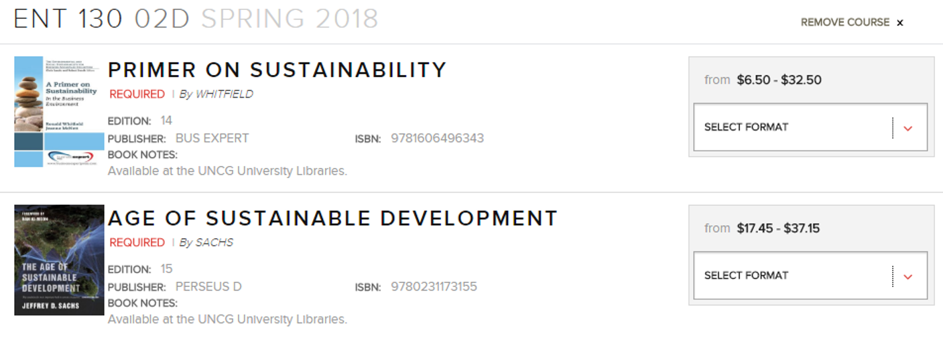
Bookstore website

Slide 6
Criteria for Purchase
Publisher and edition match
Platform allows unlimited user access
Allow download and printing of book chapters
Class size – more ROI for our investment

Slide 7
Sample Cambridge Titles purchased

Slide 8
Cambridge titles
Title | Semester Purchased | Class Size | Usage in 2017/2018 | Top 15 Cambridge titles used
In Search of Respect | Spring 2017 | 28 | 190 | 7th
Statistics for Anthropology | Spring 2018 | 12 | 153 | 9th
The Systems View of Life | Fall 2017 | 25 | 146 | 10th
The Politics of Modern Central America | Fall 2017 | 17 | 102 | 15th
Average use = 23

Slide 9
Oxford University Press
Title | Semester Purchased | Class Size | Usage in 2017/2018 | Top 10 Oxford titles used
World of Thomas Jefferson | Fall 2017 | 25 | 383 | ^{1st}
The Oxford Handbook of Thinking and Reasoning | Fall 2017 | 25 | 363 | 2nd
Specters of Revolution | Fall 2017 | 22 | 146 | 4th
Social Work and Restorative Justice | Spring 2017 | 30 | 113 | 7th
Average use = 20

Slide 10
Titles purchased by Subject
Purchased
Fall 2016
Used again in
Spring 2017
Fall 2017
Spring 2018
Purchased
Fall 2016,
Used again
Spring 2017
Summer 2017
Spring 2018
Fall 2018
Spring 2019
Purchased
Fall 2017
Used again
Spring 2018
Summer 2018
Fall 2018

Slide 11
Number of titles purchased by subject

Slide 12
Average eBook cost by subject

Slide 13
Impact of eBook purchases
 | Total ebooks owned already | Total ebooks purchased | Total Price for Purchased Ebooks | Total savings for Student enrolled | Total Students enrolled
2016/2017 | 307 | 157 | $10,657.00 | $439,168 | 12,121
2017/2018 | 540 | 124 | $10,996.38 | $445,853 | 13,221
2018/2019 | 293 | 214 | $18,963.07 | $504,911 | 14701
Total savings for students $1,389,932

Slide 14
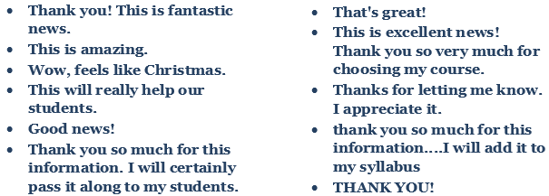
Faculty Reaction

Slide 15
Requests for other types of support
Get at Click Wrap License through Legal for an online product called BioBeyond
Paid $380 with Math Department Book funds for server support for low cost homework option for MAT 112.
Purchased the Encyclopedia of Family Studies
Paid $350 with Spanish Department Book funds for year access to Campus Difusion an online Spanish tool for 5 faculty members.

Slide 16
Requests for other types of support
I appreciated the fact that I didn't have to spend money on a textbook!
STUDENT QUOTES
It was great to not have to carry a heavy textbook around and highlight within an application on my iPad. It was also amazing to not have to pay for an expensive textbook!
I think the free library eBook program is great.
I was able to have it on my computer and iPad, which made studying and referencing the book much easier on a daily basis
It was nice not having to purchase a printed copy, plus the environmental benefits are important to me.

Slide 17
ROI
RCO252 (non-majors Biology Class)
Total Savings $14,120 in three semesters
MAT112 (non-majors Math Class)
Total Savings $73,080 in two semesters
SPA105
Total Savings $3780 in one semester

Slide 18
Future
Continue working with the bookstore
Continue to purchase eBooks for courses when appropriate
Continue to provide funding or support to faculty that want experiment with lower cost options
Examples – Smart Sparrow – Adaptive Learning Product
Lumen Learning etc.

Slide 19
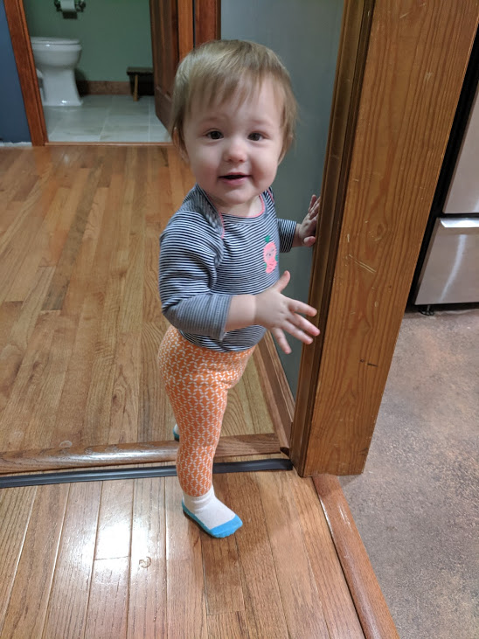
Beth Bernhardt
Assistant Dean for Collection Management and Scholarly Communications
UNC Greensboro University Libraries
PO Box 26170 | Greensboro, NC 27402
(336) 256-1210 | brbernha@uncg.edu
Laurel

