Slide 1
MIT Libraries OA strategies
Ellen Finnie
Head, Scholarly Communications &
Collections Strategy
MIT Libraries
February 2019
Meeting of ALCTS Collection Development Officers
Notes:
a few of our OA initiatives (PASS, RSC, springer autodeposit/autodeposit in general), Feb 7, via zoom, 2-3, for ALCTS collection development officers

Slide 2
Transformative Agreements
Royal Society of Chemistry Offsetting contract
Language committing RSC to transition to full OA
Discussions with 6 other scholarly societies

Slide 3
Transformative agreement language: MIT and Royal Society of Chemistry
Publisher represents that the Read & Publish model, with its foundation in “hybrid” open access – where some articles are paywalled and others published open access – is a temporary and transitional business model whose aim is to provide a mechanism to shift over time to full open access. The Publisher commits to informing Customer of progress towards this longer-term aim on an annual basis, and to adjusting Read & Publish terms based on its progress towards full open access.
http://intheopen.net/2018/06/mit-rsc-read-and-publish-agreementn-access-mit-and-the-royal-society-of-chemistry-sign-first-north-american-read-and-publish-agreement/

Slide 4
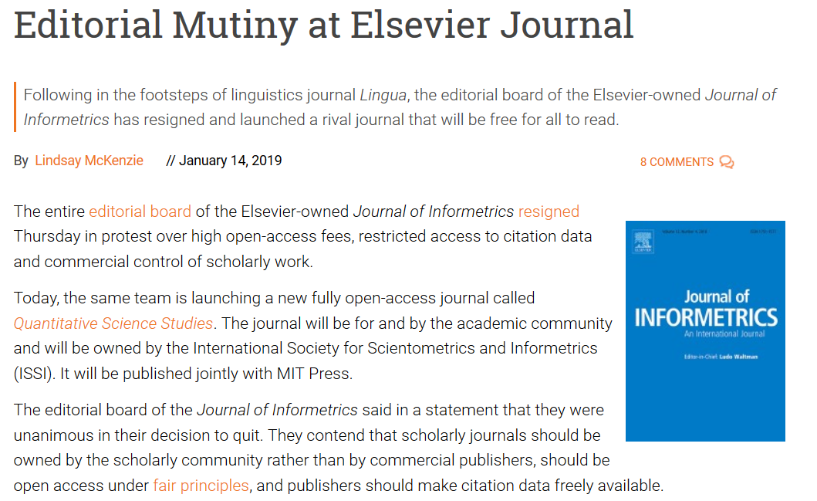
Partnership with MIT Press to support OA-- examples
MIT Press “Strong Ideas” monograph series– funded to be open access
Provided funding to support acquisition of two journals, to enable them to become OA, including new Quantitative Science Studies

Slide 5
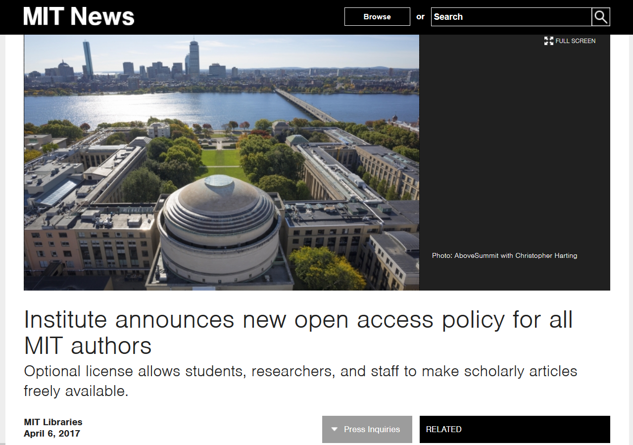
Opt-in OA license @ MIT libraries.mit.edu/opt-in
A tool to use if you want
You do not sign away copyright to MIT
Publish wherever you want
Opt out for any reason
And see: https://spark.adobe.com/video/aVF7fj20E6VOK
Notes:
Students, staff, postdocs, researchers sign license.
Because it preexists author agreements, it holds force even if researchers sign away rights.
Under the license, rights under copyright are held by MIT for authors’ use.
Authors can reuse work & make it openly available without worrying about publisher policies.
What does an OA license do:
Share your papers online
Reuse all or part of your papers in a thesis
Allow others to use your work
Comply with federal & other funder policies
[see opt-in license t-shirt: use a pic of that for ways to hold onto rights]

Slide 6
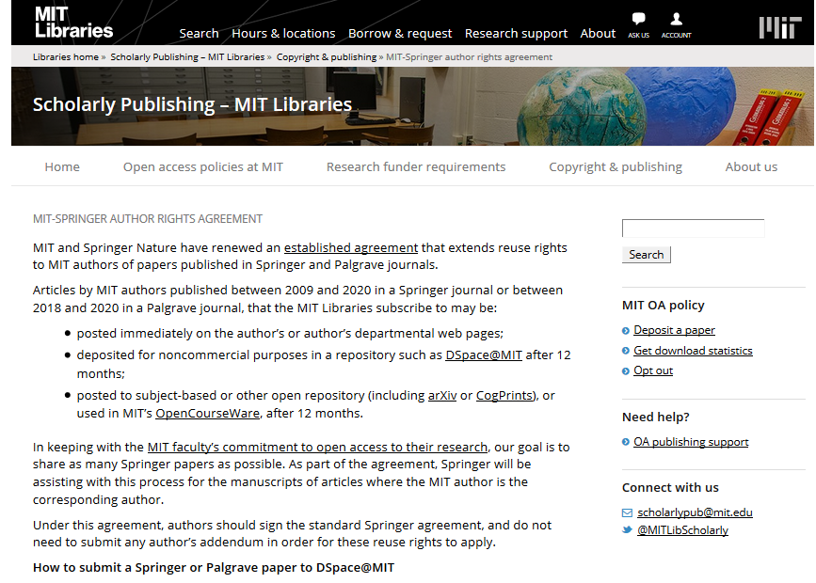
Author rights, autodeposit
Rights for repository deposit
Auto deposit, e.g.:
Springer
APS
Hindawi
Personalized author publication contract review service

Slide 7
Open Access Task Force
Formats beyond journal articles: data, code, educational materials
P&T recommendations being considered
Looking at licensing principles to support open access

Slide 8
PASS – reducing the burden on researchers
JHU, MIT Libraries, and the Harvard University Office for Scholarly Communication are building the Public Access Submission System (PASS), an open platform to support researchers’ workflows related to compliance with funding agencies’ public access policies and deposits to local campus repositories.
PASS is being built as a unified submission interface to lighten the burden on researchers and universities in making their work openly available, and improve compliance with open access policies.
Notes:
MIT Libraries contributing funding for outsourced developers, and developer resources

Slide 9
Other Green OA supports – MIT Libraries
Discipline-specific repository
Supporting arXiv and SocArXiv with collections budget
Many OA investments– 2.5% project
Outreach & personal support
Mediated deposit
Systematic acquisition process: Each author receives list of articles not yet acquired app. every 18 months
Pilot “open your legacy” – rights support for faculty materials prior to OA policy, with deposit in repository
Discovery support – open access articles
Extensive metadata, including version of article
Contribute data to SHARE
Optimize metadata for Google scholar
Offer under CC license (CC BY NC SA)
Aim towards vision of Future of Libraries report: open global platform and index of MIT’s scholarly output
OADOI in SFX

Slide 10
Scholarly communication topics and license negotiation
Fair use savings clause
Scholarly sharing language
Text and data mining
Perpetual access
Walk-in user access
Privacy protections for user data
Obligations around user breach
Authors‘ rights for reuse / repository sharing rights
Interlibrary loan
Reuse rights for MITx classes (MOOCs)
Course reserves/course packs
Autodeposit
Preferably with SWORD protocol
OA for campus-authored articles (offsetting)

Slide 11
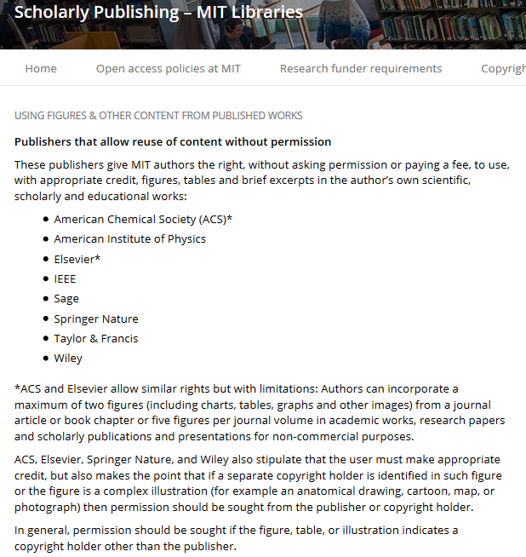
Success with schol-comm focused negotiations: TDM, Scholarly Sharing

