Slide 1
LCGFT Ten Years Later: A Survey on Genre/Form Vocabulary Usage
ALCTS CaMMS CCRIG
ALA Midwinter Meeting
January 26, 2019
Colin Bitter
Music Cataloger/Repository Librarian
Yuji Tosaka
Cataloging/Metadata Librarian
R. Barbara Gitenstein Library, The College of New Jersey
Notes:
Hello and welcome. My name is Colin Bitter and I am the part time Music Cataloger and Repository Librarian at The College of New Jersey. Today I am here with my colleague Yuji Tosaka, the Cataloging and Metadata Librarian. We conducted a survey on LCGFT use this past summer and are here to share select findings.

Slide 2
Research Questions
To what extent has LCGFT been adopted by the cataloging community?
Why do catalogers use LCGFT headings?
What is the prevalence of LCGFT use by format?
What types of institutions are using LCGFT in bib records?
How does LCGFT application relate to LCSH?
Notes:
Starting in the library field as a music cataloger some years ago I have always been excited about LCGFT. It has clear benefits for music resources, but what about others? Having seen rising rates of LCGFT use in OCLC over the past few years, I was curious about what others thought about the vocabulary. We intended to answer the following questions in conducting our survey. To what extent has LCGFT been adopted by the cataloging community? Why do catalogers use LCGFT headings? What is the prevalence of LCGFT use by format? What types of institutions are using LCGFT in bib records? And how does LCGFT application relate to LCSH?

Slide 3
Survey Methods
Summer 2018
Qualtrics
45 questions
Multiple choice, Likert scale, Free-text
Distributed on listservs
576 responses over five weeks
76% completion rate
Respondent profile
Cataloging librarians (42.1%)
Cataloging department heads/managers (19.9%)
Metadata librarians (11.7%)
Paraprofessionals (8.5%)
Administrators (7.2%)
Notes:
Using Qualtrics, we developed a 45-question survey in the summer of 2018. The survey was distributed on major listservs, such as AUTOCAT and PCCLIST, and was kept open for five weeks. We received over 500 responses and the majority of respondents finished the survey. Not all respondents were given every question--that is, flow of the survey depended upon users responses. For example, if a user said they did not plan on implementing LCGFT in original cataloging, they were asked about reasons why they had no intention of doing so, but they would not be asked about types of materials they apply LCGFTs for in original cataloging.

Slide 4
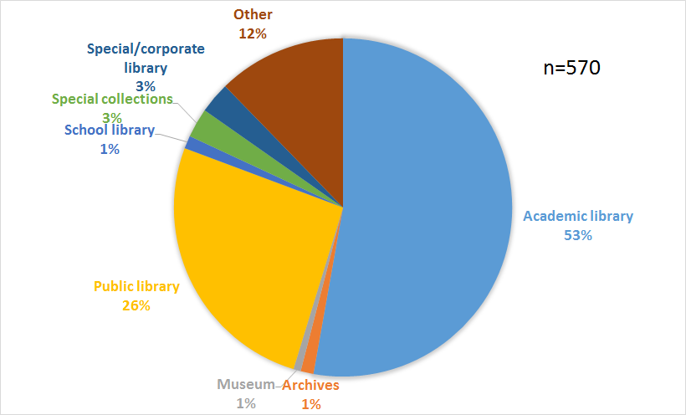
Institutional Profile
Notes:
In terms of respondents’ institutional profile, as expected academic libraries were over-represented. This is likely due to the fact that new cataloging initiatives are spearheaded in academic libraries. This being said, public libraries came in as a strong second. We also had minor representation from school libraries, special libraries, museums, and archives.

Slide 5
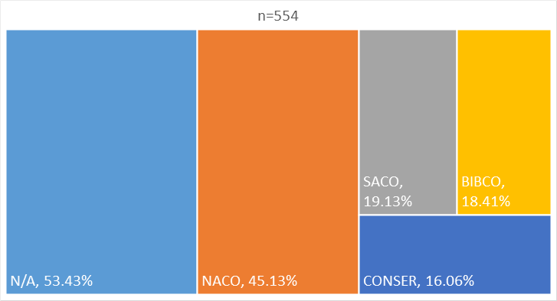
PCC Participation
Notes:
We were also interested in PCC status. Over half of respondents did not participate in any PCC program. We used these institutional characteristics to garner more sophisticated results from the survey--for example, we could examine rates of LCGFT adoption against NACO participation.

Slide 6
Survey Findings
Notes:
Moving on to the meat of the survey, we would like to share some select highlights with you today.

Slide 7
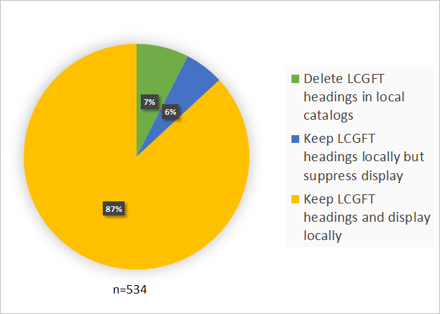
When you are copy cataloging and see LCGFT terms in a record, you generally:
Notes:
One of our primary areas of interest is what is being done with LCGFTs that already exist. Are institutions displaying these headings? Clearly, there is a move toward keeping LCGFTs in records and displaying them locally as over 87% are doing so. 7% delete headings and 6% retain headings but do not display locally.

Slide 8
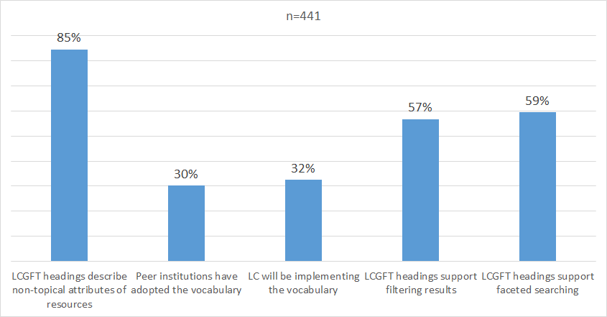
If you locally display LCGFT headings for copy records, what are the main reasons for doing so?
Notes:
For those responding yes to the previous question, we wanted to know why they retain and display LCGFTs. Respondents definitely showed interest in describing ‘is-ness’ rather than ‘aboutness’--so LCGFT has done well in attacking non-topical attributes. Additionally, the majority of respondents thought that LCGFT would help with filtering results and support faceted searching.

Slide 9
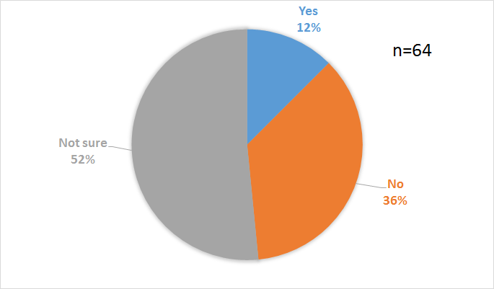
If you currently delete or suppress LCGFT headings in copy records for display, do you plan to adopt the vocabulary locally in the future?
Notes:
For those that do not display LCGFTs, we wanted to know whether they had some plan of doing so down the road. Somewhat surprising, of these 64 respondents, over half seem tentative. About a third have no plans of implementing the vocabulary. This could be for any number of reasons--perhaps more documentation and training is needed in order to show the benefits of using LCGFT. Or, perhaps LCGFT has no clear benefit for this set of respondents.

Slide 10
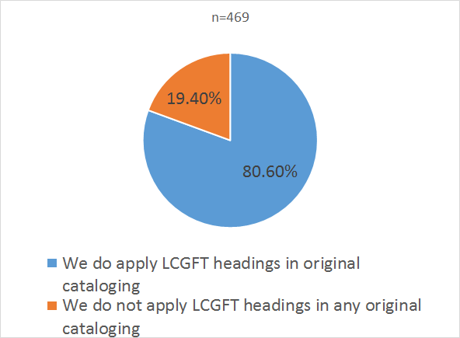
Respondents using LCGFT in original cataloging
Notes:
In addition to displaying pre-existing headings, we wanted to find out if LCGFT was being applied in new records. 80% of 469 respondents are adding LCGFTs in original cataloging.

Slide 11
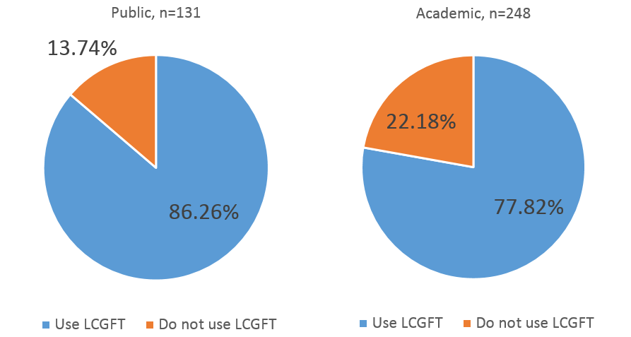
Respondents using LCGFT in original cataloging by institution
Notes:
Looking at responses to the previous question by institution, a greater percentage of public libraries are are using LCGFTs in original cataloging. This makes sense given the type of materials collected by public libraries and their historic application of subject headings. For example, in Subject heading manual H 1790, we see special provisions for increased subject access to fiction, some of which are aimed at the ‘average public library user.’ Given the vast amounts of fiction and literature that public libraries collect (to say nothing of motion pictures and sound recordings), increased rates of LCGFT application seems to make sense here.

Slide 12
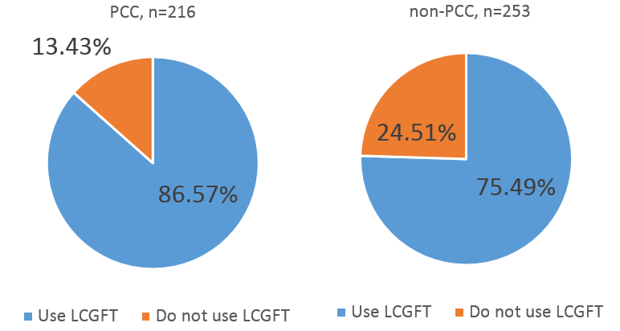
Respondents using LCGFT in original cataloging by PCC status
Notes:
And looking at original cataloging by PCC status, not surprisingly more PCC libraries are applying LCGFTs, likely due to increased access to training, documentation, and time to learn the vocabulary.

Slide 13
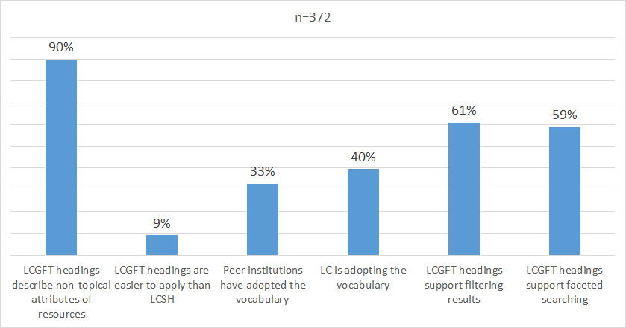
What are the main reasons you have adopted the LCGFT vocabulary for original cataloging?
Notes:
Showing similar results to the question regarding the reasons for displaying LCGFTs locally, it appears the primary reasons for LCGFT adoption in original cataloging have to do with LCGFT’s ability to describe non-topical attributes, and the vocabulary’s ability to support filtering of results and faceted searching. Somewhat surprisingly, only 9% of respondents said they used LCGFT because it is easier to apply. Looking at this, it may have been more effective to have a specific question inquiring about the ease of applying the vocabulary, because this answer doesn’t necessarily show that it is more difficult to apply than another subject index, such as LCSH; it could simply mean that ease of term application is not of significant importance to respondents.

Slide 14
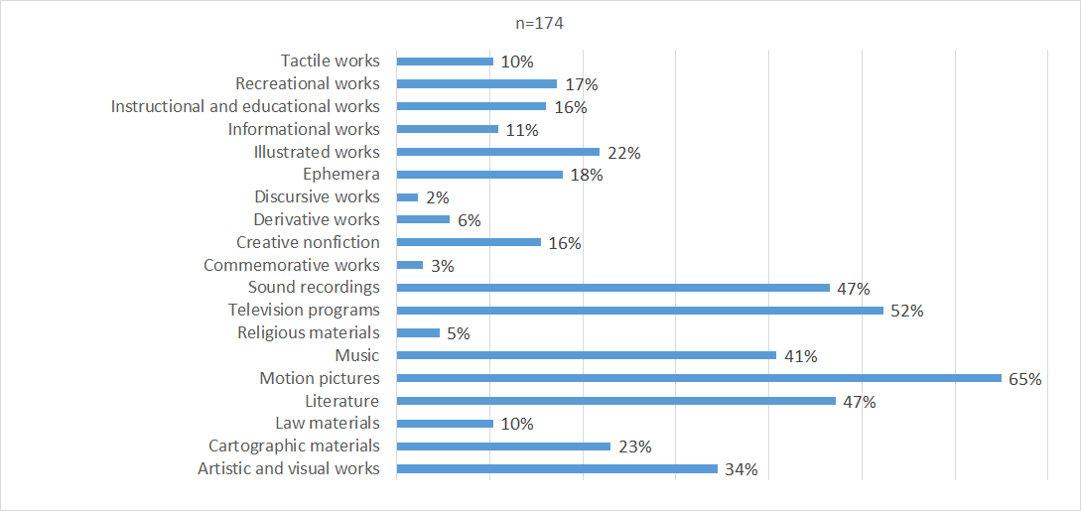
For which materials do you currently add LCGFT headings in copy records?
Notes:
We were also interested in LCGFT application between the different areas of the vocabulary. In looking at copy cataloging, we see high numbers for motion pictures, television programs, sound recordings, literature, and music.

Slide 15
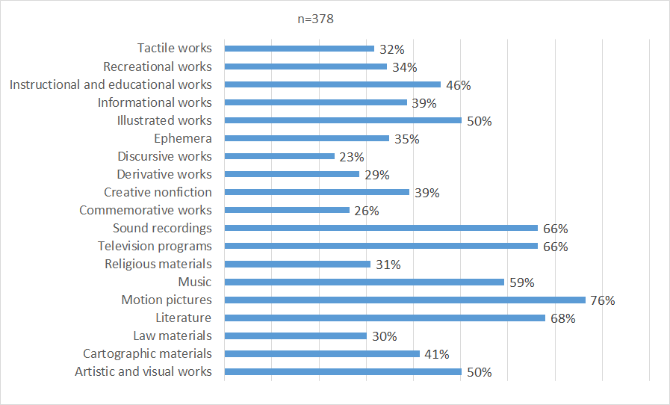
When you are performing original cataloging, for which materials do you currently apply LCGFT headings?
Notes:
Looking at the same question by original cataloging, we see a slightly more even distribution, though there is still clear domination in the same five areas.

Slide 16
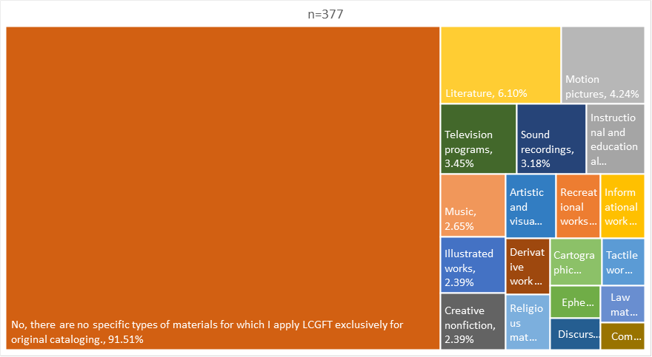
At your institution, are there certain materials for which you apply LCGFT headings only for original cataloging while omitting LCSH altogether?
Notes:
Has LCGFT overtaken LCSH? From the results of our survey, it is a clear ‘no.’ Over 90% of respondents are not abandoning LCSH in favor of LCGFT. This being said, a small number of respondents are doing so for literature, motion pictures, television programs, and others. [pause]

Slide 17
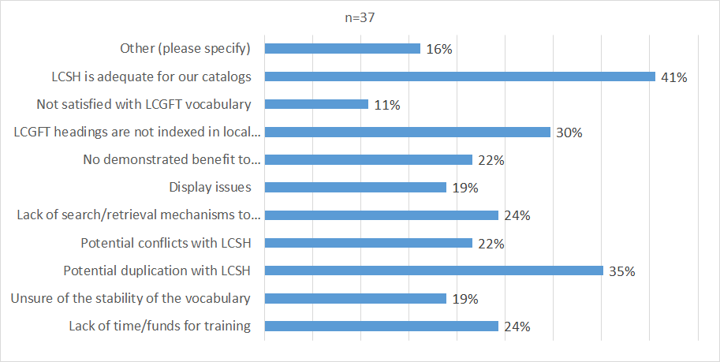
Why has implementation been delayed for copy records at your institution?
Notes:
Finding the reasons for delay in LCGFT implementation was also crucial to answering our original research questions. Popular responses include LCSH’s adequacy, issues with duplication between LCSH and LCGFT, and that LCGFTs are not indexed in some ILSs. Some other free-text responses included that not enough pre-existing catalog records contain the headings, and that LCGFT is a low priority compared with other cataloging projects.

Slide 18
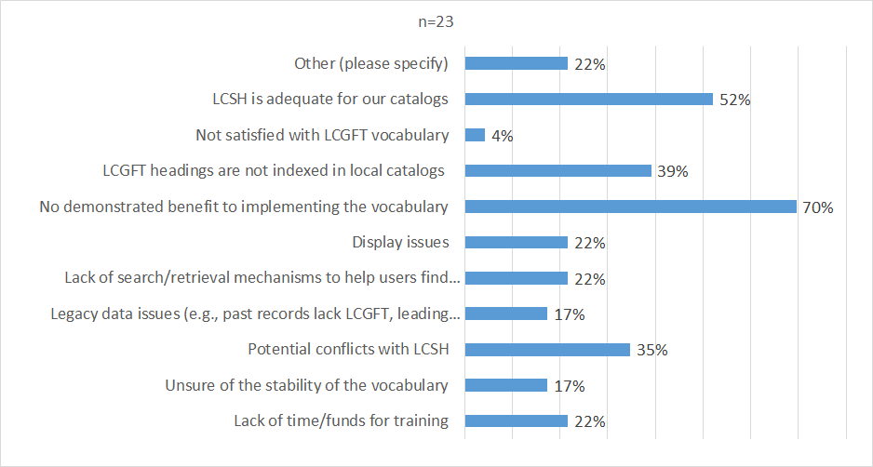
Please describe the reasons for not planning to implement the LCGFT vocabulary for copy records at your institution.
Notes:
23 respondents said that do not intend on implementing LCGFT in copy cataloging. Here 70% of respondents said there is no demonstrated benefit to using LCGFT. Again, the adequacy of LCSH and indexing issues with LCGFT were also amongst top answers. In looking at free-text responses, one respondent pointed out that they use local-genre terms instead of LCGFT. Another respondent said Sears was preferred to LCGFT at their shop.

Slide 19
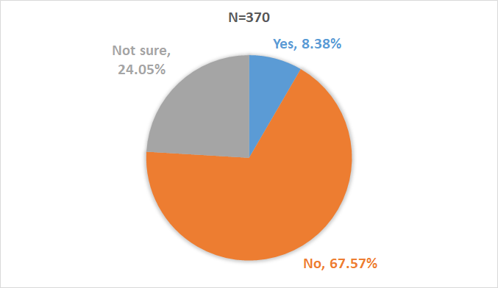
Have you experienced any display problems with LCGFT headings in your OPAC or discovery system?
Notes:
We were also curious about display issues. While only a small portion of respondents reported local display issues, their free-text responses illuminate some of the difficulties in integrating 6xx headings from a variety of sources in modern discovery systems as seen on the following slide.

Slide 20
Please describe any display issues
Currently no distinction in the OPAC between subject and genre terms (all display as subjects)
We need to educate the vendors more in the use, display and differences between LCGFT and LCSH. Ex Libris likes to lump all 6xx fields together in the discovery tool.
Subfield 2 information displayed and was confusing to students.
Because LCGFT is currently in our subject index (this will change fairly soon), instances where an LCGFT heading is a variant term for an LCSH heading have caused some issues when undertaking a subject browse
LCGFT and LCSH are separated out for faceting, but lumped together for bib record display. This is however only one of several display issues as we have recently migrated.
Notes:
The bullets on this slide represent display issues common to a number of respondents. Here we see problems with distinguishing between LCSH and LCGFT, problems in suppressing $2, indexing issues, and inconsistency between faceting and bib-record display. Many respondents expressed dismay with vendors and the desire for more communication in order to rectify some of these issues and others. [pause]

Slide 21
Conclusions
High rates of LCGFT application in both original and copy cataloging
Clear success in describing is-ness
Current non-users tentative over future adoption
Some subject areas dominate (motion pictures, television programs, sound recordings, literature, and music).
LCSH still relevant
Local display issues
Notes:
We can conclude from this data that adoption of LCGFT is high, in both copy and original cataloging. Additionally, LCGFT’s ability to describe non-topical attributes of resources has given catalogers alternatives to providing subject access to appropriate resources. This being said, many who do not currently use LCGFT are still unsure of whether or not they will implement the vocabulary locally. We also found that certain areas, such as music and motion pictures, have been adopted at higher rates, perhaps do the prevalence or nature of the resources. Or, perhaps certain cataloging communities have been quicker to adopt the vocabulary.
We also saw that only a small minority of respondents have abandoned LCSH altogether in favor of LCGFT for certain resources. Lastly, some shops still have display issues to rectify before the vocabulary can be fully integrated into discovery.
It should be noted that this was only a small subset of our survey. We plan to issue a much more comprehensive analysis of our data in the near future. Thank you.

