Slide 1
The Springhillian Student Newspaper Digitization Project
Lauren Jensen, Digital Services Librarian
Spring Hill College: Mobile, Alabama

Slide 2
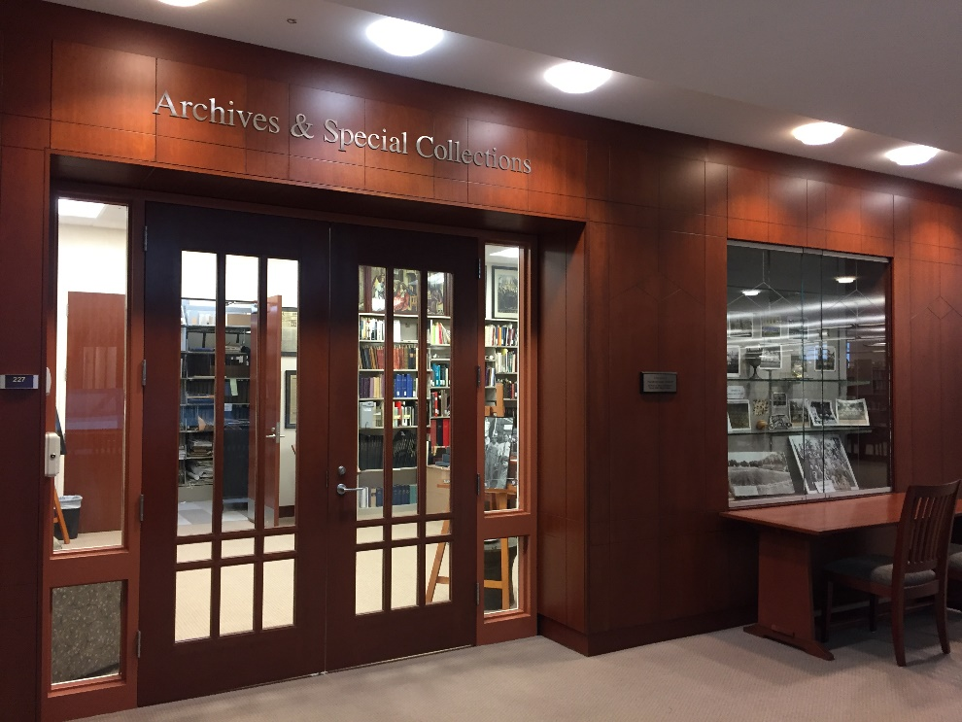
Background: Spring Hill College
Residential liberal arts college: 1,500 students
No full time archivist
Increased usage
No digital copies
Newspapers in poor
Microfilm cut into pieces

Slide 3
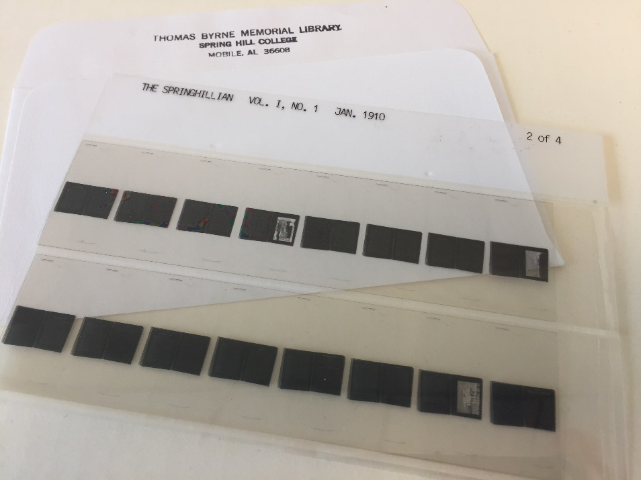
Collection Assessment: Fall 2016
No Inventory, 3 formats:
Paper 6,105 pages
69 bound volumes
1924-1989
Microfilm 351 strips
4,292 images
1910-1924; 1990–1996
Born Digital PDFs 2,683 pages
2006-present

Slide 4
Research: Fall 2016
Reviewed external and internal options
Reviewed quotes from vendors
Explored Open Source software
In house, ultimately, impractical
Researched to locate best potential funding agency
National, state and local
NEH, IMLS, state NEH, NHPRC, NA, CLIR, Mellon, Knight Foundation, Lyrasis Catalyst

Slide 5
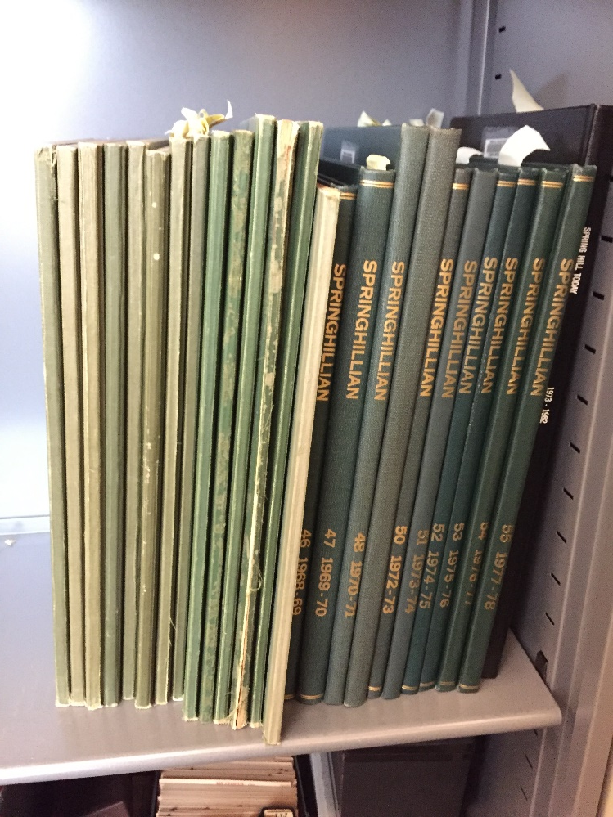
Narrowed Options: Spring 2017
Concerns: lack of staff and short timelines
Narrowed external vendor choices
Applied for local Friends of the Library grant funding
Met with Campus Risk Assessment Officer regarding insurance

Slide 6
Project Proposal: April & May 2017
Application included:
Project timeline by month
Budget (including supplies)
External vendor digitization quotes
Staff time: library would supply
Asked to present to FOL Board in person
Supplied clarification to questions

Slide 7
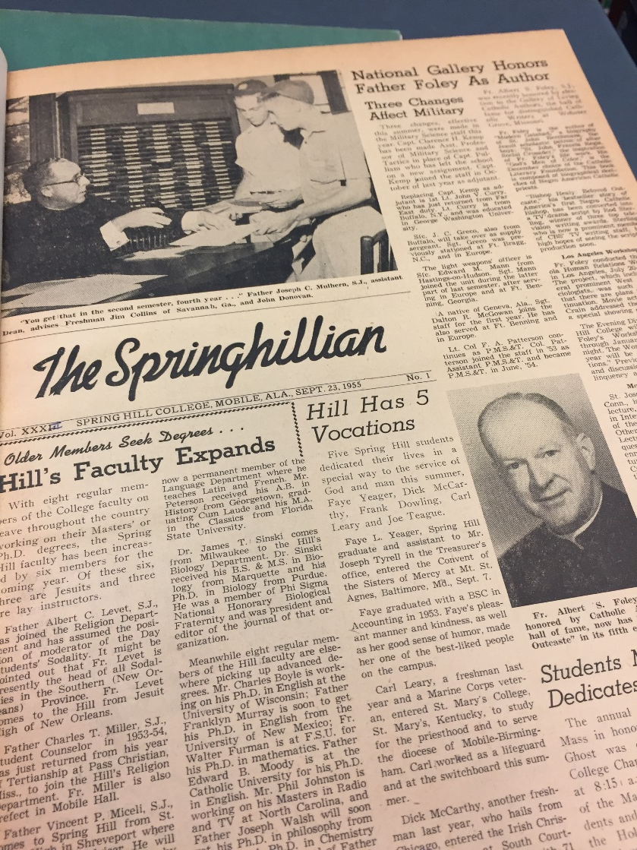
Budget Included:
$12,000 for digitization
Detailed vendor quotes
Variation among quotes
$3,000 for supplies
Archival materials ($1,150)
Housing supplies ($450)
Shipping costs ($1,400)
$0 – staff supplied by library

Slide 8
Project Funded
Grant approved: May 2017 for a total of $15,000
$12,000 for digitizing
$3,00 for supplies and shipping
Deadline set: August 2018
Required:
Monthly updates
Mention of funding source on final project
Final report when complete

Slide 9
Preparation & Scanning
Preparation: Locate missing issues
Scanning details
Paper & film scanned in grayscale at 300-400dpi and saved as uncompressed TIFF files.
Convert PDF files to TIFF files.
All formats to be de-skewed and crop images for OCR.
Metadata created with vendor and best practices
Materials shipped in batches to meet insurance requirements

Slide 10
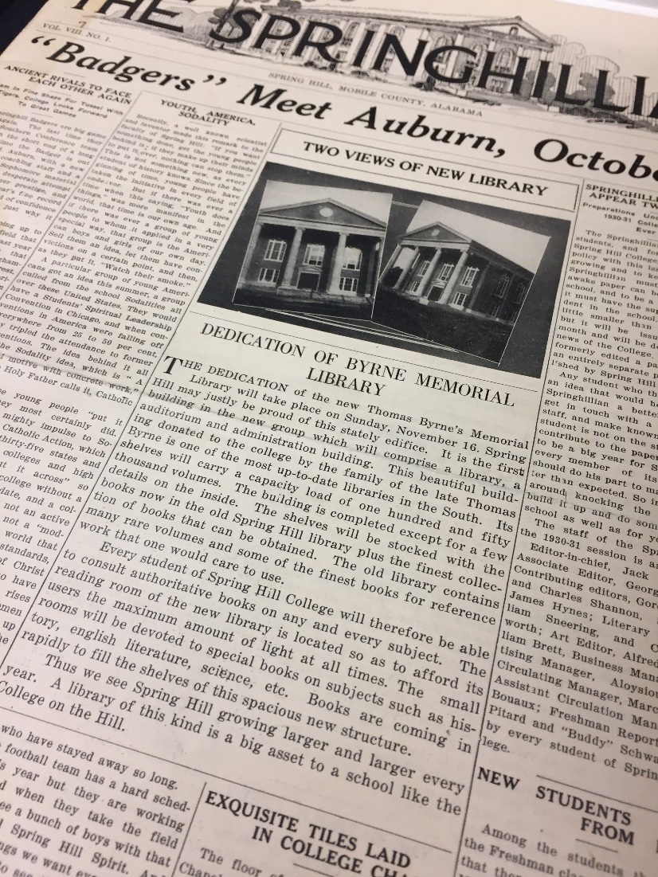
Lessons Learned
Good
Clear communication with funding agency
Well defined timeline
Budget adherence
Tricky
Timelines with adjustments
Adapt to unanticipated delays

Slide 11
Lessons Learned
Unexpected
Detailed insurance
requirements
Enthusiasm from:
Funding agency
Campus offices
Students
Next project already in the works

Slide 12
Questions?
Thank you!
Follow up with me:
ljensen@shc.edu

