Slide 1
Core Linked Data Interest Group (LDIG) Discussion

Slide 2
About LDIG
Interest Group is in Core’s Technology Section
There is no formal membership
Previously ALCTS/LITA Linked Library Data Interest Group (LLDIG)
Current co-chairs: Annamarie Klose (2019-2021) and Ben Riesenberg (2020-2022)
Incoming co-chairs: Kevin Ford and Becky Skeen (both 2021-2023)
More information at https://www.ala.org/core/member-center/interest-groups/linked-data
#alaac21

Slide 3
Housekeeping
This event is being recorded and will be shared via ALA Connect
To participate in the discussion, you can:
Unmute and share your comment or question
If discussion is lively, we will ask that you use the raise hand feature and we will call on participants
Post your question or comment using the Zoom chat feature (facilitators will read your question)
Post your question or comment using the Zoom Q&A feature (if available)

Slide 4
The Semantic Web: Twenty Years Later

Slide 5
Discussion Theme
In May 2001, Tim Berners-Lee, James Hendler, and Ora Lassila published the seminal article “The Semantic Web” in Scientific American (https://www.scientificamerican.com/article/the-semantic-web/). This work has shaped both the World Wide Web and the larger information landscape. As libraries have adapted to these changes and the vision that was outlined, there is still a gap between the ideal and reality. This discussion will allow participants to share and hear from colleagues how the Semantic Web has impacted our work (or not) and how libraries are evolving (or not) based on these changes.
Caveats: The article is behind a paywall. ☹

Slide 6
Let’s get started...
Question #1:
How would you rate your knowledge of linked data concepts?
Beginner
Intermediate
Expert
Question #2:
Do you work with linked data in your position?
No
Only a little
Regularly
I’m not sure

Slide 7
Does
“The Semantic Web” overpromise?

Slide 8
Are we there yet?
Does Tim-Berner-Lee’s vision for the semantic web seem attainable for us?
What kind of work do you Libraries need to do to be more semantic web-ready?

Slide 9
Ethics & DEI
Questions such as: Is it ethical to publish life/death dates for living persons?
Does linked data pose challenges with how people are described in terms of race, sexual orientation, etc.?
Access issues with devices?

Slide 10
“The Semantic Web is the killer app.” (p. 42)

Slide 11
What about the
Digital Divide
across the globe?

Slide 12
What about the
Digital Divide
across the globe?

Slide 13
What is linked data doing?
There’s a lot of ways linked data is being used in industry.
How is it being used in libraries?
Are libraries falling behind in terms of linked data?
How is it difficult for libraries to adapt or change to embrace linked data?
Are there downsides to the Semantic Web?
Are there potential ramifications to this futuristic vision?
Does the Internet of Things play a role?

Slide 14
Where is it?
Technology is centralized and hidden from view
Need for information literacy re. quality sources
Reference service
Customizations across devices
Context missing
Who is generating this data?
Privacy issues & hacking
Does this futuristic vision seem only for the privileged?
How can this technology further the divide?

Slide 15
Security, Hacking, & Authenticity
“Another vital feature will be digital signatures, which are encrypted blocks of data that computers and agents can use to verify that the attached information has been provided by a specific trusted source. You want to be quite sure that a statement sent to your accounting program that you owe money to an online retailer is not a forgery generated by the computer-savvy teenager next door. Agents should be skeptical of assertions that they read on the Semantic Web until they have checked the sources of information. (We wish more people would learn to do this on the Web as it is!)”
- pg. 42

Slide 16
Where are we going?
How do you feel about transitioning from MARC to BIBFRAME?
Do you see the value of Wikidata?
Do you see the benefit of sharing Libraries linked data outside of Library-specific uses?
What is the impact of linked data on search and discovery at your institution?

Slide 17
A Google search for “Maya Angelou” currently leads to about 10,900,000 results.

Slide 18
What is the Semantic Web supposed to do?
“The Semantic Web will bring structure to the meaningful content of Web pages, creating an environment where software agents roaming from page to page can readily carry out sophisticated tasks for users.”
- pg. 36

Slide 19
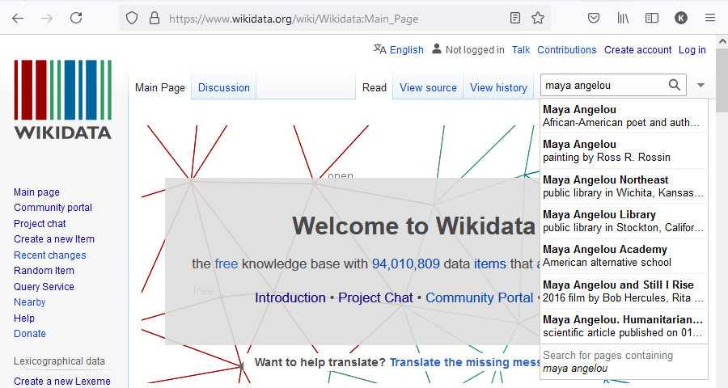
Which Maya Angelou did you want?
This one!

Slide 20
The Four Rules of Linked Data
Use URIs as names for things
Use HTTP URIs so that people can look up those names.
When someone looks up a URI, provide useful information, using the standards (RDF*, SPARQL)
Include links to other URIs. so that they can discover more things.
Tim Berners-Lee, Design Issues, W3C https://www.w3.org/DesignIssues/LinkedData.html

Slide 21
Machine readable vs. Human readable
“AGENT: A piece of software that runs without direct human control or constant supervision to accomplish goals provided by a user. Agents typically collect, filter and process information found on the Web, sometimes with the help of other agents.”
pg. 38, Glossary
Image by Chepe Nicoli from Pixabay

Slide 22
Searching in the ocean of the Web
“SERVICE DISCOVERY: The process of locating an agent or automated Web-based service that will perform a required function. Semantics will enable agents to describe to one another precisely what function they carry out and what input data are needed.”
pg. 38, Glossary
Image by Gerd Altmann from Pixabay

Slide 23
Explaining things to a machine
Subject
Object
predicate
Maya Angelou
(https://www.wikidata.org/wiki/Q19526)
instance of (https://www.wikidata.org/wiki/Property:P31)
human
(https://www.wikidata.org/wiki/Q5)

Slide 24
Subject
Object
predicate
Maya Angelou
(https://www.wikidata.org/wiki/Q19526)
instance of (https://www.wikidata.org/wiki/Property:P31)
human
(https://www.wikidata.org/wiki/Q5)

Slide 25
Resources
Tim Berners-Lee, TED Talks, https://www.ted.com/speakers/tim_berners_lee
Manu Sporny, “What is Linked Data?” https://youtu.be/4x_xzT5eF5Q

Slide 26
See you at Core IG Week!
LDIG’s next event will be at ALA Core’s Interest Group Week, July 26-30, 2021.
https://www.ala.org/core/continuing-education/interest-group-week

