Slide 1
Aggregator Ways to Account for Different Conceptual Models
ALA Core Bibliographic Conceptual Models Interest Group
ALA Core Virtual Interest Group Week
10 March 2022

Slide 2
Michael Phillips
Vocabulary Specialist, OCLC
phillipm@oclc.org

Slide 3
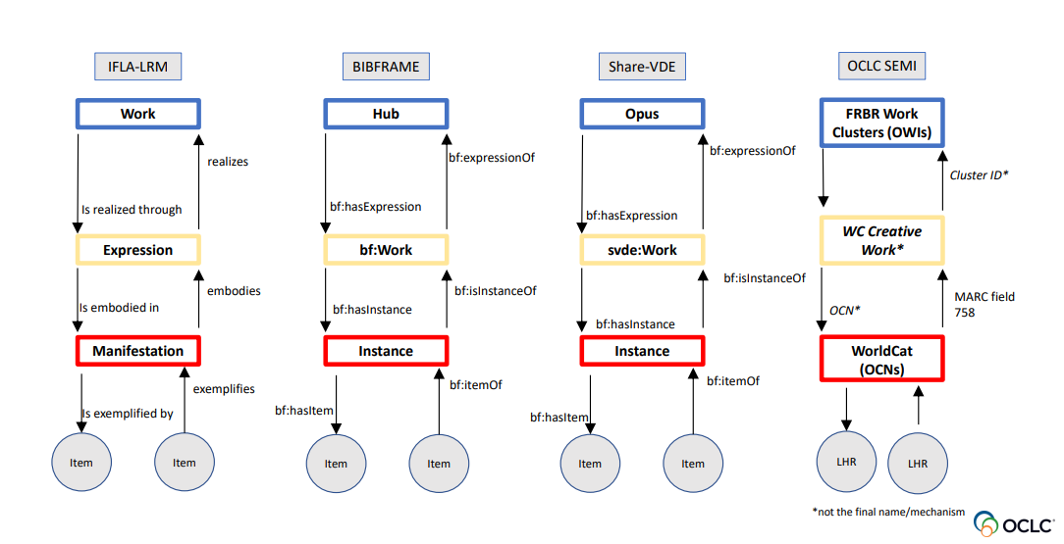
Conceptual models in cross-comparison

Slide 4
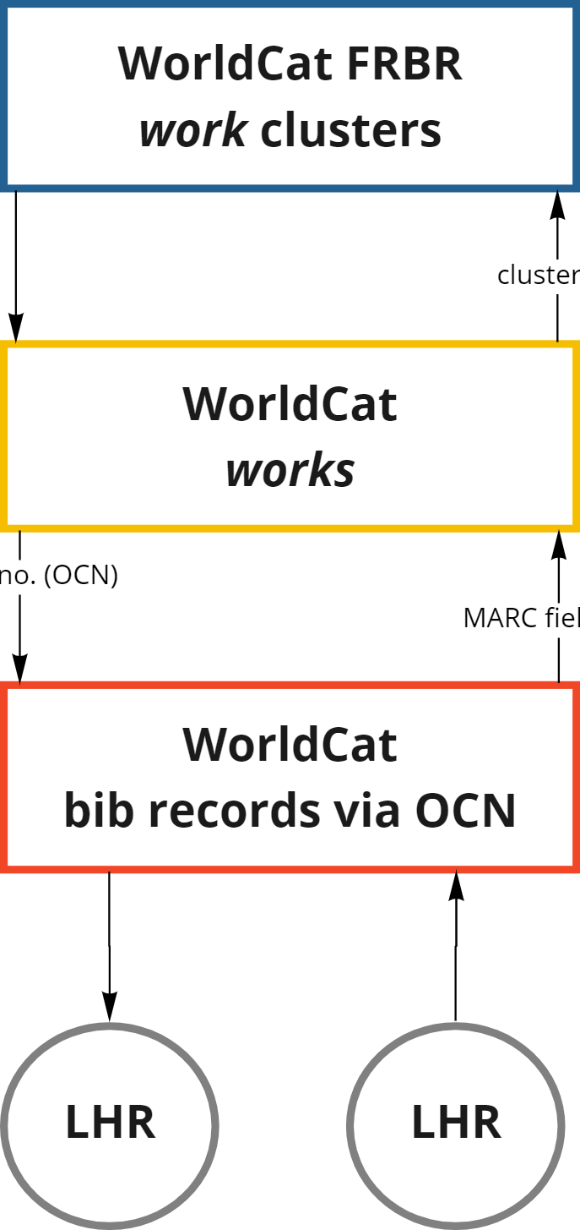
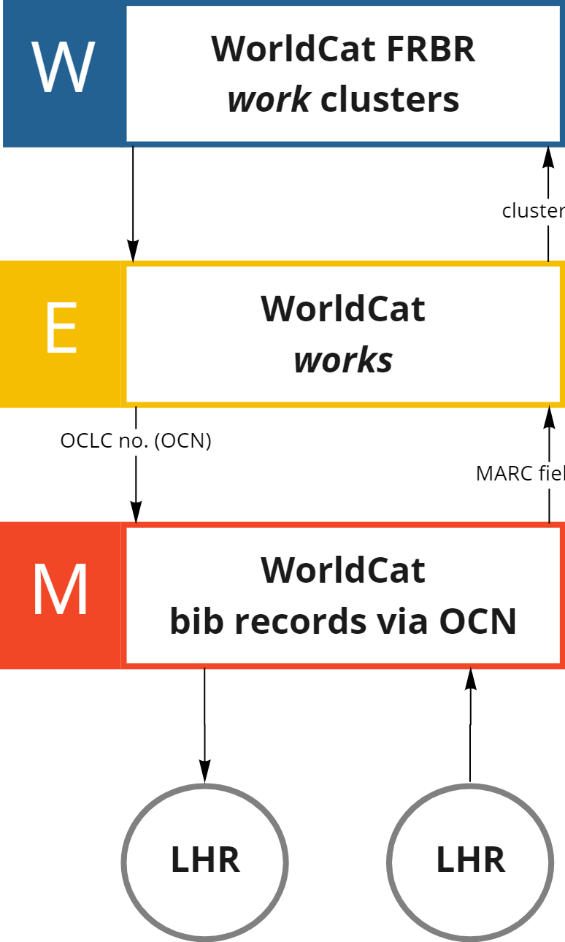
Initial model update
from previous presentations
updated for clarity
cluster ID
cluster ID
OCLC no. (OCN)
OCLC no. (OCN)
MARC field 758
MARC field 758

Slide 5
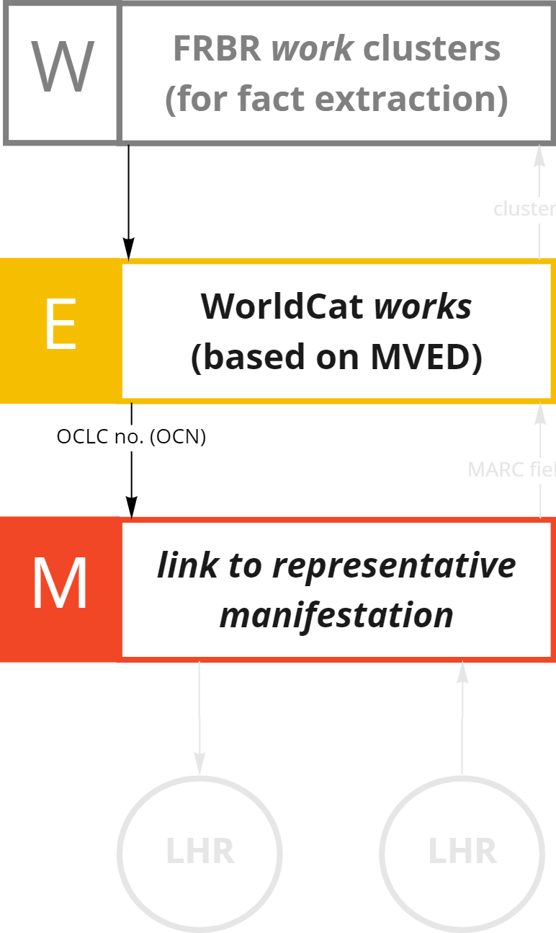
Entity management implementation
the initial representation
the current representation
cluster ID
MARC field 758

Slide 6
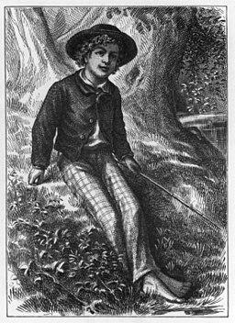
The representative expression
This image is available from the United States Library of Congress's Prints and Photographs division under the digital ID cph.3b04662

Slide 7
The representative expression: singletons

Slide 8
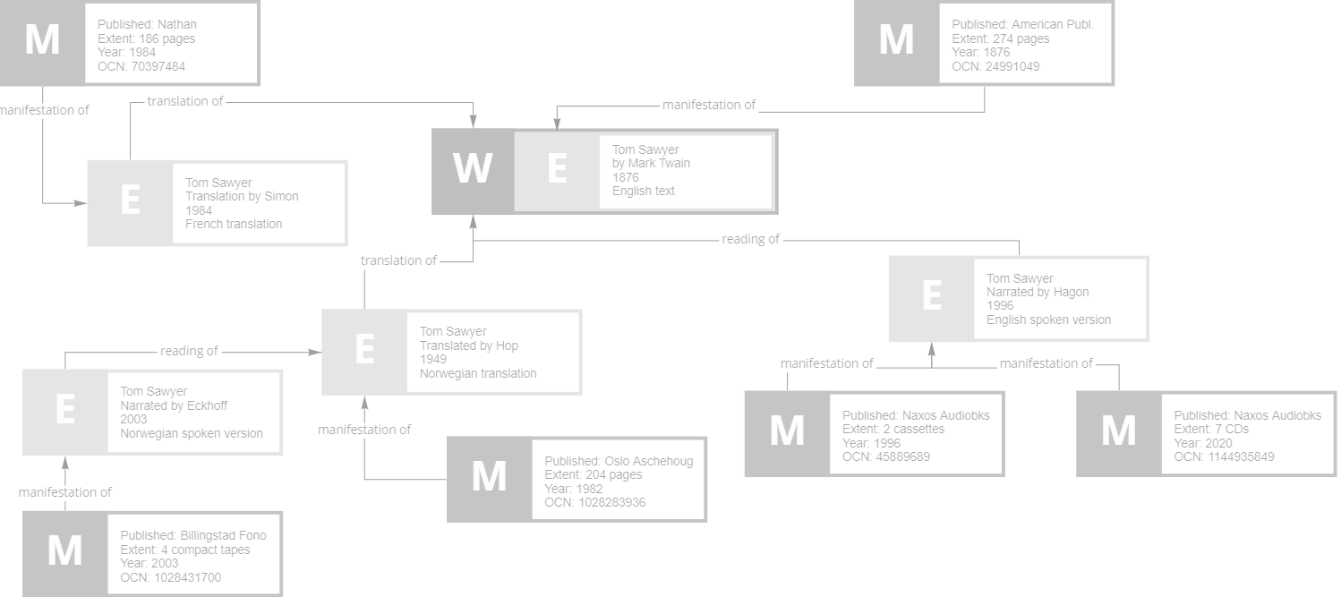
Graph complexity: in the beginning

Slide 9
Graph complexity: growth

Slide 10
Graph complexity: expression of an expression

Slide 11
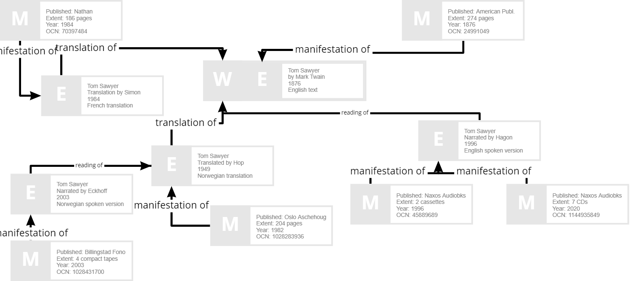
Graph complexity: the relationships

Slide 12
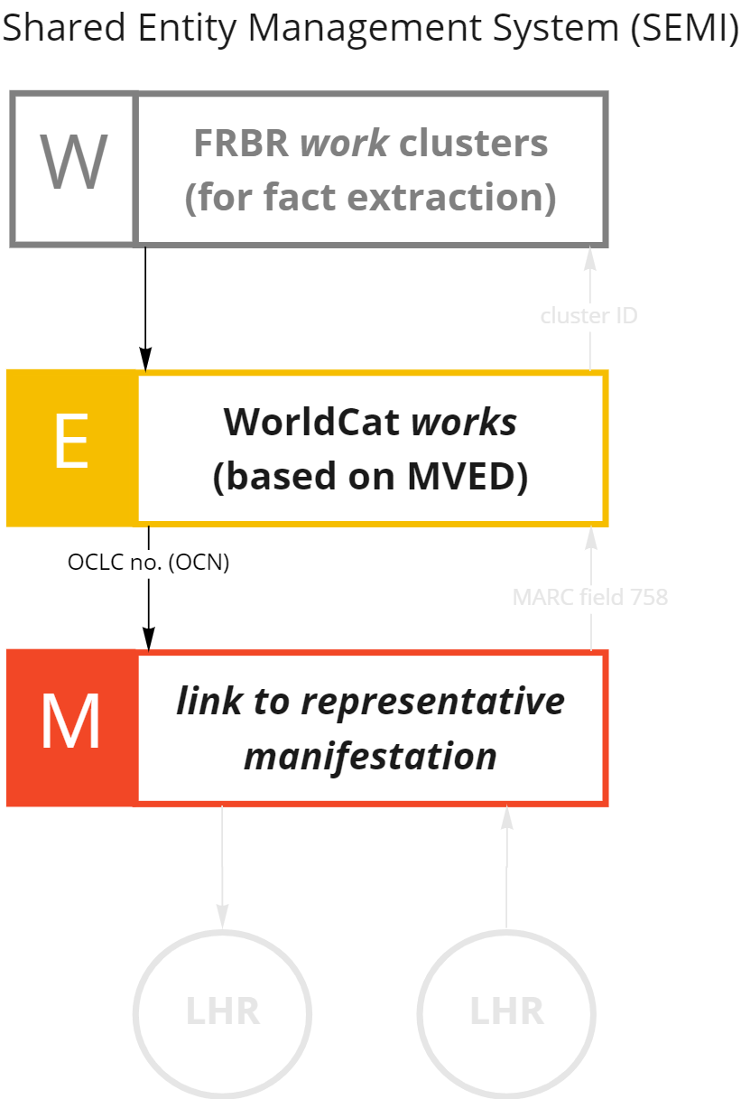
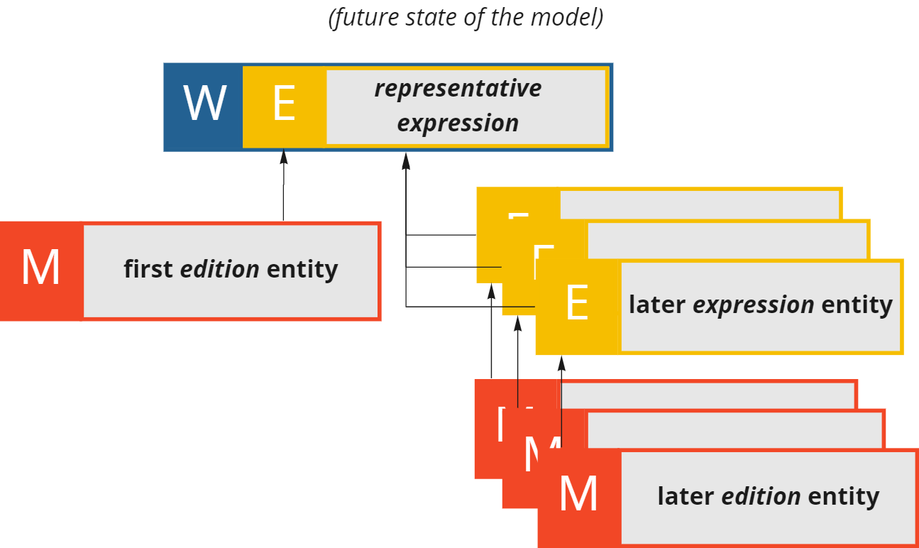
Evolution of the model

Slide 13
Next stage of evolution
work entities for the graph
edition entities for the graph

Slide 14
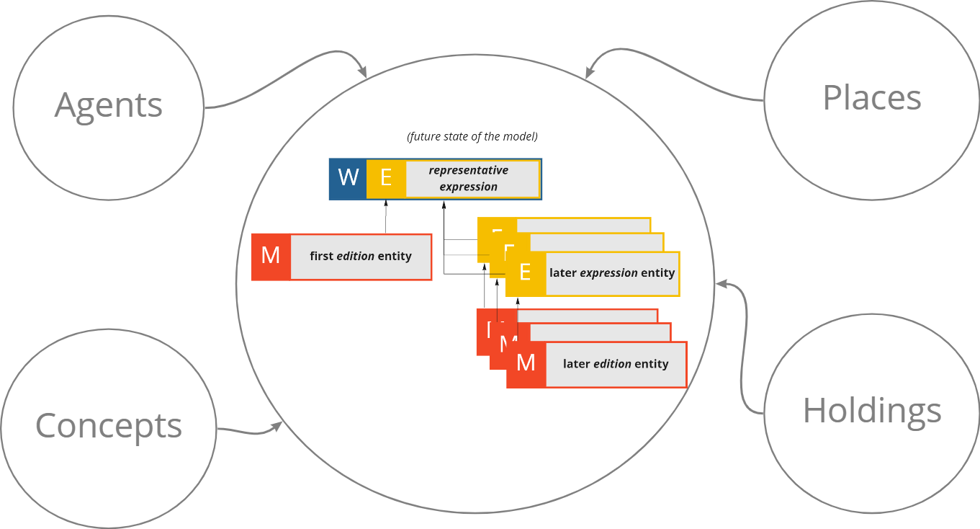
Expanding the graph

Slide 15
What’s coming up later
Synchronization with bibliographic WorldCat
Linking to subjects/concept entities
Modeling holdings data

Slide 16
Michael Phillips
Vocabulary Specialist, OCLC
phillipm@oclc.org
Thank you for listening!

