Slide 1
FACRL
Assisting Librarians to Weather the Storm

Slide 2
Recap: How did we get here?
What we are witnessing in Florida is an intellectual reign of terror. There is a tremendous sense of dread right now, not just among faculty; it’s tangible among students and staff as well. People are intellectually and physically scared. We are being named an enemy of the State. The events at Jacksonville too, feel real, and people feel it could happen to them. —LeRoy Pernell, professor of law, Florida A&M (interview with the special committee)
The human toll in Florida is catastrophic. We are tired of being demonized by our government. Many of us are looking to leave Florida, and if we don’t, we will leave academia, and nobody wants our jobs. Faculty are suffering. And when we leave, our communities, our students, families—they will all suffer. So, when we fight for faculty, we are also fighting for the people in our communities. —A faculty member and union leader in Florida (interview with the special committee)
Report of a Special Committee: Political Interference and Academic Freedom in Florida’s Public Higher Education System

Slide 3
Recap: How did we get here?
November 2022, Florida governor Ronald Dion DeSantis won reelection and soon
banned the teaching of “critical race theory” in public schools and prohibit discussion of sexual orientation or gender identity in classrooms,
proudly declared Florida a state where “woke goes to die,”
the Florida House and Senate passed legislation and the DeSantis administration took executive actions that censored the teaching and learning of certain historical topics; potentially criminalized some discussions of race, gender, and sexuality; stigmatized, marginalized, and excluded transgender people; curbed labor rights; restricted immigration; and stringently limited access to abortion, and
threatened higher education, more specifically, the foundational principles of shared governance and academic freedom, when the governor appointed six new trustees to the board of New College of Florida, an alternative liberal arts college within the Florida public higher education system with the aim of “demonstrat[ing] that the public universities, which have been corrupted by woke nihilism, can be recaptured, restructured, and reformed.”

Slide 4
Recap: How did we get here?
AAUP’s preliminary report offered four main findings:
(1) the “hostile takeover” of New College is both a “test case” and a “blueprint for future encroachments on public colleges and universities across the country”;
(2) academic administrators in Florida “not only have failed to contest” attacks on the system “but have too frequently been complicit in and, in some cases, explicitly supported them”;
(3) legislation enacted by Governor DeSantis and the legislature, “taken collectively, constitutes a systematic effort to dictate and enforce conformity with a narrow and reactionary political and ideological agenda” and represents “a uniquely bold and dangerous program designed to reshape public higher education according to ideological and partisan political standards”; and
(4) “the chilling effect on academic freedom of the governor’s and legislature’s efforts has already been felt by faculty and students.”

Slide 5
Initiatives to Support Librarians
As attacks on Library workers continue across the state, FACRL hopes to serve our members through the following actions:
Creating a safe space for professional discourse through interest groups, annual conferences, and other association activities
Respecting the privacy of our membership
Sharing resources for professional and legal support
Advocating for the needs of our members through the Florida Library Association (FLA), Association of College & Research Libraries (ACRL), and the American Library Association (ALA)
Overall - we focused on education and information dissemination this year to keep our members informed. We reached out to librarians in crisis with resources when needed.

Slide 6
Initiatives, continued
FACRL updated its bylaws to include a Diversity, Equity, and Inclusion Officer on the board. There are several candidates running for this position in Spring 2024 and we believe it will be filled.

Slide 7
IF Statement
Goals of Statement
Address recent events attacking academic freedom around the state, and the value of our profession
Provide librarians with credible resources to justify professional responsibilities in the face of ongoing challenges
Provide resources for professional and legal support
Show solidarity with librarians and academic freedom across the state
FACRL posted a strongly worded statement concerning intellectual freedom in Florida (Oct 11, 2023) https://facrl.wildapricot.org/news/13265887

Slide 8
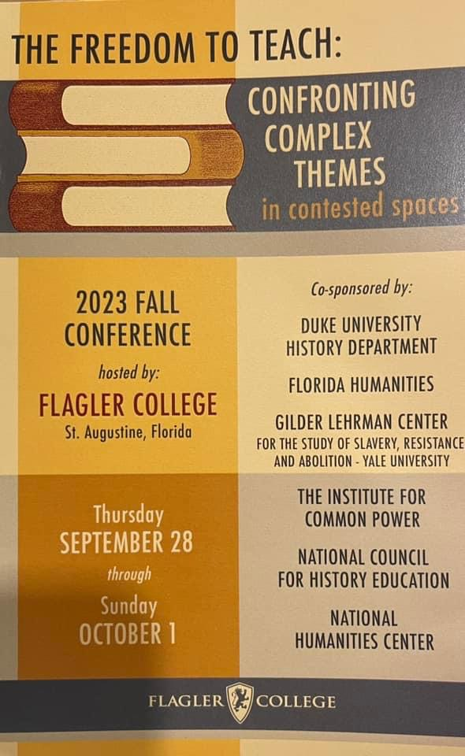
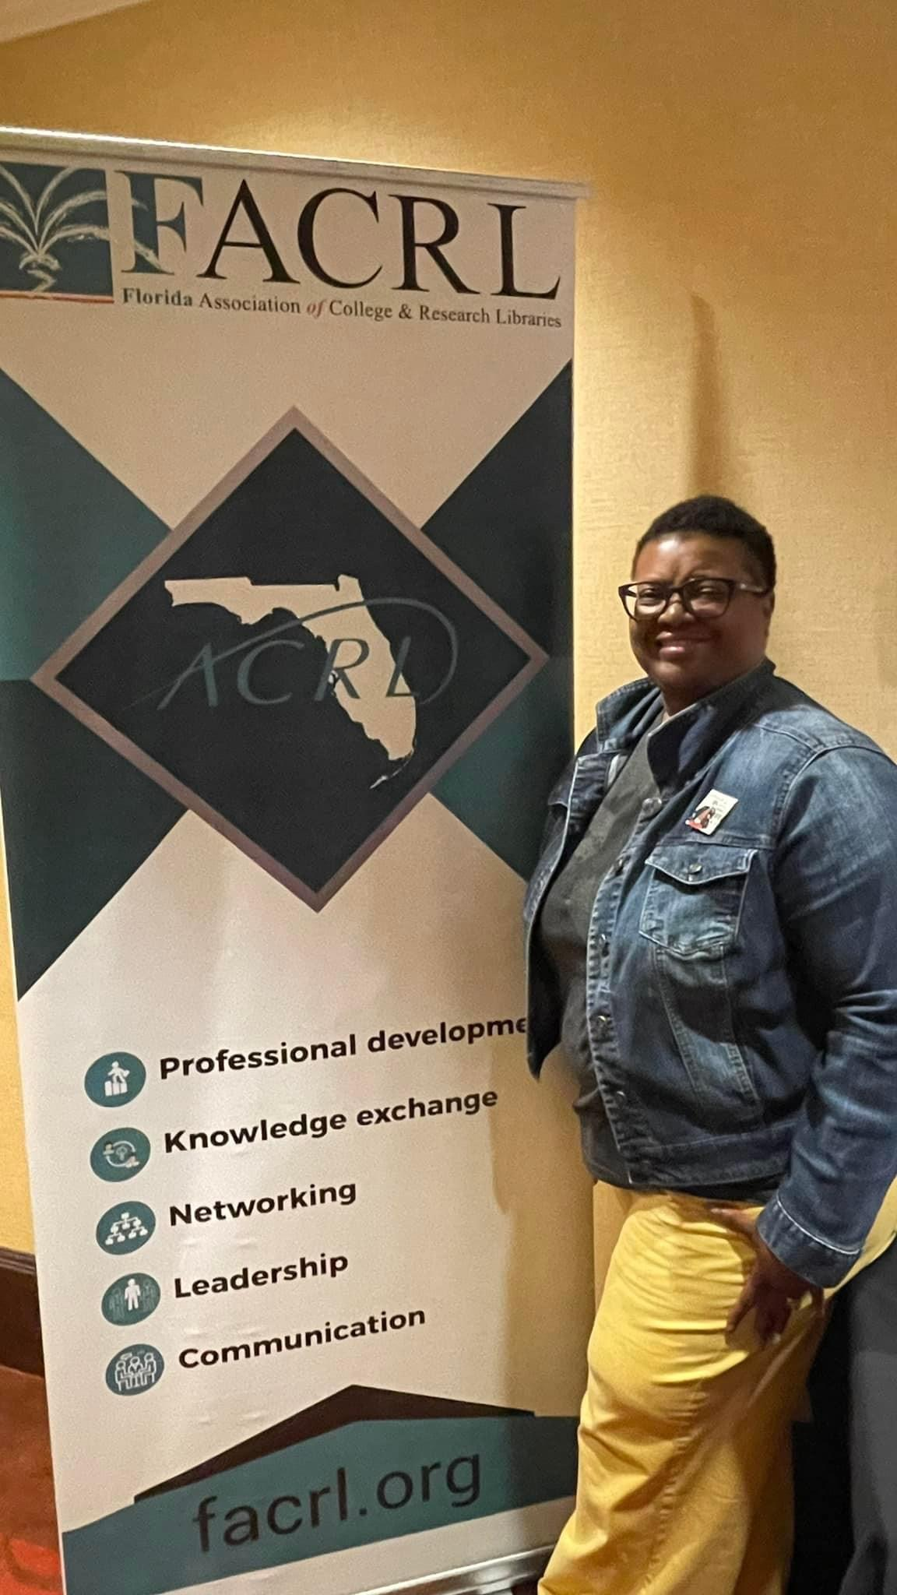
Collaboration
FACRL provided a grant support letter to the Greater Good: Humanities in Academia Grant in support of the conference The Freedom to Teach: Confronting Complex Themes in Contested Spaces at Flagler College on September 28-30, 2023. We met with the conference organizers who invited us as an organizational partner and agreed the theme of this conference would be of high interest to our members who are committed to academic freedom and open access to information. Our president, Clarissa West-White, represented FACRL at the conference as a table sponsor and several board members attended as well.

Slide 9
Legislative Impact
FACRL added several advocacy pages to our website this year:
Voting in Florida - in person and by mail - and links to authoritative sites.
Resources for contacting legislators.
Attending town halls.
Inviting legislators to visit your library or institution.
FACRL strengthened ties with FLA this year with several meetings between the FACRL and FLA Presidents and Vice-Presidents. Communication with ALA legislative office was shared with both organizations and the FACRL Legislative Liaison joined the FLA Advocacy group meetings. The FLA president attended legislative days in Tallahassee and reported back to the FACRL president.

Slide 10
FLA’s Challenges
State issued a New Rule
Grant project activities associated with ALA and affiliates are not permitted
Impact on FLA
Guilty by association
Institutional members dropping
Conference Attendance?

Slide 11
What is FLA doing?
Issued statement independent non-profit organization
Exec. Director, President, & others met with Secretary of Education to reverse rule
Refused unless FLA condemns ALA
Options:
Statement to thread a needle to appease
Lay low
Library Legislative Day

Slide 12
Toolkit
Advocacy resources from ALA and ACRL.
Legal roundups from AAUP
For librarians in crisis:
The Academic Freedom Alliance - which provides legal support to members whose rights to academic freedom have been violated
Scholars at Risk Network - an international network which protects scholars and promotes academic freedom.

