Slide 1
Perceptions and Realities of Information Literacy Proficiency of International and Returning Graduate Students
ALA Midwinter 2019
Graduate Student Interest Group
Britt Foster & Matt Doyle
California State University, Fresno

Slide 2
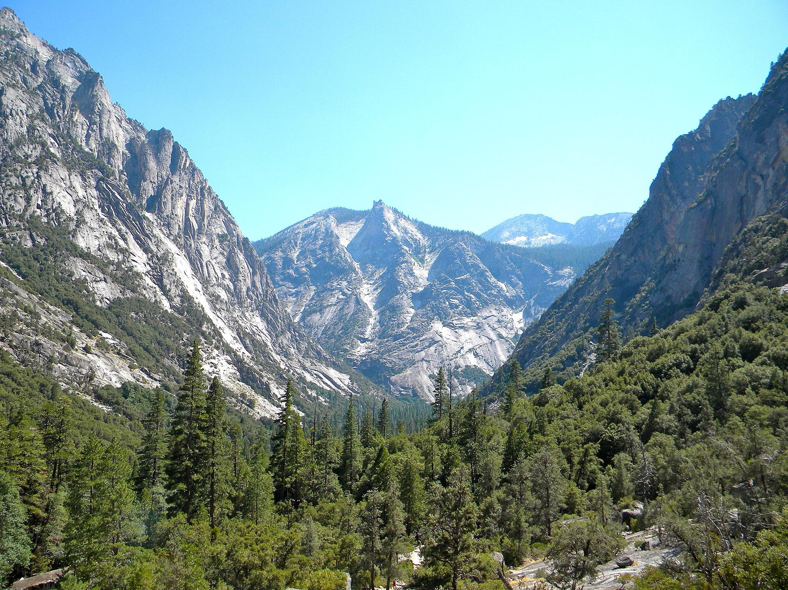
Study Background
Crd637. 16 Aug 2011. Kings Canyon as seen from the Mist Falls trail. CC BY-SA 3.0. https://commons.wikimedia.org/wiki/File:KingsCanyonNP.JPG

Slide 3
Perception of Information Literacy Scale (PILS)
Threshold Achievement Test of Information Literacy (TATIL)

Slide 4
Faculty Perceptions of Graduate Student IL
International Students | Returning Students
Language barrier | Maturity, resilience
Intellectual property and citation practices | Affect: engaged, but lack confidence
Learning style is focused on rote learning and memorization | Technology barrier
Strong work ethic | Strong work ethic
Broader world view

Slide 5
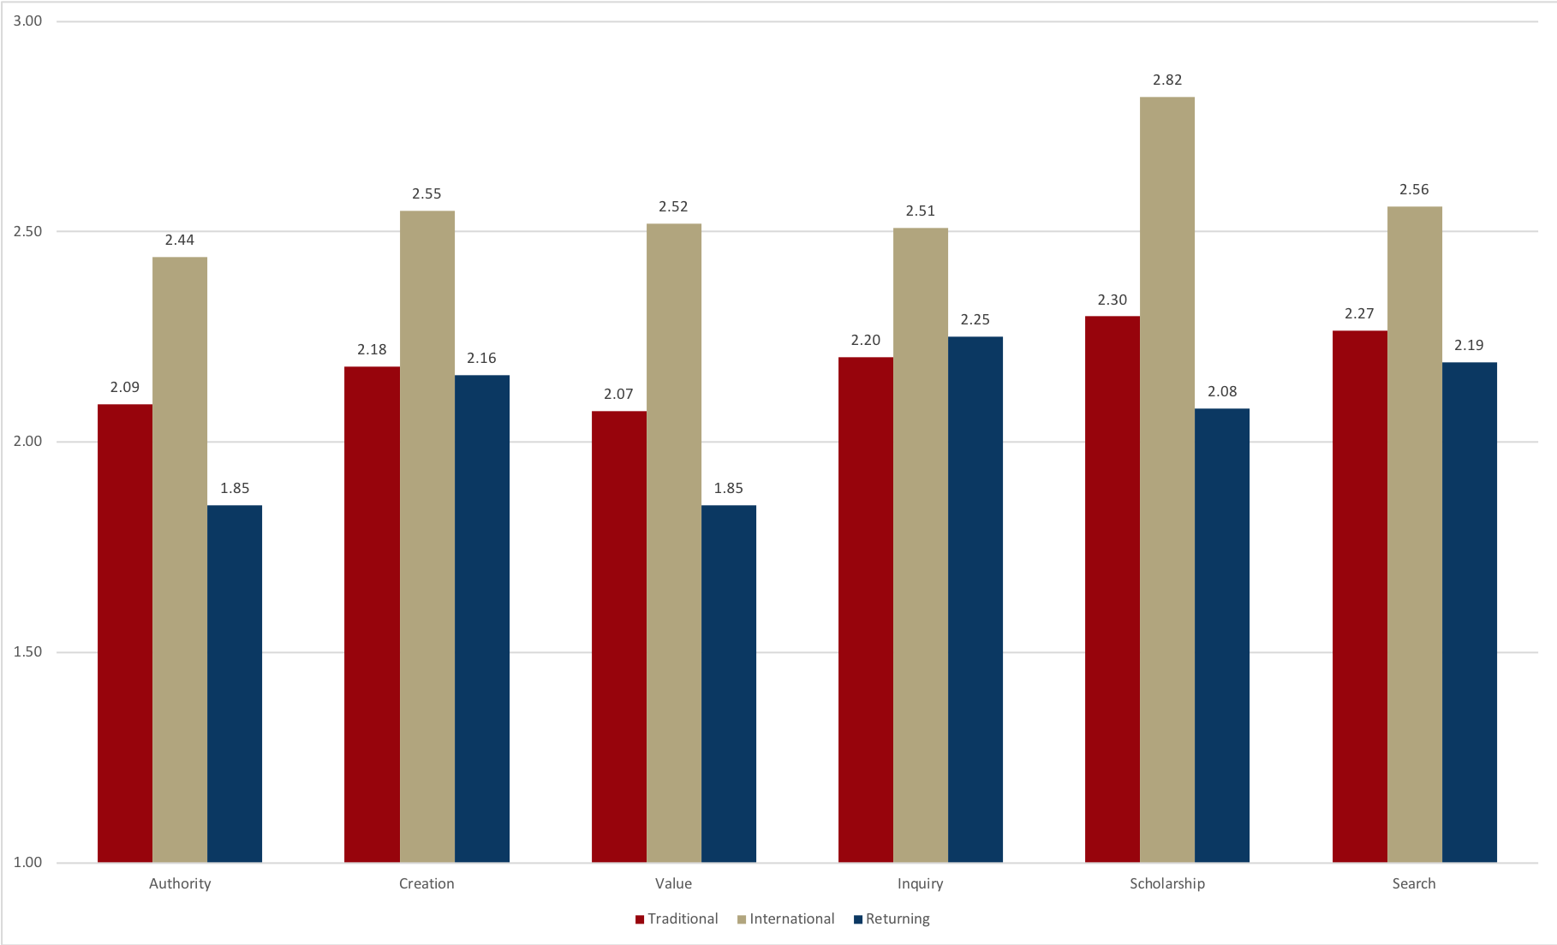
Student Self-Perceptions of IL Skills & Understandings
Scale
1- Novice
2- Advanced Novice
3- Emerging
4- Advanced Emerging
5- Developing
6- Advanced Developing
7- Expert

Slide 6
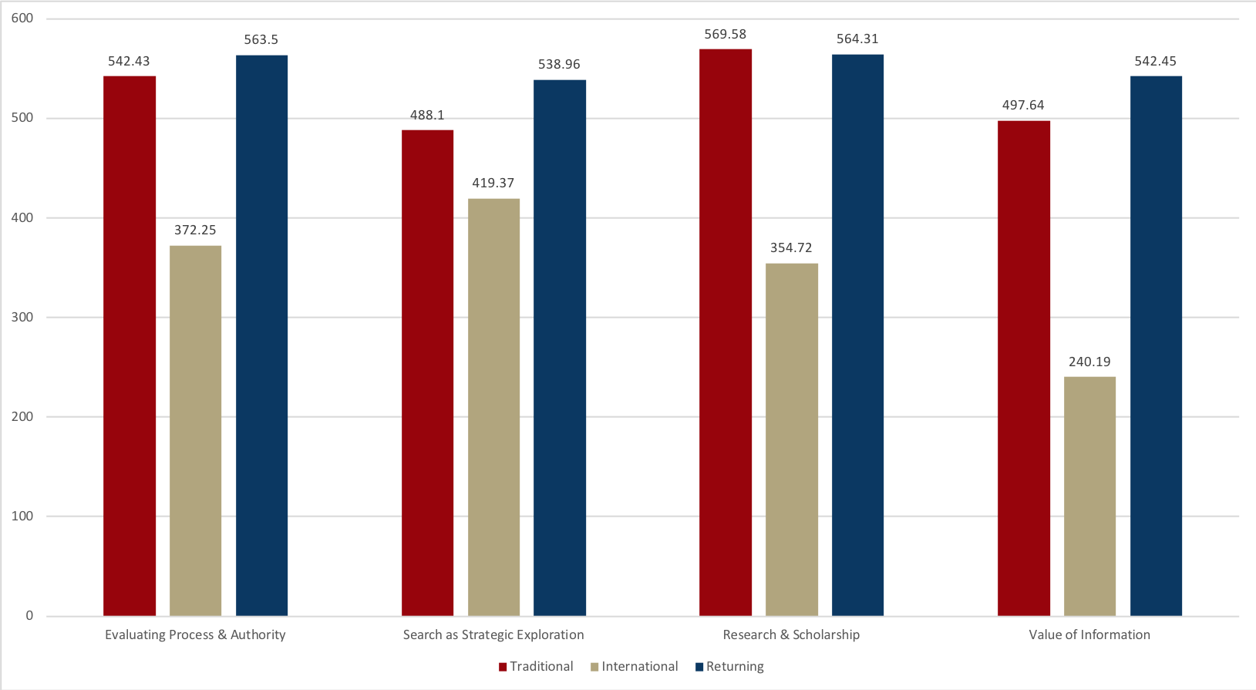
Student Actual IL Proficiency: TATIL Knowledge Outcome Performance

Slide 7
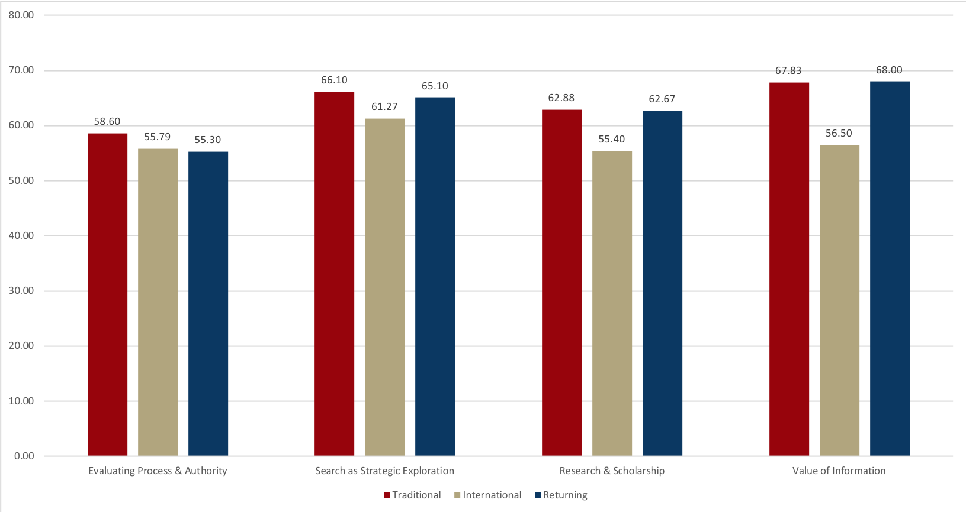
Student Actual IL Proficiency: TATIL Disposition Performance

Slide 8
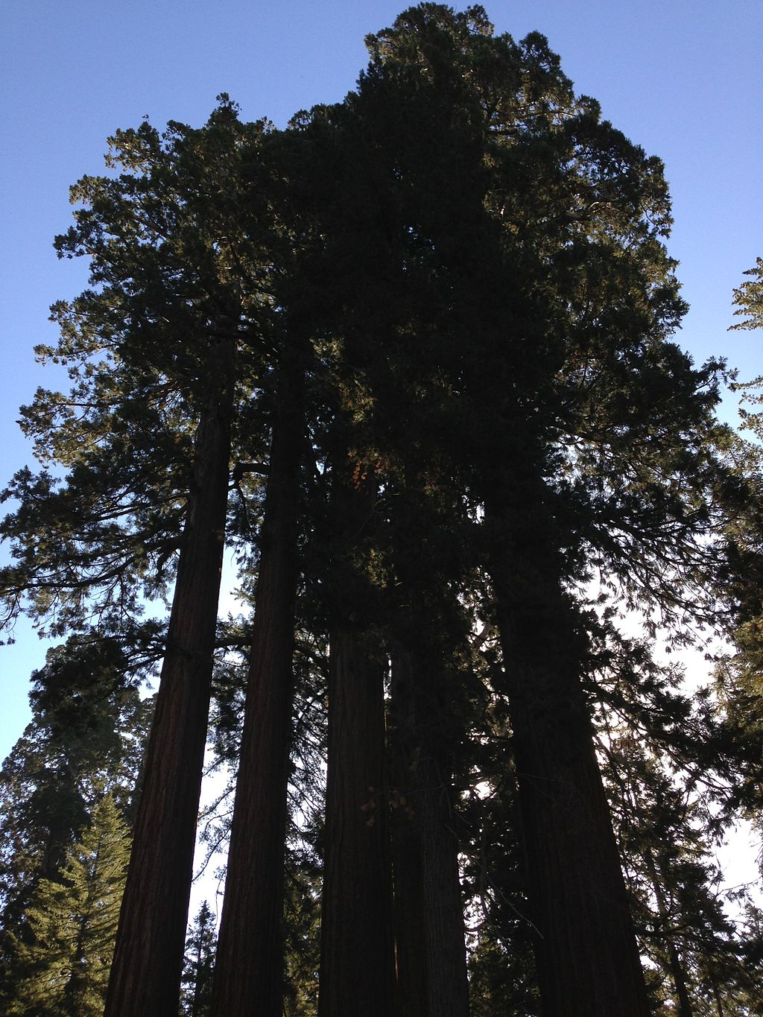
Implications
for Practice
FaMartin. 20 Sep 2013. Giant Sequoias in Grants Grove. CC BY-SA 3.0. https://commons.wikimedia.org/wiki/File:2013-09-20_09_24_10_
Giant_Sequoias_in_Grant_Grove.JPG

