Slide 1
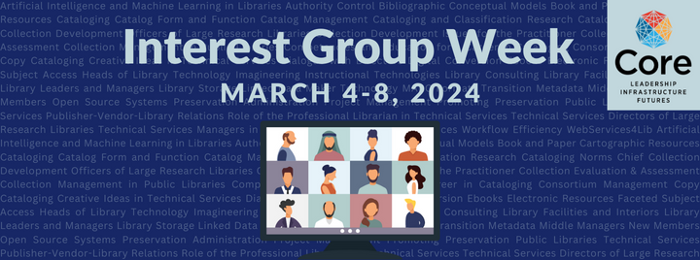
Community College Librarians’ Research Practices
Linda Miles, Open Educational Resources Librarian, Michigan State University
Robin Brown, Head of Public Services,
Borough of Manhattan Community College
March 5, 2024
Notes:
Community college librarians’ research practices
Research my colleague, Robin Brown, and I carried out in 2020 and 2021

Slide 2
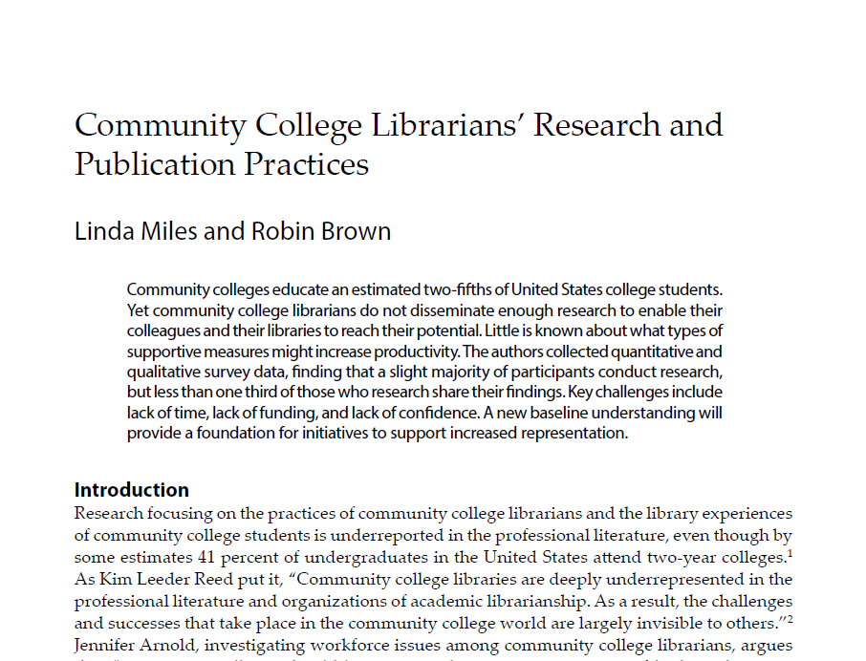
http://tiny.cc/milesbrown
Notes:
Our full results were published in C&RL (College & Research Libraries) in November of 2023

Slide 3
“The ACRL publications seem to focus more on four-year schools and research institutions, than two-year schools and teaching colleges.”
“Better access to national trends and articles related to the day-to-day struggle of being a community college librarian.”
McKinley Advisors. (September 2017). "Association of College and Research Libraries: Community College Research Study Findings and Recommendations."
Notes:
So why this research?
The professional practices of community college librarians are underrepresented in the professional literature of our discipline
For us, professional practice includes includes all the ways that we serve the institution and our patrons
Developing collections of materials to support teaching and learning at the institution
And making those accessible, either physically or electronically
Research help and instruction
The myriad other ways we serve the students and faculty, the college, and the profession
As we know, community colleges serve a population that is different in many ways from college-going populations at other types of institutions
And community college missions and structures are distinct from these other institutions as well
Therefore, in general, the practice of community college librarians is distinct from that of other academic librarians
So this is the context of our research -- the vital need for more published research on the practices of a neglected field
These quotes are from market research carried out on behalf of ACRL
Robin and I were both members of the Executive Committee of CJCLS, the Community & Junior College Libraries Section of ACRL
Both also members of the CJCLS Scholarly Research Committee
This was at the time a new committee charged with encouraging new research and supporting professional development for community college librarian researchers
One of the first questions for the committee was - what kind of scholarship and publication do community college librarians do?
Community college librarians are rarely represented in existing studies of the research practices of academic librarians

Slide 4
How much research do community college librarians do, and what types of research do they take on? (disciplines, solo vs. collab, etc.)
How much research-related publication do community college librarians do, and in what venues?
What are the perceived barriers to/supports for this kind of work, and how do community college librarians feel about these?
Are there correlations between certain institutional characteristics (faculty status, tenure, etc.) and these data?
RQ1
RQ2
RQ3
RQ4
Notes:
These were our 4 primary research questions
How much research and publication do community college librarians do, and what types of research do they take on?
How much research-related publication do community college librarians do, and in what venues?
What are the perceived barriers to/supports for this kind of work, and how do community college librarians feel about these?
Are there correlations between certain institutional characteristics (faculty status, tenure, etc.) and these data?

Slide 5
Methodology
Online survey with 36 closed and open questions
Past 5 years’ research activity
Past 5 years’ presentation/publication activity related to research
Perceived barriers and supports
Personal/institutional demographics
234 qualified respondents
Notes:
Methodology: Online survey with 36 closed and open questions
Past 5 years’ research activity
Past 5 years’ presentation/publication activity related to research
Perceived barriers and supports
Personal/institutional demographics
234 qualified respondents

Slide 6
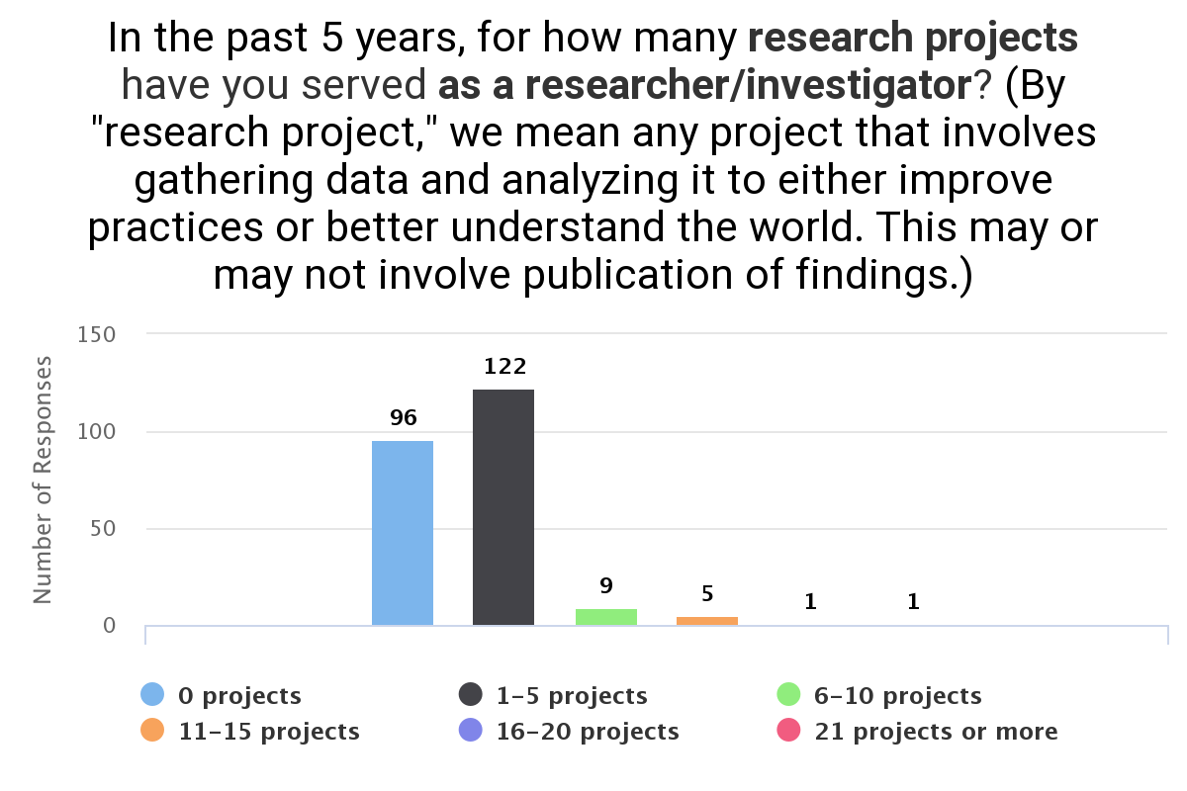
RQ1
Research
n = 234
Notes:
In the past 5 years, for how many research projects have you served as a researcher/investigator?
Observations:
Slightly more than half of individuals had worked on at least one research project (53.14%)
(41.03%) worked on no research projects in the past 5 years
===
The vast majority of our researchers worked on 1-5 projects (88.41% of those who reported any research activity)

Slide 7
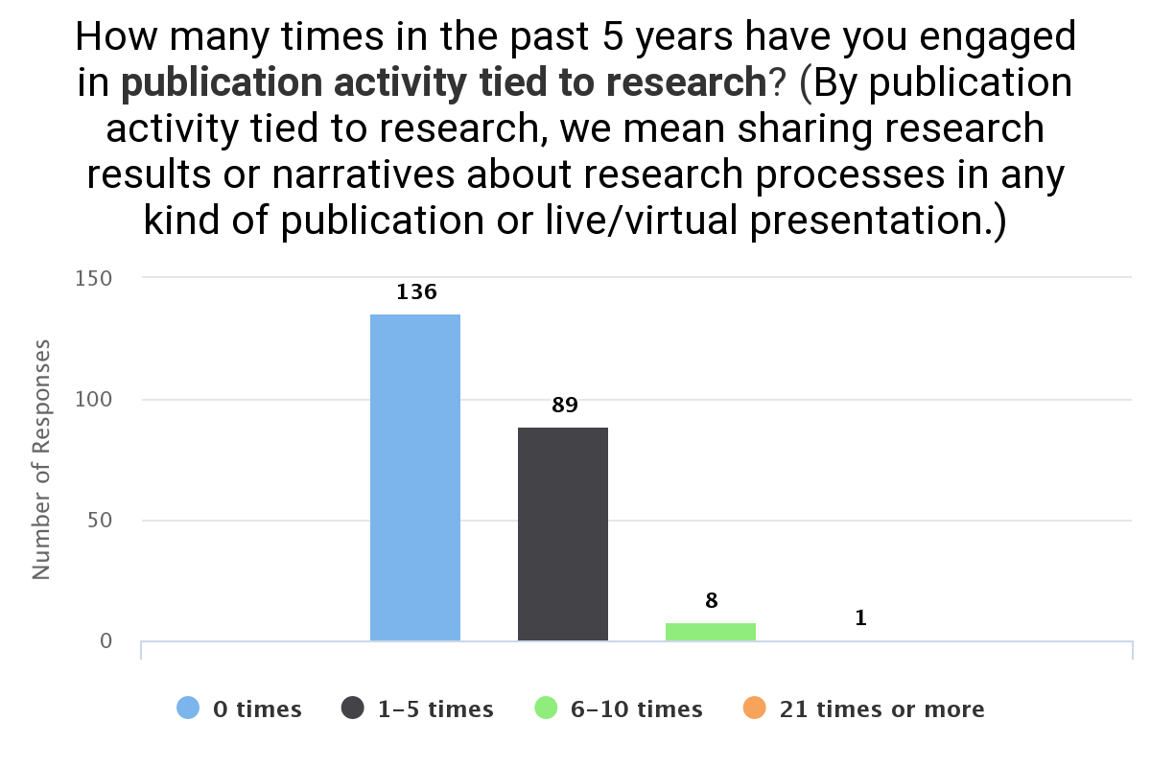
RQ2
Publication
n = 234
Notes:
How many times in the past 5 years have you engaged in publication activity tied to research?
Observations:
As we saw from the earlier slide: more than half of respondents had worked on at least one research project (58.12%),
BUT only about 40% had at least 1 research-related publication/presentation
This means that community college librarians are doing more research than they are publishing or presenting
Some of this research is simply not making it into circulation
Support initiatives aimed at demystifying the publication process could help increase this activity
===
The vast majority of those who publish/present have done so 1-5 times in the past year (90.82%)
Conference presentations where the most frequent mode of sharing research (64.29%)

Slide 8
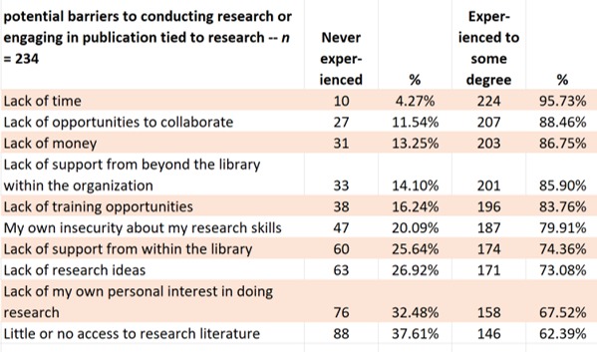
RQ3
Barriers
n = 234
Notes:
Potential barriers to conducting research or engaging in publication tied to research
These potential barriers are listed
most often experienced at the top (lack of time, lack of opportunities to collaborate)
Least often experienced at the bottom (lack of personal interest in doing research, little or no access to the research literature)
Even the least-often experienced barrier was still experienced by over 62% of respondents

Slide 9
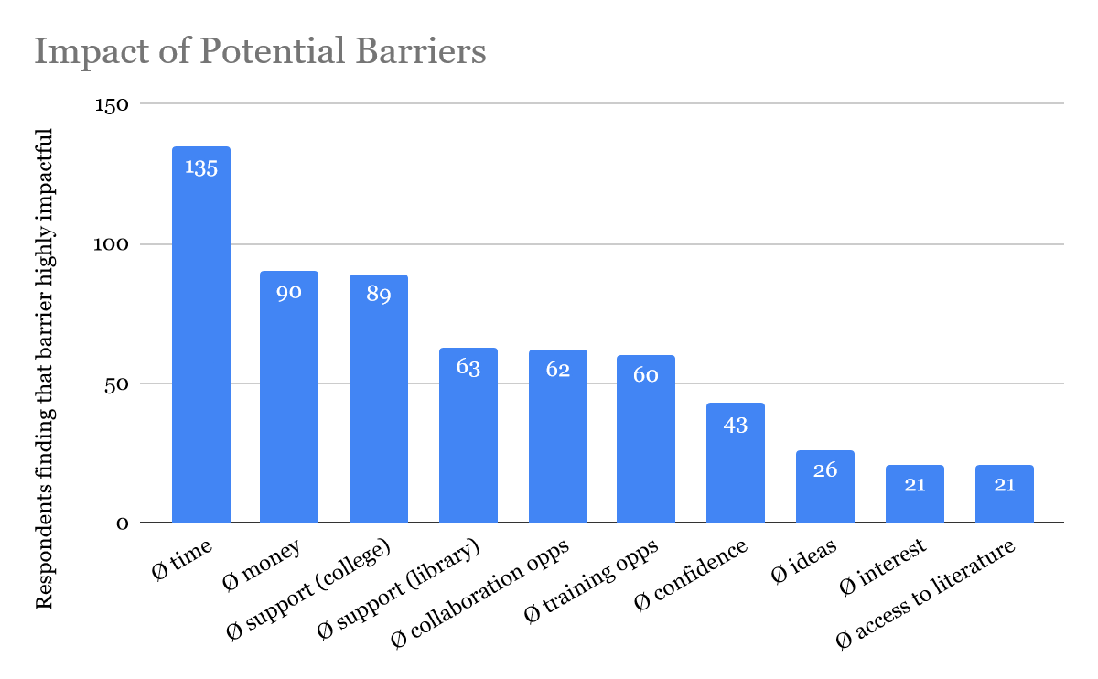
RQ3
Barriers
n = 234
Notes:
How impactful were these barriers? Scale of 1-5 from “minimal impact” to “completely insurmountable”
Lack of time got the highest score again -- almost 16% said this barrier was “completely insurmountable”
Followed by lack of money at almost 15%
And lack of institutional support from beyond the library at nearly 11%
This chart shows the number of respondents who found each barrier highly impactful.
The O symbol signifies “lack of”

Slide 10
RQ3
Barriers
“
There isn't enough time in the day to do my regular job functions, much less more.
Research and publication are not important factors for tenure or promotion at my institution.
I would like to try to do some sort of study, but need mentoring, etc.
I chose to work in a community college because research is not required. I have more than enough to do, so would not pursue additional unpaid work.
Nobody cares about what happens in a community college library.
Notes:
Some things that stood out for us related to barriers from the qualitative data:
Issues related to lack of time and lack of relevance to one’s job are by far the issues most often mentioned in relation to barriers to doing this kind of work -- this includes the concept of having to do this kind of work on their own time
In many community colleges, librarians are scheduled to focus full time on tasks related to library operations
There are work-life balance implications where they need to use evenings and weekends to research and write.
Although it didn’t rank near the top, over 18% of our survey participants talked about lacking confidence in their own research skills
One respondent noted feeling “out of my element even considering being a contributor”

Slide 11
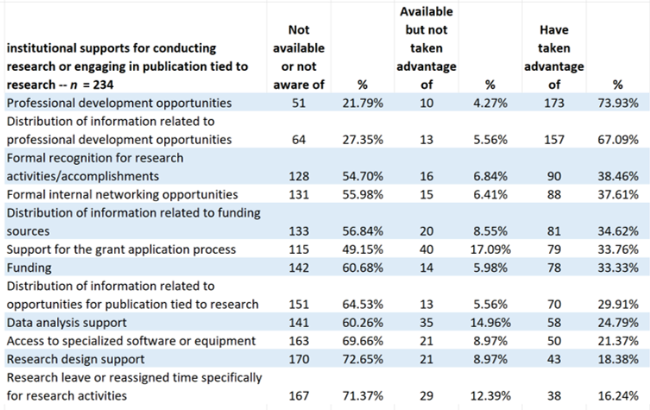
RQ3
Supports
n = 234
Notes:
Institutional supports for conducting research or engaging in publication tied to research
These potential supports for research are listed
most often available/taken advantage of at the top (PD opportunities, info about PD, recognition, networking opportunities)
Least often available/taken advantage of at the bottom (data analysis support, software or equipment, research design support, research leave)

Slide 12
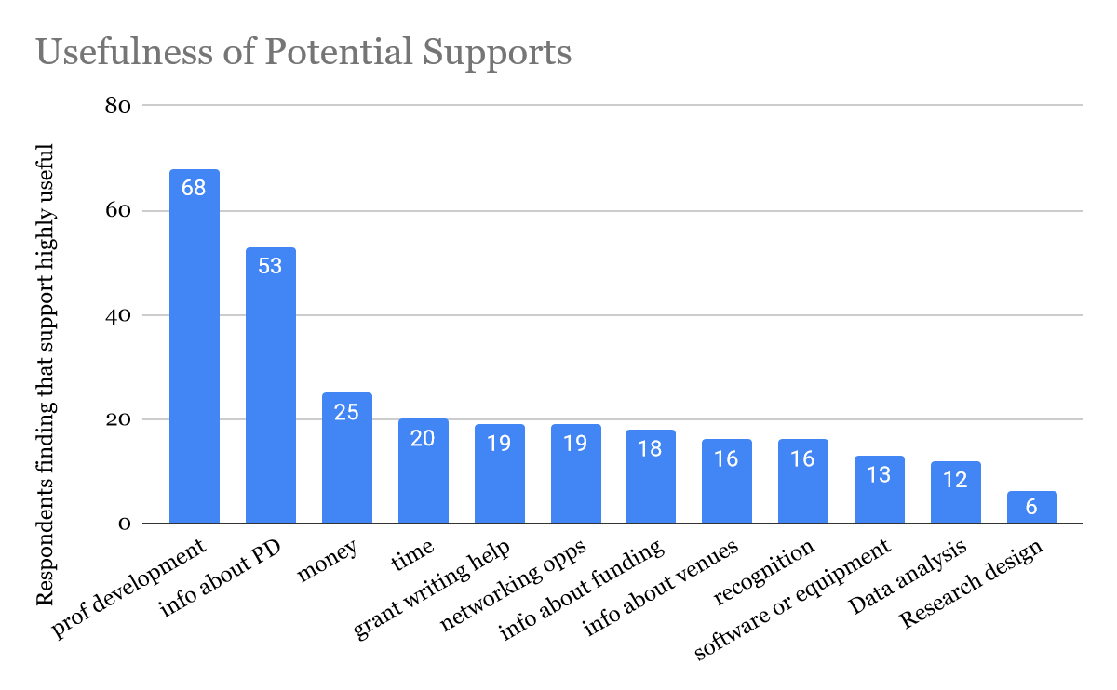
RQ3
Supports
n = 234
Notes:
How useful have these institutional supports been for you? Scale of 1 to 5, from “not useful at all” to “extremely useful”
Professional development opportunities is both the most-often available/taken advantage of support, and the most often deemed “extremely useful” (14.96%)
Followed by availability of info about PD (9.83% extremely useful)
This graph shows the number of respondents who found each of these potentially supports highly useful

Slide 13
RQ3
Supports
“
When my book sold out, my institution allowed me to upload [it] to our digital repository as a free ebook.
What institutional supports?
The supports are narrow and frankly outliers . . . . Institutional supports are token and still leave nearly all the onus on individuals.
For my community college, [their default position] is "protect your budget, keep your head down, protect your fiefdom" rather than "let's identify what the new opportunities are, in the current (and ongoing) chaos"
The library director acts as a gatekeeper who shares opportunities and resources at an individual level. It’s a fundamentally unfair practice.
Notes:
Interestingly, but not surprisingly, the data in this question about supports also contained a lot of commentary about barriers or LACK of supports, rather than supports they might have available.
===
In these data, participants also seemed to open up and provide more detail about their institutional contexts
Or provide more detail about the kind of research that happens in their institutions

Slide 14
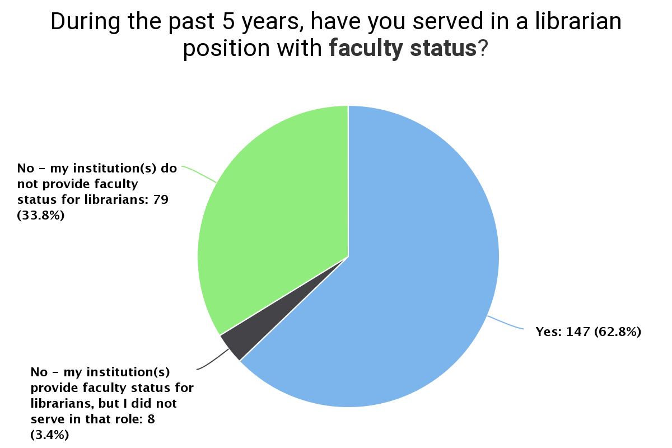
RQ4
Correlation
n = 234
Notes:
During the past 5 years, have you served in a librarian position with faculty status?
Of our 234 respondents:
62.8% have/had faculty status
Another 3.4% were at institutions with faculty status, but did not serve in that role
Just over ⅓ are/were at institutions without faculty librarians

Slide 15
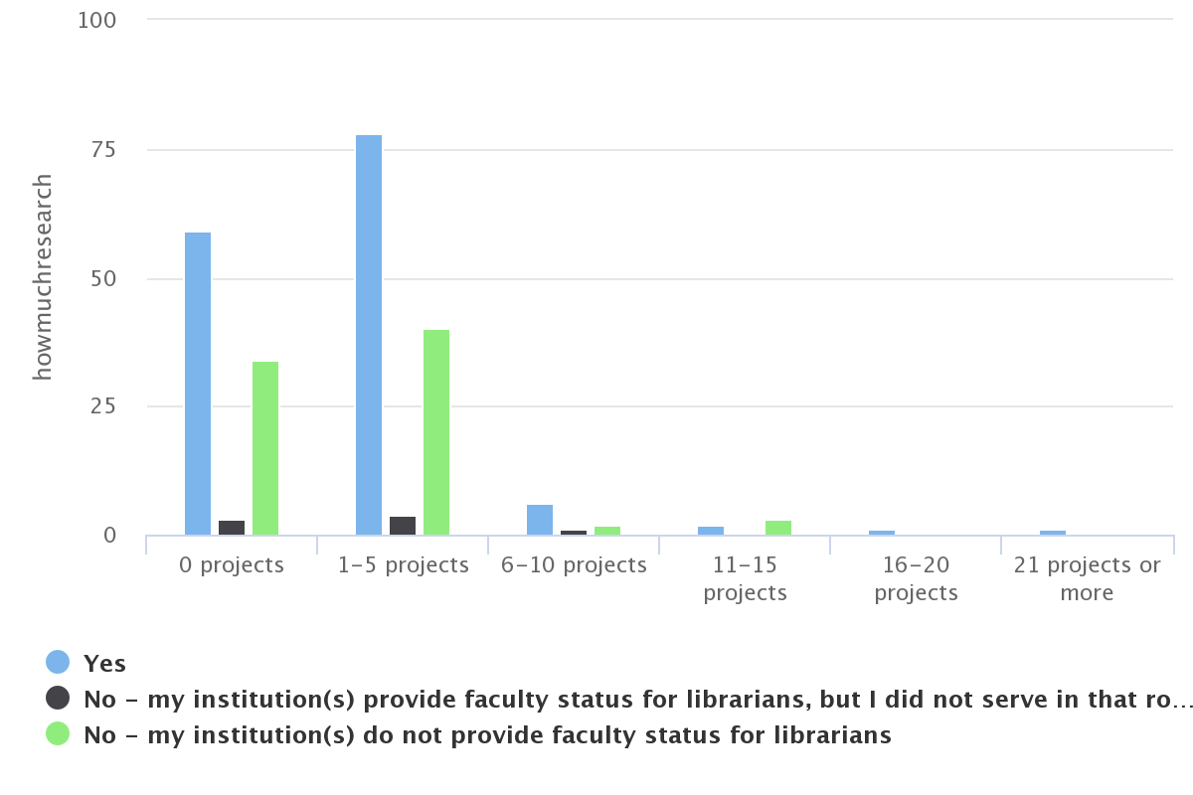
RQ4
Correlation
How many research projects, based on faculty status for librarians
n = 234
Notes:
How many research projects, based on faculty status for librarians
Having faculty status (blue on this chart) makes you slightly more likely to have done research in the past 5 years (nearly 60%)
BUT this means that just over 40% of the librarians with faculty status did NOT work on research projects during that time

Slide 16
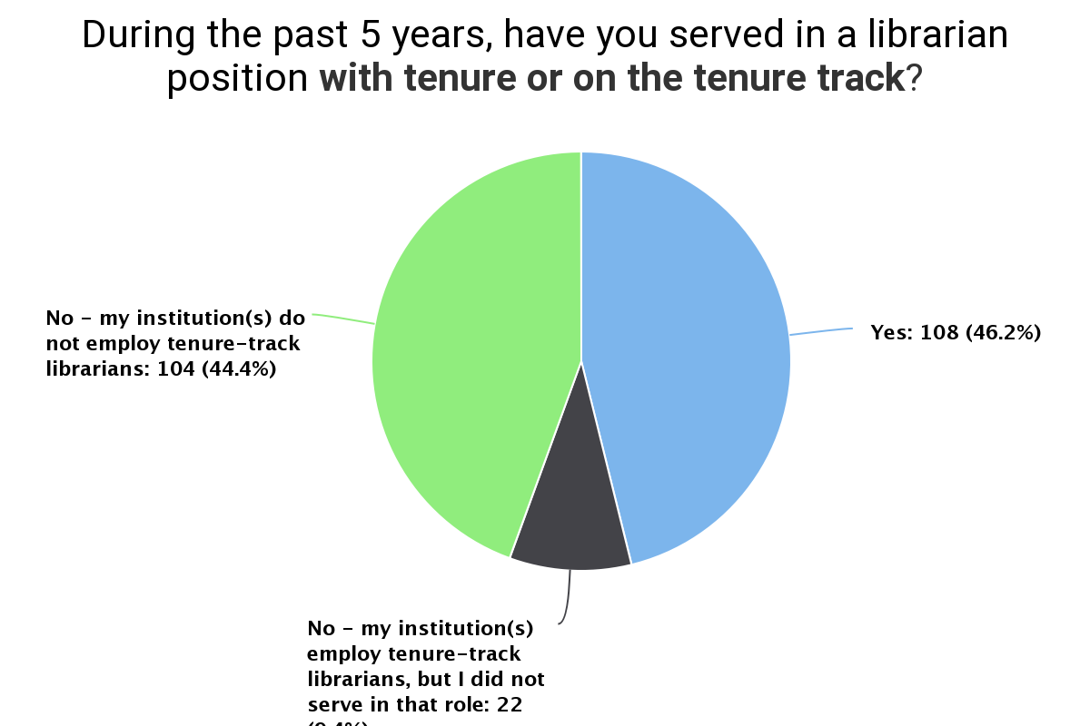
RQ4
Correlation
n = 234
Notes:
During the past 5 years, have you served in a librarian position with tenure or on the tenure track?
Of our 234 respondents:
46.2% have been in tenured or tenure-track positions
Another 9.4% were at institutions with tenure-track librarians, but did not serve in that role
44.4% are/were at institutions without tenure-track librarians

Slide 17
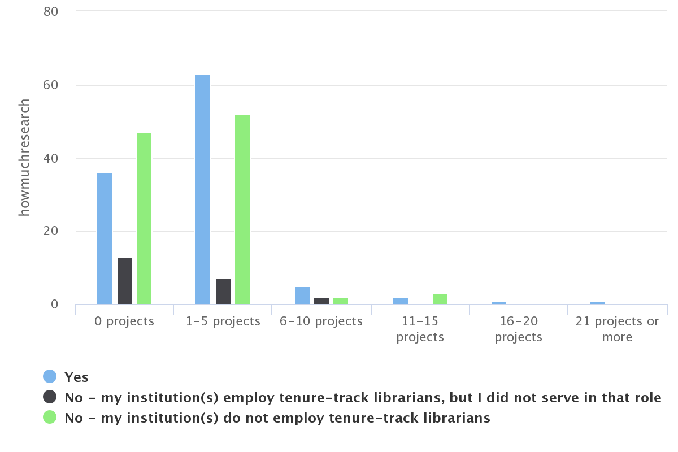
RQ4
Correlation
How many research projects, based on tenure/tenure-track or non-tenure-track positions
n = 234
Notes:
How many research projects, based on tenure/tenure-track or non-tenure-track positions
2 thirds of librarians who are/were tenured or on the tenure track (blue on this chart) did at least one research project in the past 5 years
1/3 of the librarians in this category did NOT work on research projects during that time
It is interesting, but again not surprising, that being in a tenure track position has more impact on this activity than being in a faculty position.

Slide 18
Additional Findings
Respondents who work in technology (66.15%) or library management (61.45%) are most likely to have conducted research, those working in access services (56.34%) are least likely.
Collaboration emerged as an important theme, with 74.64% of those who have conducted research having done so with one or more partners.
Notes:
Additional findings
Respondents who work in technology (66.15%) or library management (61.45%) are most likely to have conducted research, those working in access services (56.34%) are least likely.
Collaboration emerged as an important theme, with 74.64% of those who have conducted research having done so with one or more partners.

Slide 19
Additional Findings
Reported negative institutional responses range from silence, apathy, or lack of encouragement/ expectation for research to antipathy or direct restrictions on participation.
In some contexts, focusing on areas related to one’s regular responsibilities on the job helps legitimize research and dissemination activities.
Notes:
Additional Findings
Reported negative institutional responses range from silence, apathy, or lack of encouragement/ expectation for research to antipathy or direct restrictions on participation.
In some contexts, focusing on areas related to one’s regular responsibilities on the job helps legitimize research and dissemination activities.

Slide 20
Community College Librarians’ Research Practices
Thanks!
Any questions?
You can find us:
Linda Miles - miles.librarian@gmail.com
Robin Brown - rbrown@bmcc.cuny.edu
You can find our research article:
http://tiny.cc/milesbrown
March 5, 2024

