Slide 1
Quantifying Penn's Federally Funded Research, Publications and APCs
Core Chief Collection Development Officers Meeting
June 14, 2023
Holly Zerbe, Assistant University Librarian for Collection Strategy
hzerbe@upenn.edu

Slide 2
Overview
Project Charge and Questions:
How much research at Penn is federally funded?
NSF HERD data
In which publications do Penn researchers publish their federally funded research?
Dimensions Data ​
How much is spent on Open Access APCs by Penn researchers?
Data analysis ​
Impacts/Outcome of data analysis​

Slide 3
Project Overview
Charge
As articulated in the Penn Libraries’ Framework of Values for Collections and Scholarly Communications, the Libraries support broad, open access to scholarly research. Additionally, the White House Office of Science and Technology has released updated policy guidance to make all taxpayer-funded research available to the American public with no embargo and at no cost. This new guidance will:
Eliminate the optional 12-month publication embargo for federally funded peer-reviewed research articles.
Make data published in peer-reviewed research articles immediately available upon publication and other research data available within a reasonable timeframe.
The Libraries should begin exploring options for how it might support Penn researchers in compliance with the publishing requirements of the memo.
Questions
How much research at Penn is federally funded?
In which publications do Penn researchers publish their federally funded research?
How much is spent on Open Access APCs by Penn researchers?

Slide 4
How much Research at Penn is federally funded?
NSF Higher Education Research and Development (HERD) Survey
https://ncses.nsf.gov/pubs/nsf23304
Table 22
Higher education R&D expenditures, ranked by all R&D expenditures, by source of funds: FY 2021
(Dollars in thousands)
Institution | Rank | All R&D expenditures |  | Source of funds
 |  |  |  | Federal government |  | State and local government |  | Institution funds |  | Business |  | Nonprofit organizations |  | All other sources
All institutions | - | 89,723,447 |  | 49,143,460 |  | 4,736,015 |  | 22,448,362 |  | 5,115,480 |  | 5,590,273 |  | 2,689,857
Johns Hopkins U.ª | 1 | 3,181,385 |  | 2,774,643 |  | 4,677 |  | 147,355 |  | 103,162 |  | 145,027 |  | 6,521
U. California, San Francisco | 2 | 1,710,036 |  | 683,179 |  | 33,056 |  | 418,589 |  | 128,370 |  | 254,406 |  | 192,436
U. Michigan, Ann Arbor | 3 | 1,639,645 |  | 891,125 |  | 2,066 |  | 581,768 |  | 91,117 |  | 63,650 |  | 9,919
U. Pennsylvania | 4 | 1,631,950 |  | 792,089 |  | 20,733 |  | 511,958 |  | 190,755 |  | 111,885 |  | 4,530
U. Washington, Seattle | 5 | 1,488,645 |  | 1,046,377 |  | 21,877 |  | 105,070 |  | 54,751 |  | 212,584 |  | 47,986
U. California, Los Angeles | 6 | 1,454,880 |  | 721,043 |  | 71,014 |  | 302,528 |  | 87,959 |  | 194,232 |  | 78,104
U. California, San Diego | 7 | 1,425,499 |  | 801,117 |  | 51,346 |  | 250,863 |  | 85,003 |  | 87,380 |  | 149,790
U. Wisconsin-Madison | 8 | 1,380,075 |  | 646,764 |  | 135,923 |  | 412,540 |  | 31,502 |  | 117,817 |  | 35,529
Stanford U. | 9 | 1,274,483 |  | 811,183 |  | 17,802 |  | 136,444 |  | 113,691 |  | 186,565 |  | 8,798
Harvard U. | 10 | 1,254,008 |  | 616,589 |  | 5,137 |  | 384,197 |  | 55,357 |  | 172,327 |  | 20,401

Slide 5
Table 25
Federally financed higher education R&D expenditures, ranked by all federal R&D expenditures, by R&D field: FY 2021
(Dollars in thousands)
Institution | Rank | All R&D expenditures |  | Computer and information sciences |  | Geosciences, atmospheric sciences, and ocean sciences |  | Life sciences |  | Mathematics and statistics |  | Physical sciences |  | Psychology |  | Social sciences |  | Sciences nec |  | Engineering |  | All non-S&E fields
All institutions | - | 49,143,460 |  | 1,994,728 |  | 2,145,163 |  | 28,452,956 |  | 475,827 |  | 3,852,415 |  | 812,660 |  | 955,852 |  | 374,088 |  | 8,714,829 |  | 1,364,942
Johns Hopkins U.ª | 1 | 2,774,643 |  | 258,141 |  | 73,509 |  | 765,565 |  | 113,772 |  | 321,641 |  | 5,471 |  | 2,726 |  | 48,543 |  | 1,183,154 |  | 2,121
U. Washington, Seattle | 2 | 1,046,377 |  | 17,605 |  | 105,493 |  | 683,132 |  | 5,223 |  | 52,053 |  | 9,989 |  | 6,899 |  | 0 |  | 119,758 |  | 46,225
U. Michigan, Ann Arbor | 3 | 891,125 |  | 5,841 |  | 7,910 |  | 549,127 |  | 5,490 |  | 38,670 |  | 6,813 |  | 85,904 |  | 1,805 |  | 180,607 |  | 8,958
Georgia Institute of Technology | 4 | 852,319 |  | 121,473 |  | 7,744 |  | 11,713 |  | 3,808 |  | 22,213 |  | 1,944 |  | 3,055 |  | 0 |  | 666,235 |  | 14,134
Columbia U. in the City of New York | 5 | 831,648 |  | 24,889 |  | 53,955 |  | 611,343 |  | 2,190 |  | 40,994 |  | 3,688 |  | 2,513 |  | 0 |  | 64,962 |  | 27,114
Stanford U. | 6 | 811,183 |  | 14,181 |  | 8,901 |  | 578,172 |  | 5,209 |  | 72,190 |  | 10,678 |  | 5,926 |  | 0 |  | 89,861 |  | 26,065
U. California, San Diego | 7 | 801,117 |  | 18,932 |  | 107,137 |  | 465,019 |  | 2,995 |  | 54,485 |  | 13,008 |  | 5,282 |  | 6,414 |  | 100,212 |  | 27,633
U. Pennsylvania | 8 | 792,089 |  | 16,523 |  | 749 |  | 644,430 |  | 3,206 |  | 39,630 |  | 9,265 |  | 12,742 |  | 1 |  | 49,526 |  | 16,017
Duke U. | 9 | 776,632 |  | 4,468 |  | 5,406 |  | 638,716 |  | 6,364 |  | 19,826 |  | 4,657 |  | 21,294 |  | 7 |  | 74,308 |  | 1,586
U. North Carolina, Chapel Hill | 10 | 747,895 |  | 27,834 |  | 11,575 |  | 569,385 |  | 4,735 |  | 25,924 |  | 24,136 |  | 43,473 |  | 0 |  | 19,983 |  | 20,850

Slide 6
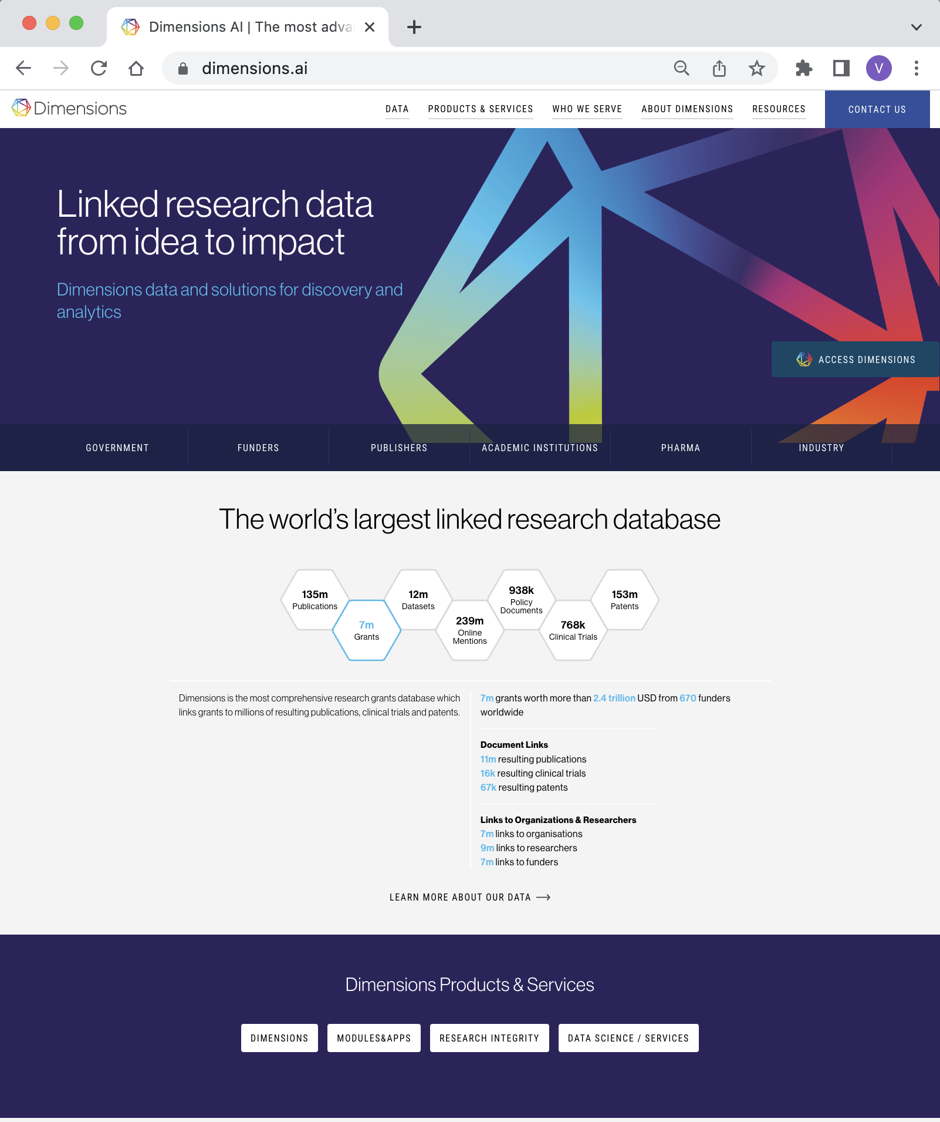
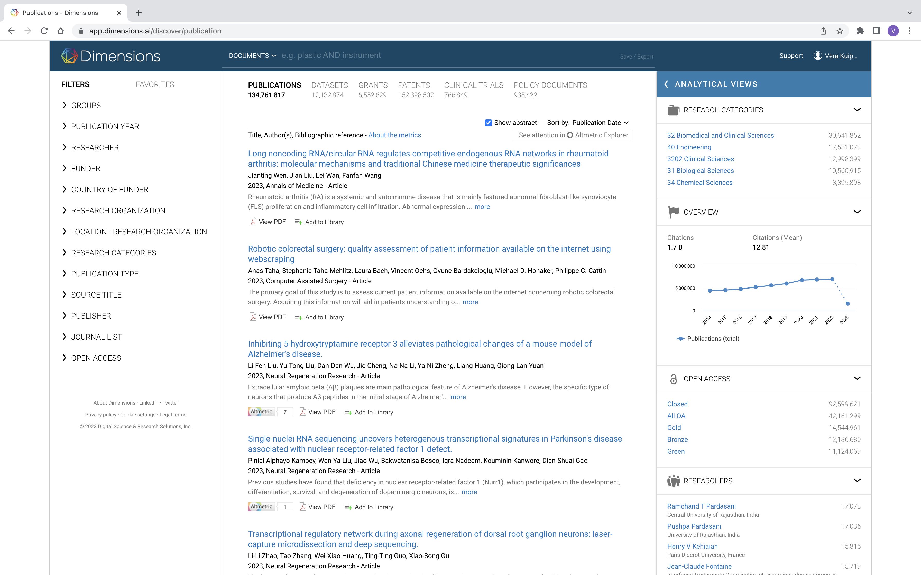
Dimensions https://www.dimensions.ai

Slide 7
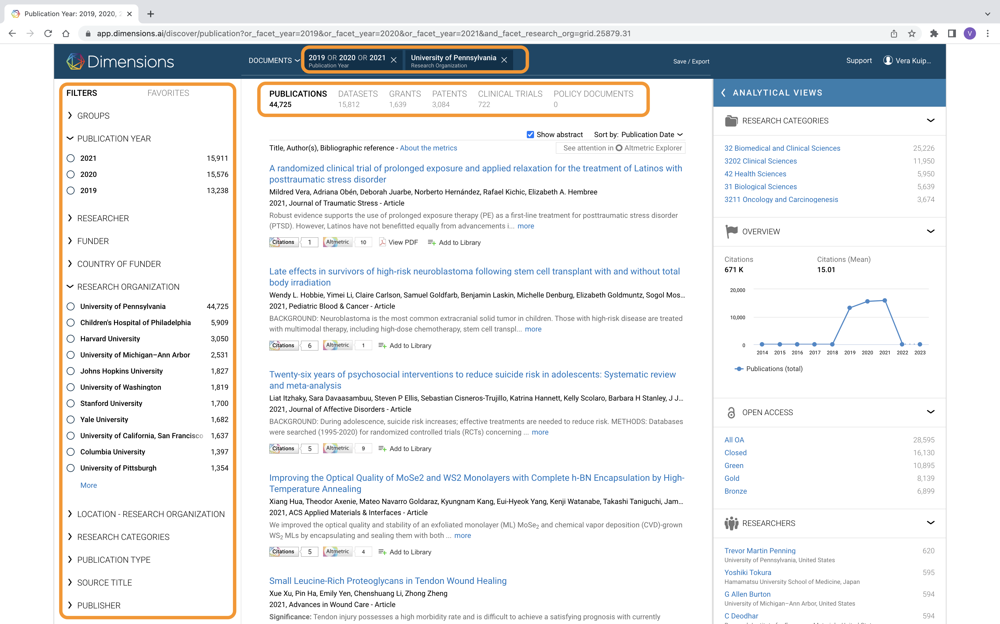

Slide 8
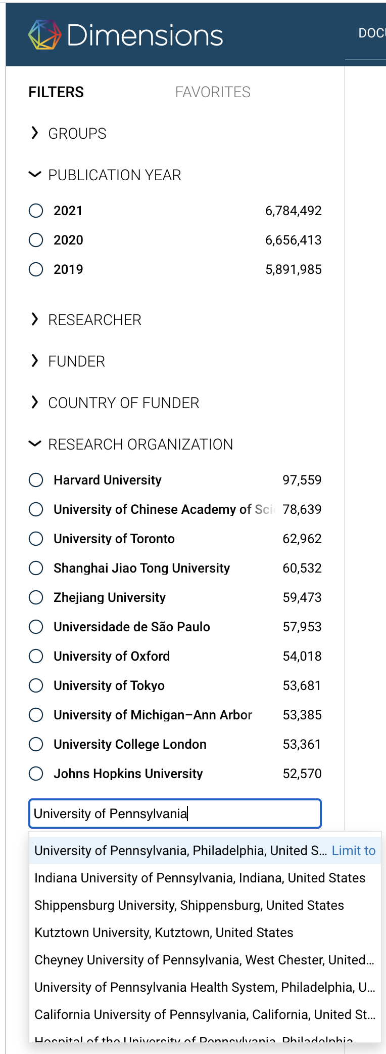
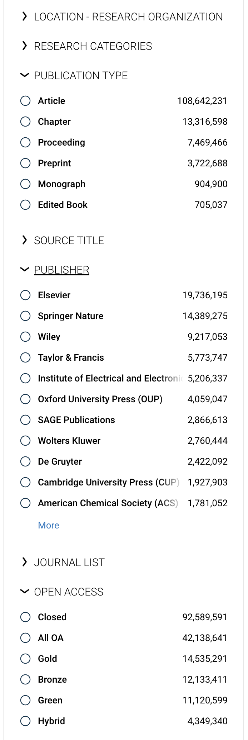

Slide 9
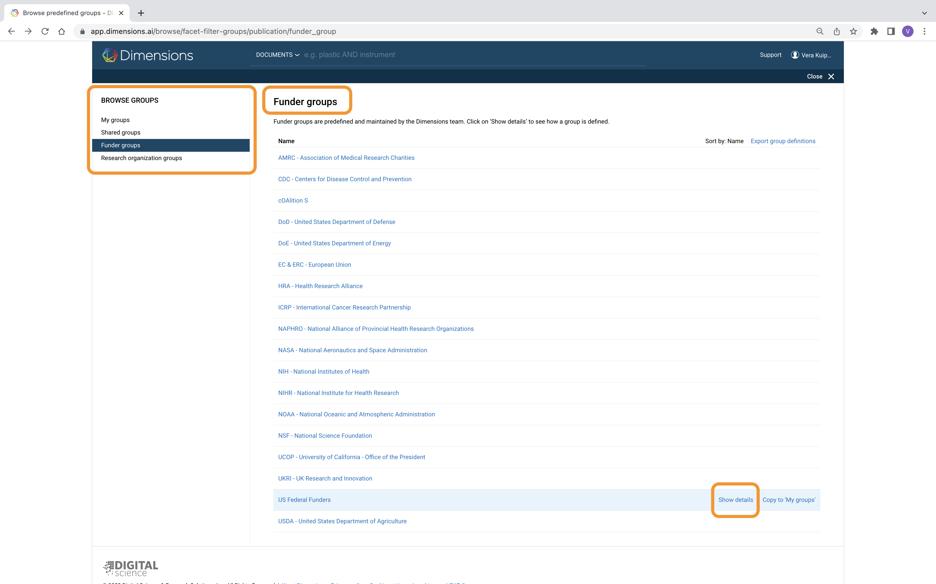
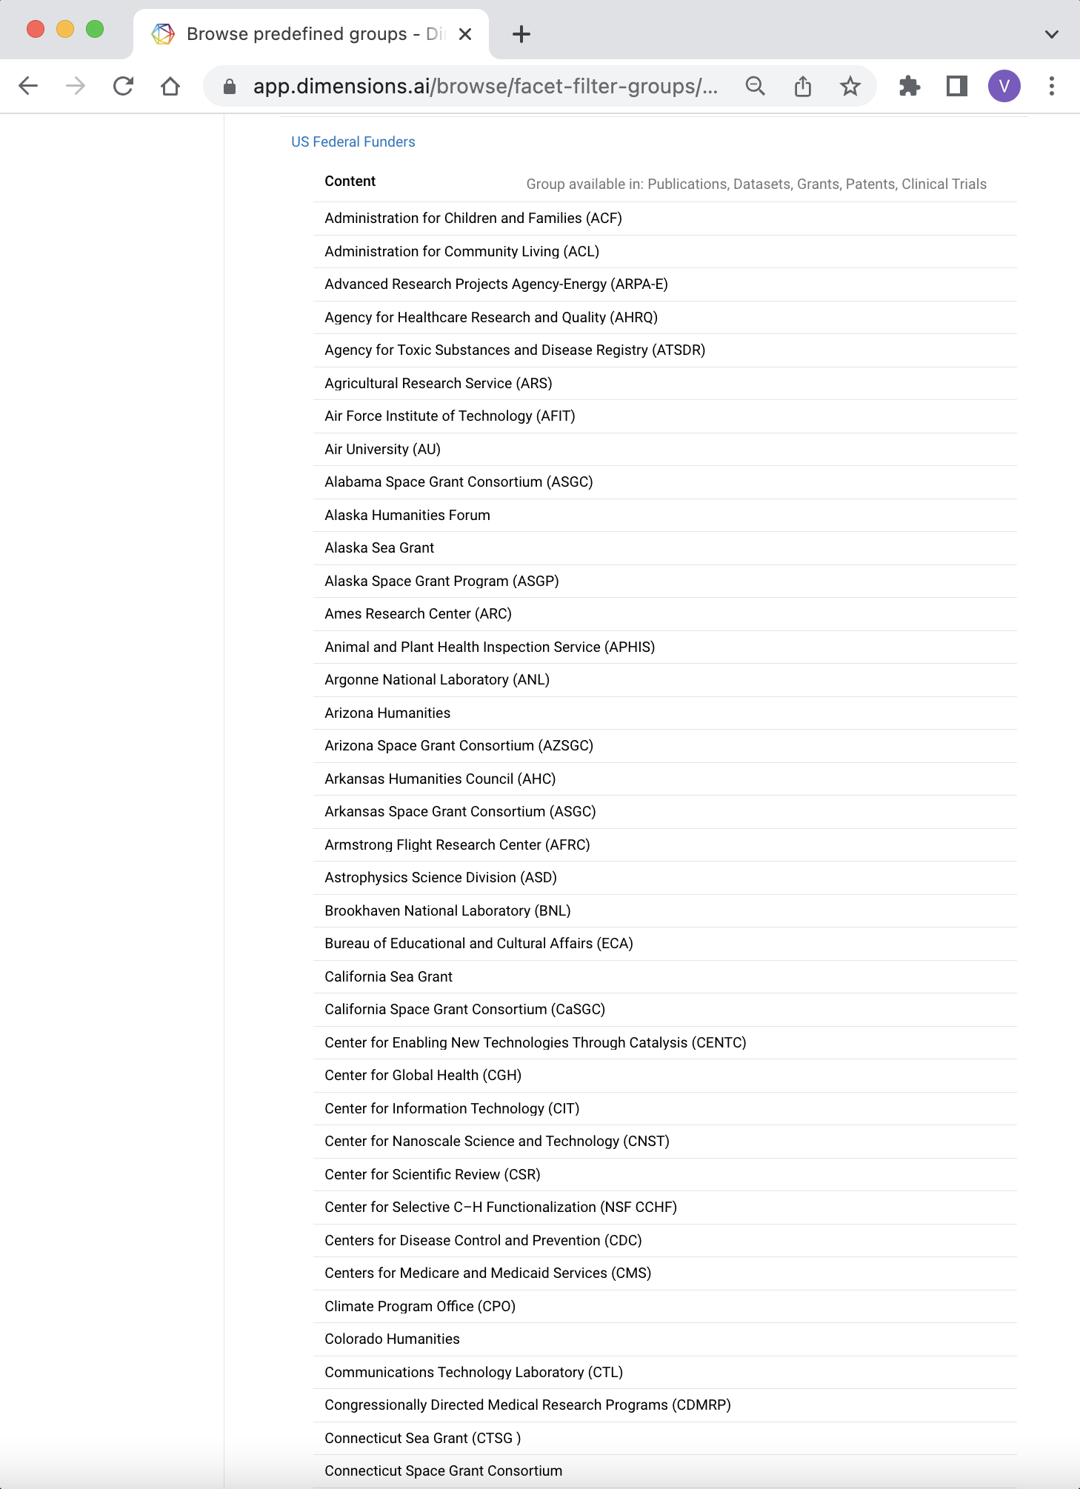

Slide 10
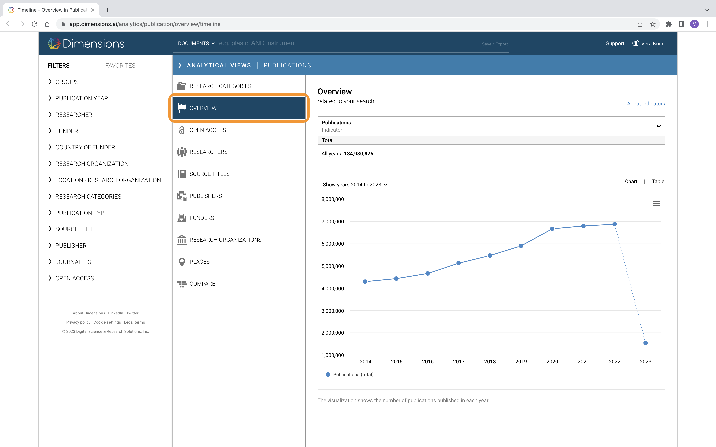

Slide 11
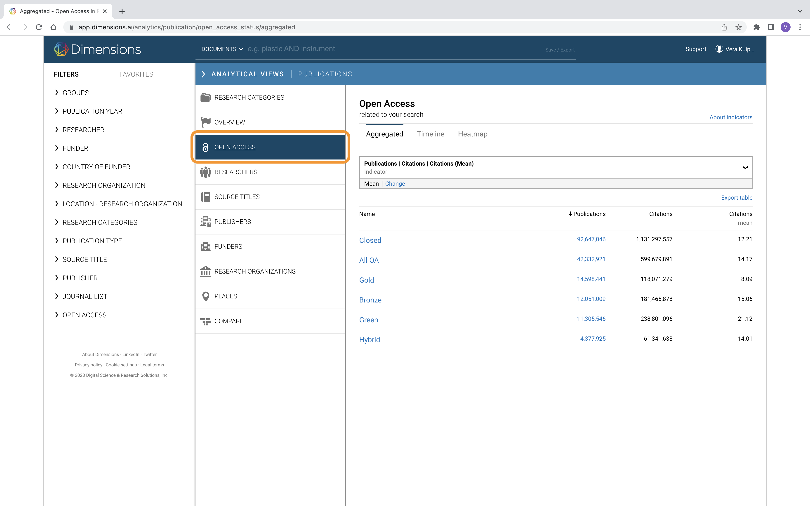

Slide 12
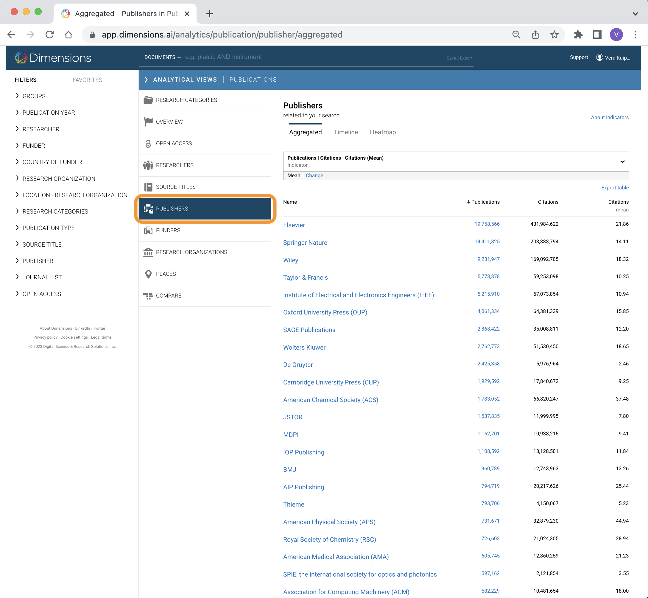

Slide 13
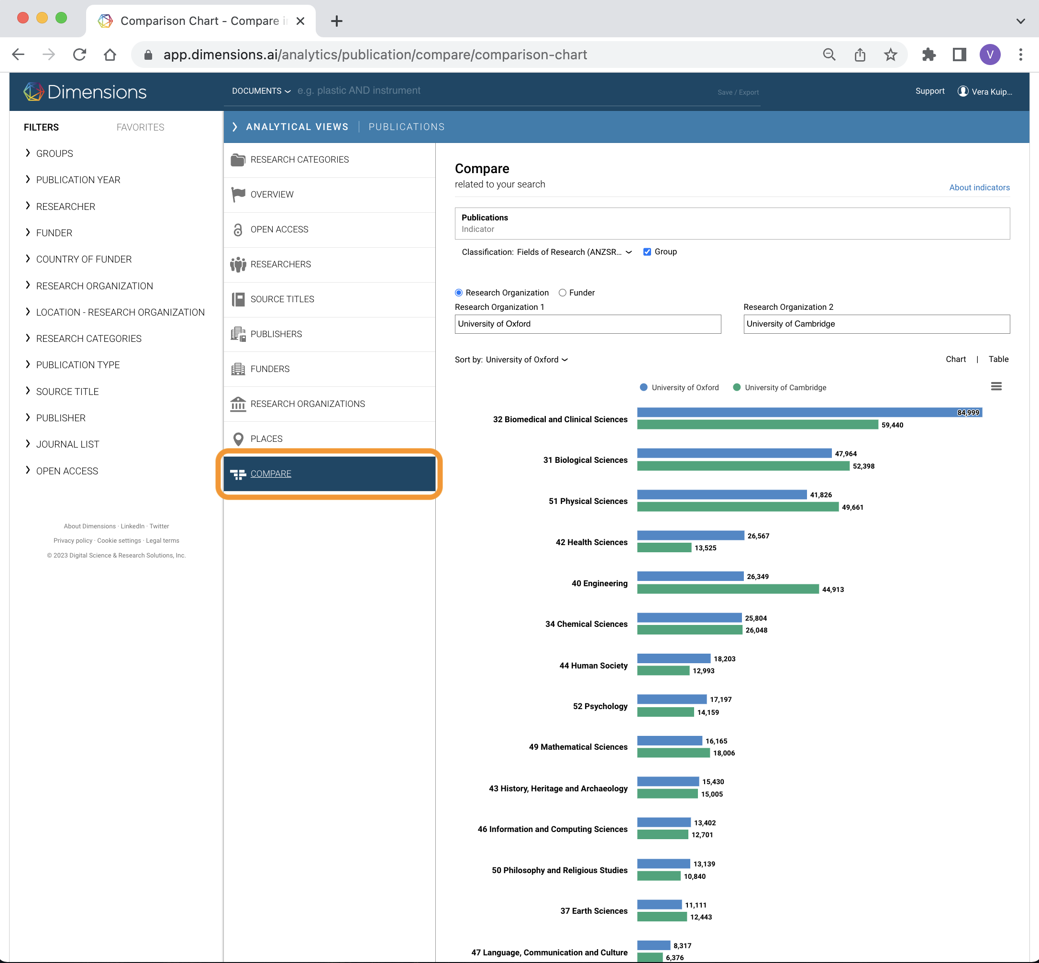

Slide 14
FILTERS applied to the Dimensions dataset:
Research Organization: University of Pennsylvania
Publication Year: 2019, 2020, and 2021
Publication Type: Article, Chapter, and Proceeding (excluded Monograph and Preprint)
Funder: US Federal Funder
Author:
either Corresponding Author from University of Pennsylvania
OR
ONE of the first TWO authors in Authors Affiliations are from University of Pennsylvania

Slide 16
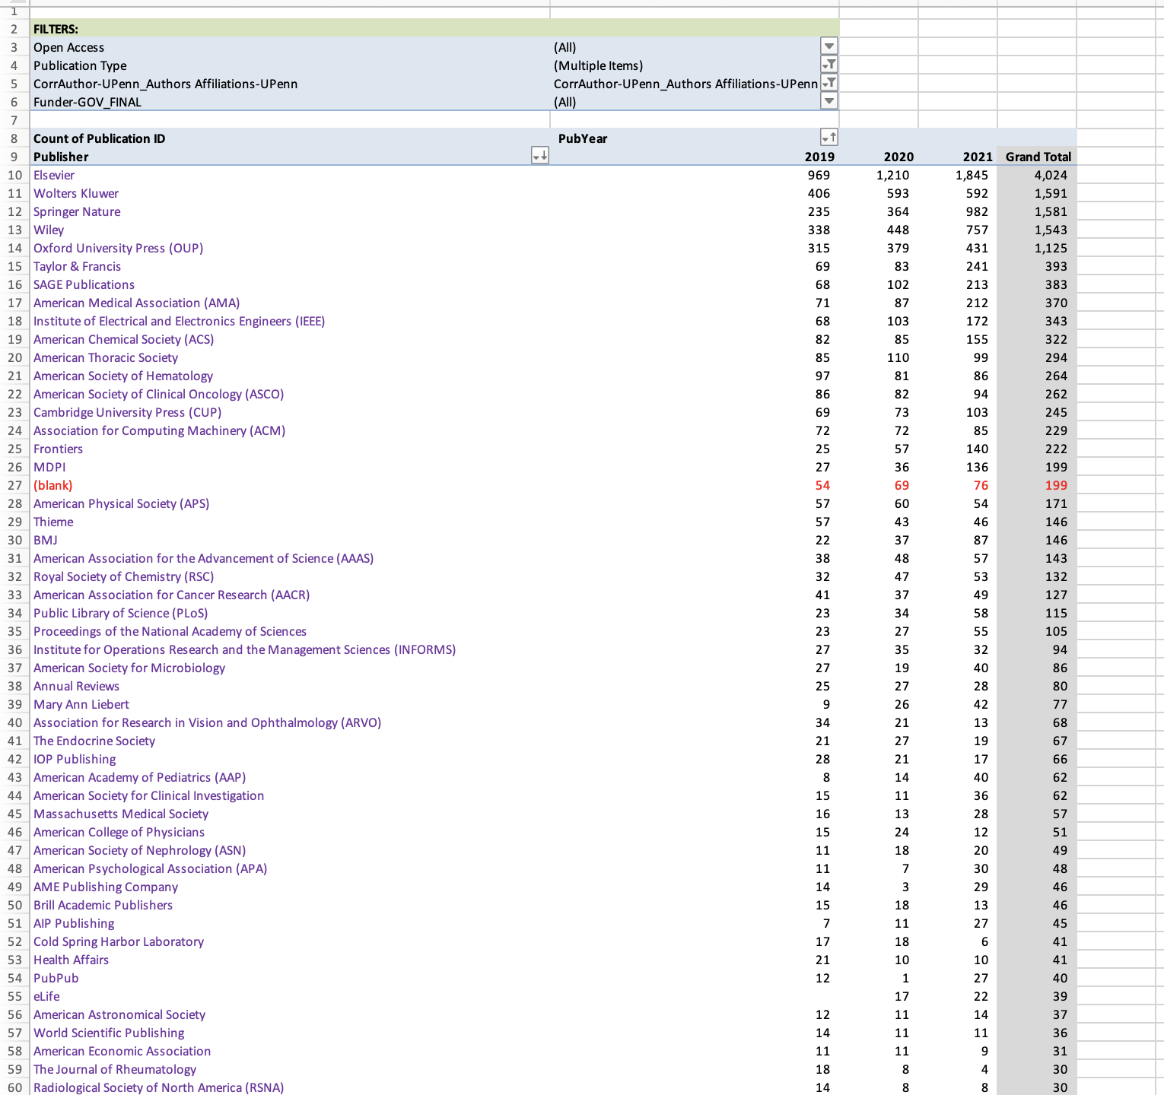
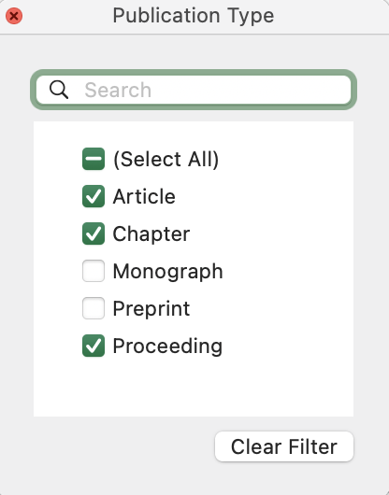

Slide 17
Proportion of federally funded publications
 | 2019 | 2020 | 2021 | Total
Total Publications | 4,249 | 5,185 | 8,037 | 17,471
Federally funded publications | 1,550 | 2,012 | 3,510 | 7,072
% of publications that will need to comply with OSTP guidelines | 36% | 39% | 44% | 40%

Slide 18
Where do Penn researchers publish their federally funded research?
Top Publishers
Publisher | 2019 | 2020 | 2021 | 3-year total | % of total
Elsevier | 252 | 392 | 767 | 1,411 | 20%
SpringerNature | 141 | 198 | 476 | 815 | 12%
Wiley | 142 | 167 | 350 | 659 | 9%
Wolters Kluwer | 118 | 184 | 164 | 466 | 7%
Oxford (OUP) | 105 | 125 | 168 | 397 | 6%
ACS | 77 | 77 | 135 | 289 | 4%
IEEE | 42 | 65 | 116 | 223 | 3%
ACM | 53 | 44 | 58 | 155 | 2%
Frontiers | 21 | 33 | 86 | 140 | 2%
T&F | 28 | 30 | 77 | 135 | 2%
Publisher | 2019 | 2020 | 2021 | 3-year total | % of total
APS | 38 | 48 | 48 | 134 | 2%
MDPI | 12 | 25 | 75 | 127 | 2%
AMA | 27 | 25 | 75 | 127 | 2%
RSC | 24 | 41 | 51 | 116 | 2%
AACR | 36 | 33 | 46 | 115 | 2%
SAGE | 18 | 24 | 71 | 113 | 2%
AAAS | 29 | 33 | 43 | 105 | 1%
PNAS | 22 | 33 | 43 | 88 | 1%
PLOS | 19 | 25 | 41 | 81 | 1%
Total | 1,204 | 1,591 | 2,906 | 5,697 | 81%

Slide 19
Where do Penn researchers publish their federally funded research?
Top Publications
Journal Title | Publisher | Total Articles 2019-2021
Proceedings of the National Academy of Sciences | PNAS | 88
Nature Communications | Springer | 86
Scientific Reports | Springer | 69
Journal of Clinical Oncology | ASCO | 52
JAMA Network Open | AMA | 48
Neurology | Ovid | 43
PLOS One | PLoS | 43
Physical Review D | APS | 42
Journal of the American Academy of Dermatology | Elsevier | 39
Journal Title | Publisher | Total Articles 2019-2021
Science | AAAS | 39
Cell Reports | Elsevier | 38
Clinical Cancer Research | AACR | 35
Critical Care Medicine | Ovid | 33
Physical Review Letters | APS | 33
Science Advances | AAAS | 32
Journal of the American Chemical Society | ACS | 31
Soft Matter | RSC | 30
Monthly Notices of the Royal Astronomical Society | OUP | 29

Slide 20
How much is spent on OA APCs by Penn Researchers?

Slide 21
How much is spent on OA APCs by Penn Researchers?
In 2021 from our top publishers
46% federally funded
53% of federally funded published OA
24% of total published OA
These 25 vendors represent 86% of our total federally funded publications
Overall, Penn authors independently spent $5.9M on APCs

Slide 22
Impacts/Outcomes of data analysis
The future is murky!
Illuminating to see how much we’re paying in APCs
Data will inform decision making in contract negotiations and prioritization
Value proposition for additional funding?
Values Framework - Sustainability
Little guidance from University but increasing pressure for the Libraries to “solve” the problems they see
Together, we're figuring it out

Slide 23
Thank you!
Holly Zerbe
Assistant University Librarian for Collection Strategy
hzerbe@upenn.edu

