Slide 1
Exploring the Use of Wikidata: Highlights of a Sabbatical Project
Lori Robare
University of Oregon Libraries

Slide 2
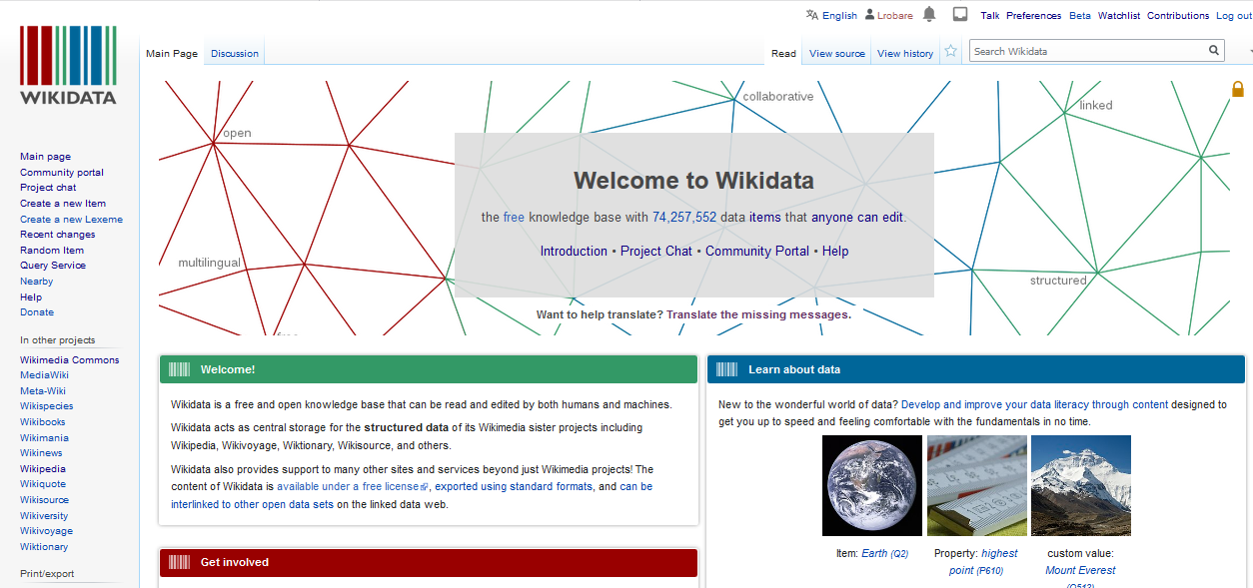

Slide 3
Wikidata is structured data
Like Wikipedia:
Part of the Wikimedia Foundation suite of projects
Free, open, collaborative
Anyone with an account can edit
Unlike Wikipedia:
Structured linked open data
Can be read and edited by both humans and machines
Much data has been imported from Wikipedia and other sources
Multilingual in the true sense: one data store with different language interfaces
Potential to be a linking hub for identifiers

Slide 4
Items, Properties, Statements
Repository consists mainly of items
Each item is uniquely identified by a “Q” number
(Ideally) Each item has a label, description, may have aliases
Statements
Describe individual facts -- detailed characteristics of an item
Consist of a property and a value; (ideally) backed up by references
Properties
Can be thought of as a category of data
Each property is uniquely identified by a “P” number

Slide 5
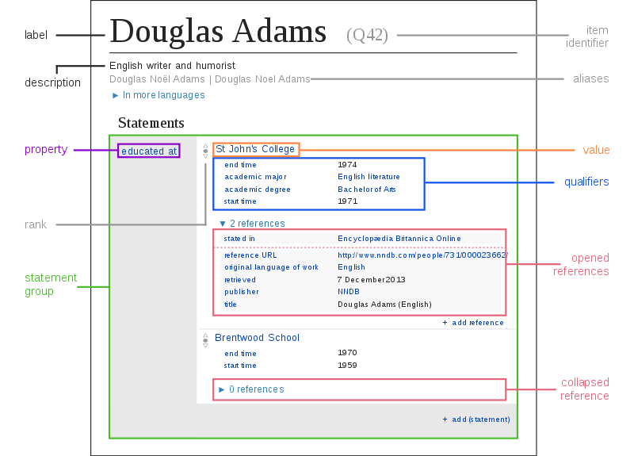
Image by Charlie Kritschmar, CC0

Slide 6
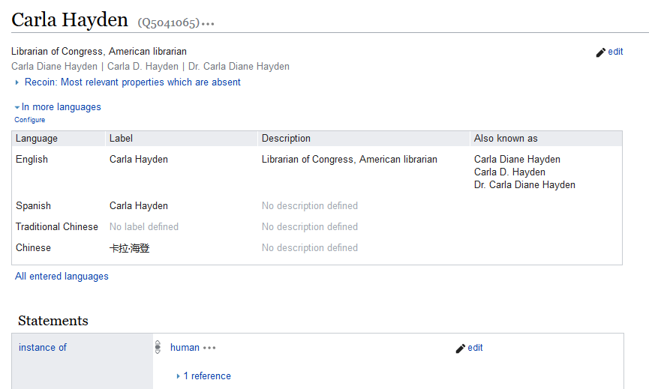
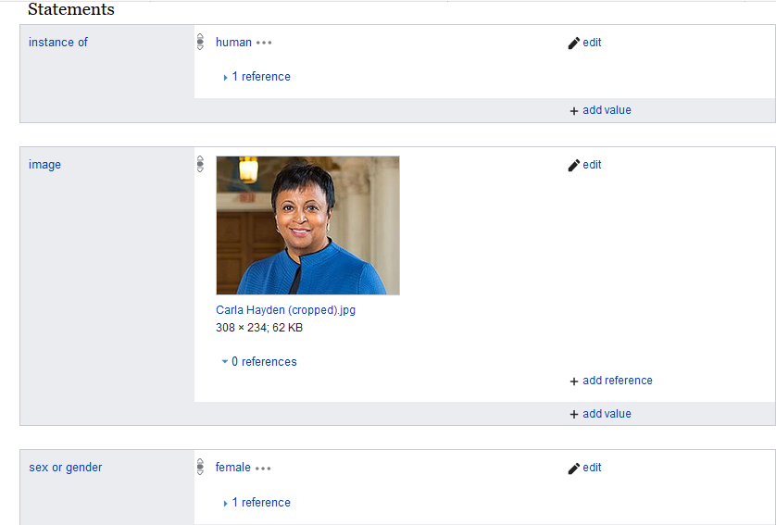
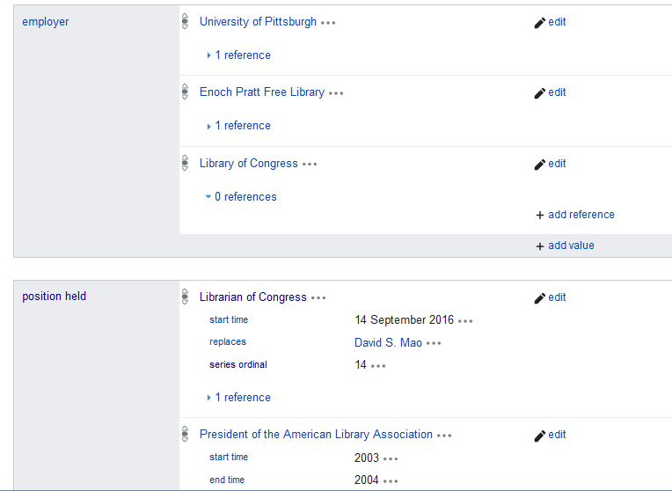
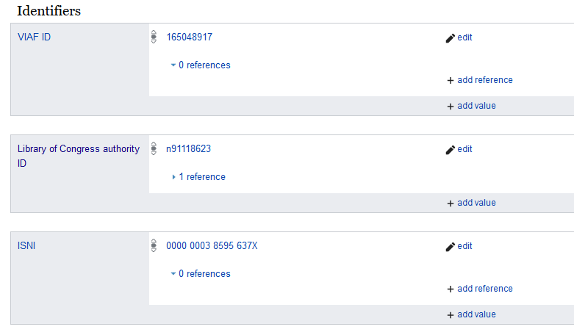

Slide 7
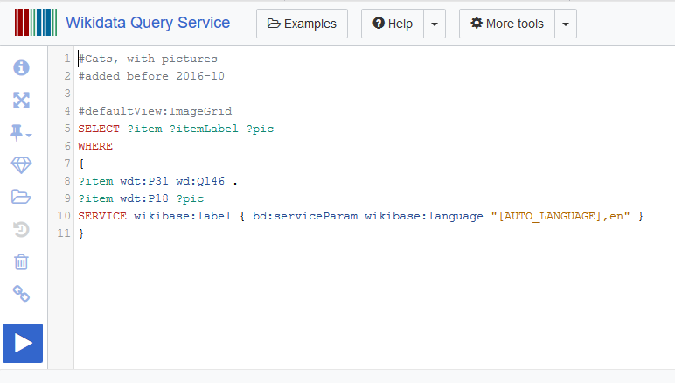
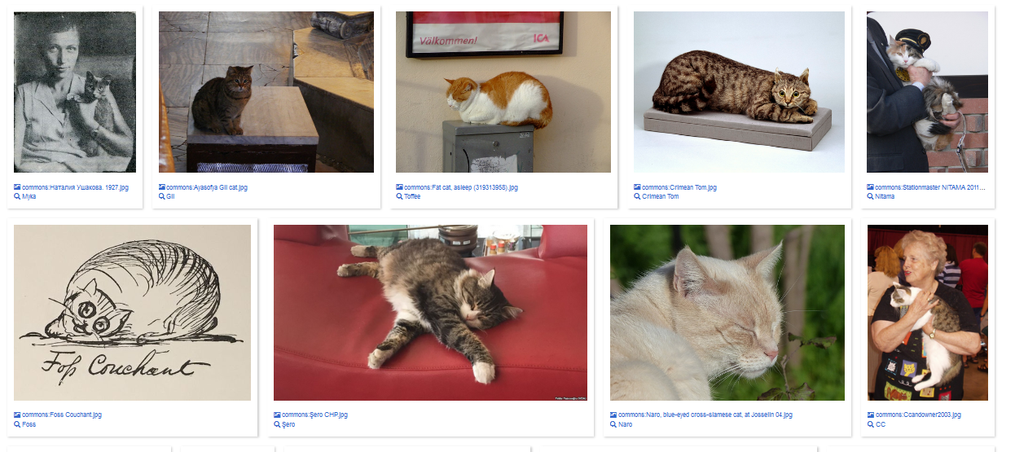

Slide 8
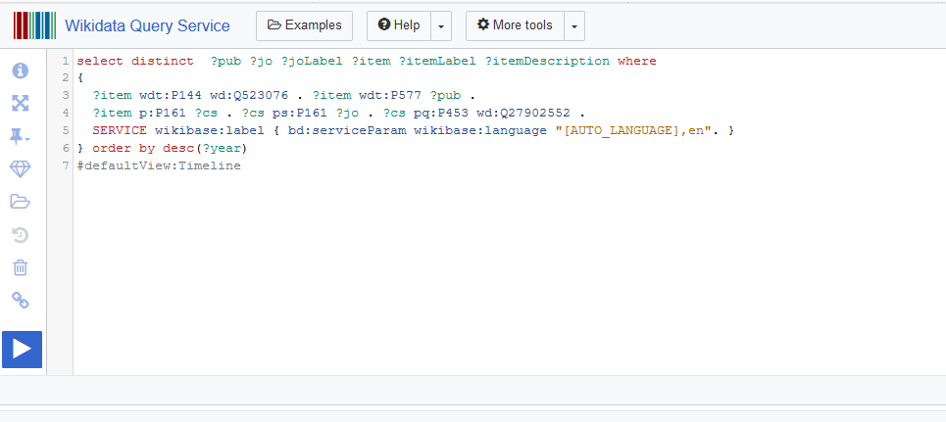
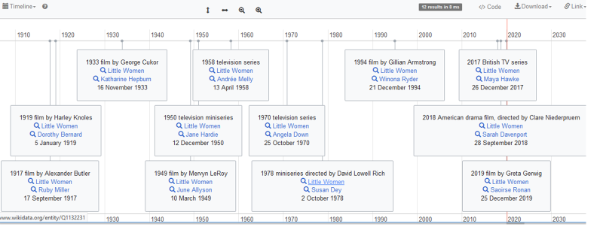
Timeline of adaptations of Little Women and actresses who played Jo

Slide 9
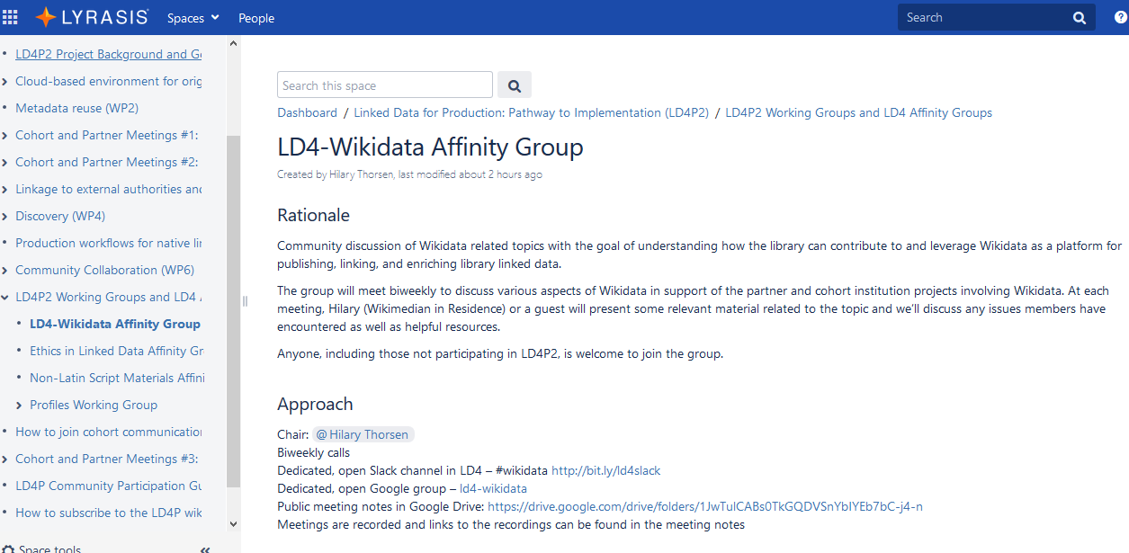
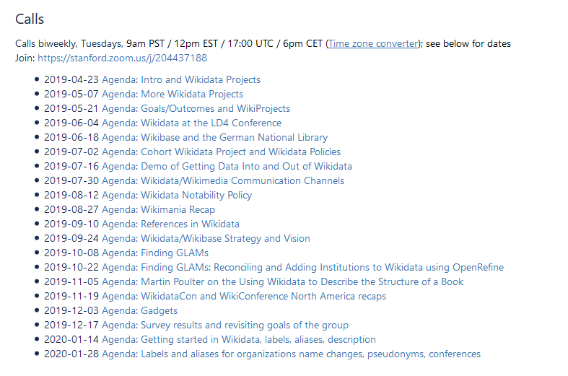

Slide 10
ARL White Paper on Wikidata: Opportunities and Recommendations April 18, 2019
For individual librarians:
Use and experiment with Wikidata, for example:
Contribute local name authorities, particularly for underrepresented creators and organizations
Add institutional holdings to existing Wikidata items using the “archives at” property
Create items for faculty in an institution
Explore and experiment with Wikidata editing tools
Create a “hub of hubs” for authority control, metadata vocabularies, and other data sources
Get involved in the greater Wikimedia community

Slide 11
My sabbatical project goals
Explore the use of Wikidata for identity management, beyond traditional authority control
Raise the profiles of people, organizations, entities important to the university and to Oregon generally by:
Creating structured data about them and their works in Wikidata
Connecting this data to identifiers in other registries
Particular focus on underrepresented groups

Slide 12
Mini-projects
Oregon generally
Women mayors in Oregon
Oregon Book Awards winners
State parks: adding LC authority IDs
UO Libraries (data describing all libraries)
“archives at”
Open access journals
UO
Presidents
Faculty

Slide 13
General approach
Exploring data models and best practices, querying and batch editing tools
No attempt to be comprehensive in contributing data in most categories
Following developments and community discussions
Adding identifiers whenever possible
LC authority numbers, ORCID, ISNI
Adding “educated at” routinely

Slide 14
Exploring tools – for editing, querying, visualizing data
Wikidata Query Service
VizQuery
SQID
Tabernacle
Reasonator
Quick Statements
Orcidator
OpenRefine

Slide 15
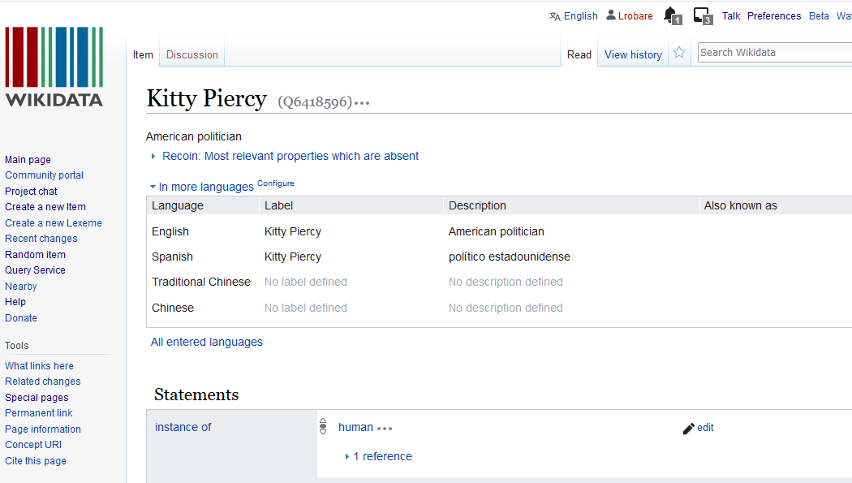
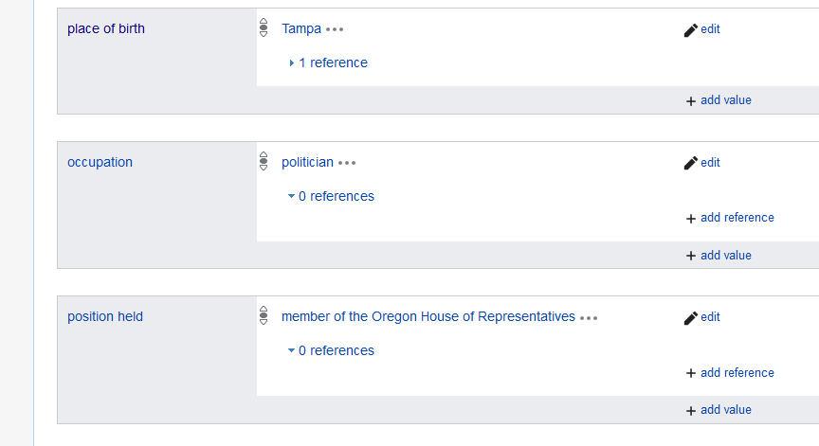

Slide 16
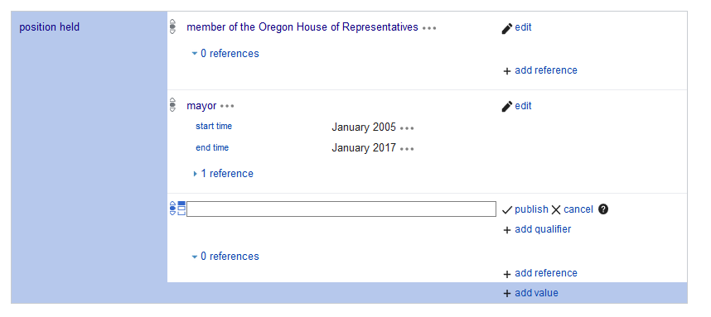

Slide 17
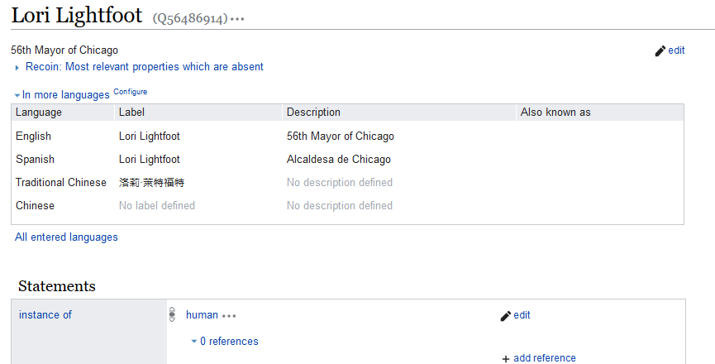
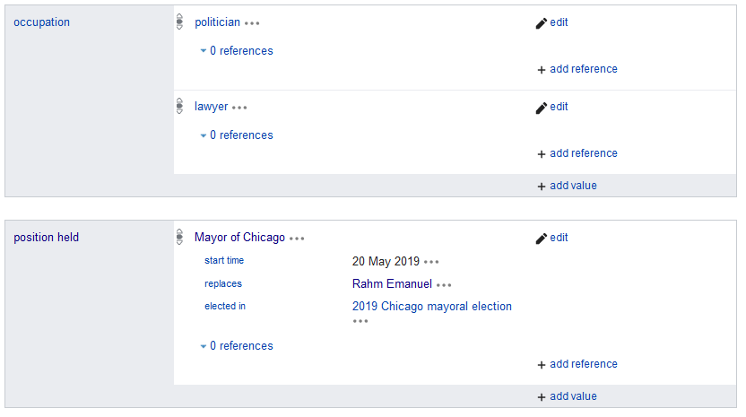

Slide 18
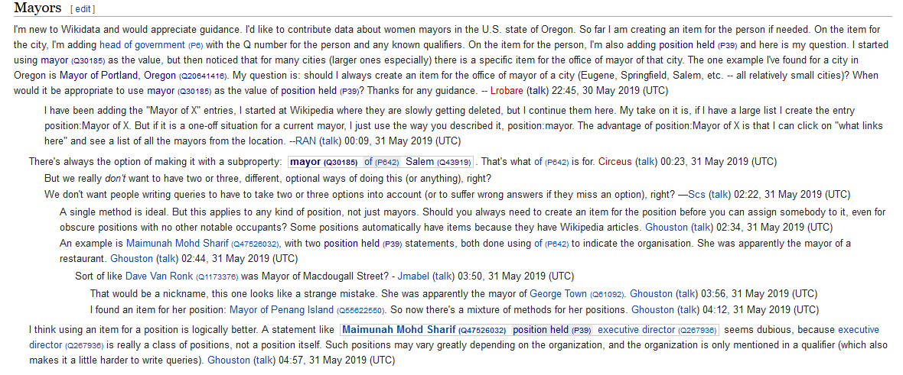

Slide 19
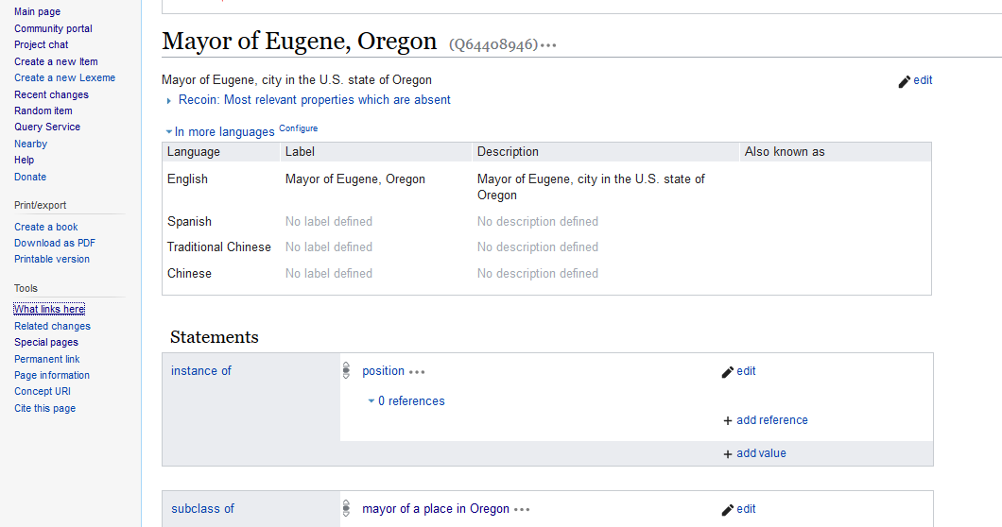
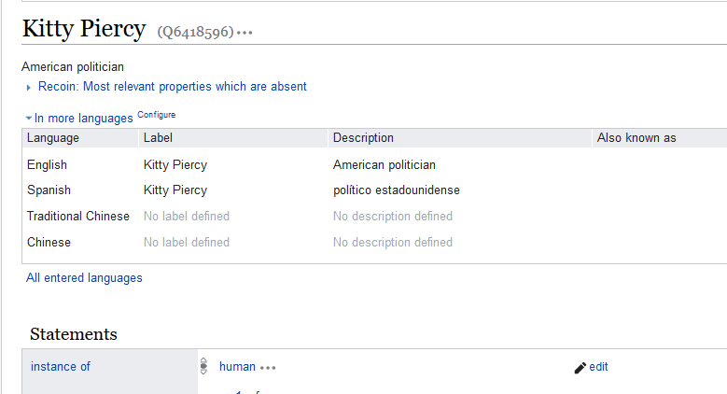
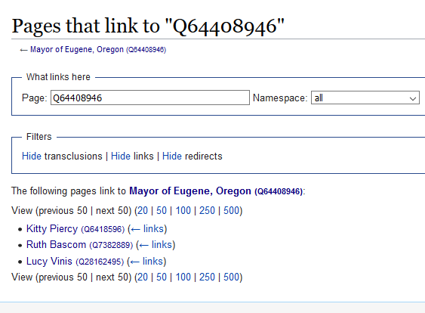

Slide 20
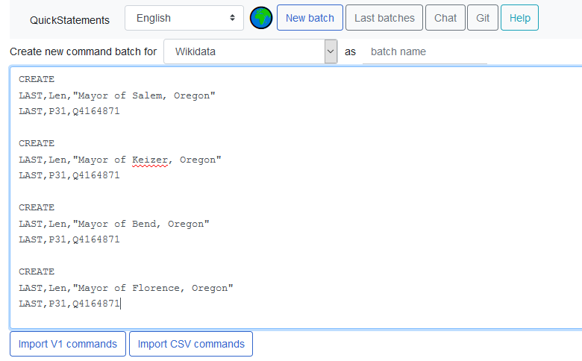
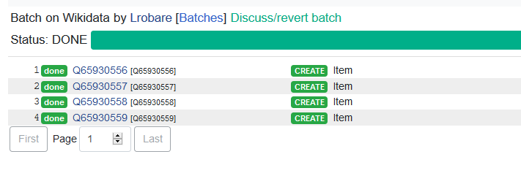

Slide 21
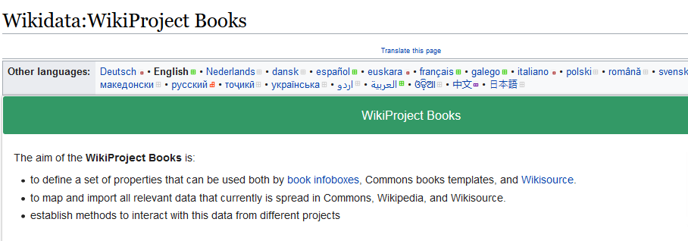
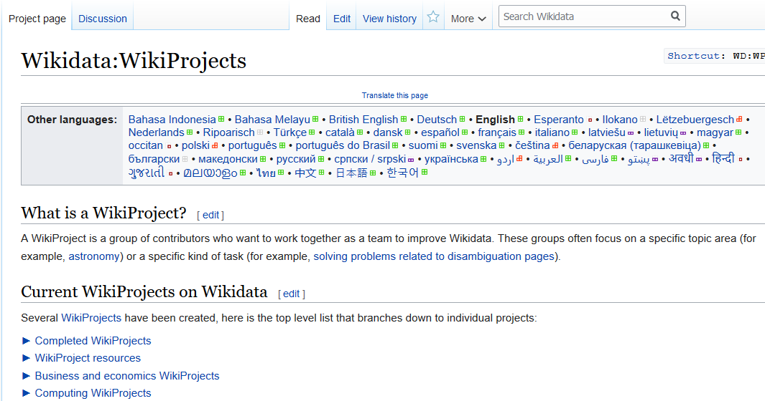
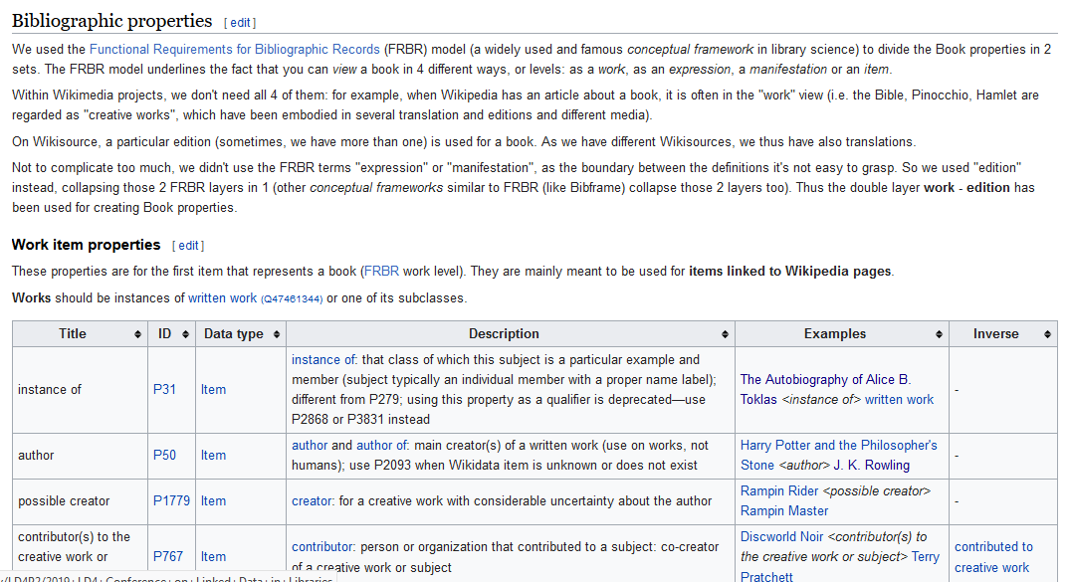

Slide 22
Oregon Book Awards winners
Existing: Oregon Book Award; instance of: award
Data modeling:
Actually a group of awards (one for fiction, one for poetry, etc.)
Awards were named after a person at some point in time
WikiProject:Books had guidelines for data about books
WikiProject:Award had good guidance for group of awards/recipient

Slide 24
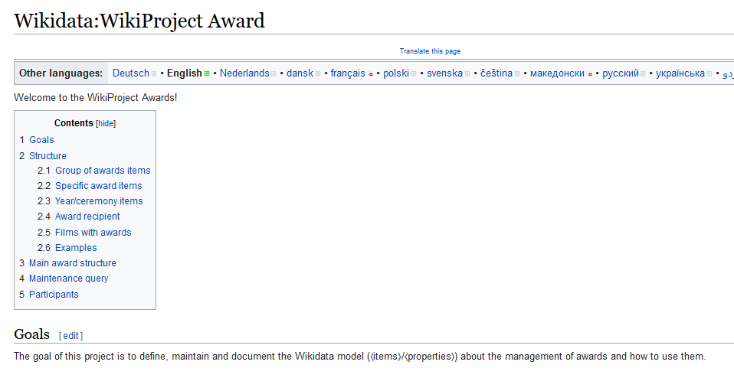
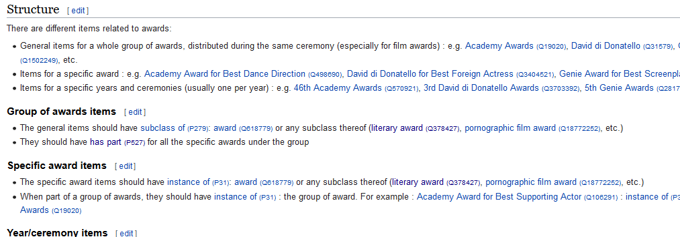

Slide 25
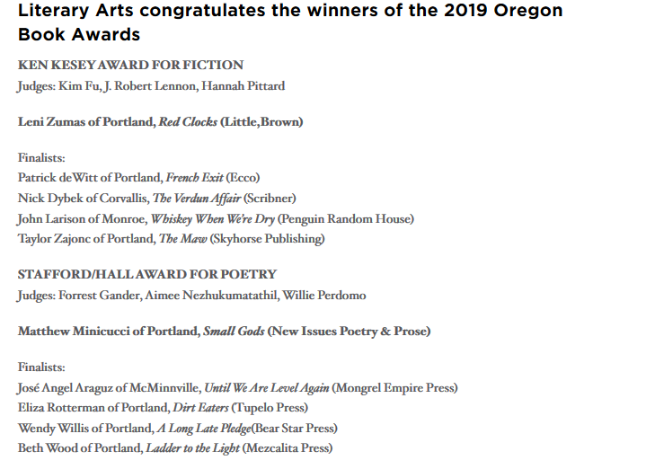

Slide 26
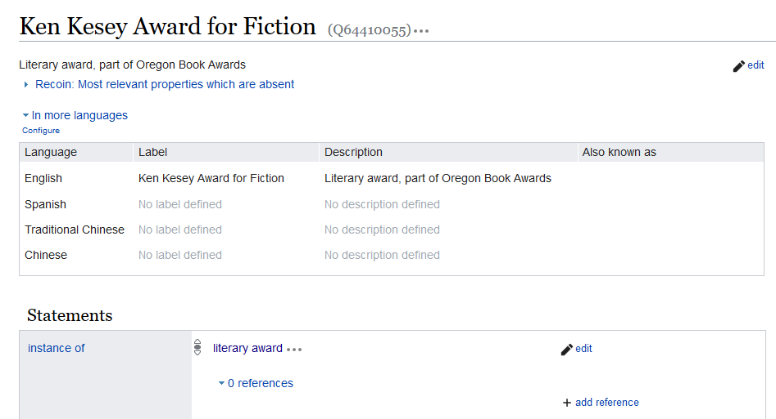
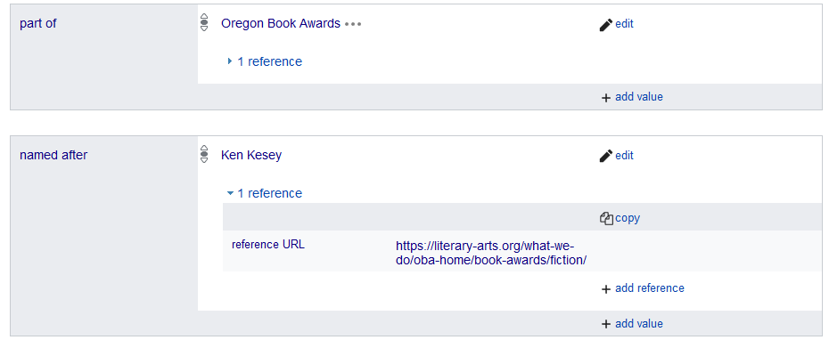

Slide 27
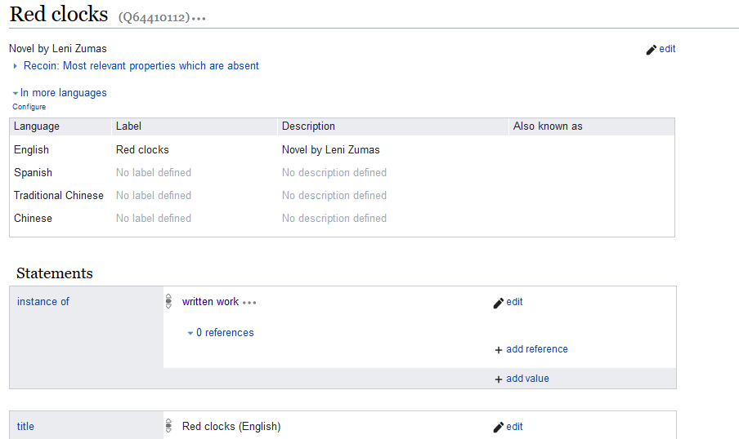
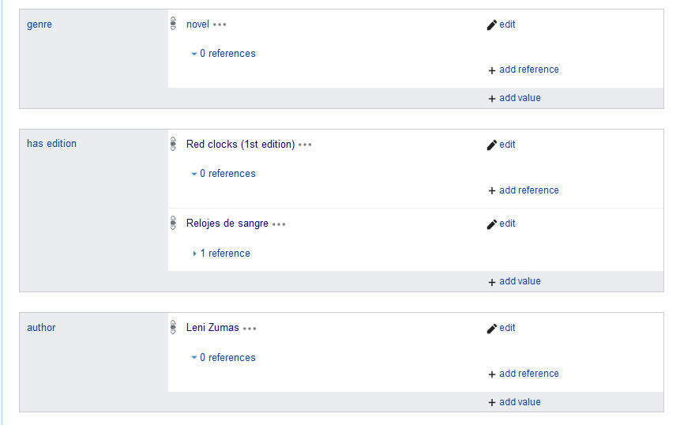
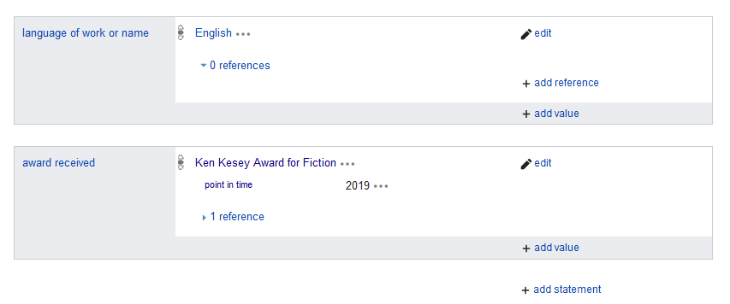

Slide 28
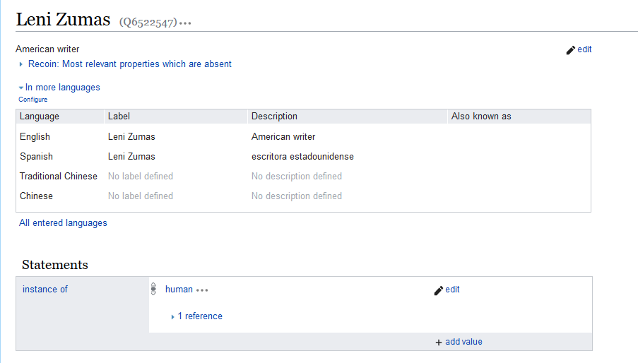
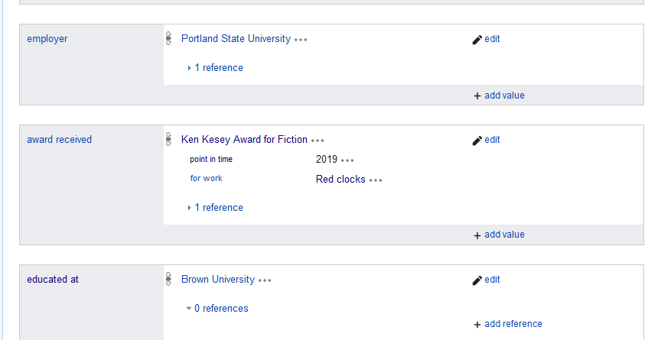

Slide 29
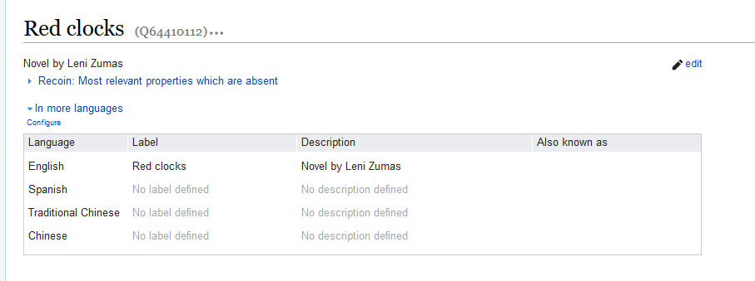
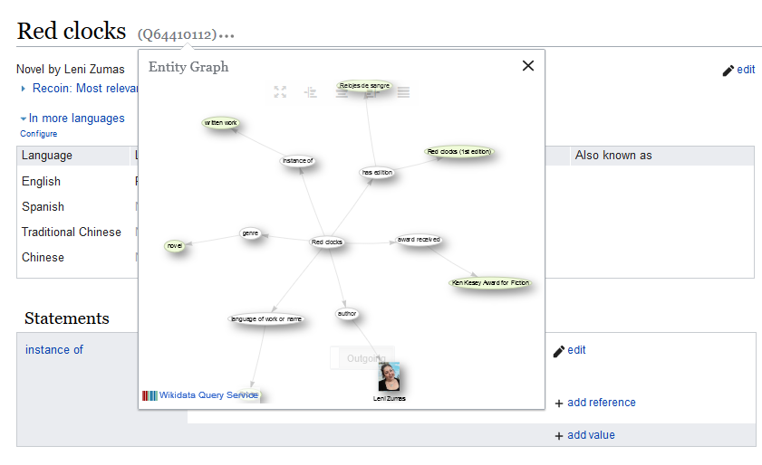

Slide 30
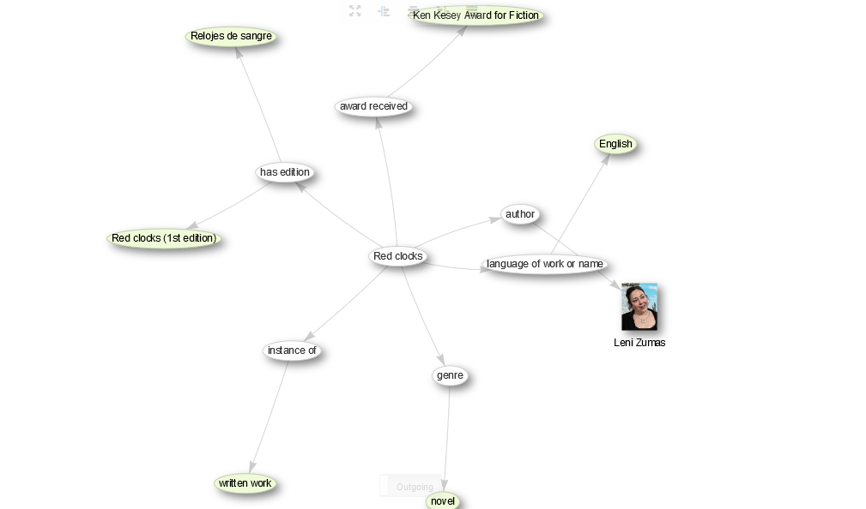

Slide 31
University of Oregon Libraries (seven libraries, Knight is the main library)
Item in Wikidata (hybrid): Knight Library
Data modeling question:
How to represent relationship between branches and system?
WikiProject:Libraries
Dan Scott blog

Slide 32
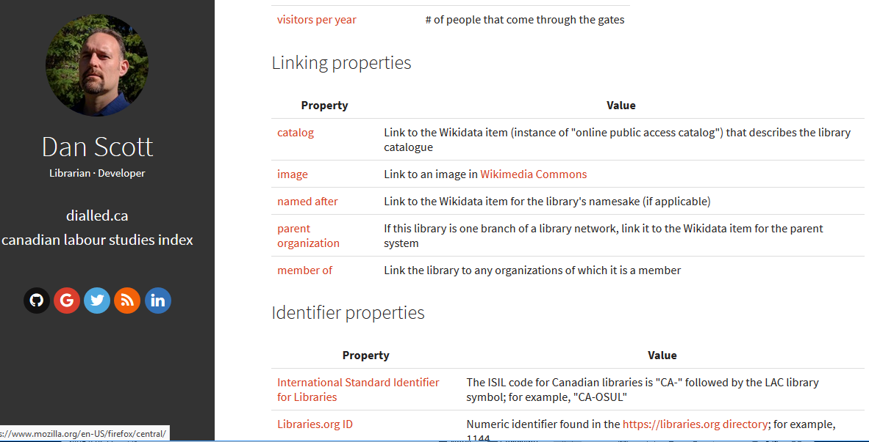

Slide 33
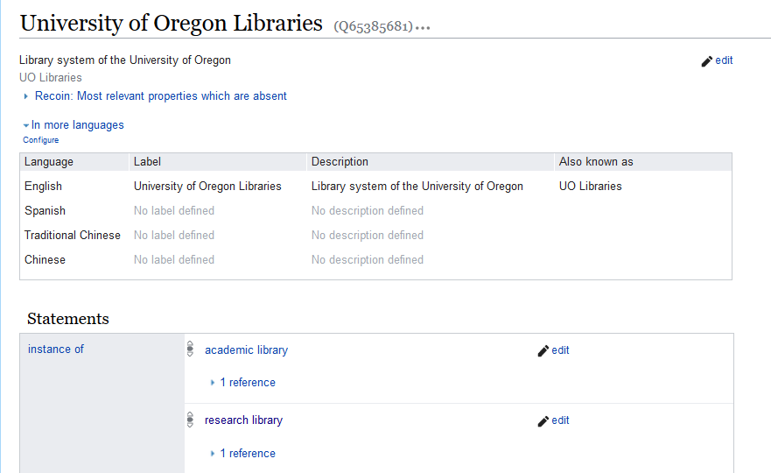
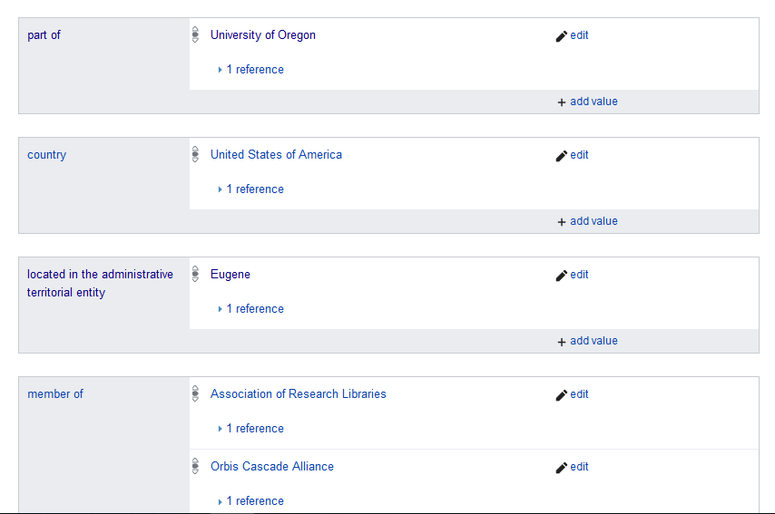

Slide 34
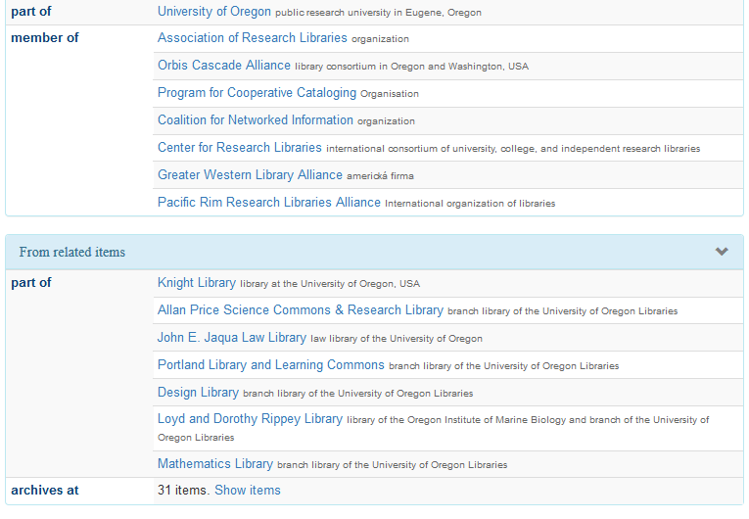
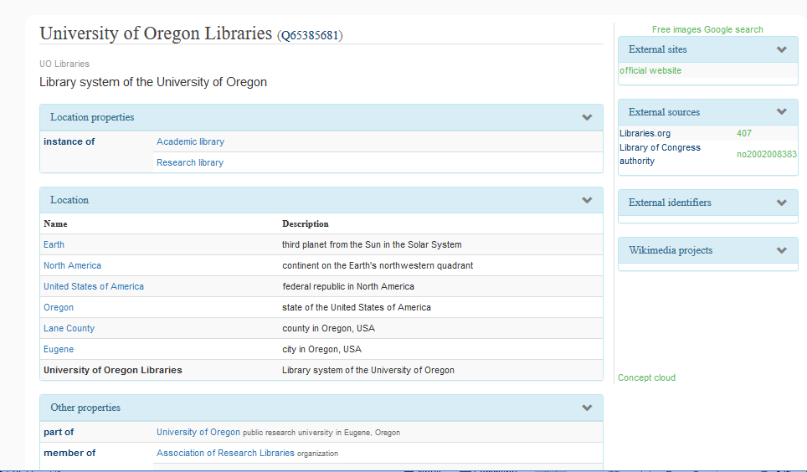

Slide 35
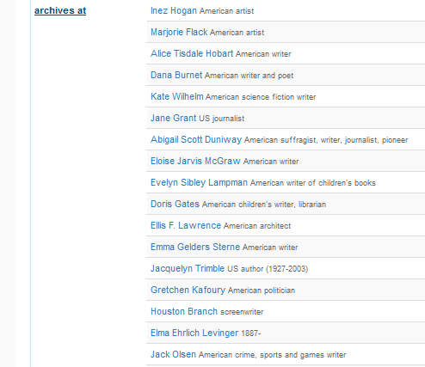
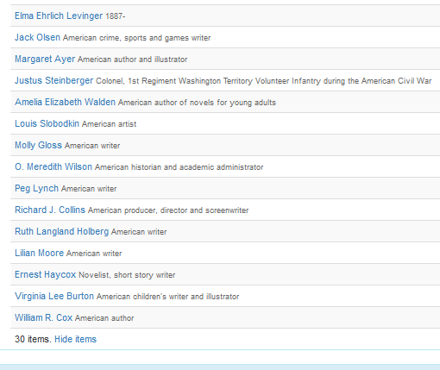

Slide 36
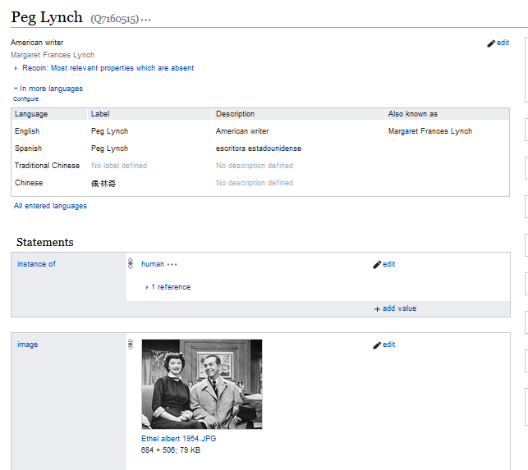

Slide 37
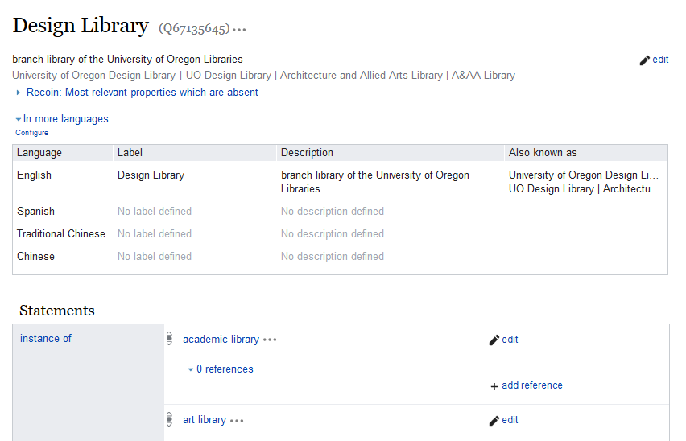
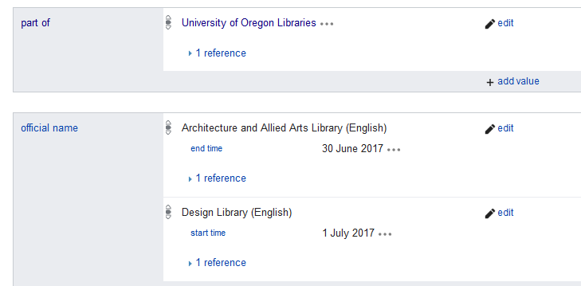

Slide 38
UO Presidents
Most individuals already had Wikidata items
But no indication of their role as UO president
Added item for book: History of University of Oregon, by Henry D. Sheldon, and could then use “stated in” references
Data modeling question:
Position held: “university president” (of) “University of Oregon”
Position held: “President of the University of Oregon”

Slide 39
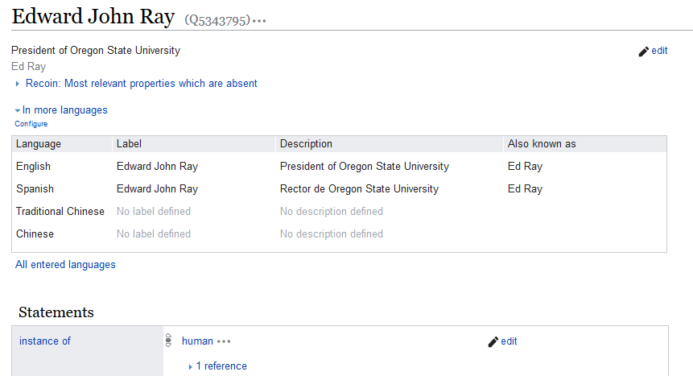

Slide 40
Project chat

Slide 43
UO faculty
Created or updated Wikidata items for individual faculty
Using data from CV or department website bio
Main focus: Indigenous, Race, and Ethnic Studies
Emphasis on properties:
Educated at ; Occupation ; Employer
Notable work in some cases
And identifiers:
LC authority ID
ORCID, ISNI if known

Slide 45
Positives: ability to put structured data on the open web fairly easily
Ease of editing
Simple to add data about people, publications, organizations (once the data model is figured out)
Open and collaborative – ability to involve more people
No requirement for completeness of data
“Something is better than nothing”
Ease of minting URIs
Fun!

Slide 46
Challenges
Lack of documentation
Tools can be difficult to learn
Difficulties with consensus model
Different approaches to data modeling (Nobel Prizes)
Much worked out on Project chat
Answers can depend on who is paying attention and responding
WikiProjects have good guidance, but …
Reflect the consensus of whoever pulled the project together
Data quality (mass imports of minimal data)

Slide 47
SPARQL query: find all Nobel Prize winners
Nobel Peace Prize (Q35637) part of (P361) Nobel Prize (Q7191)
Nobel Prize in Literature (Q37922) subclass of (P279) Nobel Prize (Q7191)
Nobel Prize in Economics (Q47170) instance of (P31) Nobel Prize (Q7191) ; part of (P361) Nobel Prize (Q7191)
Nobel Prize in Chemistry (Q44585) instance of (P31) Nobel Prize (Q7191) ; part of (P361) Nobel Prize (Q7191)
Nobel Prize in Physics (Q38104) subclass of (P31) Nobel Prize (Q7191) ; part of (P361) Nobel Prize (Q7191)

Slide 48
Next: forming a Wikidata Working Group at UO
Continue to learn about Wikidata and implications for libraries
Explore ways to continue contributing UO data:
“archives at”, faculty data, digital collections, etc.
Monitor Wikidata activity in the community:
LD4P; Wikidata Affinity Group
PCC – possible Wikidata pilot
Work of institutions such as Harvard, Stanford, Virginia
Uses of Wikibase instances
OCLC’s “Entity Management Infrastructure” Mellon grant

Slide 49
Resources
Linked Data for Production
Wikidata Affinity Group: https://wiki.lyrasis.org/display/LD4P2/LD4-Wikidata+Affinity+Group
Practical Wikidata for Librarians: https://www.wikidata.org/wiki/Wikidata:WikiProject_Linked_Data_for_Production/Practical_Wikidata_for_Librarians
Stanford Wikidata Working Group: https://www.wikidata.org/wiki/Wikidata:WikiProject_Stanford_Libraries
WikiEdu training modules: https://dashboard.wikiedu.org/training/wikidata-professional

Slide 50
Thank you! lrobare@uoregon.edu

