Slide 1
CURRENT ISSUES WEEK TWO The Right People for the Job
A CERTIFIED PUBLIC LIBRARY ADMINISTRATOR (CPLA) COURSE
Catherine Hakala-Ausperk
chakalaausperk@gmail.com

Slide 2
WHAT DO PEOPLE HAVE TO DO WITH ISSUES?
WHO?

Slide 3
Q: HOW CAN YOUR LIBRARY ACHIEVE EXCELLENCE?
WITH YOUR PERMISSION…

Slide 4
WHAT IS AN INNOVATIVE CULTURE?

Slide 5
WHAT SKILLS ARE NEEDED?
THIS WORKS BOTH WAYS!

Slide 6
WHAT SKILLS DO YOU HAVE ON STAFF ALREADY?
WHAT ARE STRENGTHS, REALLY?

Slide 7
GAPS AND WHAT TO DO ABOUT THEM
REQUIRE
EXPECT
SUPPORT

Slide 8
RISKS, MISTAKES & DAMAGE CONTROL
OOPS! (ROCKET BOOKS)

Slide 9
BULLETS NOT CANNONBALLS
TRY TO AVOID…
READY,
FIRE,
AIM

Slide 10
CONSIDERING STAKEHOLDERS
WIIFT

Slide 11
THE BENEFITS OF NETWORKS
Who else is there?

Slide 12
VOLUNTEER SUCCESS
WITH A
LITTLE
HELP
FROM
MY
FRIENDS…

Slide 13
STUDENTS MATTER!
A+

Slide 14
PARTNERS FOR LIFE
BUSINESSES
SCHOOLS
GOVERNMENT
SOCIAL ORGANIZATIONS

Slide 15
YOU CAN’T STAY CURRENT WITHOUT PEOPLE

Slide 16
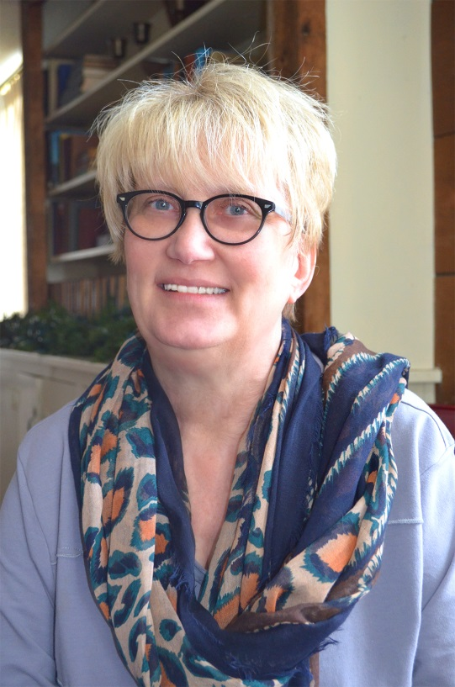
QUESTIONS??? LET ME HELP!
chakalaausperk@gmail.com

Slide 17
COMING NEXT…WEEK #3 HOW WAS I SUPPOSED TO KNOW?
Edreformnow.org

