Slide 1
How end users’ expectations and behaviors affect cataloging norms
Bela Gupta
Cataloging & Metadata librarian
Claire T. Carney Library
University of Massachusetts Dartmouth

Slide 2
User’s expectations and behaviors aligned with Ranganathan’s Five Laws:
Multi access: As the library clientele expands multiple users want multiple access (sometimes simultaneously) at all times (24 hours, 7 days a week)
Speed: Users want discovery-to-delivery barriers eliminated, connect and contextualize resources, and to cross-search or reference between different publications.
Functionality: Users want to access the publications to analyze content by way of enhanced browsing opportunities.
Content: Users want information that contain a vast amount of information, but more importantly the material can consist of print, electronic, and mixed media i.e. electronic books, images, video, audio, animation.

Slide 3
Cataloging norms
Creation, maintenance and enrichment of metadata for physical and electronic resources.
Activation of electronic resources utilizing ExLibris Alma, the library’s cloud based unified resource management system.
Withdrawal of video cassettes (VHS tapes) based on low usage statistics and cataloging of DVDs.
Location change for books located in basement of the library to upper levels for better visibility and discoverability.

Slide 4
Cataloging norms: cataloging in the cloud
Cataloging norms are not just cataloging of print material but include management of electronic resources to facilitate patron discovery and access.
Cataloging Maintenance Projects.
Use of local fields in bibliographic records to provide better access to our patrons.
Retrospective cataloging.

Slide 5
JSTOR Discovery ebooks
EBA (Evidence Based Acquisitions)
To give users access to “critical mass” of content easily.
Align spending with demonstrated need.
What do users actually want.
Librarians in control of making final informed decisions.

Slide 6
JSTOR Discovery Ebooks- aggregator package in EXLIBRIS ALMA
Activated this Electronic Collection from the Community Zone.
Provided it a public name.
Service Type: Full Text.
Proxy Selected: UMassD Proxy.
Linking Level: Book.
Deactivated electronic books for which we already had access from other electronic collections in the library.
Deduped the JSTOR electronic books in Excel by conditional formatting.
Made global changes by running a job in ExLibris Alma to “Suppress Duplicate Portfolios”.
Created Normalization Rule in Alma for this electronic collection.

Slide 7
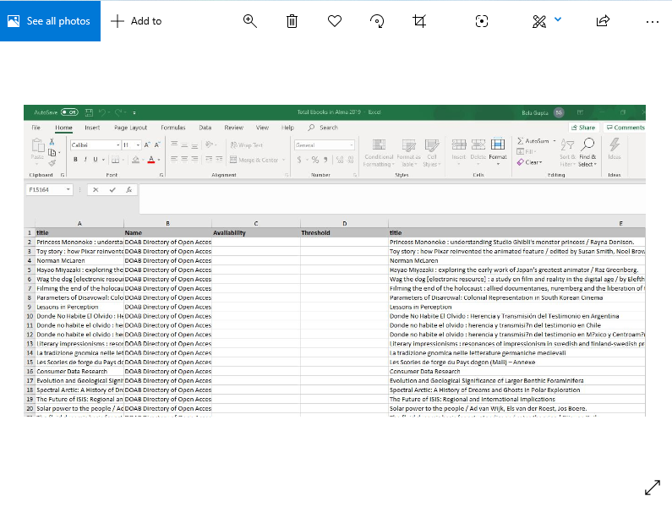

Slide 8
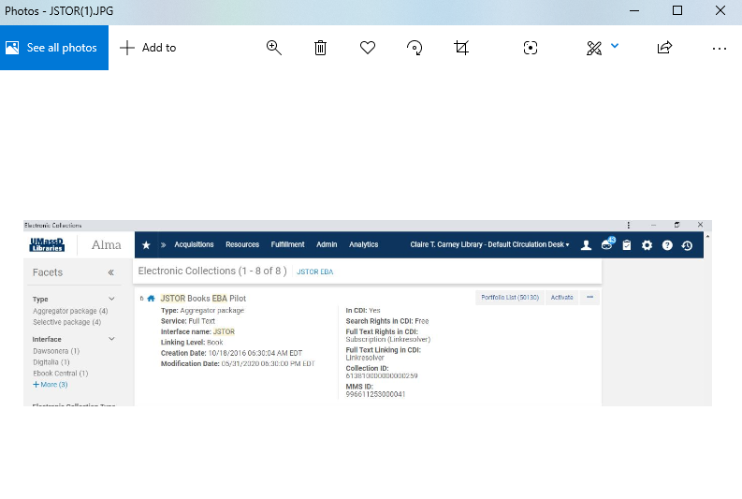

Slide 9
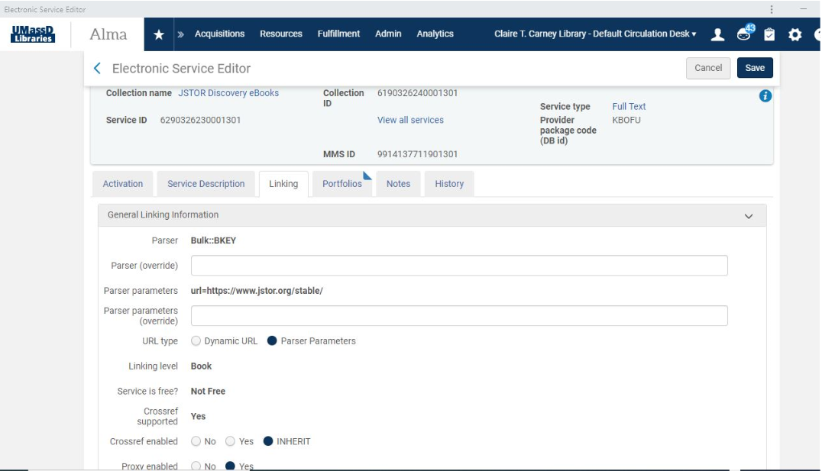

Slide 10
Normalization rule for the JSTOR discovery ebook collection

Slide 11
Cataloging maintenance projects
Provide better visibility to the library’s holdings as these books are integrated in the library’s collections and made available to the community at large.

Slide 12
Thousands of Books in basement moved to library shelves
Work with Access Services staff to process almost forty-five thousand books lying in basement.
Batch Process books in:
https://sandbox01-na.alma.exlibrisgroup.com/mng/login?institute=01MA_DM_INST
Move these books to the library shelves in Level 3 and Level 5.
Troubleshoot problems related to Missing/Not Found items.

Slide 13
SPREADSHEET FOR barcodes of books in basement of library

Slide 14
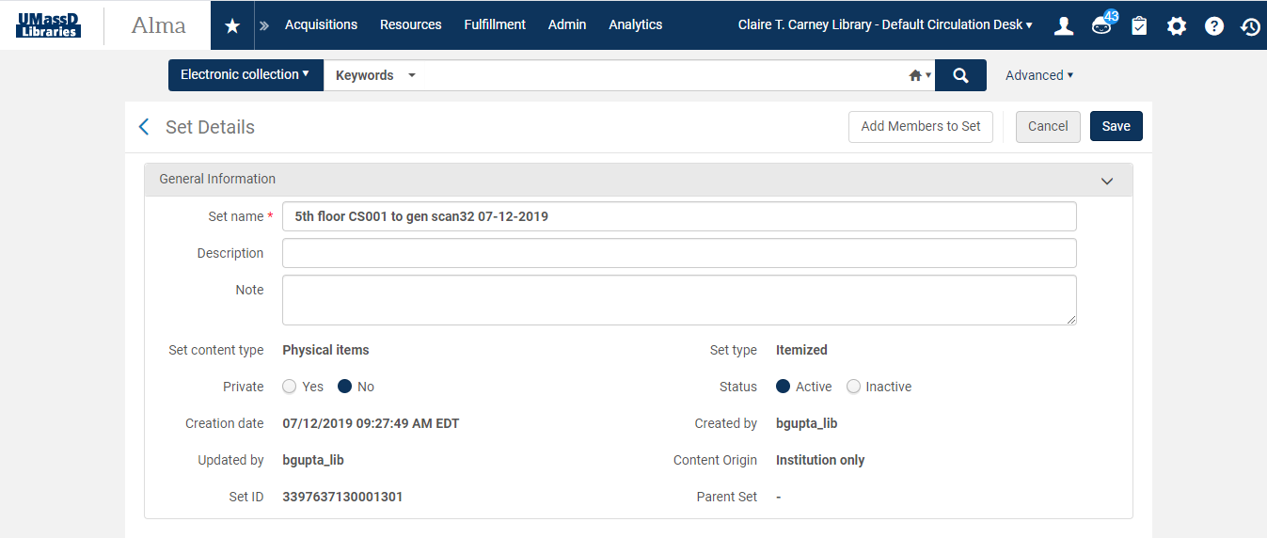

Slide 15
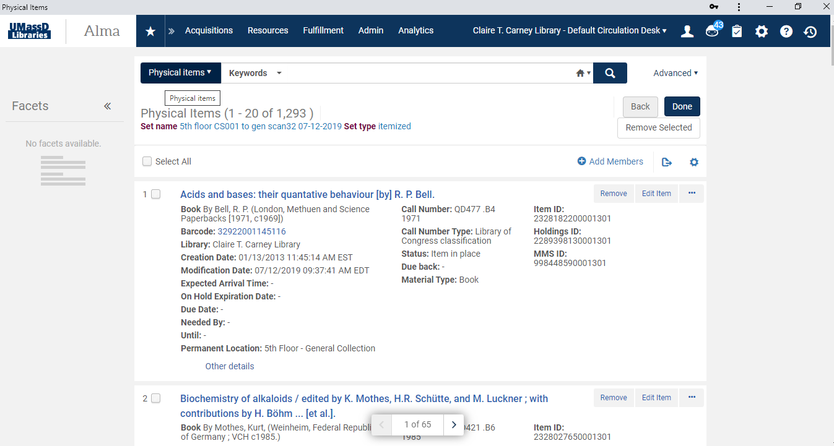

Slide 16
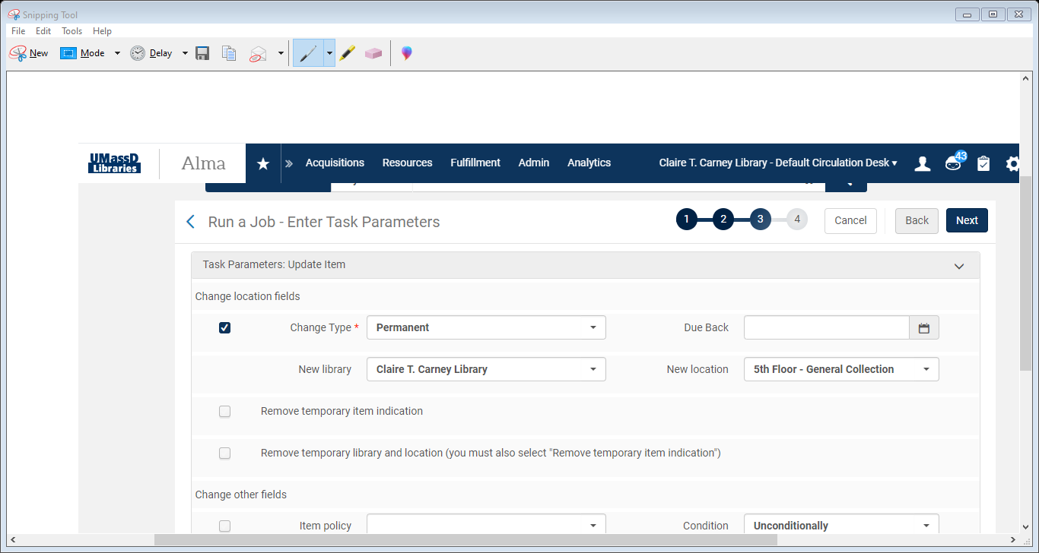

Slide 17
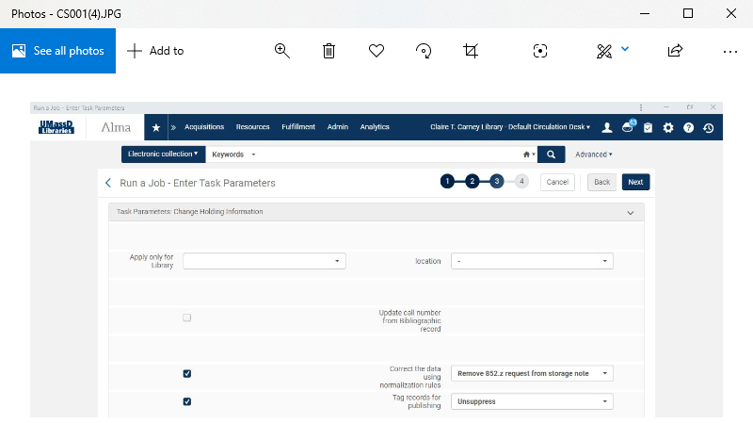

Slide 18
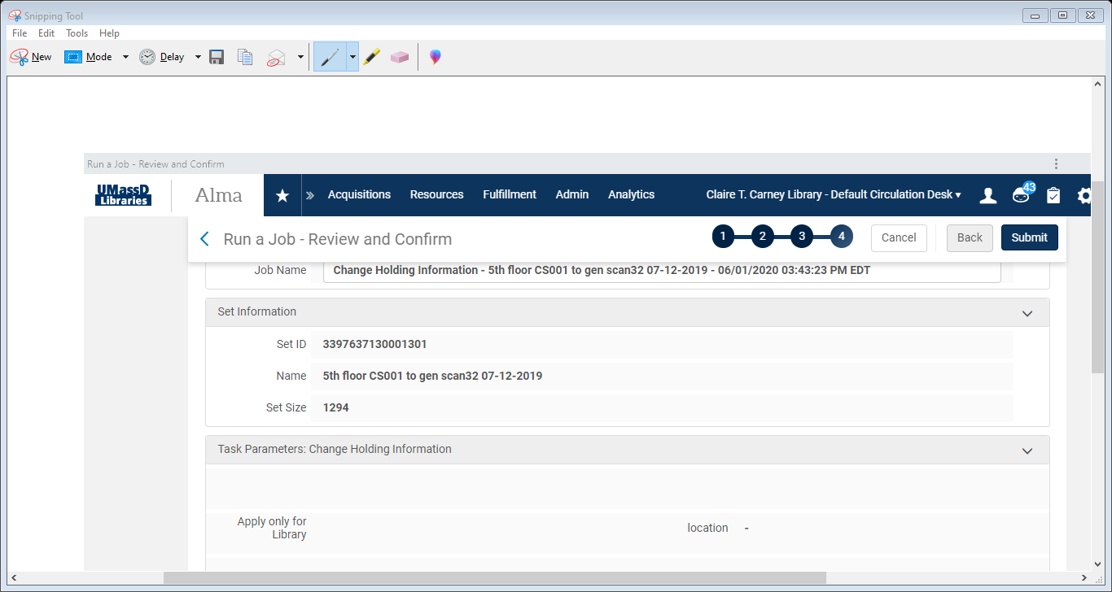

Slide 19
Create a title set from a physical items set in exlibris alma

Slide 20
Creation of a local electronic collection for cvpa (College of visual & performing arts students)

Slide 21
Creation of electronic portfolios in exlibris alma

Slide 22
Normalization rule for larkin books
rule "Add field 590“
when
not exists "590.a.Gift of Judge Francis J. Larkin, Professor of Law and Dean Emeritus, University of Massachusetts Dartmouth."
then
addField "590.a.Gift of Judge Francis J. Larkin, Professor of Law and Dean Emeritus, University of Massachusetts Dartmouth\\\\."
end
rule "Add 796"
when
(not exists "796.*.*")
then
addField "796.{1,-}.a.Larkin, Francis J\\\\.,"
addSubfield "796.{1,-}.e.donor\\\\." if (not exists "796.e" )
end
rule "Add field 797"
when
not exists "797.a.Judge Francis J. Larkin Collection."
then
addField "797.{2,-}.a.Judge Francis J. Larkin Collection\\\\."
end

Slide 23
Adding local marc fields 590, 796, 797 to larkin gift books

Slide 24
Alternate method: manipulation of metadata in marcedit for larkin gift books

Slide 25
Batch process of suppressed storage books - a global change: created an itemized set to run a job

Slide 26
Suppressed books: CHAnge physical item job

Slide 27
Change holding information: unsuppress

Slide 28
a third job on title set: suppress bibliographic records from discovery

Slide 29
DOAB: Directory of open access books
DOAB seeks to increase discoverability of Open Access books. Academic publishers provide metadata of their Open Access Books.
A recent project: To check for duplicate electronic books in DOAB Electronic Collection and delete them.
This will promote better visibility and discoverability for our users.

Slide 30
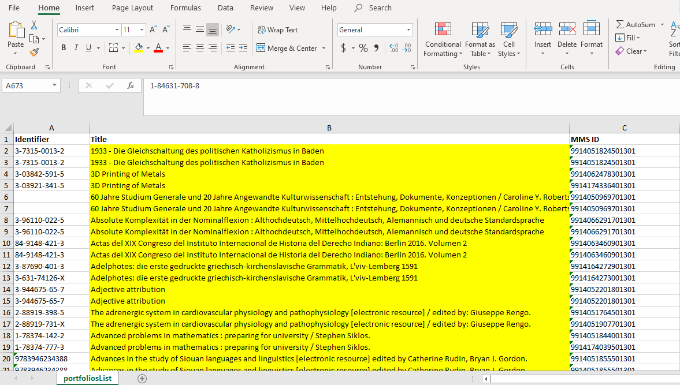

Slide 31
VHS Tapes withdrawn and DVD(s) cataloged
Usage statistics of VHS Tapes taken into account.
If null then VHS Tapes for which DVD format available in the library were withdrawn. DVDs were cataloged.

Slide 32
references
Gallagher, D. & Kaelin, S. (2018). All there is to know about evidence based acquisitions [PowerPoint slides]. Retrieved from https://www.charlestonlibraryconference.com/wp-content/uploads/2018/09/ATG-EBA-25SEP2018.pdf
Velumani, K.V. (2013). An investigation into the impact of e-resources in modern library and information centers. Retrieved from http://hdl.handle.net/10603/54204
Haider, S. (2017). Five laws of library science. Retrieved from https://www.librarianshipstudies.com/2017/09/five-laws-of-library-science.html

Slide 33
Questions? Thanks!

