Slide 1
Charting a Course of Collaboration Between an Academic Library and a Museum
Brian Falato
Senior Cataloger
University of South Florida Tampa Library

Slide 2
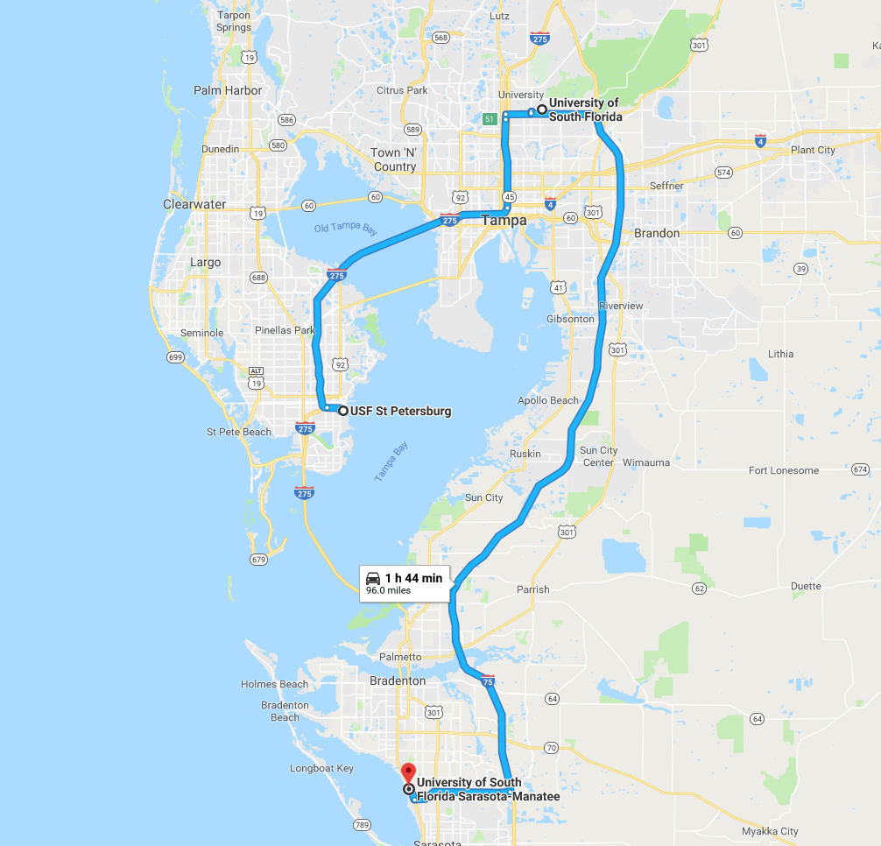
The University of South Florida (nickname the Bulls) is a public
university that was founded in 1956. It has campuses in Tampa (the
main campus), St. Petersburg, and Sarasota, Florida.

Slide 3
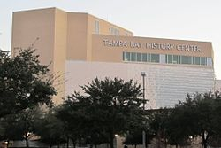
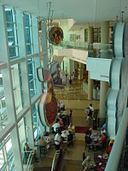
The Tampa Bay History Center is located about 12 miles to the south
of the USF Tampa Campus and has displays on the history of Florida
and the Tampa Bay Area. It also houses the Florida Center for
Cartographic Education and the Touchton Map Library.

Slide 4
The Touchton Map Library contains 4000 maps donated by private
collector and museum co-founder Tom Touchton. Over half the
maps have been digitized and are available on the History Center
Web site.
Metadata on the digitized maps has been sparse, however, and
the Collection was never properly cataloged. USF and TBHC, as
part of their partnership in the Center for Cartographic Education,
agreed to have a USF librarian work part-time at TBHC cataloging
the map collection.

Slide 5
TBHC wanted the metadata to show both in the LUNA system it uses
and in OCLC. It also requested that a link to the digitized version of a
map be included in the OCLC record.
USF wanted to be able to count the maps as part of its collections,
putting the records into its Aleph catalog with the location marked
as TBHC.
It took some work to figure out the best workflow to accommodate
everything that was desired.

Slide 6
The LUNA software is web-hosted and used to manage and display
all types of digital collections. Many museums and
library Special Collections departments use LUNA.
Metadata templates can be configured for different collections. For
maps, the categories have a greater specificity than what is found
in MARC cataloging.

Slide 7
Different types of notes that would all go in 500 fields in MARC are
broken out in LUNA. There are separate named fields for verso and
inset descriptions. A 500 field note in MARC detailing the scope of a
map would go in the Geographical Description field in LUNA. Other
notes about a map would go in the Cartobibliographical Notes field.
The height and width of a map are each in their own field in LUNA.
In MARC, they are paired together in one subfield.
If a date is expressed as a range instead of single year, or there is a
question mark after year, information goes in Date Range rather
than Date.

Slide 8
Since records will be put in both OCLC and LUNA, it was originally
thought that OCLC data could be crosswalked to LUNA. This proved
to be difficult because there were not one to one correspondences
between LUNA and OCLC.
Additionally, TBHC was not using Gateway Export on records, which
meant several more steps were necessary to get the records to
LUNA.
The digitized maps have records with minimal metadata already in
LUNA, so you would not want the OCLC records to go to a new
template, but rather the one already existing.

Slide 9
Given these conditions, it was decided to do the OCLC and LUNA
work separately.
A map title is first searched in LUNA by accession number. The record
retrieved contains title, creator, and date or date estimate.
The item is then searched in OCLC. If a matching record is found, the
TBHC symbol is added to holding libraries, and an 856 41 field with
link to TBHC digital scan of map is added.
If no appropriate record is found, an original record is created,
including link in 856 field, and symbol added to holdings.

Slide 10
Original cataloging is generally full-level and done according to RDA.
Library of Congress Subject Headings and OCLC FAST faceted headings
are used in description. If appropriate, Library of Congress Genre and
Form Terms are included.
Headings are controlled to authority files. If a name heading is not
found in the authority file, it is left uncontrolled. No attempt is made
to create name authority records.

Slide 11
Finding records in OCLC, or determining that a new record is needed,
is a challenge with a comprehensive collection such as this. Many
items will have the same title and creator.
The cataloger has to figure out what differentiates a particular item.
It could be:
date of publication,
title of the atlas in which the map was published
complimentary distributor
something else (use of color or accompanying text, for instance).

Slide 12
When cataloging in OCLC, particular attention must be paid to
differentiations that will avoid the Duplicate Detection and
Resolution algorithm from merging two records.
One way to prevent this is by creating an edition statement in
brackets, such as [New Indexed Atlas edition], [First National
Bank edition], or [Red overlay edition].
Jay Weitz of OCLC has a series of PowerPoints called “Cataloging
Defensively” that offer suggestions for adding information to a
record so that DDR is not triggered.

Slide 13
After the OCLC record is identified or created, information from it is then copied and pasted into appropriate LUNA fields.
The Subject Information fields in LUNA use a more faceted approach
than LCSH. The heading Real property $z Florida $v Maps would be
entered in LUNA as Real property in one Subject Information field
and Florida in another. The form subdivision Maps is not used.
Items originally issued folded have been fully unfolded for display in
LUNA. In these cases, full measurements of map, sheet size, and
folded size are given in OCLC. In LUNA, only map size is listed, but in
a Cartobibliographical Note field, it is noted that item was originally
issued folded. Title appearing on front panel when folded is given, if
different than title on map.

Slide 14
After cataloging data is entered in OCLC and LUNA, a spreadsheet is
used to record the OCLC number, map title, year, TBHC accession
numbers, and whether the record was original cataloging.
The spreadsheet is stored in the Box drive cloud storage system USF
Uses. A USF Tampa Library staffer will access the spreadsheet, look up
the OCLC numbers, export the records to the library’s Aleph ILS, and
add the USF Tampa holding symbol.
A holdings record is made in Aleph with the location marked as TBHC.
The TBHC accession number is used as the classification. Since TBHC
lacks an ILS, this is the only formal holdings statement used.

Slide 15
Since Mr. Touchton collected comprehensively, some unusual items
have come up for cataloging.
Among those worked on so far are maps as jigsaw puzzles, maps on
placemats, a map in a cross stitch pattern, and a magazine
advertisement.
Examples of these appear in the following slides.

Slide 16
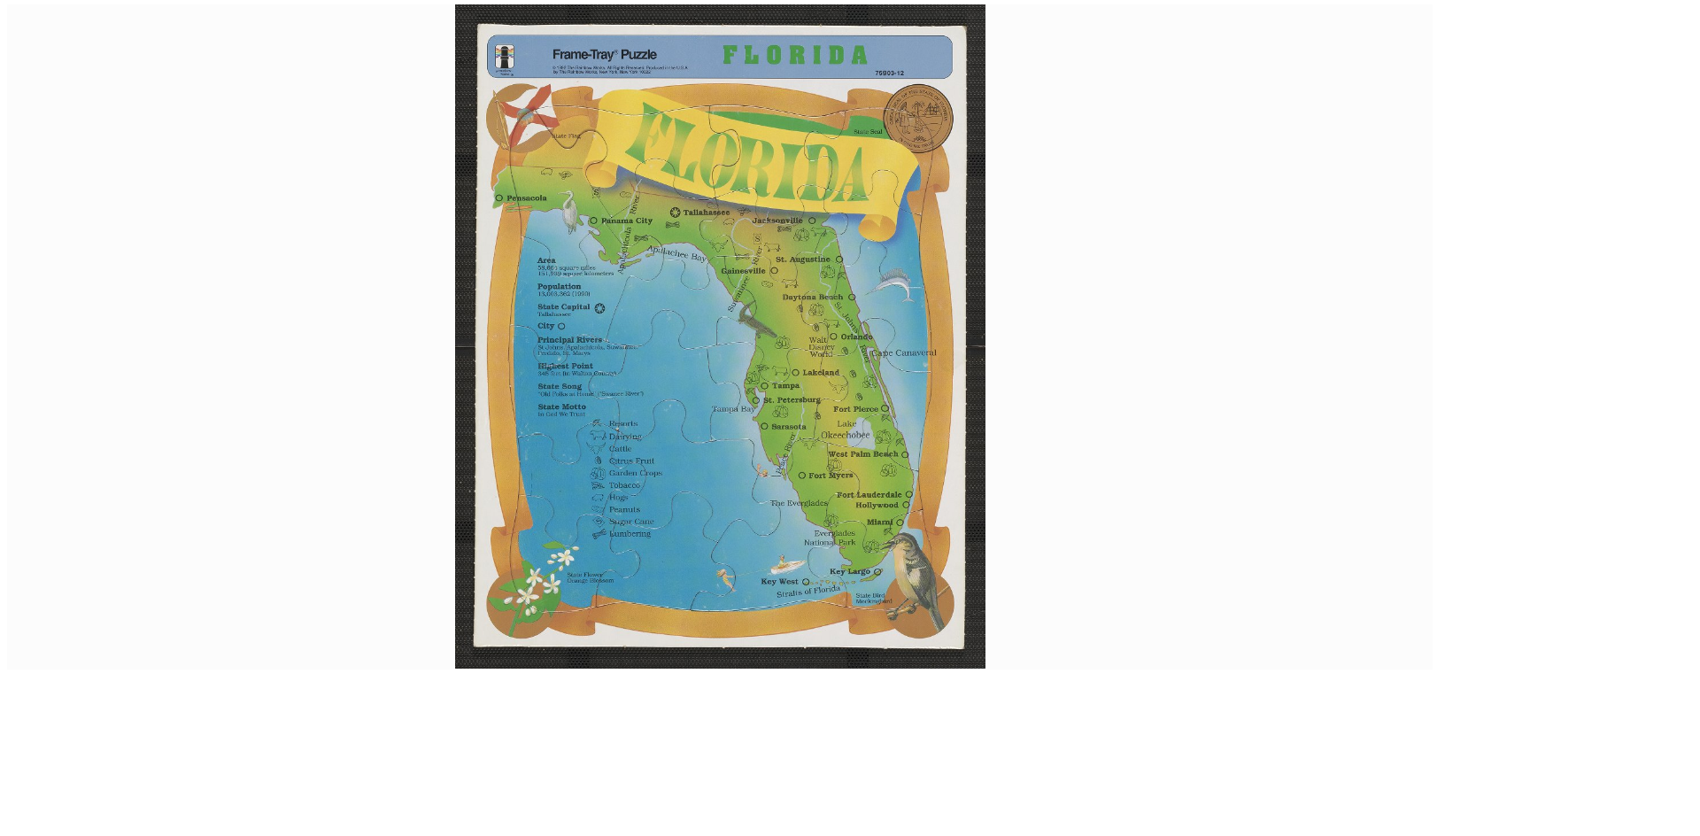
A jigsaw puzzle map of Florida.

Slide 17
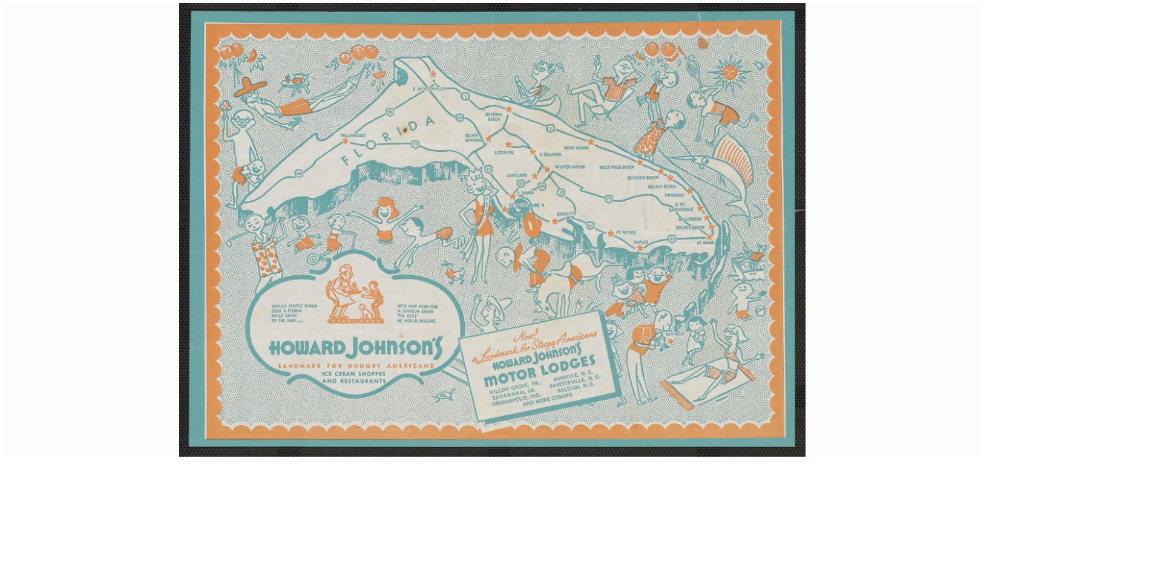
Map of Florida on placemat from Howard Johnson’s restaurant.

Slide 18
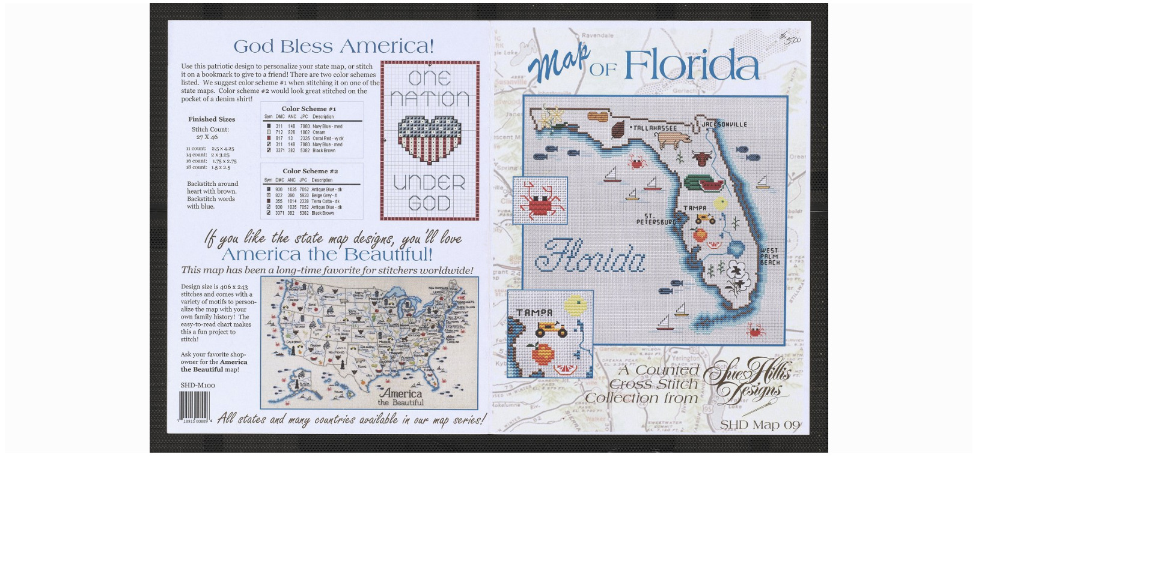
A map of Florida as a cross stitch creation. Instructions are on verso.

Slide 19
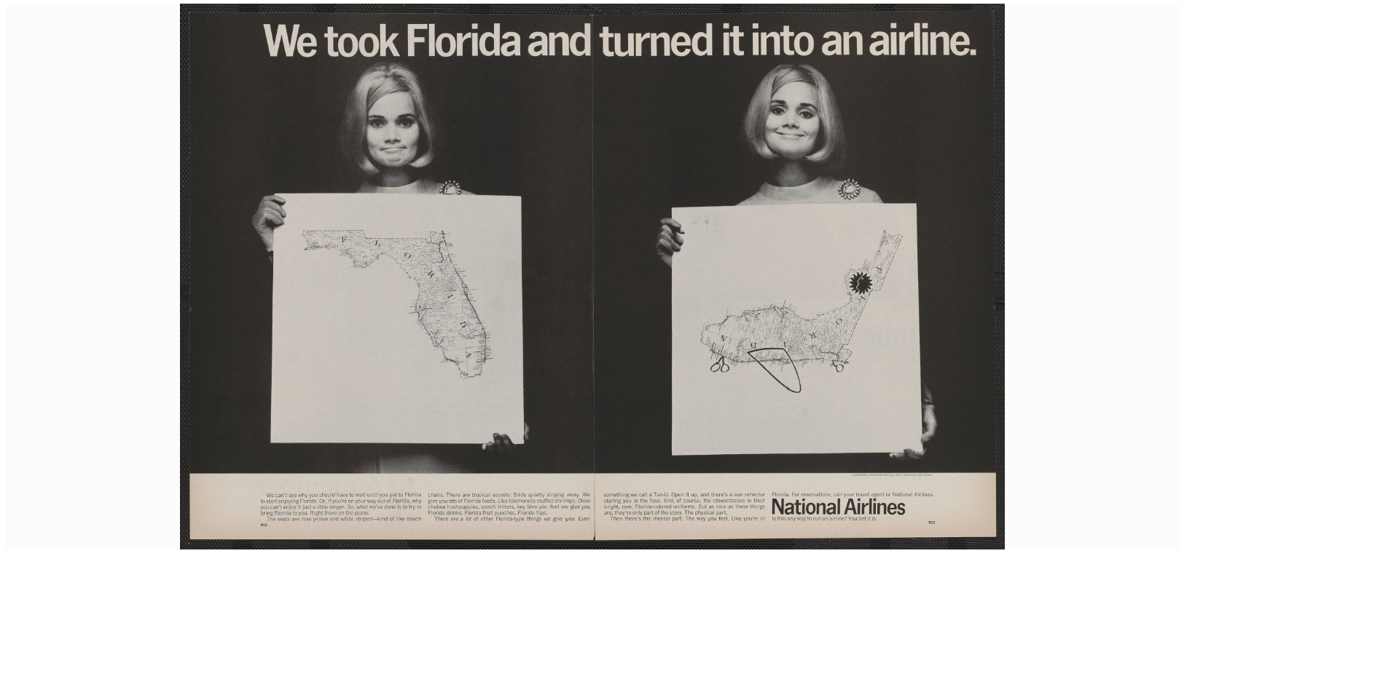
A magazine ad for Florida-based National Airlines. The map on the
right shows Florida turned to look like an airplane.

Slide 20
Working two days a week at TBHC (with exceptions for meetings at
USF or attendance at conferences) since February 7, 2019, 225 items
have been cataloged. 161 of these items have been original
cataloging (about 72 per cent.)
At his time, there is no fixed time for this assignment to end.
Working at the current pace, it would take approximately five years
to catalog all items.

Slide 21
Questions?
Contact info:
Brian Falato
University of South Florida Tampa Library
bfalato@usf.edu

