Slide 1
Beyond Budget Allocations
ALA Annual Chief Collection Development Officers (CCDO) | June 22, 2018
Implementing change, being intentional, and maintaining our values
Jennifer Roper, University of Virginia (UVA)
Denise Pan, University of Washington (UW)

Slide 2
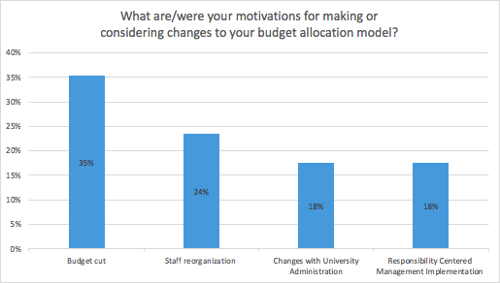
Introduction
Major Trends from CCDO Budget Allocation Survey
Majority of respondents are currently using historical allocation patterns
Half of the Libraries are considering significant changes to their collections budget
Beyond CCDO -- New Budget Allocation Survey -- please participate!

Slide 3
Case Studies
Implementation: University of Washington (UW)
developing an iterative process for making budget allocation changes
Intentionality: University of Virginia (UVA)
When budget allocations are not enough

Slide 4
UW: Process for Reviewing Budget Allocations
Convened sub-committee to conduct environmental scan
Consultant lead discussions and reported findings
Collections Resources Council approved budget allocation changes for FY19

Slide 5
UW: Environmental Scan Report
Major components:
Core values to serve as a benchmark for considerations
Literature review of 46 articles from 1980-2017
Budget Allocation Survey: 23 CCDO Libraries -- Thank you!
Follow-up conversations with CCDO colleagues -- Kudos!
Ohio State, Texas A&M, U of Alberta, and U of Arizona
Findings: no simple solution or “magic bullet”
Recommended: near and longer term actions

Slide 6
UW: External Consultant
Facilitated Discussions
Method: In-person 1.5 days;
small & Large Groups
Goal: promote clarity and shared understanding regarding values, pro/cons for each near and longer term action, and next steps
Final Report
Major components:
●Introduction and context
●Summary of discussions on near and longer term actions
●Recommendations
●Observations

Slide 7
UW: Establishing iterative process
Outcomes
Achieved consensus to implement recommendations.
Focused on reviewing serials annually, and investigate one-time orders in the future.
Established process for reviewing budget structure.

Slide 8
UVa: Shifting allocations a first step
Collections budget is not infinitely elastic
Multiple perspectives on collections.
Continuing expectations, historical and modern
Attempts at intentionality

Slide 9
UVa: Additional Historical Expectations
End of year deus ex machina
Disciplines with deep well of endowment funds
No negative feedback about purchases made.
Different disciplines = different pressures
Serials cancellation is a monolithic process.

Slide 10
UVa: Modern Expectations
Ebook packaging create an expectation for purchasing entire front list, not just in particular areas.
Netflix and Amazon world for personal purchasing and consumption not mirrored in library world

Slide 11
UVa: New Intentionality
Review gift agreements.
Inform faculty about serials contracts.
Shift discussions of money.
Lean in on consortial agreements
Focus on institutional mission
Reward feedback.

Slide 12
Thank you! Questions?
Denise Pan, University of Washington (dpan@uw.edu)
Jennifer Roper, University of Virginia (jroper@virginia.edu)

