Slide 1
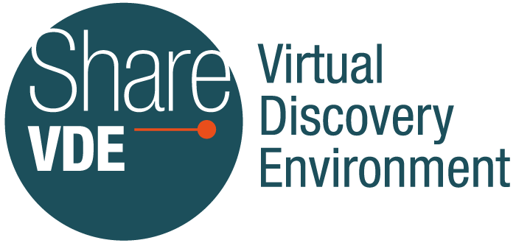
Prototyping a Linked Data Discovery Interface
ALCTS/LITA Linked Library Data Interest Group - February 2020
Beth Picknally Camden
University of Pennsylvania

Slide 2
Share-VDE (Virtual Discovery Environment)
Share-VDE is a library-driven initiative to establish an effective working environment for the use of linked data by libraries within a global context.
Partners
22 International Research Libraries
Casalini Libri
@Cult
Samhaeng
Notes:
Library governance of the project: the Advisory Council and Working Groups
Penn has been a participant since the initial project in 2016

Slide 3
Share-VDE Goals
Enrichment of MARC record with URIs; Conversion from MARC to RDF using the BIBFRAME vocabulary.
Creation of a linked data discovery platform.
Creation of a database of relationships and clusters (Sapientia Cluster Knowledge Base)
Implementation of tools for direct interaction with the data (J. Cricket Editor)
Batch/automated data updating procedures and dissemination to libraries.
Notes:
Mention: Progressive implementation of use cases, with priorities defined by the Share-VDE community

Slide 4
OPUS
Notes:
Mention Superwork→Opus
-relation to BF Work and LC Hub

Slide 5
Penn’s Vision for Share-VDE
Focusing on how linked data can support users.
Recognizing the value of a large data set to support delivery to library users
Embedding the BorrowDirect API into Share-VDE
Notes:
Penn:
-engaged in SVDE since initial phase
-making the case for continuing→vision for user discovery
-developed use cases focus on user support and reuse of the large SVDE data pool
This vision led to the project that Penn is currently engaged: developing a local version of SVDE

Slide 6
Penn’s Share-VDE project goals
Prototype linked data discovery interface
Test how linked data supports user discovery needs
Support user delivery needs
Use APIs to find available versions
Streamline ILL options in a single interface
Options based on data from many institutions
Develop in a reproducible way
Notes:
Plan to test with real users
Delivery options are the big deal: currently users have to move system to system for BD/EZB;
Develop in a reproducible way:
-Skin on top of general development; Institutional settings that can be reused by other libraries
-Penn’s version will inherit improvements made to the general version

Slide 7
Development Process
Work with UX/UI designer (Samhaeng)
Mock-up
Current: Tech review (@Cult)
Next: Prototype with live data
Library and User testing
Notes:
UX/UI=User Experience/User Interface
Tech review: are the functions in the mockup workable; which APIs are needed to make them work as envisioned.
At the same time working on updating Penn data in the CKB and move to weekly (eventually daily) updates.

Slide 8
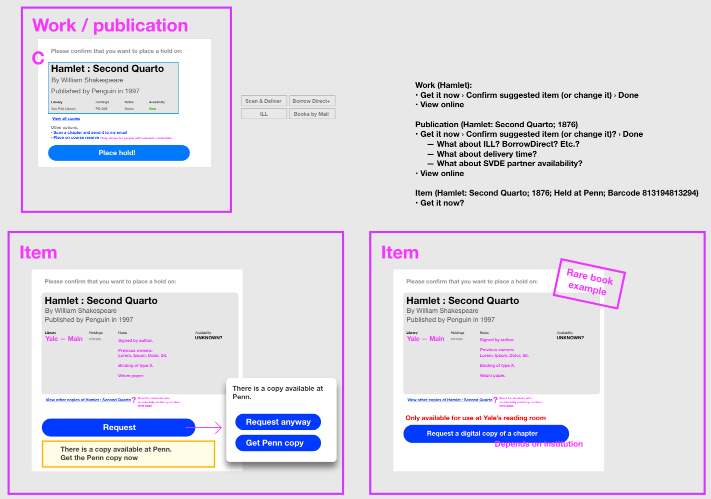
UX/UI Sketching Ideas
Notes:
UX/UI process – Sketching ideas during WebEx calls

Slide 9
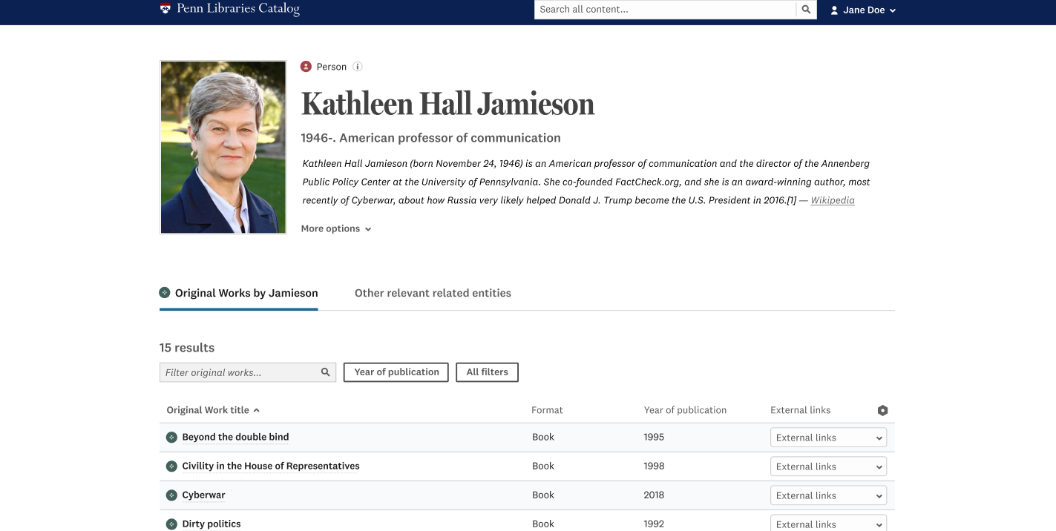
Notes:
Mock-up: Author page (based on the Agent cluster)
Person entity/cluster
Note: Knowledge panel (photo/info) - Wikipedia
Note: design simplifies the BF structure for better user experience; assumption that most users are not power users (difference between librarian needs and users needs)

Slide 10
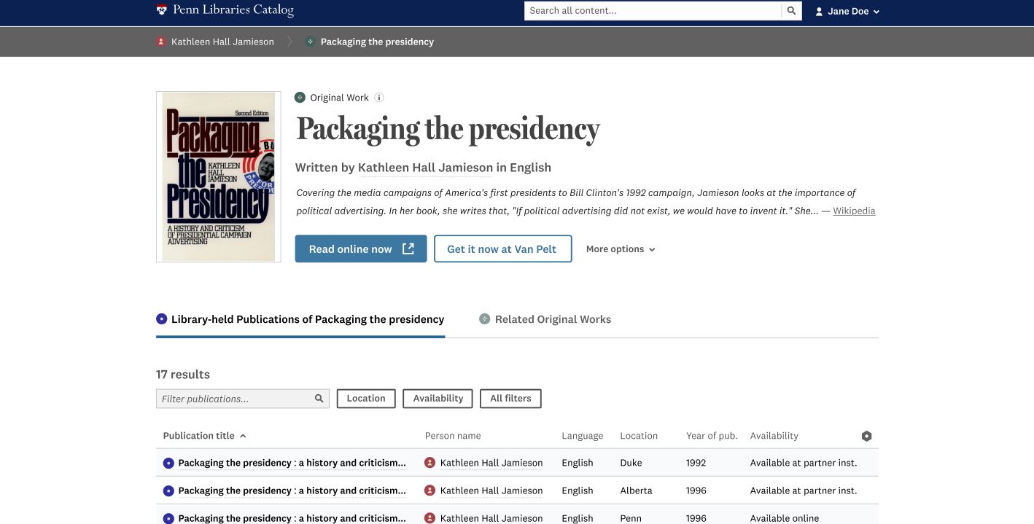
Notes:
Mock-up: Original Work based on the Opus (aka Superwork) cluster
Knowledge panel – image and info from Wikipedia
Listing of the publications of this work

Slide 11
Notes:
Mock-up: Publication page (Instance)
Publication level (BF instance)
Note: bread crumbs
Info base on the biblio. data

Slide 12
Demo
Notes:
See “Script for Demo”

Slide 13
Resources
General Information: https://www.share-vde.org/sharevde/info.vm
Share-VDE brochure: https://www.share-vde.org/sharevde/files/Share-VDE_brochure_201906.pdf
Share-VDE short overview: https://www.share-vde.org/sharevde/files/Share-VDE_Short_overview_EN.pdf
Share-VDE webinar: https://www.youtube.com/watch?v=CO-Z24PL2jg&t=3s
Notes:
Note: slides will be shared

Slide 14
Questions?

