Slide 1
FAST Policy and Outreach Committee Update
Alan Danskin
Dean Seeman
Co-Chairs FAST Policy & Outreach Committee
FSAIG 7th March 2022

Slide 2
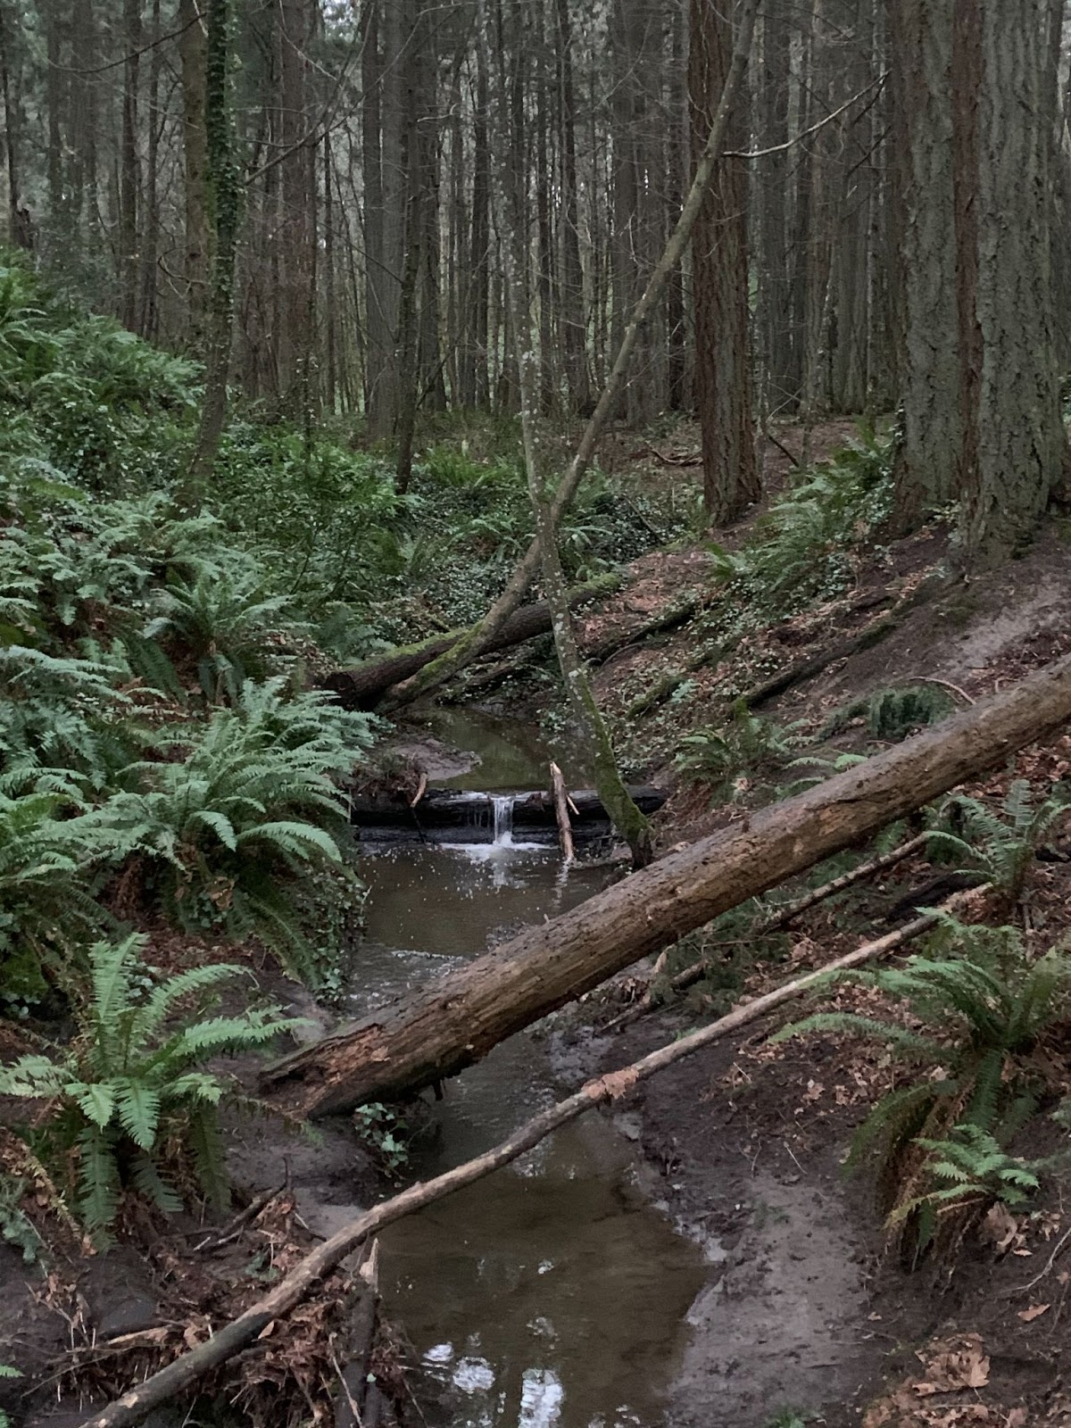

Slide 3
Overview
FAST Policy & Outreach Committee (FPOC)
FAST Quick Start Guide
FAST SACO Funnel
Questions

Slide 5
FAST Policy and Outreach Committee
”…the joint committee of OCLC and FAST implementers acts as an advisory and outreach body. Their priority is to ensure FAST will be a fully supported, widely adopted and community developed general subject vocabulary derived from LCSH with tools and services that serve the needs of diverse communities and contexts.”

Slide 6
Who are FPOC?
Institutional members
Jill Annitto, American Theological Library Association (ATLA)
Heidy Berthoud, Smithsonian Libraries
Carol Campbell, National Library of Scotland
Chew Chiat Naun, Harvard University
Alan Danskin, (Co-Chair) British Library
Lucy Kilpatrick, Bibliographic Data Services
Kim Mumbower, The Library Corporation (TLC)
Dean Seeman, (Co-Chair) University of Victoria Libraries
OCLC Liaisons
Becky Dean
Nathan Putnam
Diane Vizine-Goetz
Cynthia Whitacre

Slide 7
FAST Quick Start Guide
“The FAST Quick Start Guide is intended to give you answers to some of the most frequently asked questions about FAST and offer instructions for getting up and running with FAST in any environment.”
Arose out of a survey on FAST usage from 2021
Centralized information about FAST
Expect it will be published this spring

Slide 8
FAST Quick start guide
FAST Quick Start Guide
What is FAST?
Why Use FAST?
How Do I Start Using FAST?
1. FAST in the Library Catalog
2. FAST in Other Systems
3. FAST Maintenance
What FAST headings do you want to use?
FAST in WorldCat vs. searchFAST
Statistics
Examples of FAST usage by various systems/organizations

Slide 10
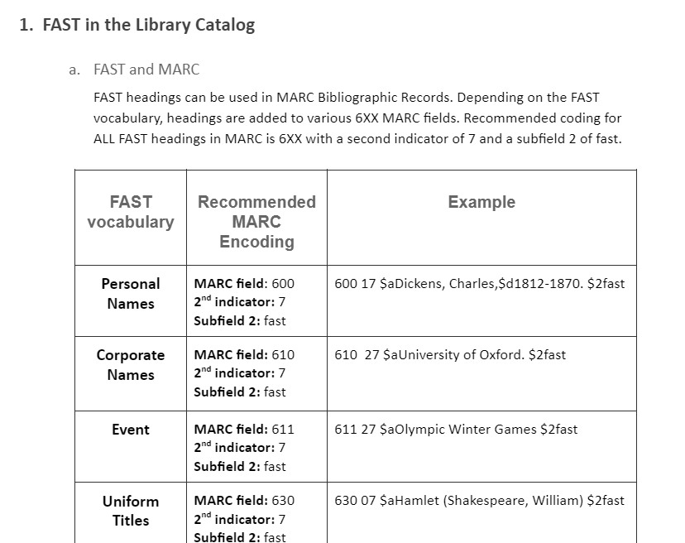

Slide 11
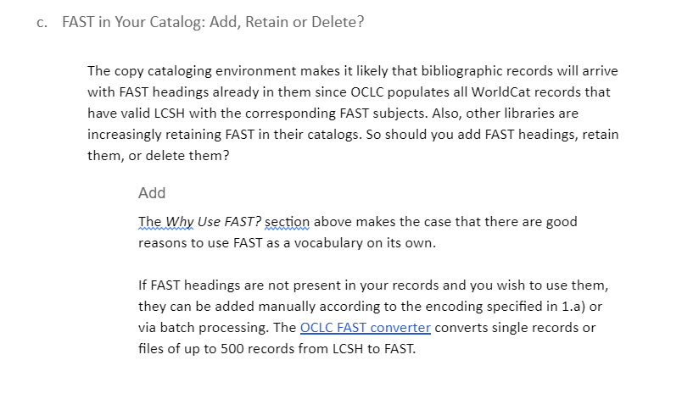

Slide 12
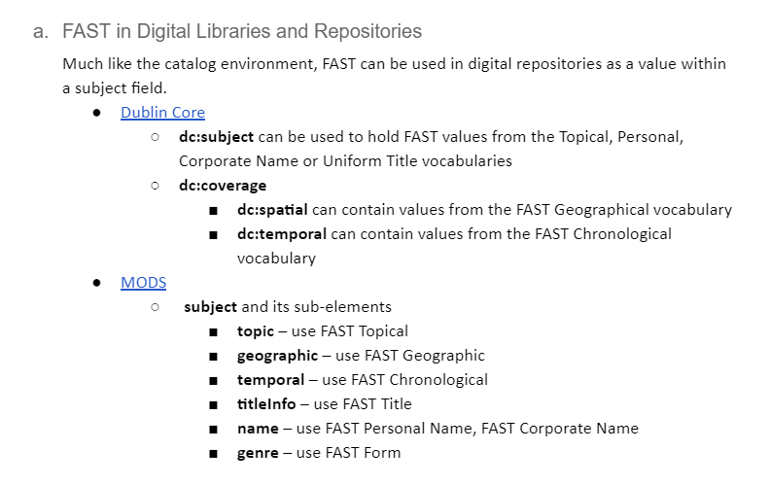

Slide 13
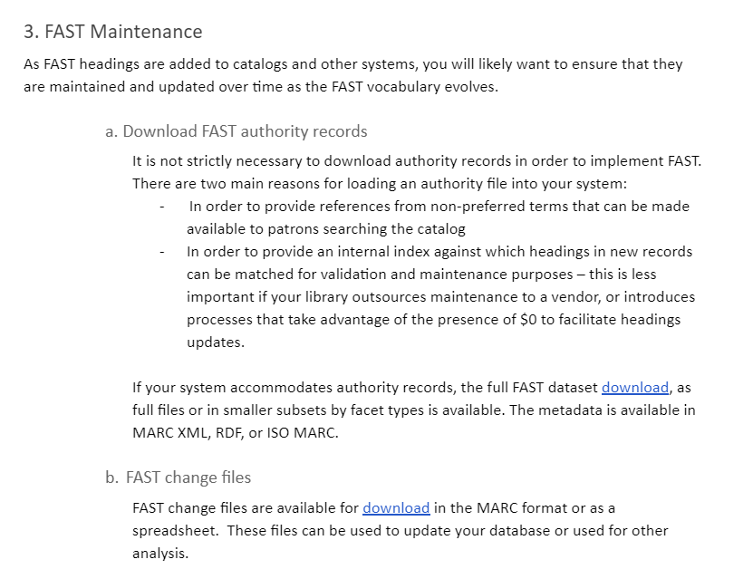

Slide 14
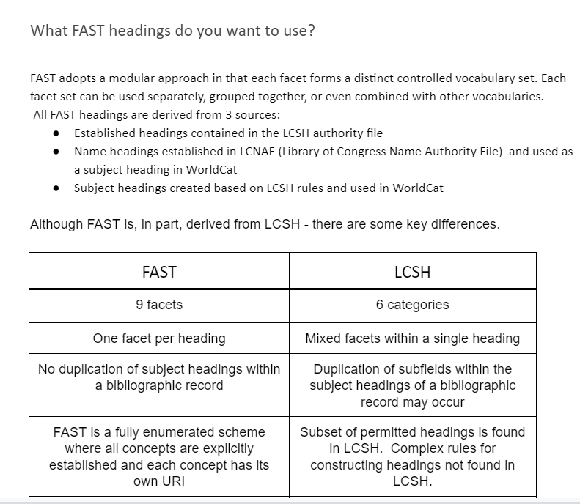

Slide 16
FAST Funnel
Purpose
The priority for the funnel is to prepare and submit SACO proposals on behalf of the FAST Community. The funnel will particularly benefit those FAST users who do not use or are unfamiliar with Library of Congress Subject Headings (LCSH).
The Funnel also provides a valuable source of information for the development of FAST and its evolving relationship with LCSH.
If you would like to participate in the Funnel or have questions about the Funnel please contact the Co-coordinators.

Slide 17
FAST Funnel
Status
Public launch announcement imminent
The funnel team comprises subject experts from institutions using FAST and LCSH
The funnel team has been working together informally for several months on a backlog of proposals to develop processes and to get to know one another
Capacity will be limited by the size of the team
FAST Funnel does not currently provide a means of bypassing the LCSH Editorial process. Terms are proposed for inclusion in LCSH in order that they can be added to FAST.

Slide 18
FAST Funnel
Proposals
We will be accepting new proposals following public launch
Details of how to submit proposals to the funnel will be published
Funnel capacity will be limited
Priority will be given to those without LCSH expertise/access to alternative routes.
Co-Coordinators:
Janet Ashton
janet.ashton@bl.uk
Alan Danskin
alan.danskin@bl.uk

Slide 19
Thanks for listening
Are there any questions?
dseeman@uvic.ca

