Slide 1
Hybrid Workflow Development for Catalog Maintenance
A Case Study on Composers’ Collected Works
David Floyd, Chief Cataloging Librarian, Binghamton University

Slide 2
Outline
Background
Collection Analysis
Workflow Design
Progress

Slide 3
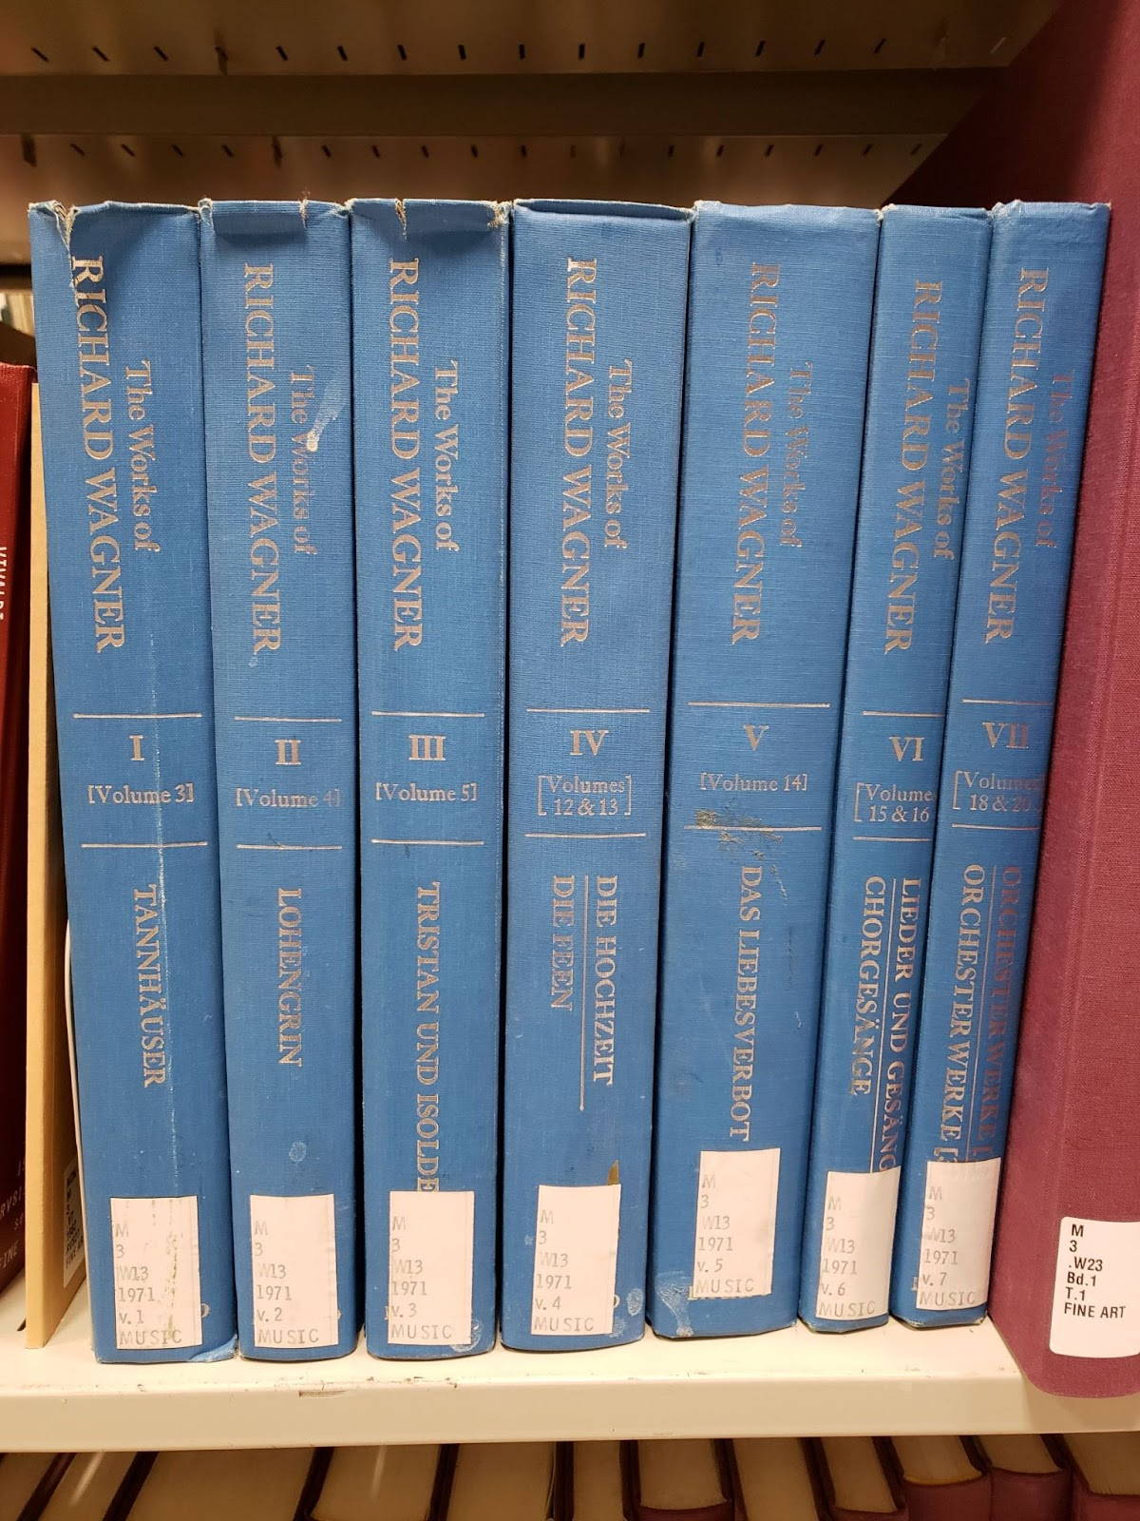
Background
Composer’s Collected Works (CCW): a critical edition of every known work by a composer, often published simultaneously with detailed editorial commentary and occasionally facsimiles of significant manuscripts.
Can be published as a complete set, or by volume over a number of years.
Even when published sporadically over many years, they are not true continuing resources.

Slide 4
Background
Cataloging Approach
FTC: Fully analyzed, Traced, Classed as a collection. Sets are cataloged score by score.
Titles come from the individual work
245 10 $a Lohengrin : $b romantische Oper in drei Aufzügen ...
Set is described with a series statement
490 1_ $a Works of Richard Wagner …
800 1_ $Wagner, Richard, $d 1813-1883. $t Works.
FTC Cataloging
Bib 1
Bib 7
Bib 2
Bib 6
Bib 3
Bib 4
Bib 5

Slide 5
Background
Cataloging Approach
Comprehensive: One bibliographic record is used to describe the entire set.
Title comes from the set
245 14 The works of Richard Wagner …
Titles of works described with detailed contents note.
505 0_ $a Music dramas: I. Tannhäuser ; II. Lohengrin …
Comprehensive Cataloging
Bib 1 (detailed contents note)

Slide 6
Collection Analysis
Identifying the problem
By CCW set, most, but not all are cataloged comprehensively.
Inconsistency leads to poor search result quality, lack of distinction from circulating score collection.

Slide 7
Collection Analysis
Identifying the problem
By volume, the majority of the scores are analyzed FTC sets.
Some large FTC sets
Mozart
Beethoven
Bach
Haydn
Handel

Slide 8
Workflow Design: Goals and Challenges
Goals
Convert the FTC records to comprehensive.
Reprocess physical material when necessary.
Challenges
Tasks require varied expertise.
Too much work for one cataloger in a reasonable amount of time.
Remote work is done on an inconsistent basis.

Slide 9
Challenge #1: Tasks require varied expertise.
One-Time/Ongoing Tasks
Repeated Tasks
Evaluate cataloging of CCWs.
Run Python scripts to group the CCW item records into sets and mark analyzed titles.
Build the project spreadsheet.
Test core workflow.
Create documentation.
Train participants.
Move items in Alma.
Pull physical items for reprocessing.
Record progress.
Update the spreadsheet.
Update documentation.
Update holdings records.
Identify/create the correct comprehensive description for a CCW.
Troubleshoot problems.

Slide 10
Challenge #2: Too much work for one cataloger in a reasonable amount of time
Training
Shared support
New workflow for moving inventory in Alma
Introduction to the documentation
Introduction to the format of CCW sets
Google Drive
Regular communication about roles and responsibilities
Building confidence over time

Slide 11
Challenge #3: Remote work is done on an inconsistent basis.
On-Site Required
Flexible
Remote Required
Pull items to be reprocessed
Process physical items
Shelf-check cases with questionable cataloging
Convert CCWs from FTC to Comprehensive (Core task)
Create and manage documentation
Assign and manage tasks
Update holdings records
Create or Update comprehensive bib records for CCWs
None

Slide 12
Workflow Design: Results
NOTE: Image shows two parallel workflows, not displayed for readability on this slide.
Left: Building and maintaining project resources
Right: Executing the conversion
Not a 50/50 division of labor. Workflow #1 represents ~10% of total work required.

Slide 13
Project Progress
206 out of 233 sets are now Comprehensive. Up from 169.
Remaining sets are identified projected to be completed in Summer 2023.

Slide 14
Project Progress
3261 out of 3905 volumes are part of Comprehensive sets. Up from 1778.

Slide 15
Thank you!
David Floyd, Chief Cataloging Librarian, Binghamton University
dfloyd@binghamton.edu
Link to poster with detailed workflow: https://orb.binghamton.edu/librarian_fac/64/

