Slide 1
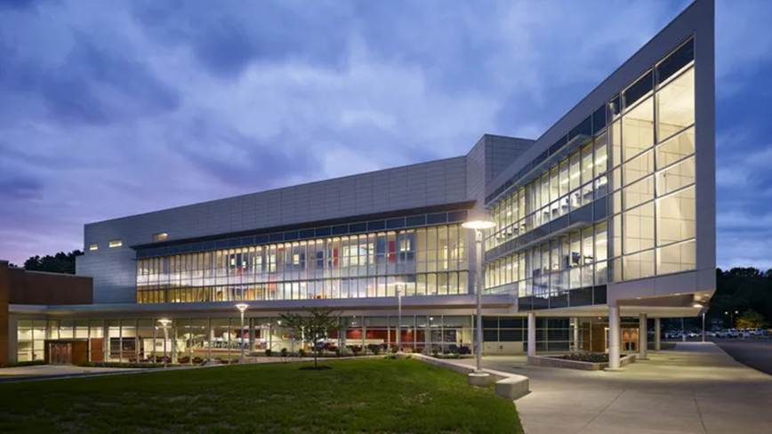
Open Access Discoverability and Advocacy
a community college perspective
Louise Feldmann
Andrea Rodgers, Delaware County Community College, Media, PA

Slide 2
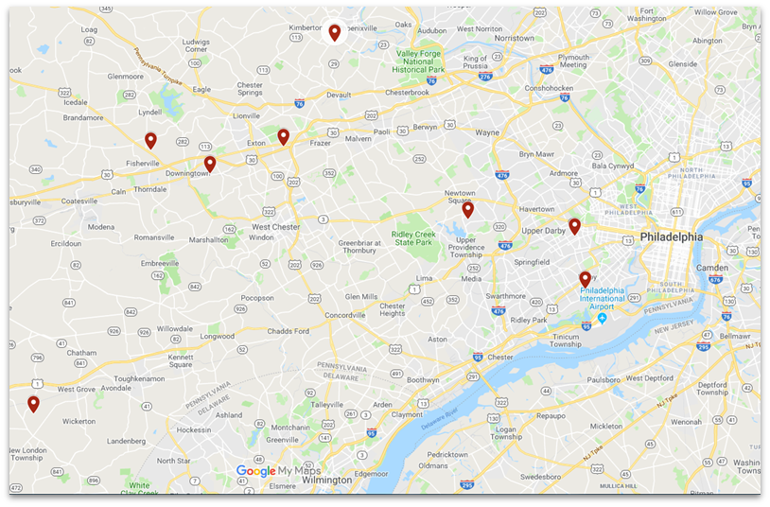
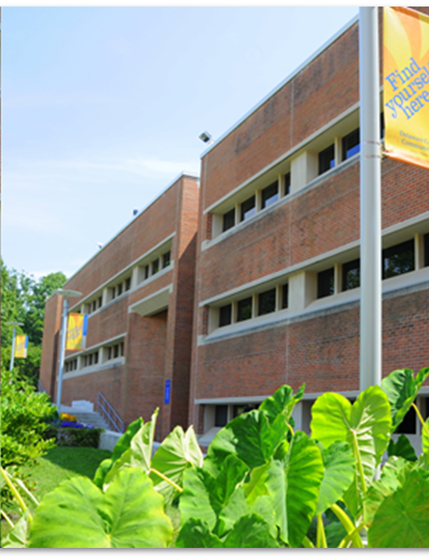
Delaware County Community College

Slide 3
Institutional Context
Founded in 1967
8 locations in Southeastern Pennsylvania across two counties (Delaware & Chester)
As of Fall 2021:
Full-time Equivalent (FTE): 5,714
Total Enrollment: 9,143
Full-time attendance: 23%
Part-time attendance: 77%
Program enrollment:
Transfer programs: 57%
General studies: 3%
Career/Occupational: 40%

Slide 4
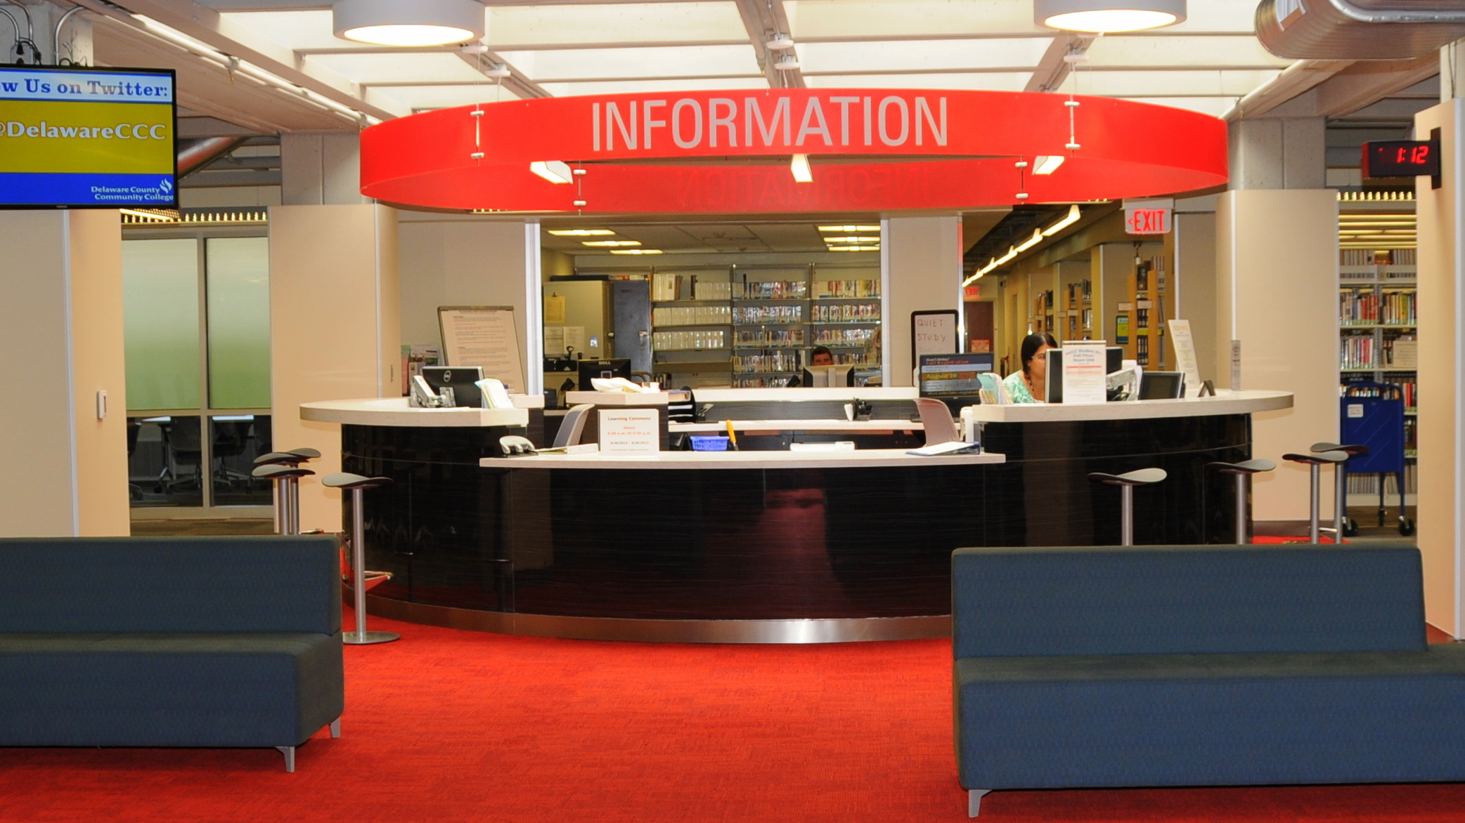
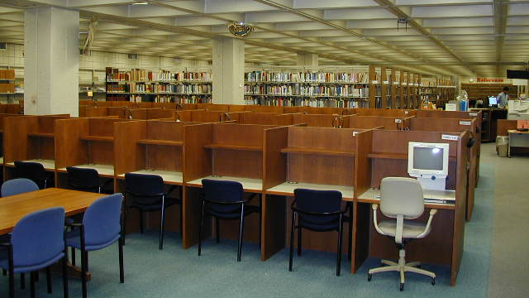
From Library to Learning Commons

Slide 5
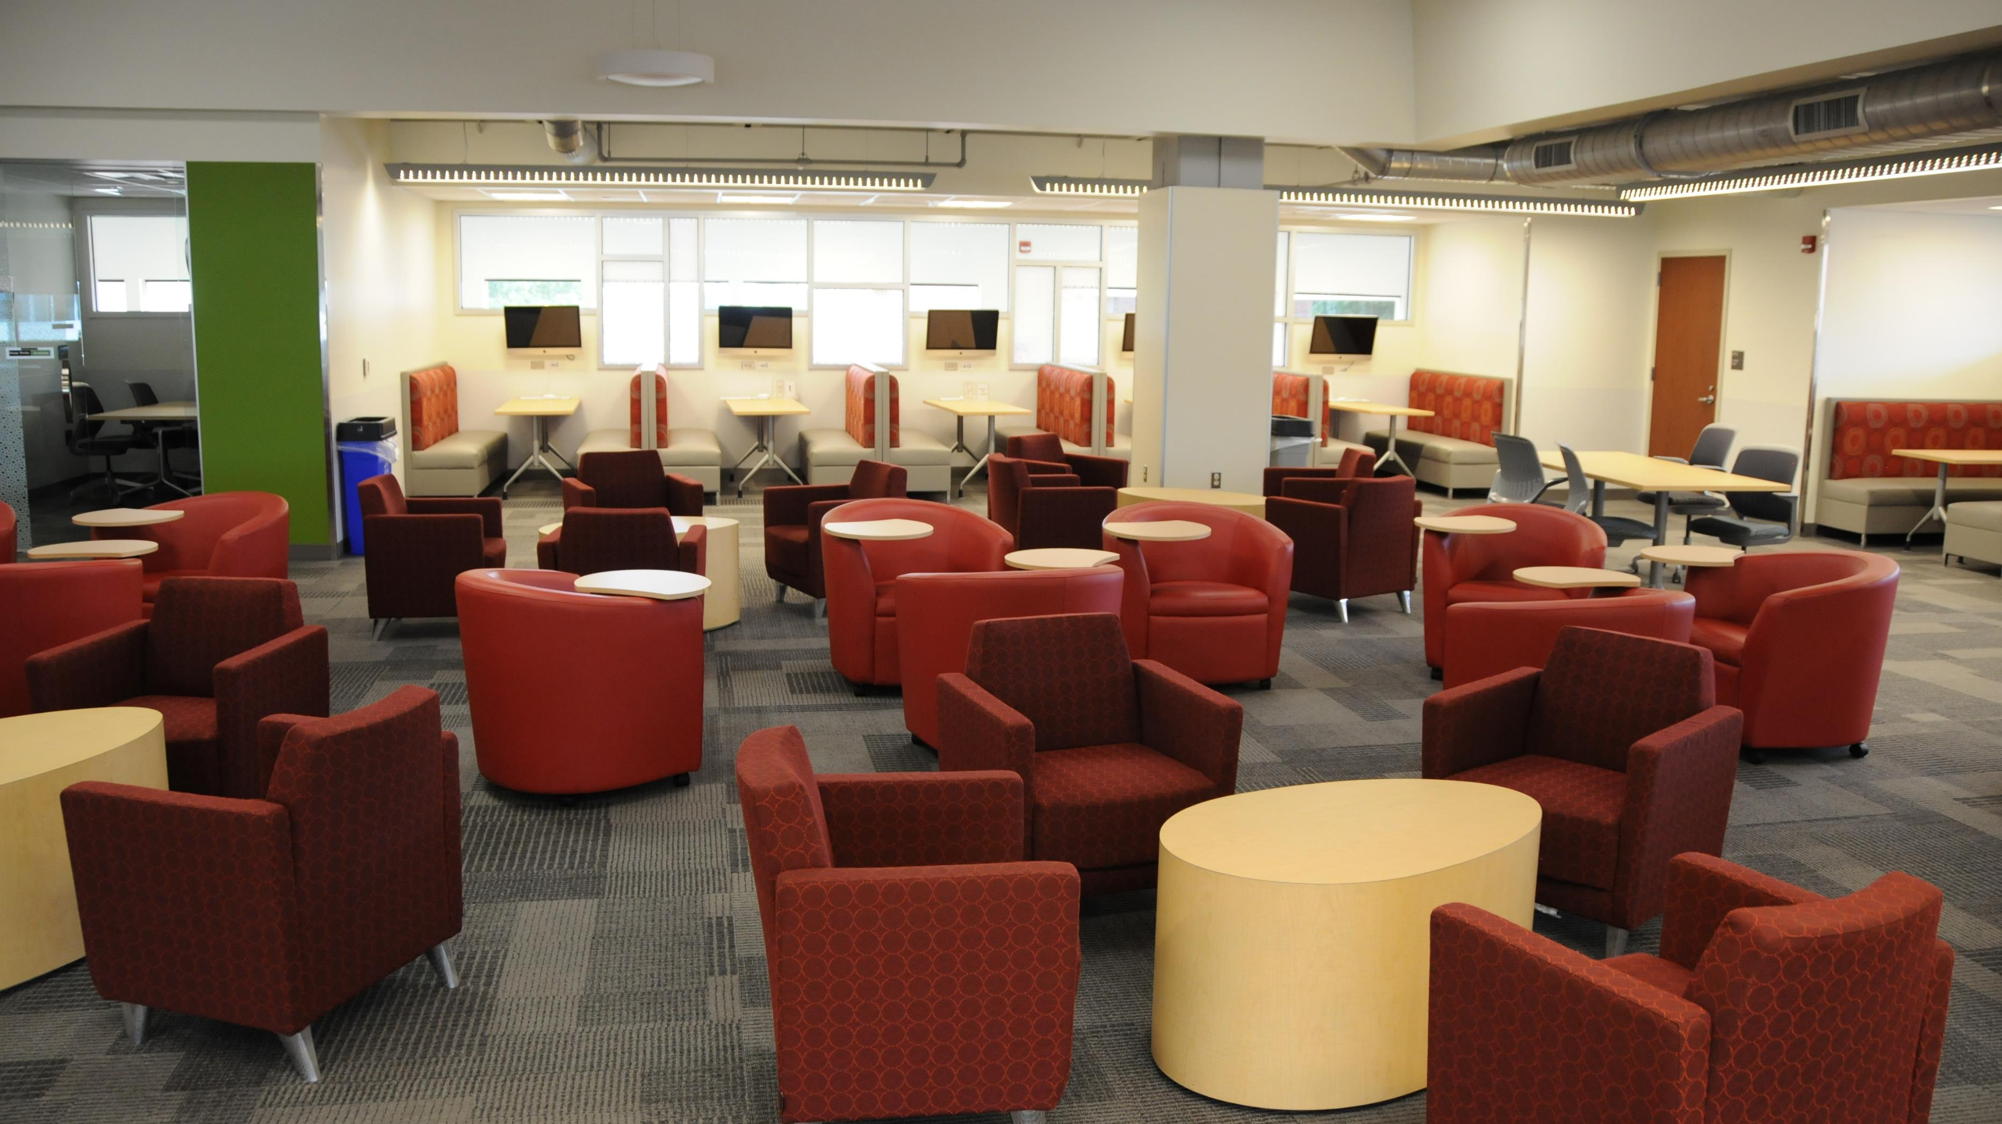
Heavy weeding - 30,000 physical materials removed

Slide 6
Open Access & Open Education Resources
“Open Access logo” by Nick Shockey is licensed under CC-BY 4.0 ; “OER Logo Open Educational Resources” by Markus Busges is licensed under CC-BY-SA 4.0

Slide 7
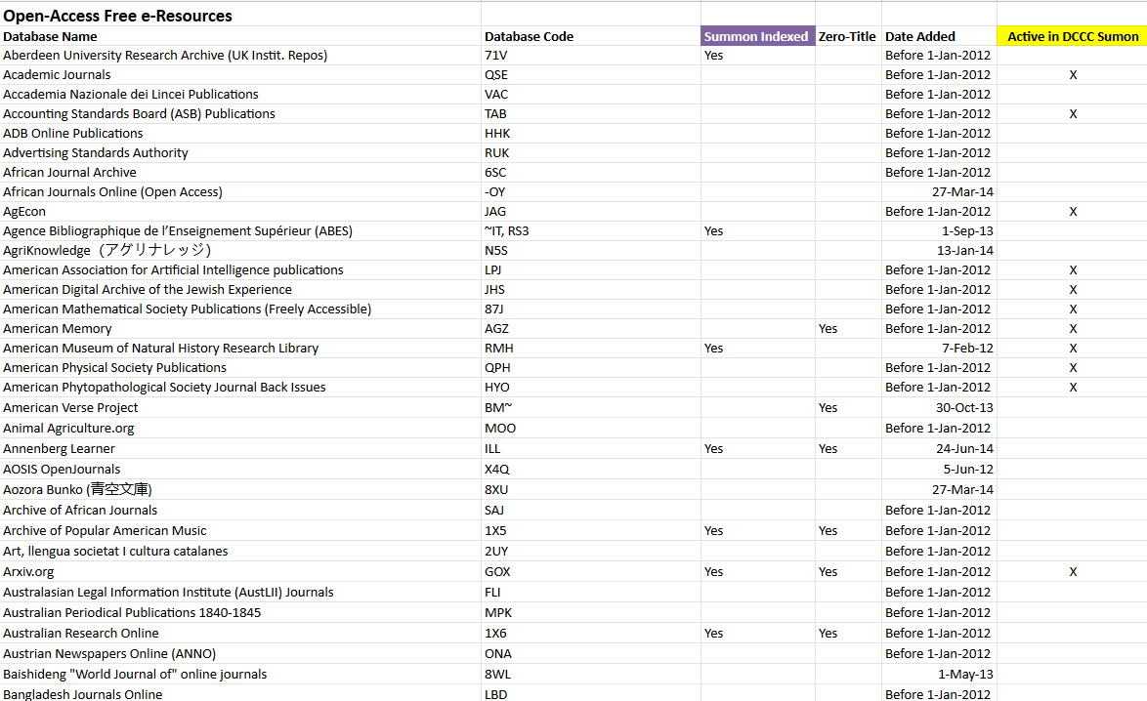
Discoverability: Open Access

Slide 8
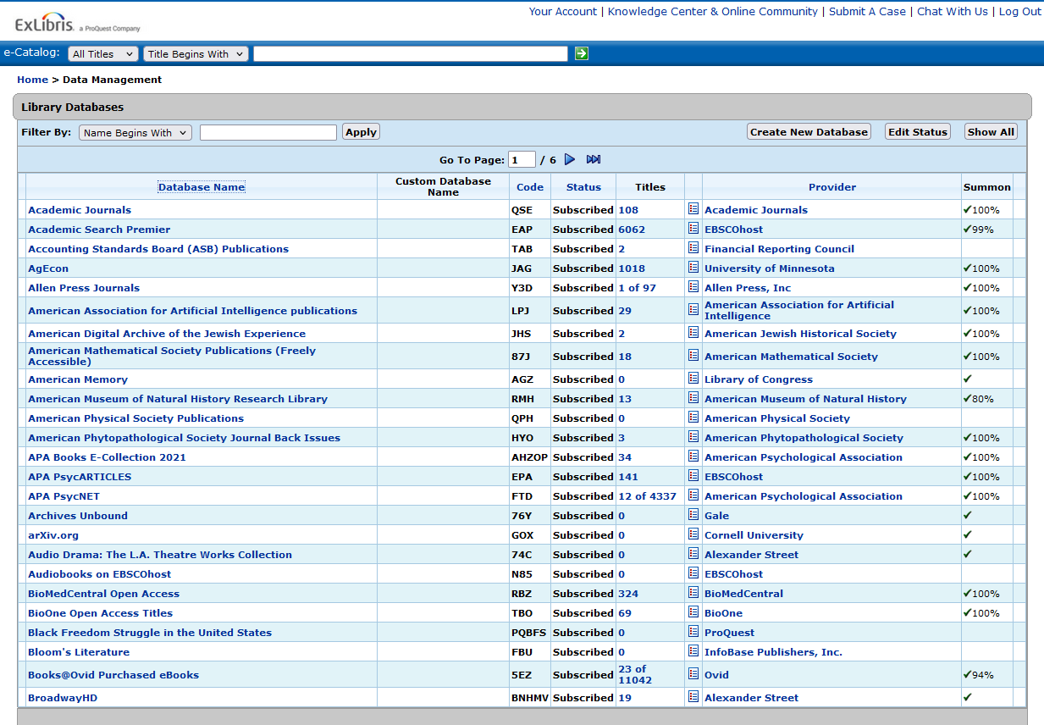
Discoverability: Open Access

Slide 9
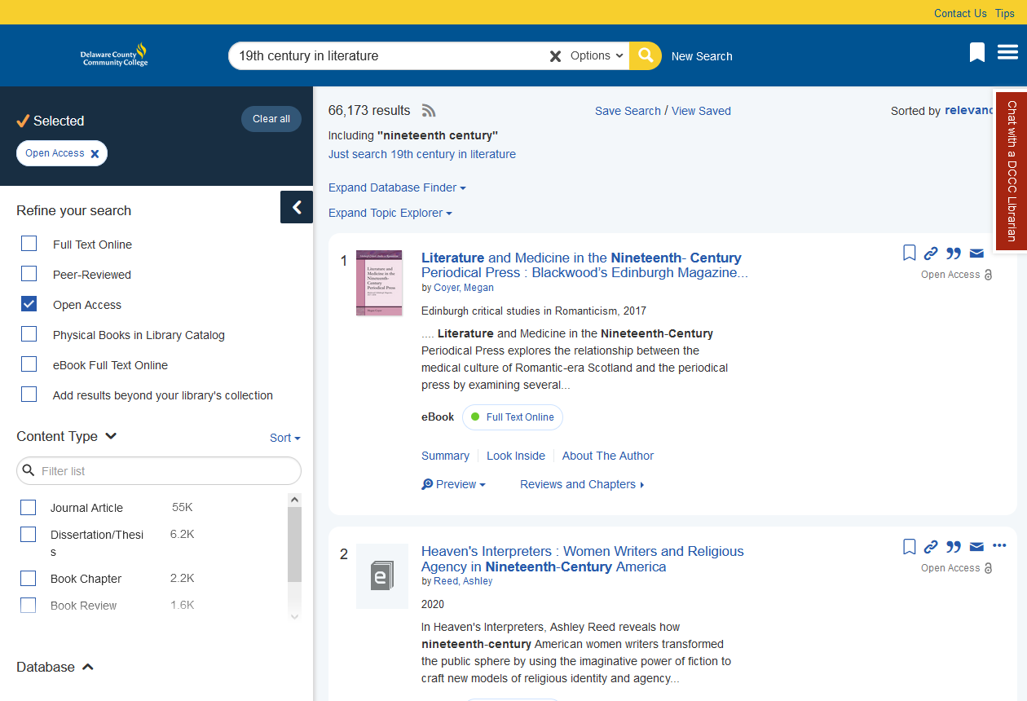
Discoverability: Open Access

Slide 10
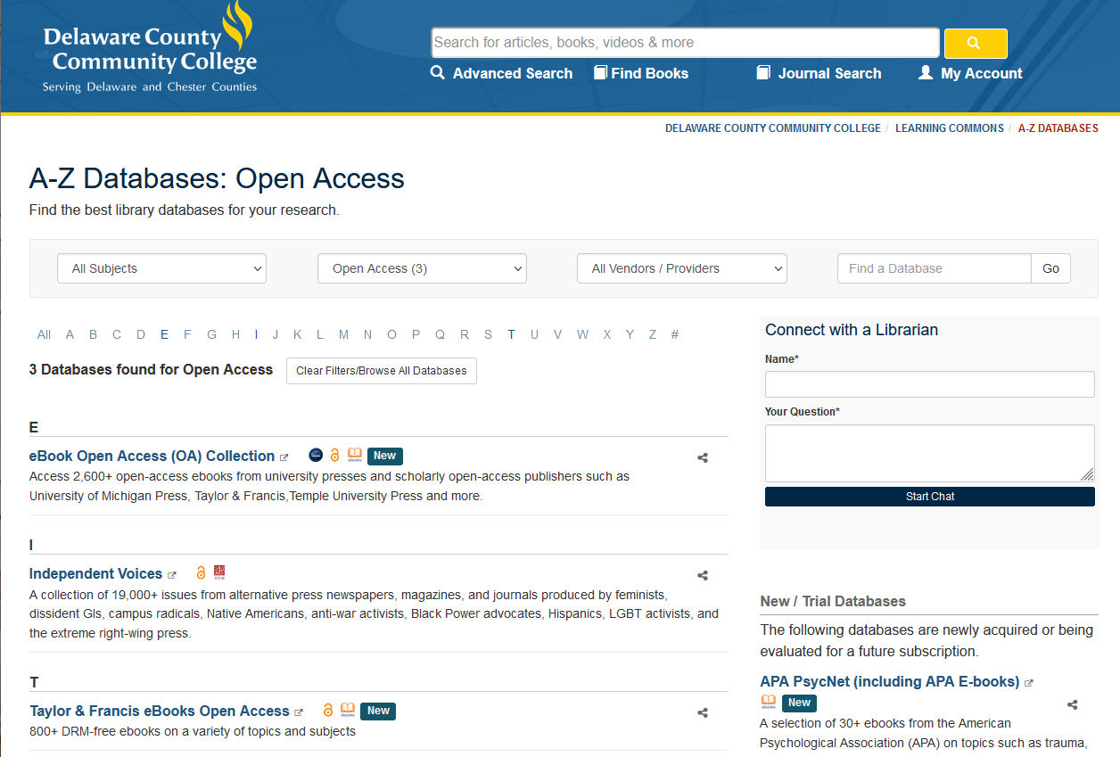
Discoverability: Open Access

Slide 11
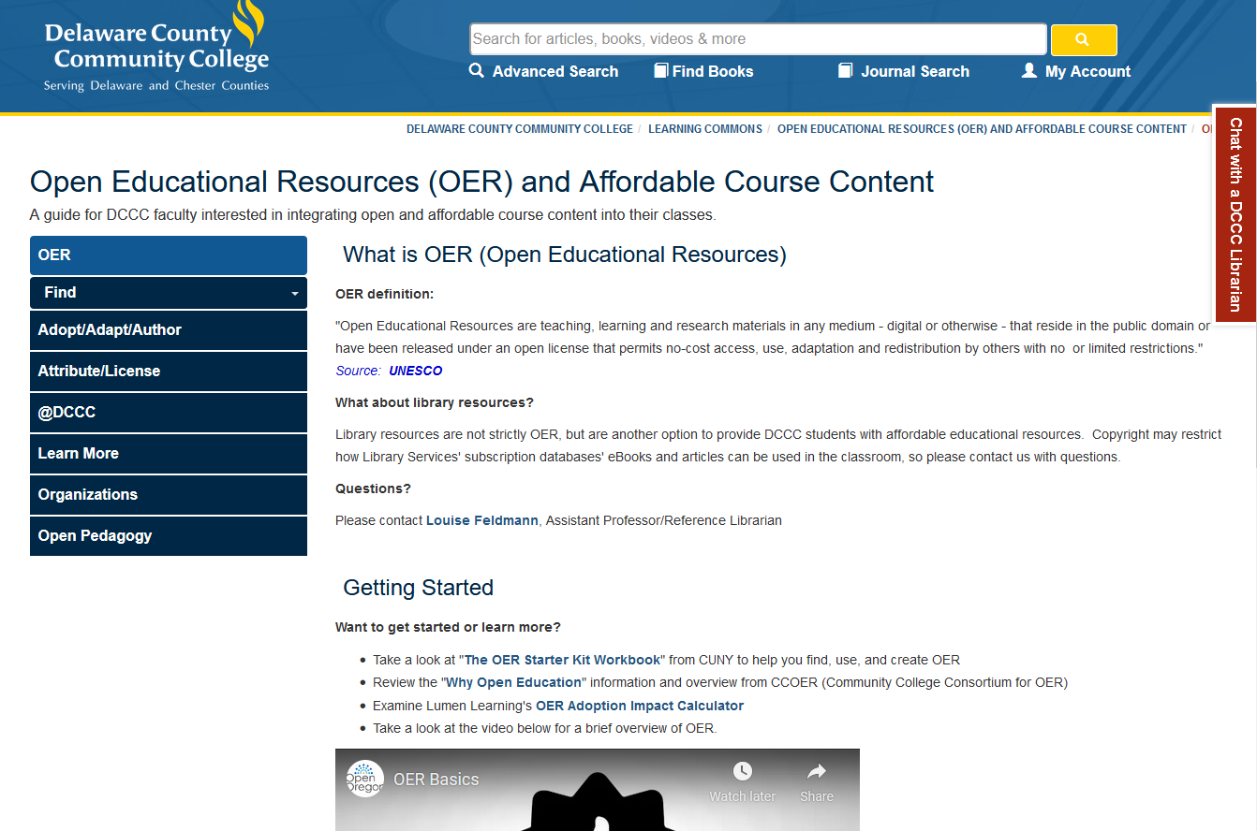
Discoverability: OER

Slide 12
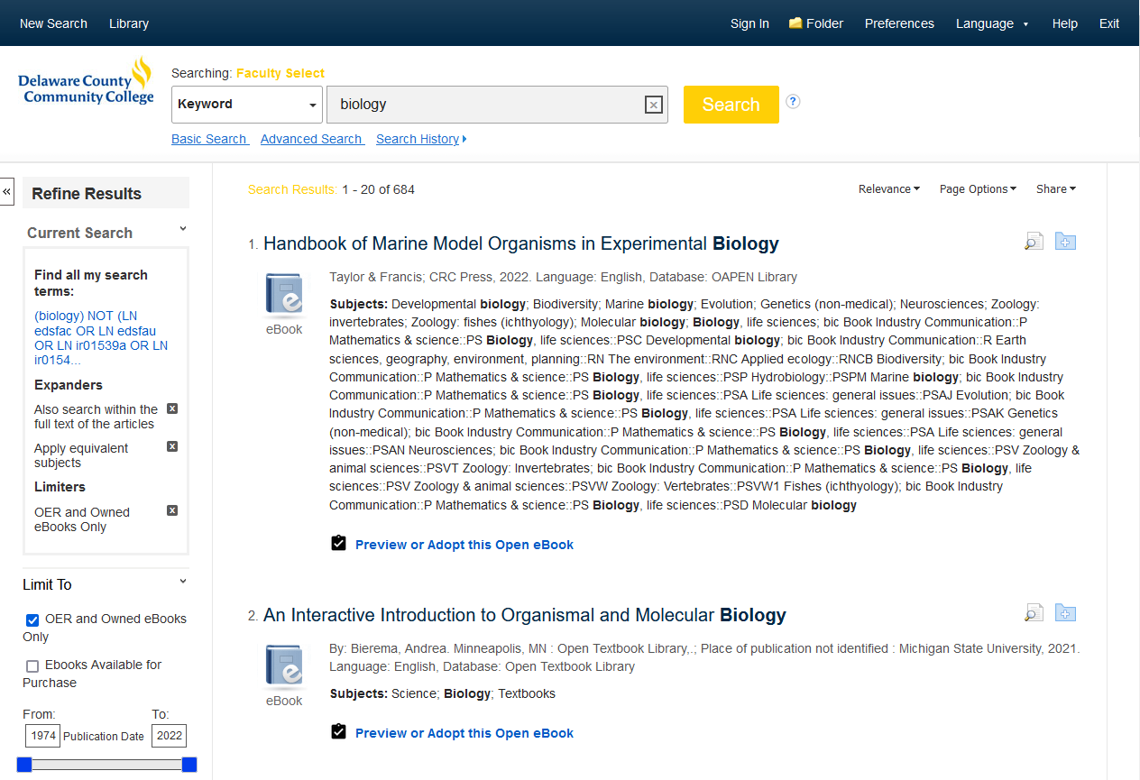
Discoverability: OER

Slide 13
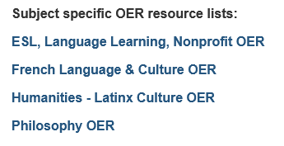
Discoverability: OER

Slide 14
Discoverability: OER

Slide 15
Advocacy
Surveys
Grant opportunities
OA and OE weeks
Professional development
Support | Resources | Webinars

Slide 16
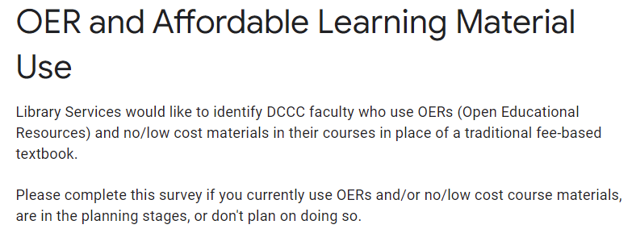
Surveys

Slide 17
Grants
Pennsylvania Grants for Open and Affordable Learning (PA Goal)
Awarded
Art History
Reading
In process
Workforce Development (Construction)
Other grants​
Spanish

Slide 18
Professional Development

Slide 19
Continued Advocacy
OER inventory
OA & OER webinars
OER organizations
And more

Slide 20
Questions & Comments
Louise Feldmann Assistant Professor & OER Librarian lfeldmann@dccc.edu
Andrea Rodgers Assistant Professor & Electronic Resources Librarian arodgers4@dccc.edu

