Slide 1
Parlez-Vous NACO? Authority Training at LAC
Dominique Bourassa
Catalog Librarian
Yale University Library

Slide 2
Disclosure
Trainer in Training!
training wheels

Slide 3
Training Sessions

Slide 4
First training
May 28 to June 1, 2018
7 trainees (Government Publications Team)
1 team leader
3 librarians
3 technicians
Pilot project to prepare staff for to migrate unique English-language Canadian federal government authorities to NAF

Slide 5
First training
Proposed Modified NACO Program
Day 1: NACO Foundations
Day 2: Corporate Bodies, Places
Day 3: Persons
Day 4: Works and Expressions
Day 5: Changes to Existing Authority Records; NACO Administration
NACO training presentations in English
Qs & As in English and French

Slide 6
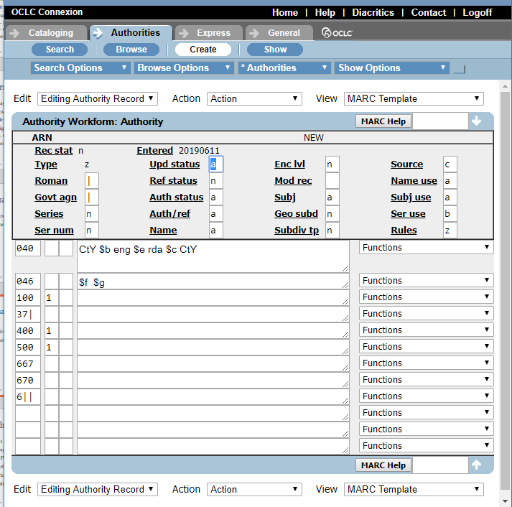
Connexion Web Browser

Slide 7
Differences in practice
Normalization, duplicates and conflicts did not exist in Canadiana.
Record 1 | Record 2
100 1- $a O’Brien, John 400 1- $a O’Brien, Jack | 100 1- $a O’Brien, Jack 400 1- $a O’Brien, J. (Jack)
Correct in Canadiana
Conflict in NAF

Slide 8
Differences in practice
110 vs 151: jurisdictions, military installations
Canadiana | NAF
110 1- $a Canada | 151 -- $a Canada
110 1- $a Canada. RCAF Station High River | 151 -- $a RCAF Station High River (Alta.)

Slide 9
Differences in practice
Information in 670 recorded differently
Canadiana | NAF
110 1- $a Canada. $b Department of Finance | 110 1- $a Canada. $b Department of Finance
670 -- $a title, date: $b location (Department of Finance) | 670 -- $a title, date: $b location (Canada Department of Finance)

Slide 10
1st LAC Record added to NAF
Linda Laroque
Cataloguing technician
Government Publications Team

Slide 11
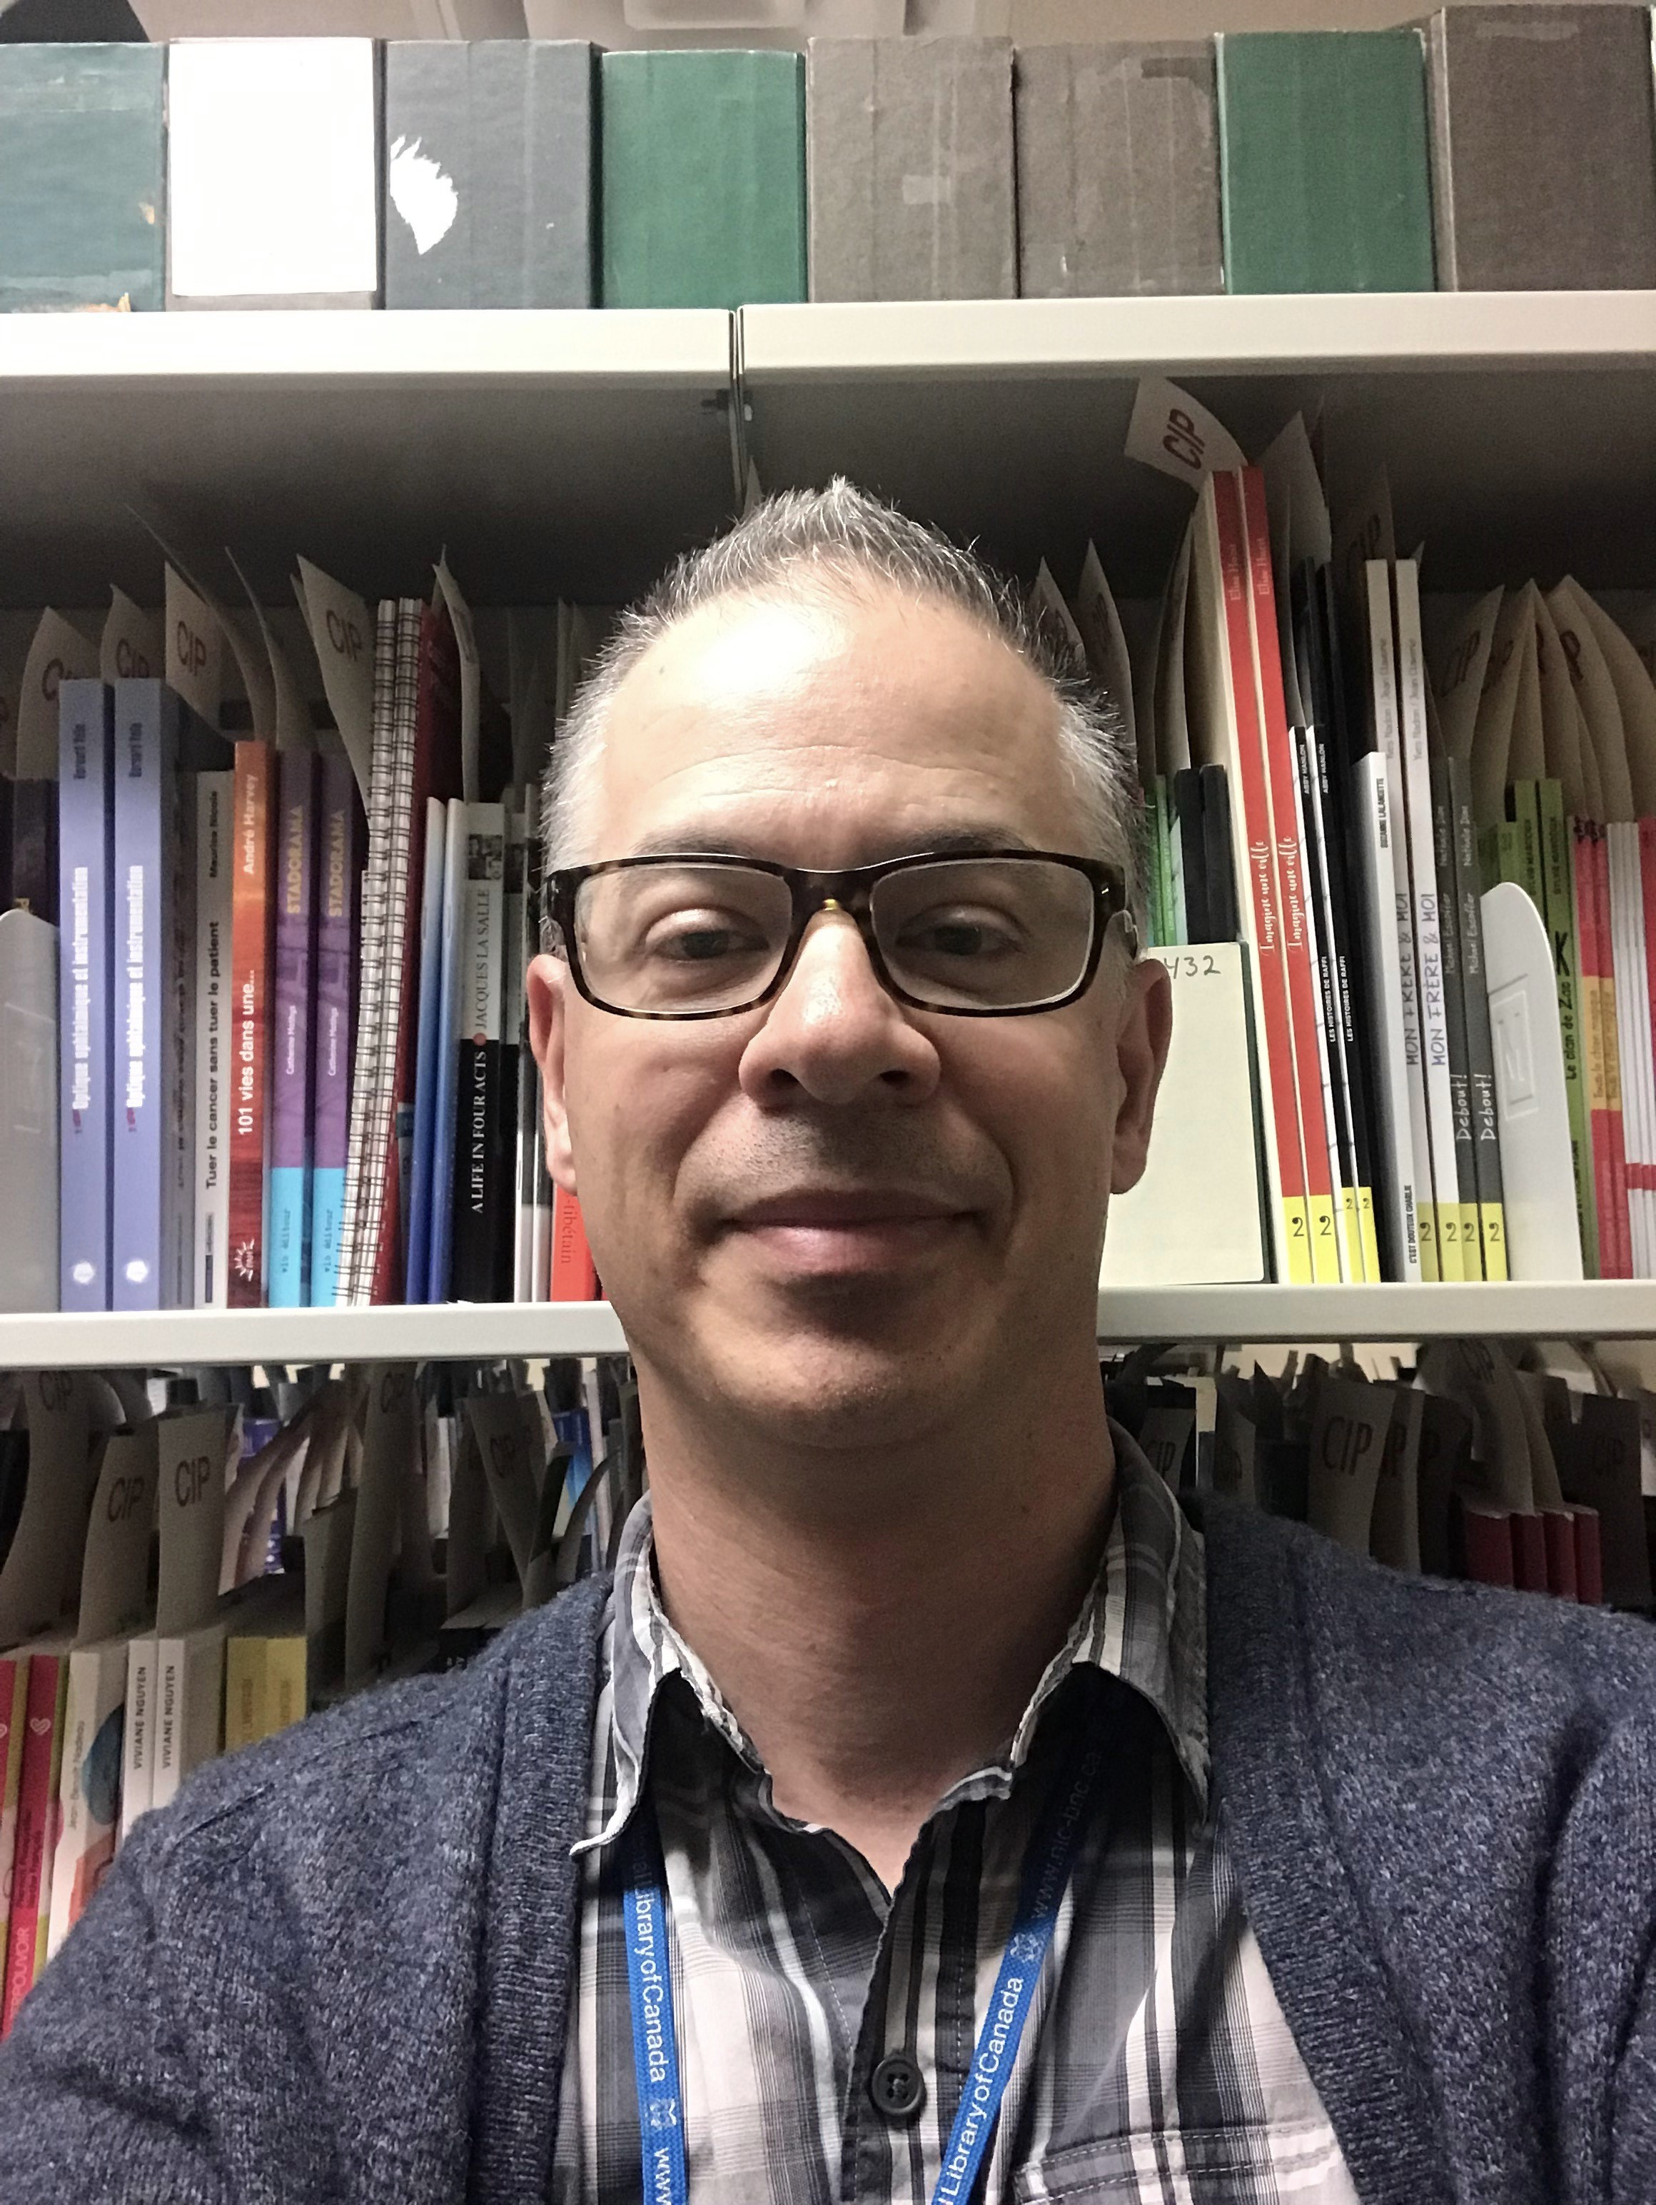
Training in English
September 10 to 14, 2018
26 LAC trainees
CIP Team
Government Publications team
Music Team
Serials Team
2 guests from Concordia University
Michael van Dyk
Senior Librarian
Government Publications Team

Slide 13
WorldShare Record Manager

Slide 14
Training in French
September 24 to 28, 2018
17 trainees
French Monographs Team
CIP Team
Government Publications Team
Music Team
Serials Team

Slide 15
Training in French
11 guests from francophone academic libraries
École de technologie supérieure (Montréal)
HEC Montréal
Polytechnique de Montréal
Université de Montréal
Université de Sherbrooke
Université du Québec à Montréal
Université du Québec en Outaouais (Gatineau)
Université Laval
Help: Arouce Wasty, Cataloguing Librarian, Government Publications Team

Slide 16
NACO Presentations in French

Slide 17
Woops…

Slide 18
Review Process

Slide 19
Estimated Weekly Output
Team | Number of New Authority Records | Service Standard
Cataloguing in Publication (English monographs) | 100 | 15 days from receipt of application
French monographs | 34 | None
Serials | 10 | None
Government publications | 20 | 10 day from receipt of new publication checklist
Music | 10 | None

Slide 20
Non-Latin Scripts and Specialities
Canadian Aboriginal Syllabics
Arabic, Dari, Farsi, Urdu
Belarusian, Bulgarian, Croatian, Czech, Polish, Serbian, Slovak, Slovenian, Macedonian, Russian, Ukrainian
Chinese, Japanese, Korean
Greek
Hebraica
Legal works
Music

Slide 21
Building the Review Team
Contacted coordinators of 7 funnels:
Atlantic Canada
Canada
Arabic
CJK
Hebraica
Law
Music
Recruited NACO reviewers

Slide 22
Meet the Review Team
21 reviewers
From 6 Canadian and 10 American libraries
Anne Adams | Karen Jensen | Adam L. Schiff
Adam Baron | Kevin Kishimoto | Brian Stearns
Dominique Bourassa | Heidi G. Lerner | Yukari Sugiyama
Sean Chen | Robert Maxwell | Elizabeth Tobiasson
Rowena Griem | Roman S. Panchyshyn | Larisa Walsh
Larry Heiman | Heather Pretty | Linda Woodcock
May Hmaidan | Mark Scharff | Jia Xu

Slide 23
Unanticipated Issues

Slide 24
Reviewers’ Concerns
Reviewees touch “perfectly good” records
To add specific LAC fields (016, 065, etc.)
To transfer valuable information from Canadiana
Local practice transferred to NAF
370 -- $c Canada $2 naf
(to indicate Canadian citizenship)
Reviewers’ suggestion
368 -- $c Canadians $2 lcdgt
(more appropriate way to indicate Canadian citizenship)

Slide 25
Variant Access Points
Authorized access points from the French file cannot always be added as a variant access point in NAF.
111 2- $a International Nuclear Safety and Decommissioning Industry Forum $d (2018 : $c Kyŏngju-si, Korea)
411 2- $a Forum international de l'industrie sur la sûreté nucléaire et le déclassement $d (2018 : $c Kyŏngju, Corée)
411 2- $a Forum international de l'industrie sur la sûreté nucléaire et le déclassement $d (2018 : $c Kyŏngju-si, Korea)

Slide 26
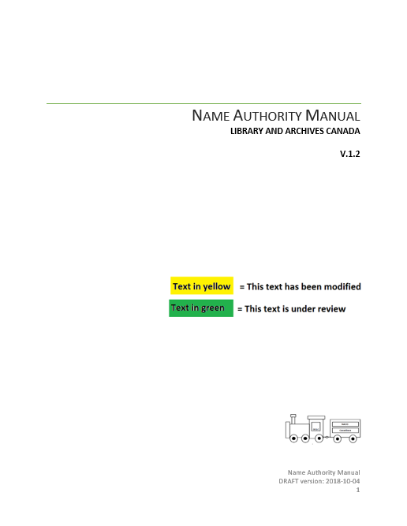
Local Authority Manual
Nathalie Mainville
Senior Librarian
Information Standards
Version 2

Slide 27
Local Authority Manual
Version 13, English
Version 13, French

Slide 28
Thank you…
Sarah Stacy and Hong Cui
Paul Frank
Bob Maxwell and Adam Barron
Team of dedicated reviewers
LAC staff…

Slide 29
LAC’s Contributions to NAF
LAC Statistics October 2018 – March 2019
New NARs: 2,206
Changed NARs: 5,768

Slide 30
https://www.vexels.com/vectors/preview/144618/live-breaking-news-header-image

Slide 31
LAC has been granted
institutional independence
in name authority work
Congratulations!
Félicitations!
https://www.vexels.com/vectors/preview/144618/live-breaking-news-header-image

