Slide 1
Welcome to LAC/ Bienvenue à BAC : A new bilingual NACO partner Authority Control Interest Group (ALCTS LITA) Sarah Stacy and Hong Cui
Sunday, June 23 2019

Slide 2
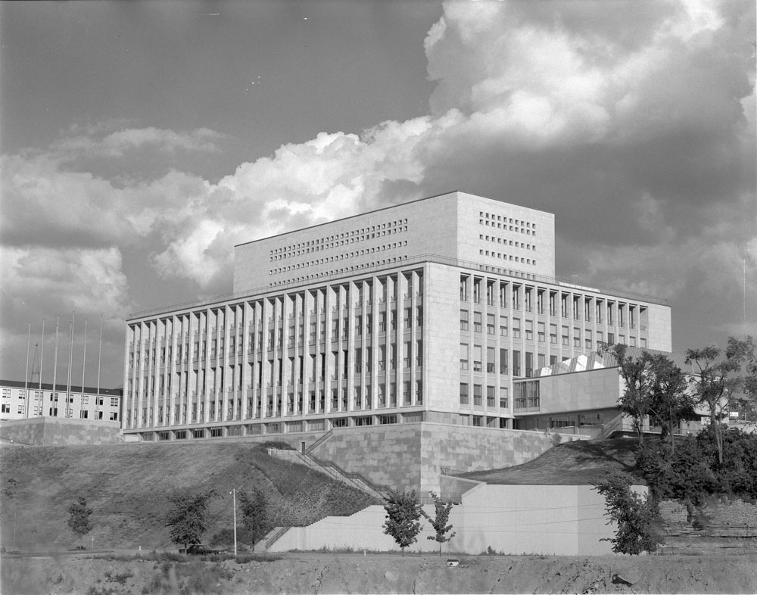
Welcome to LAC!
Cameron, Duncan. “Opening of Public Archives and National Library.” [With Prime Minister Lester B Pearson]. June 20, 1967. Library and Archives Canada, e011197968.
Notes:
Library and Archives Canada (LAC) combines the holdings, services and staff of both the former National Library of Canada and the National Archives of Canada. As outlined in the Preamble to the Library and Archives of Canada Act, LAC’s mandate is as follows:
to preserve the documentary heritage of Canada for the benefit of present and future generations;
to be a source of enduring knowledge accessible to all, contributing to the cultural, social and economic advancement of Canada as a free and democratic society;
to facilitate in Canada co-operation among communities involved in the acquisition, preservation and diffusion of knowledge;
to serve as the continuing memory of the Government of Canada and its institutions.

Slide 3
A history of bilingual cataloguing
Official languages Act, 1969
Task force on Cataloguing Standards, 1972
Authorities: parallel authorities in English and French
AMICUS, launched in 1995, allowed authorities to be linked
AMICUS required replacement

Slide 5
Canadiana Authorities
Vancouver (B.C.)
The French-language equivalent from Amicus and in Canadiana is: Vancouver (C.-B.)
Aelfgifu, Queen, consort of Edwy, King of England, active 956
NACO: OCLC 00909716
Basak, Amit (Professor of chemistry)
NACO: OCLC 10694573
ABACUS (Computer file)
NACO: OCLC 02750982
Aaron ben Joseph, ha-Levi, approximately 1235-
NACO: 01556759

Slide 6
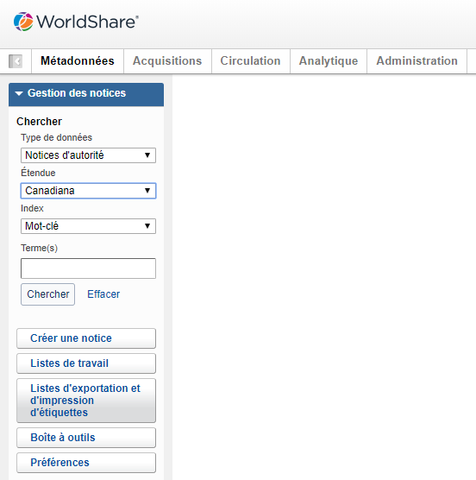
Canadiana Authorities

Slide 7
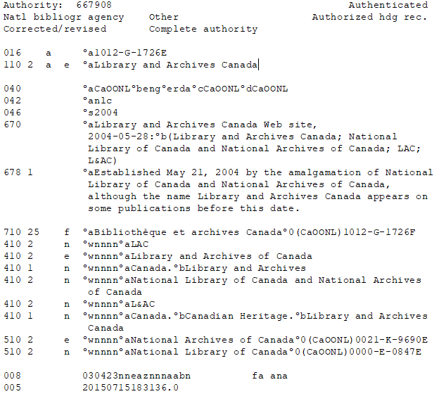
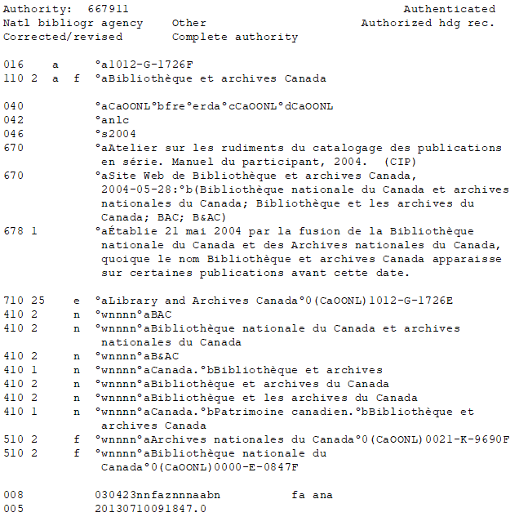
AMICUS Authority

Slide 8
Joining NACO
Canadiana Authority
NACO Authority

Slide 9
Benefits to LAC and Libraries

Slide 10
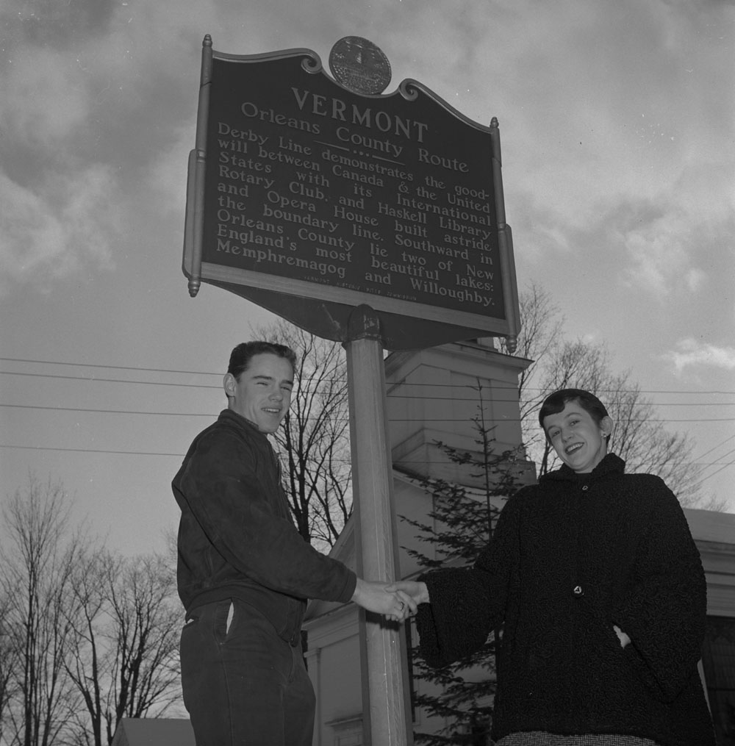
Thank you

