Slide 1
Wisdom of the Crowd
Successful Ways to Engage the Public in Metadata Creation
Metadata Interest Group Meeting - ALA Midwinter 2019 – Seattle, Washington
Andrea Payant
Metadata Librarian
Utah State University
andrea.payant@usu.edu
Becky Skeen
Special Collections Cataloging Librarian
Utah State University
becky.skeen@usu.edu

Slide 2
Crowdsourcing Metadata at USU
Outsourcing
Interviews
Community Events
Gathering information from students/donors and using online webforms
Working one-on-one with community members to gather information
Organizing events that engage the community and encourage participation

Slide 3
Outsourcing

Slide 4
Background
Coordinating efforts for new collections
Donors
Metadata spreadsheets
Booklets
Student groups
Reviewing online feedback for all collections
Webforms / Comments

Slide 5
Coordinating Efforts - Donors
Donated Materials
SCA Curator
Donors
CMS
Metadata Spreadsheet

Slide 6
Coordinating Efforts - Students
SCA Curator
CMS
Students
Metadata Spreadsheet
Collection Materials

Slide 7
Webforms / Comments
Digital Collection
Users
Webform / Comments
Additional Metadata

Slide 8
Examples
Folklore collections
Upcoming FOLK COLL 66 (Donor: Hal Cannon)
Meeting with Hal and Folklore Curator
Basic primer on metadata and how to use the metadata spreadsheet
Student groups
Jackson Hole Dude Ranching Tradition
The Climate Challenge: USU Voices
Online feedback
Compton Studio Photographs, 1884-1994

Slide 9
Challenges
Metadata education
Dublin Core
Excel spreadsheet metadata templates
Webform
Accuracy of information

Slide 10
Successes
Improved collection information
Simplified processes
General education on importance of metadata
Excel spreadsheet metadata templates
Who, what, where, when etc. instead of Dublin Core fields
Increased library interaction with campus and community

Slide 11
Interviews

Slide 12
Background
Community members
1 liaison community member
1 family member
2 cataloging and metadata representatives
One rep to interact directly with interviewee
One rep to record audio/take notes
Packets
Printouts of collection items (2 copies)

Slide 13
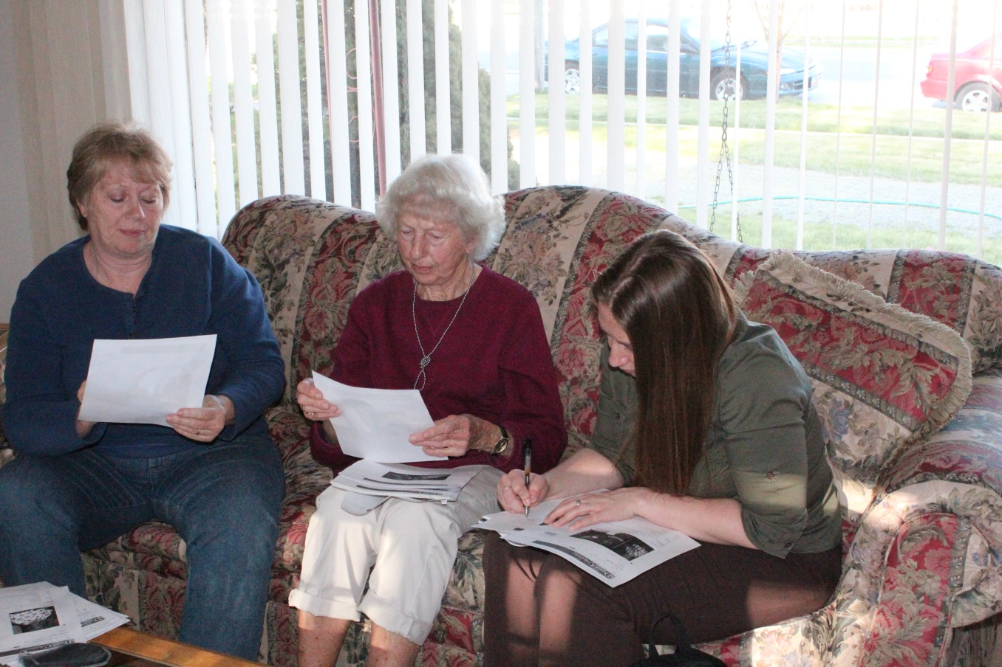

Slide 14
Challenges
Scheduling
Storytelling
Accuracy of information
Return on investment

Slide 15
Successes
Improved collection information
Investment given by the community led to higher collection usage
The interviewees really enjoyed themselves and reminiscing about the past
Extraordinary experience for catalogers
Flexible Administration

Slide 16
Community Events

Slide 17
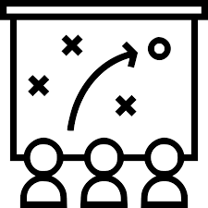
Background
Determine objective
Research relevant community organizations/events
Choose community liaison(s)
Establish strategy to reach goal
Where (location of event)
What (Resources needed)
Staff
Equipment
Forms
Who & How (Publicity)
Flyers
Postcards
Word-of-mouth

Slide 18
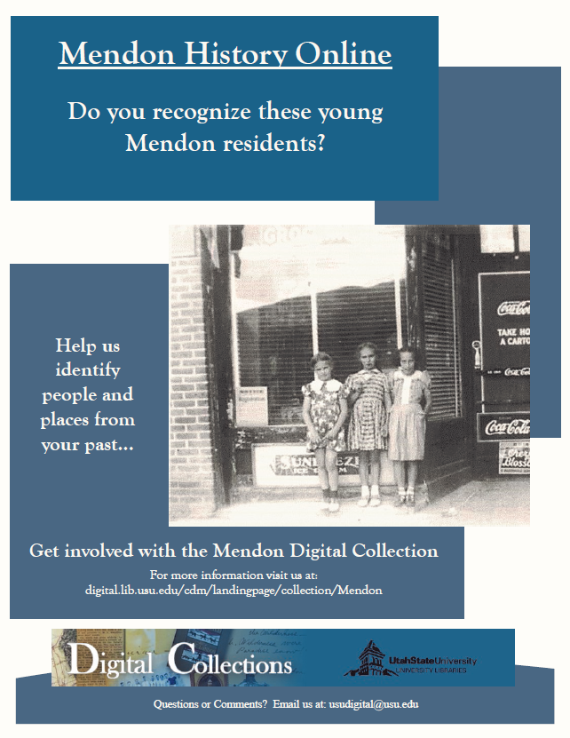
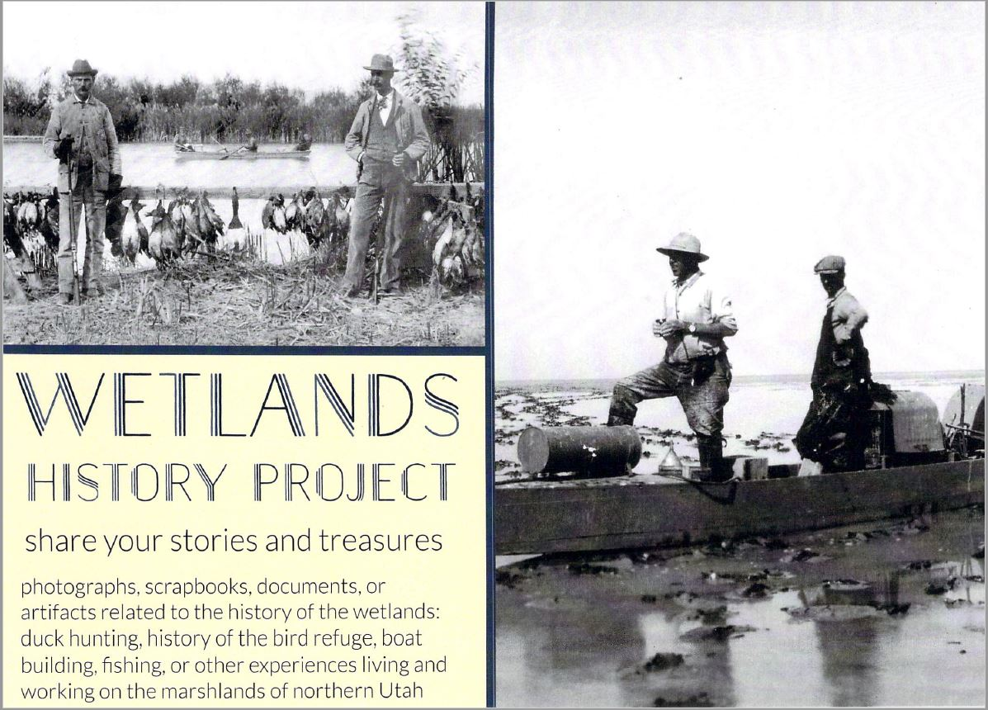
Publicity

Slide 19
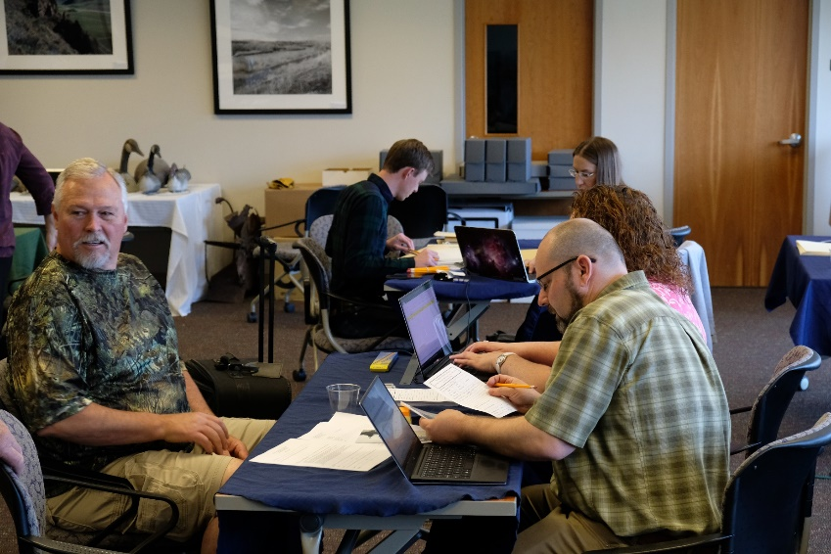
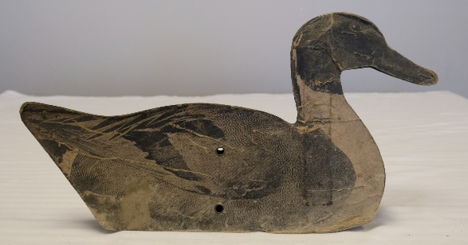
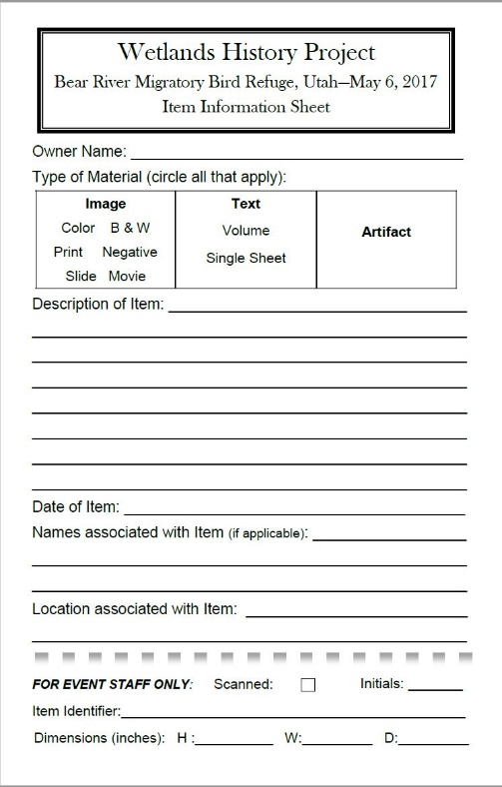
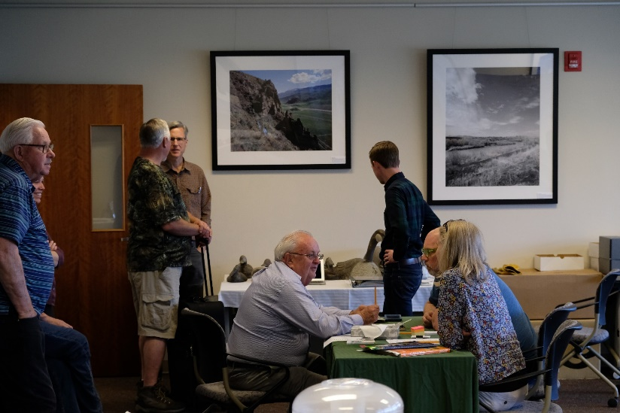
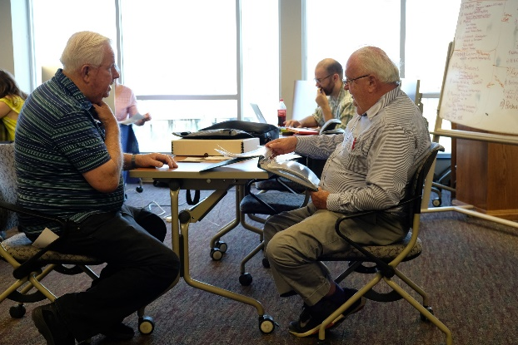
Community Event

Slide 20
Challenges
Logistics of large-scale event
Balancing staff with community members (supply = demand)
Spending appropriate amount of time with each person
Publicity - what forms would be most useful?
Getting staff and equipment to/from event
After event metadata gathering (know limitations of your event)
Notes:
Logistics - Making sure event is efficient and beneficial

Slide 21
Successes
Positive relationships with community – future donations
Good turnout
Digital collections with robust metadata
Improved metadata collection workflows

Slide 22
Lessons Learned
Have a plan and follow it
Need to evaluate process and make necessary changes
Community members are eager to contribute information and share their stories
Collective knowledge is invaluable for gathering robust metadata
Consider audience when creating strategies for collecting metadata – Be Flexible
Important to form strong relationships with community leaders and organizations
Location of community events important, need to make community members feel ownership for the project
What may be seen as a lost opportunity may actually open up new possibilities = referrals

Slide 23
Thank You

