Slide 1
Notes:
Good morning and welcome.
Clearly, ladies and gentlemen, something is happening with this ‘crowdsourcing thing’. First, there is the fact we are discussing the subject today at Midwinter. In addition, there must be a reason why …

Slide 2
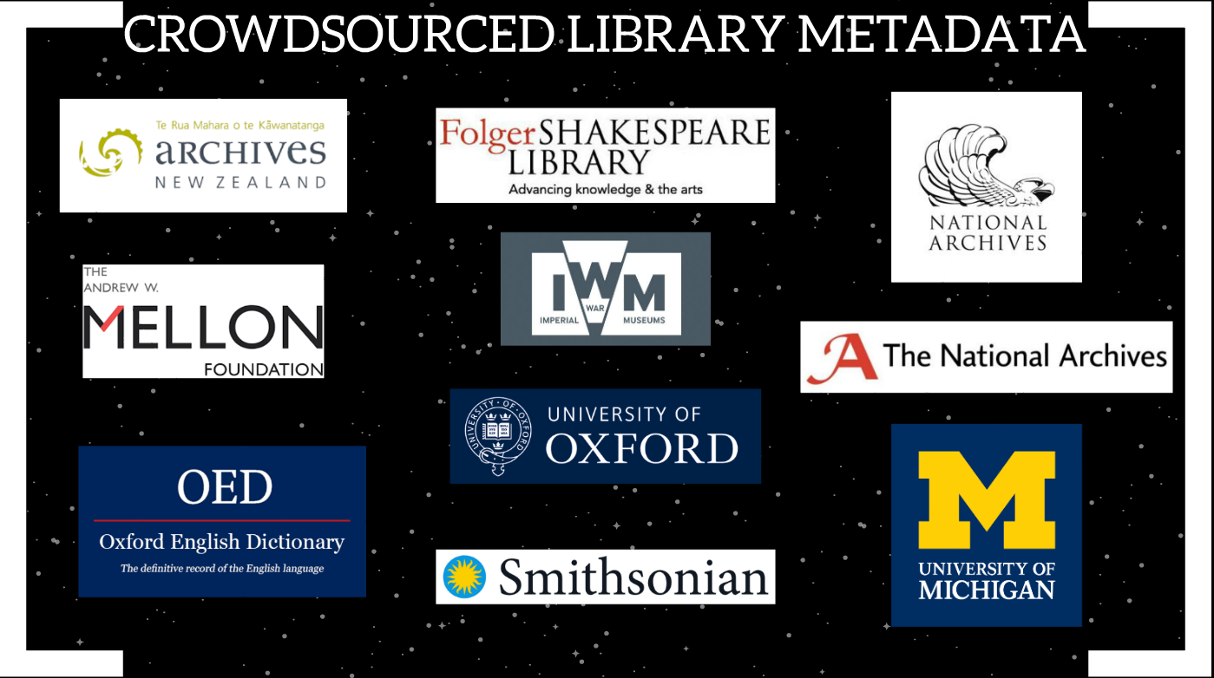
Notes:
All these library, archive and museum-related institutions are either currently engaged in the crowdsourcing of metadata, or have completed such projects in the recent past. The above, it should be noted, is a very brief and far from exhaustive list.
So why is this phenomenon becoming increasingly prevalent? What is the institutional motivation for becoming involved?
My recent research proposed crowdsourcing as a viable solution to the enduring Hidden Collections problem. And though there are additional benefits to this innovative approach, it’s reasonable to assume that participating institutions agree.

Slide 3
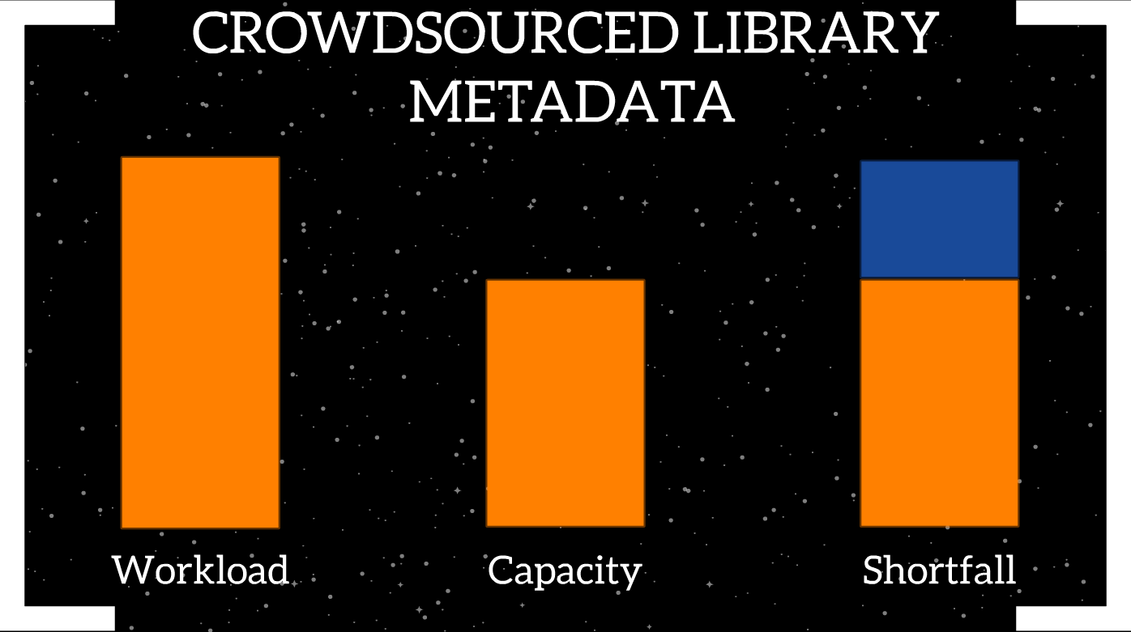
Notes:
After all, I’ve yet to find a Cataloging Unit or Department whose capacity exceeds their workload. The resulting shortfall is enduring and difficult to counter effectively. Crowdsourcing, I would suggest, primarily targets this shortfall.
This is a very important point to keep in mind: crowdsourcing is not about replacing professional and para-professional employees with volunteers. It is about utilizing volunteer input to augment our current capability and accordingly deal with work we otherwise would struggle to do.

Slide 4
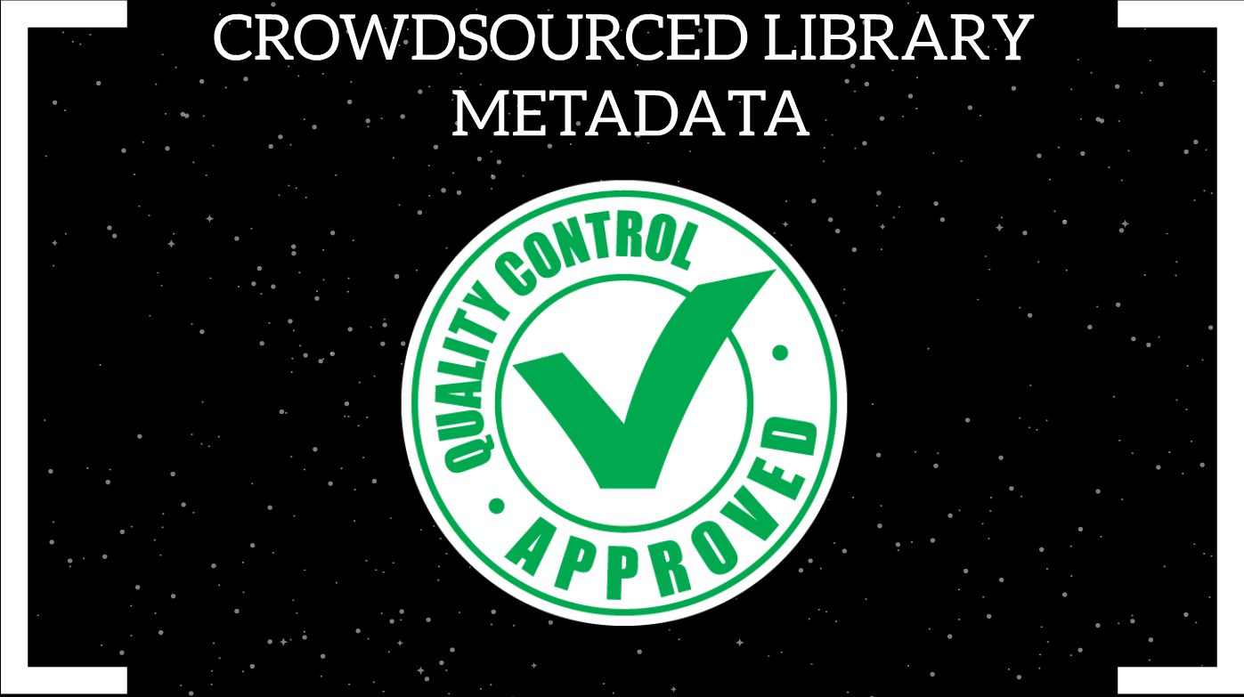
Notes:
However, when proposing the idea to allow – and actively encourage – volunteers from the crowd with prior experience levels ranging from as little as zero to undertake comparable work to professionals, concerns are understandably raised about quality control. And also, the resource cost of quality control.

Slide 5
Notes:
This is the main reason, I would argue, that it is appropriate to describe the metadata creation interfaces developed for recent crowdsourcing projects as truly revolutionary.
Why? Because these interfaces contain a number of automated quality control features built directly into the platform. These features accordingly maintain maximum quality control at maximum efficiency.

Slide 6
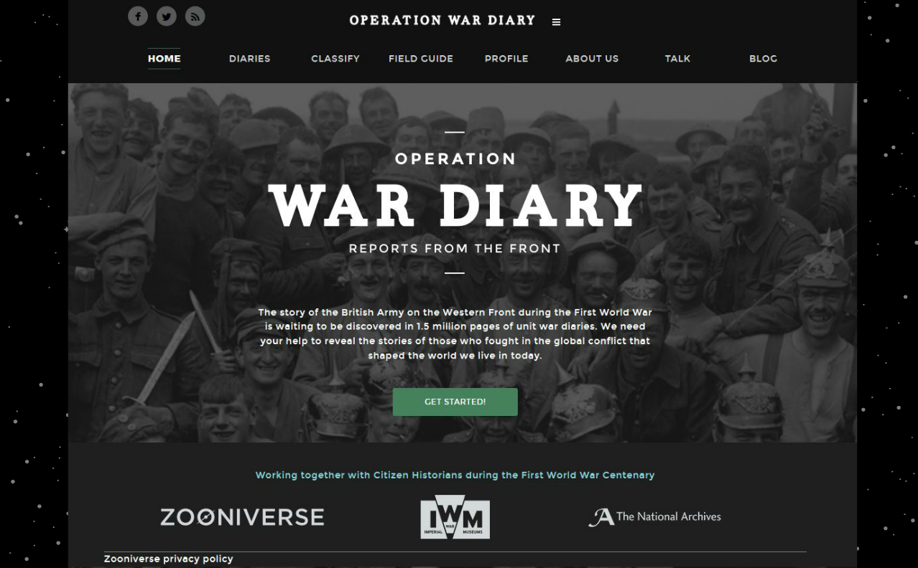
Notes:
The case study for this talk is Operation War Diary (OWD), a collaborative effort between Zooniverse (an international, cross-disciplinary citizen science organization), the Imperial War Museum (London) and The National Archives (UK). The OWD collection consists of approximately 1.5 million manuscript pages from regimental British Army diaries dating from the First World War.

Slide 7
Notes:
Interface ease of use and intuitiveness is a simple consideration to mention, but one which positively impacts data quality control. I am, of course, a genuine fan of Henriette Avram’s most enduring creation. However, the interfaces we use to create and edit MARC are perhaps not the most intuitive systems we might imagine. When one compares a typical MARC editor on the right with the OWD ‘tag menu’ on the left, we see numerical field tags being instead communicated to users via text labels accompanied with pictorial icons. Research and testing has confirmed that users find these field labels clear, understandable and intuitive to work with. Remember, crowdsourcing volunteers may possess little to no previous metadata creation experience, so the more comfortable they feel with the interface, the more confident and oriented they become. Accordingly, the likelihood of users producing accurate and consistent metadata is increased.

Slide 8
Notes:
The Consensus Principle is enabled by a further principle common to many crowdsourcing projects. In order for a diary page to be considered fully described, 5 separate descriptions are required from 5 different volunteer metadata creators. Smaller projects may reduce the number to 3 descriptions, but an odd number is recommended.
Here, we see an example of a named person for which variant data values have been submitted. A simple majority rule is automatically implemented to record ‘Barber’ as THE authorized value for the named person. OWD discards the minority values, though interface designers agree it would be possible to retain the variants and link them to the authorized value as ‘see’ references. In the event of a tie, the values (and all corresponding information) is forwarded automatically for human moderator review.

Slide 9
Notes:
The clustering algorithm is best described by the following example: if I hold up a manuscript letter from our archival collections dating from the Civil War era and ask you to tell me what it is, you’ll likely say in unison “Why, Samuel, it’s a manuscript letter from our archival collections, and it looks like it dates from the Civil War era”.
If I scan the letter and show you the result on a screen some of you might not change your answer, but most will instead say “Ah, it’s a digital surrogate or a digital copy of the original manuscript letter”.
If, however, I ask a computer it will reply “Why, Samuel, it’s a digital image file with a pixel map containing an x and y axis”. This obvious yet important fact enables the clustering algorithm via a simple proximity mapping technique.

Slide 10
Notes:
What is important here is to establish a method to confirm whether multiple submitted data values pertain to the same entity on a diary page. When wishing to record and submit the geographical place name ‘Blandain’, metadata creation volunteers click the ‘Place’ icon on the left. This effectively ‘arms’ their mouse cursor with a pin that is then placed where ‘Blandain’ occurs on the page. The interface records both the submitted data value and the x / y pixel coordinates of the pin. If the clustering algorithm determines that pins occur with 10% of each other on the horizontal axis, and within 3% of the vertical, the interface records the multiple data values as pertaining to the same entity. Why the percentage variance between the 2 axes? Simply because words tend to be longer than they are tall.

Slide 11
Notes:
Here, for demonstrational purposes, I have entered a geographical place name value ‘Fullerton’ in the ‘Name’ field. This field is linked via a look-up service to the GeoNames database. Next, I deal with the question ‘Can you add this to the map?’. Viewing the Google maps applet, it appears that indeed I can. So, let’s click on the map for a closer view …

Slide 12
Notes:
Here, we see Fullerton is a small village or hamlet south of Andover and north of Southampton on the English South Coast. So what is happening here?
The terms available on the instance of the GeoNames database the OWD interface references have been restricted to the geographical coverage of the project collection: England, France, Belgium, the Netherlands and Germany.
This is an excellent example of restricting the possible data values volunteers can submit. Such restrictions have a beneficial impact on data quality control.

Slide 13
Notes:
Further examples of this important principle are demonstrated here. The ‘First name’, ‘Surname’ and ‘[Military] Number’ fields are – as one would expect – free-text fields. ‘Rank’ and ‘Reason’, however, are not. These fields expand drop-down menus pre-populated with data values: de facto controlled vocabularies. These controlled vocabularies are created in advance of launch by project designers, in this case the OWD Academic Advisory Group. The OWD interface contains many more similar controlled vocabularies of terms accessed via drop-down menus.
Again, restricting data values wherever possible plays a significant role in automatically controlling the quality and consistency of submitted data.

Slide 14
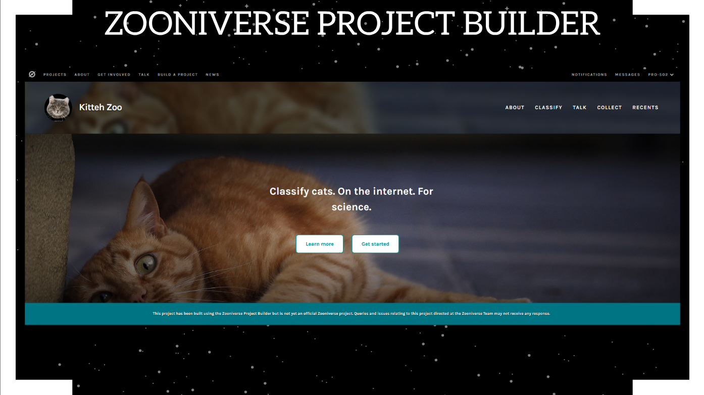
Notes:
Finally, do be aware that Zooniverse has made the code behind the revolutionary cataloging interface available for general use. Rather than coding bespoke systems, institutions can instead concentrate on digitizing and hosting their collections before configuring the ready-made interface to suit their metadata requirements.
As of January 29, 2019, Zooniverse is actively involved in 92 ‘official’ crowdsourcing projects, about a dozen of which are library, archives and museums-related. See https://www.zooniverse.org/projects for more details. Many more non-official library, archives and museums-related projects – classed as ‘Public Projects’ – are currently live and based on the Zooniverse Project Builder.

Slide 15
