Slide 1
Soldering the Links
ALA Linked Data Interest Group
3/9/2022
bit.ly/LDIdiscovery
Notes:
ABSTRACT: In late December 2021, Cornell University used linked data to supplement the author knowledge panel and author and subject description pages in the library catalog. In this presentation, we will describe how this integration resulted from explorations in the Linked Data for Production: Closing the Loop grant. Cornell and Stanford collaborated on the exploratory phase of this work. We will review the overall process of getting Cornell stakeholder feedback to decide which data points and features to include in the catalog.

Slide 2
Overview
Linked data integration at Cornell
Demo
Data
Journey to production
Original prototypes
Usability testing
Stakeholder feedback
Future possibilities

Slide 3
Background
Linked Data for Production: Closing the Loop (LD4P3).
“LD4P3 aims to "close the loop" to create a working model of a complete cycle for library metadata creation, sharing, and reuse.”
Funded by Andrew W. Mellon Foundation
Discovery
Using linked data to support and enhance discovery
Continue experiments
Work on integration into production

Slide 4
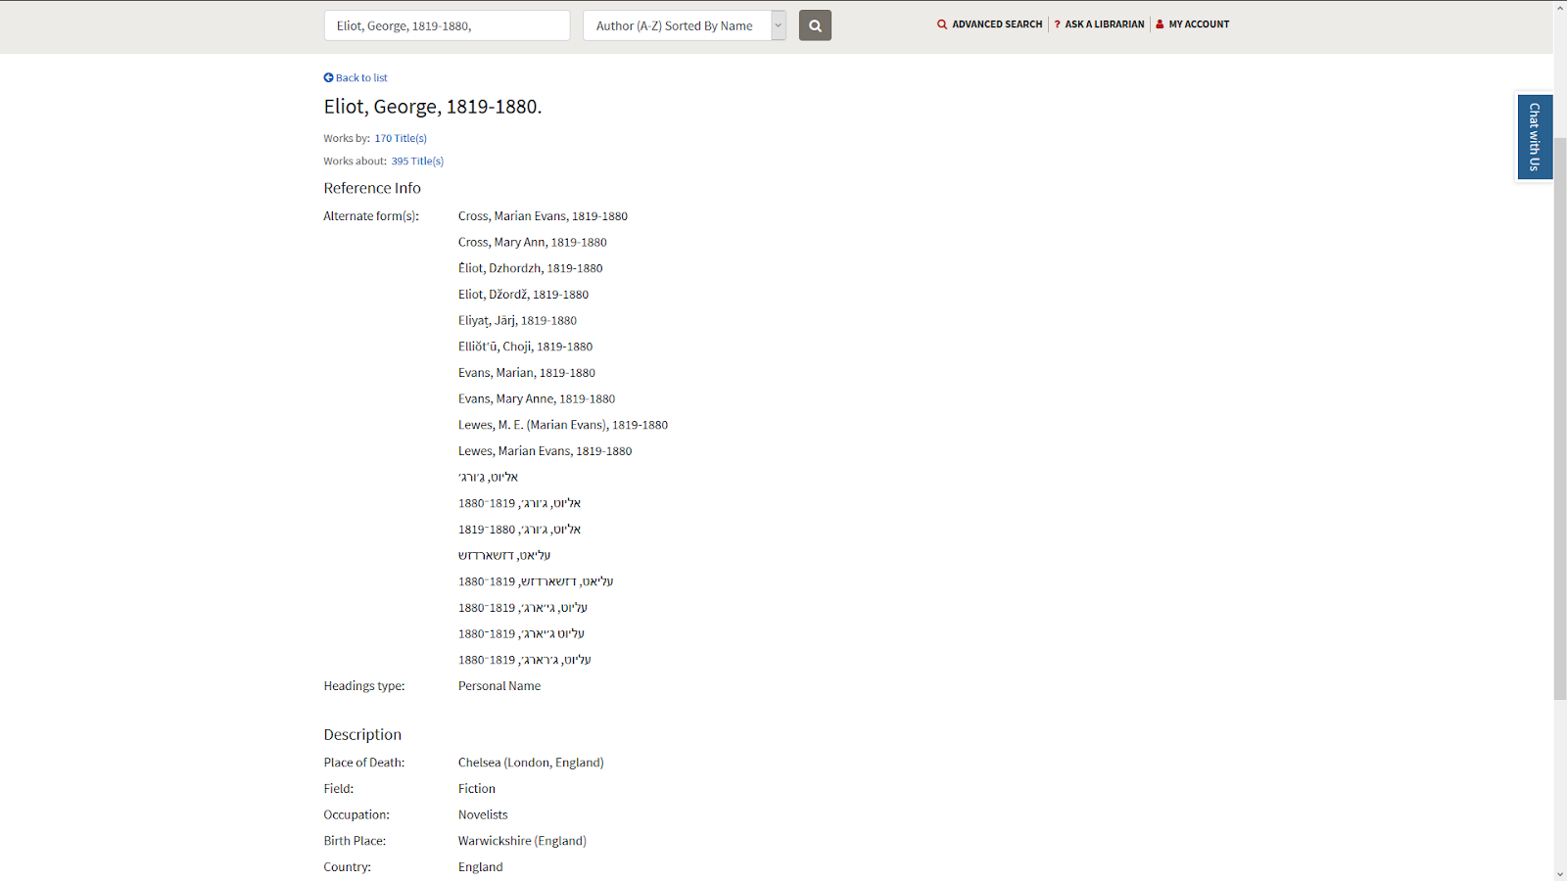
Where we started

Slide 5
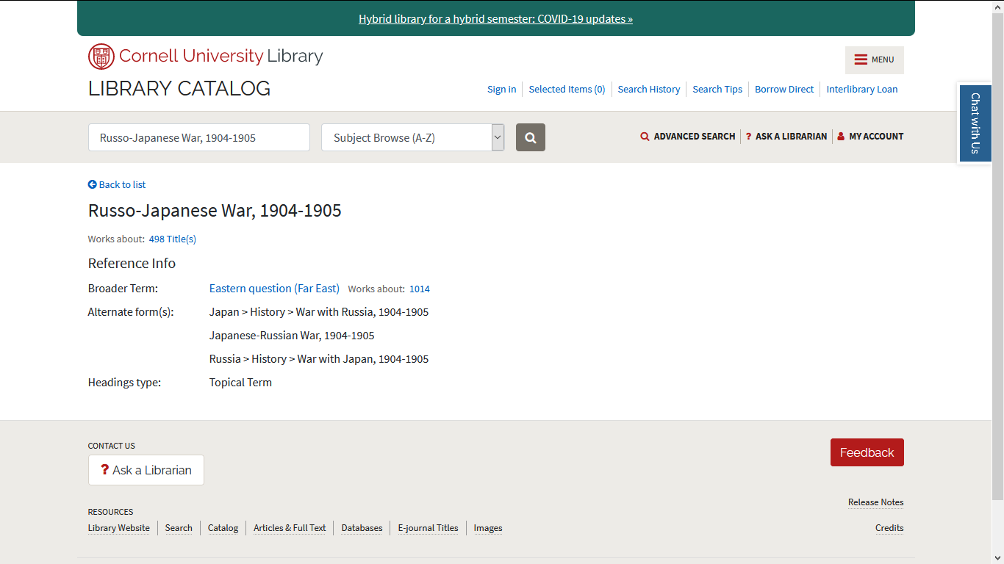

Slide 6
Where we are now
Author knowledge panel
Author details
Subject browse
Subject details

Slide 7
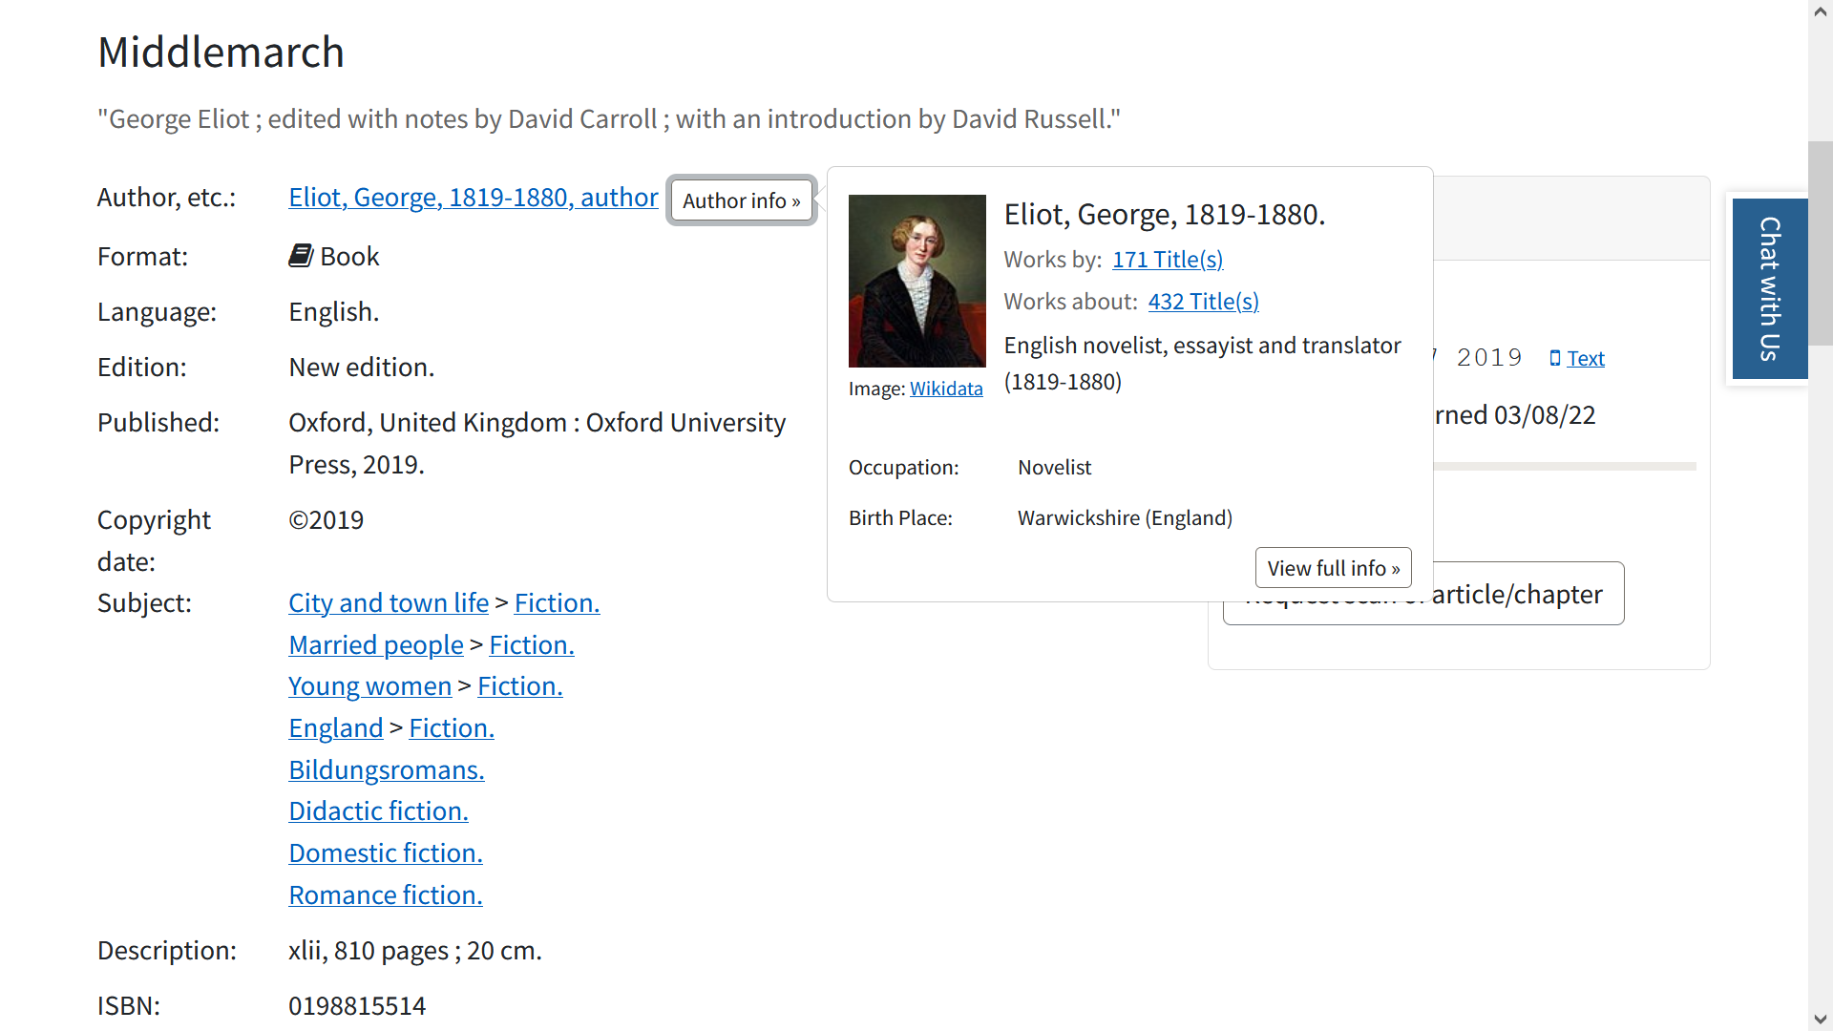

Slide 8
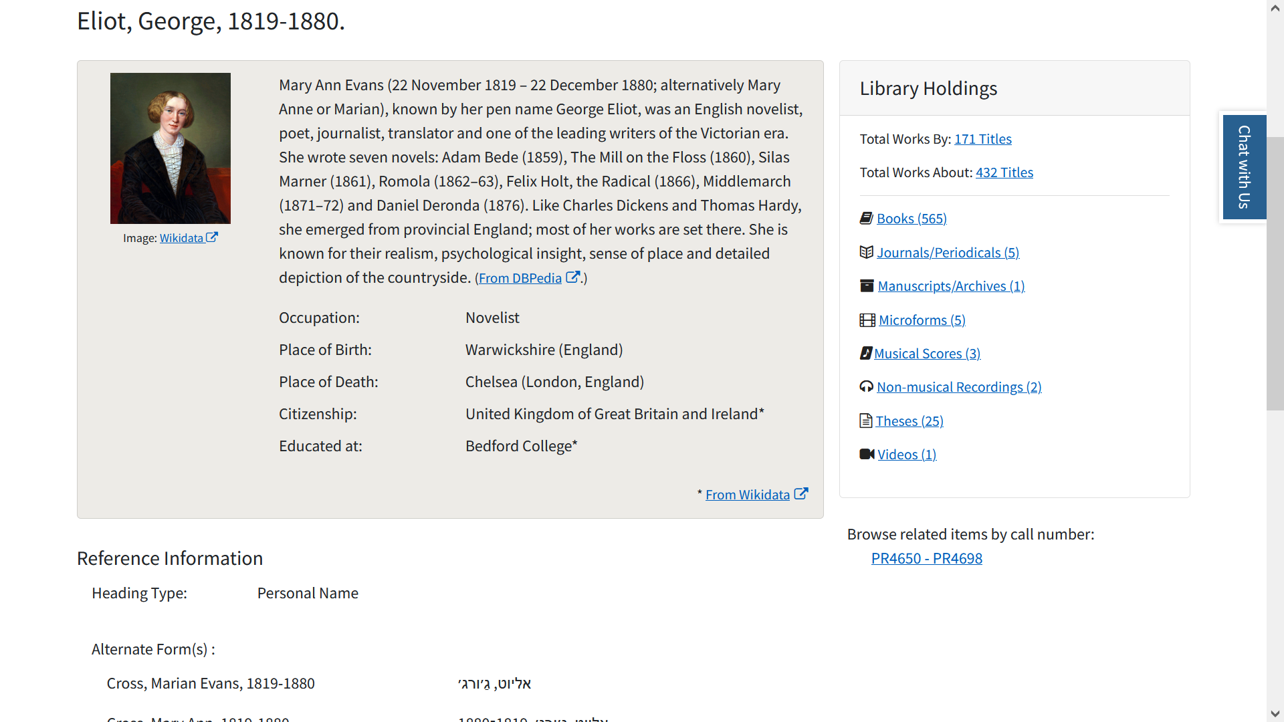

Slide 9
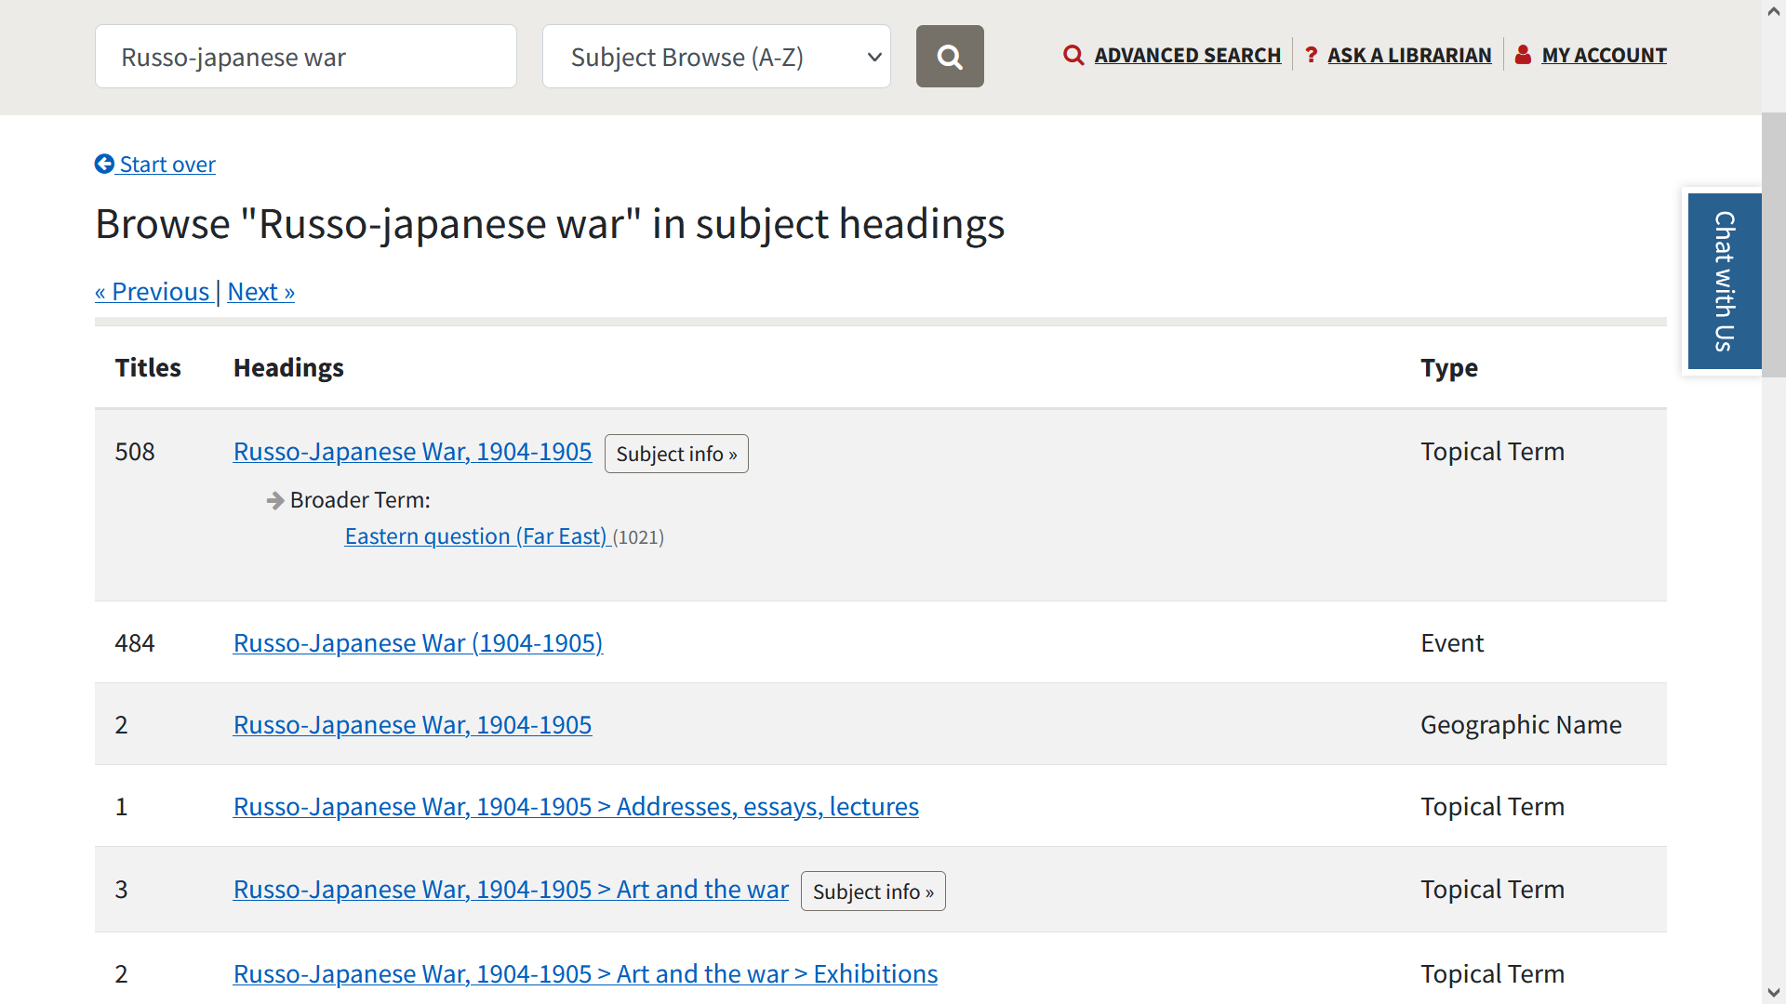

Slide 10
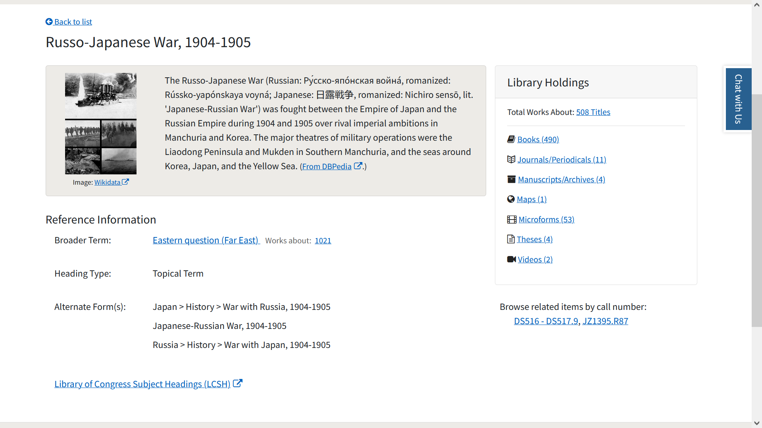

Slide 11
Implementation Details

Slide 12
Notes:
https://encrypted-tbn0.gstatic.com/images?q=tbn:ANd9GcRd-wS1c3i3UFqsxBf7OkCqqNPT1N1nZhQJDg&usqp=CAU

Slide 13
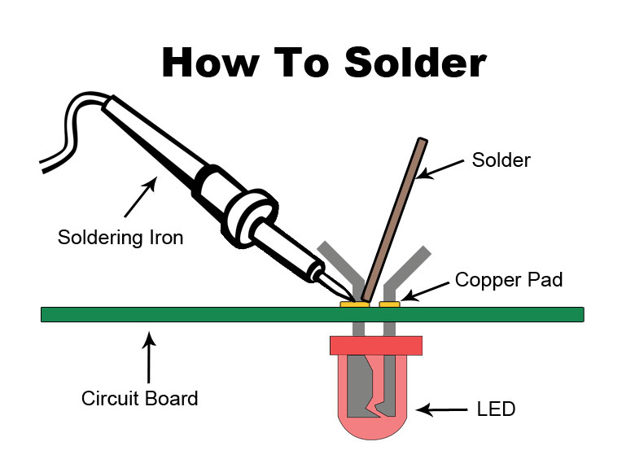
Soldering Linked Data in Blacklight
RDF from external sources
APIs/Calls
Identifiers/Headings in Solr Index
Blacklight UI
New feature enabled by linked data

Slide 14
Implementation details
Client-side requests
Pre-existing separate author and subject indices
“Disallowing” or hiding certain information

Slide 15
Author info
Description
Description
Educated at
P69
Author
P27
Citizenship
P742
P244
P18
Pseudonyms
LOC ID
Image
LOC Author
Notes:
Can change this to use for the overview instead of client workflow

Slide 16
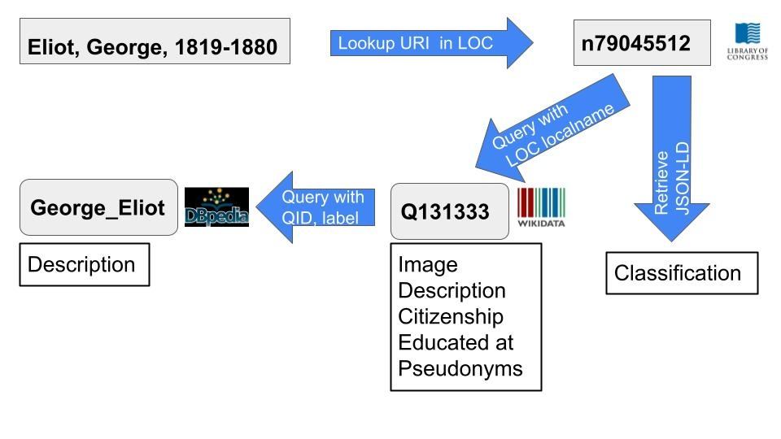
Client side requests
Notes:
We will go into a little more detail in this area on the Wikidata Affinity Group call

Slide 17
Author index
{
"id":"139715",
"heading":"Eliot, George, 1819-1880.",
"alternateForm":[
"Cross, Marian Evans, 1819-1880",..."
],
"headingTypeDesc":"Personal Name",
"blacklightField":"author_pers_browse",
"authority":true,
"mainEntry":true,
"rda_json":"{\"Place of Death\":[\"Chelsea (London, England)\"],\"Field\":[\"Fiction\"],\"Occupation\":[\"Novelists\"],\"Birth Place\":[\"Warwickshire (England)\"],\"Country\":[\"England\"]}",
"count":171,
"counts_json":"{\"worksBy\":171,\"worksAbout\":427}",
"_version_":1714597321997549586,
"timestamp":"2021-10-25T13:10:28.877Z"
}
Notes:
https://wiki.lyrasis.org/display/LD4P3/Interactions+with+the+author+and+browse+indices

Slide 18
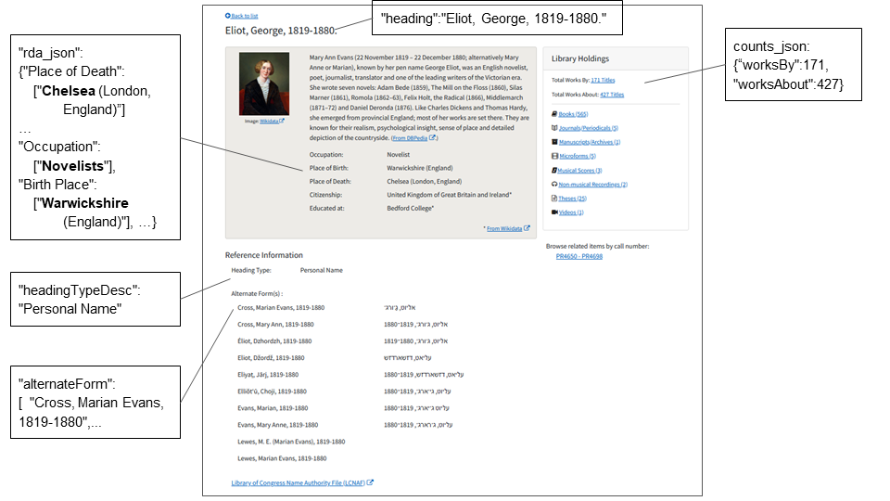
Author index
Notes:
https://wiki.lyrasis.org/display/LD4P3/Interactions+with+the+author+and+browse+indices

Slide 19
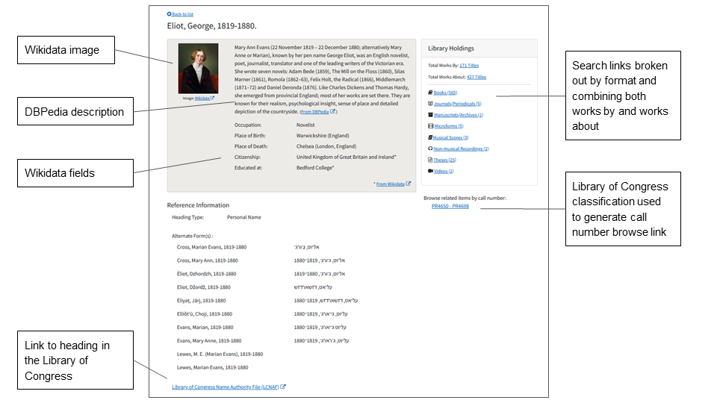
Supplementing with linked data
Notes:
https://wiki.lyrasis.org/display/LD4P3/Interactions+with+the+author+and+browse+indices

Slide 20
Subject index
{
"id":"1147324",
"heading":"Russo-Japanese War, 1904-1905",
"seeAlso":"{\"Broader Term\":[{\"worksAbout\":1021,\"heading\":\"Eastern question (Far East)\",\"count\":1021,\"headingTypeDesc\":\"Topical Term\"}]}",
"alternateForm":[
"Japan > History > War with Russia, 1904-1905",
"Japanese-Russian War, 1904-1905",
"Russia > History > War with Japan, 1904-1905"
],
"headingTypeDesc":"Topical Term",
"blacklightField":"subject_topic_browse",
"authority":true,
"mainEntry":true,
"count":506,
"counts_json":"{\"worksAbout\":506}",
"_version_":1714589676466077698,
"timestamp":"2021-10-25T11:08:57.595Z"
}
Notes:
https://wiki.lyrasis.org/display/LD4P3/Interactions+with+the+author+and+browse+indices

Slide 21
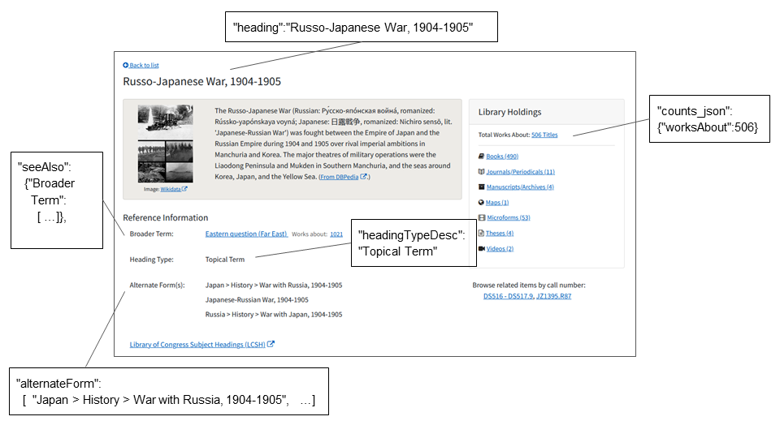
Subject index
Notes:
https://wiki.lyrasis.org/display/LD4P3/Interactions+with+the+author+and+browse+indices

Slide 22
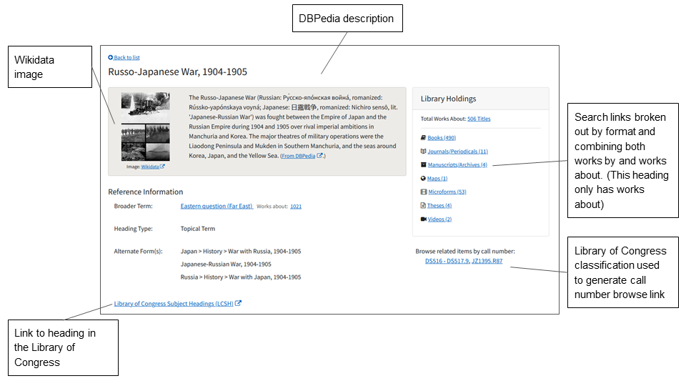
Supplementing with linked data
Notes:
https://wiki.lyrasis.org/display/LD4P3/Interactions+with+the+author+and+browse+indices

Slide 23
Hiding information
Why hide?
Ethical concerns
Data source concerns
Updates or inaccuracies
What can be hidden?
All the info for a heading
Specific properties for a heading

Slide 24
Hiding information
? "Saunders, George, 1958-"
: ~
? "Eliot, George, 1819-1880"
:
- "image"
- "description"
- "citizenship"
- "education"
- "pseudonyms"
Notes:
The example on the left shows a possible YAML file exclusion for an entire heading. The example on the right shows the individual properties that can be excluded.

Slide 25
Usability Testing and Stakeholder Feedback Process

Slide 26
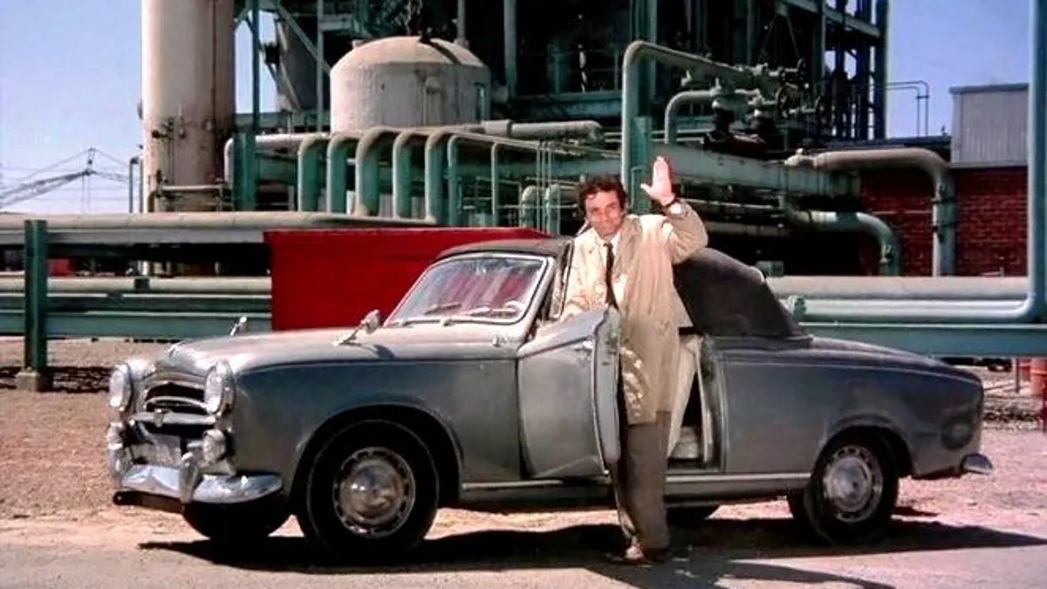
Notes:
https://www.gannett-cdn.com/presto/2020/06/17/NTHR/0fc4114f-8cd9-4092-82e7-f7c88300d398-AR-200619949.jpg?auto=webp&crop=663,373,x0,y61&format=pjpg&width=1200

Slide 27
Notes:
Fuller version of knowledge panel

Slide 28
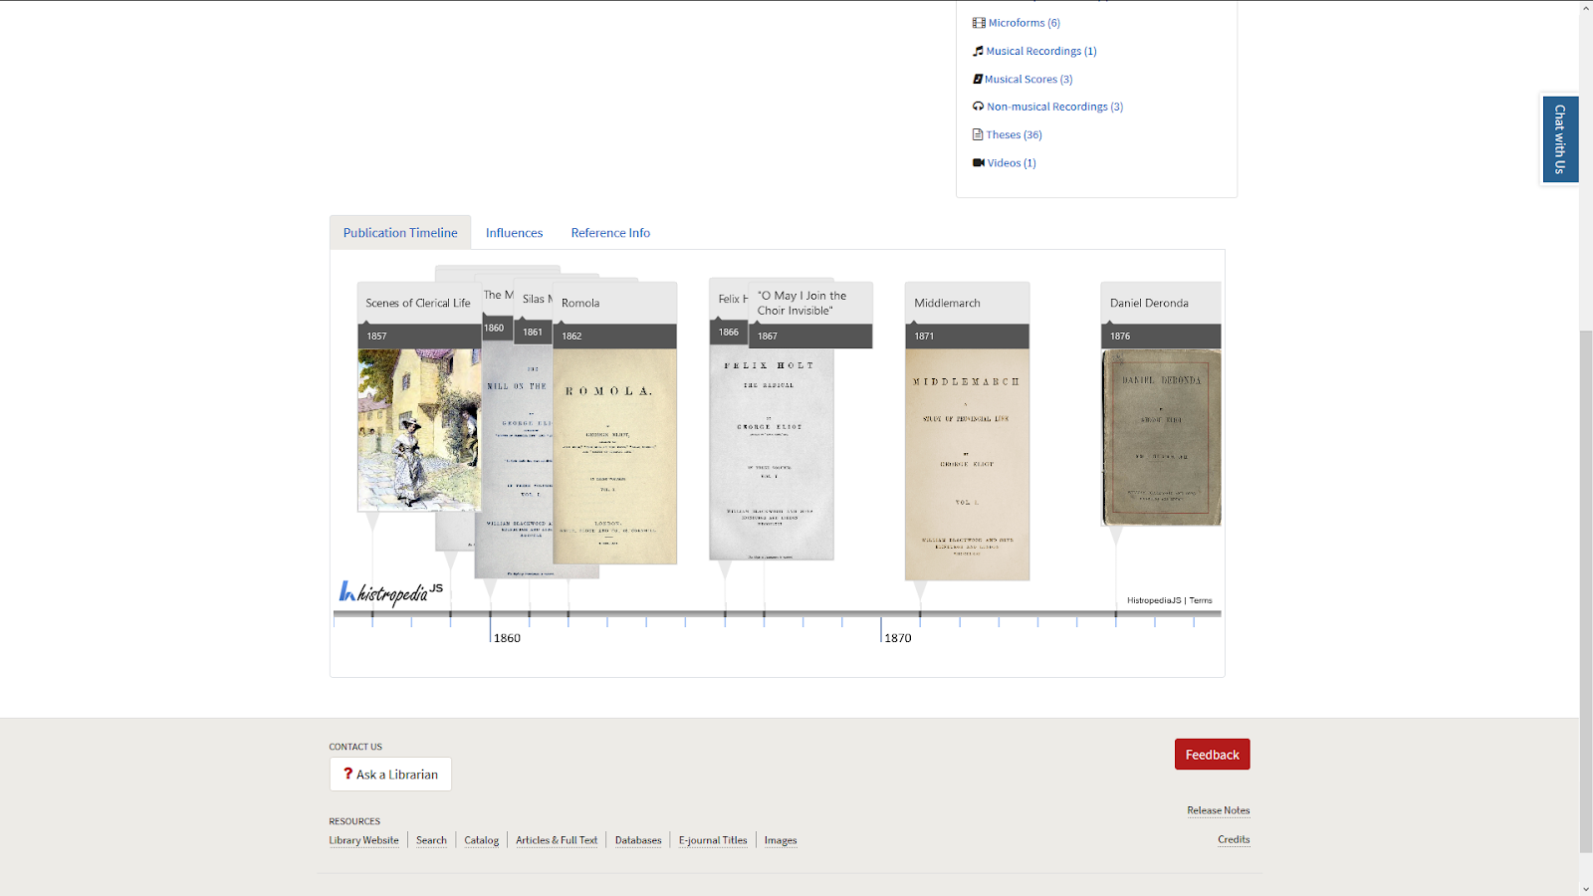

Slide 29
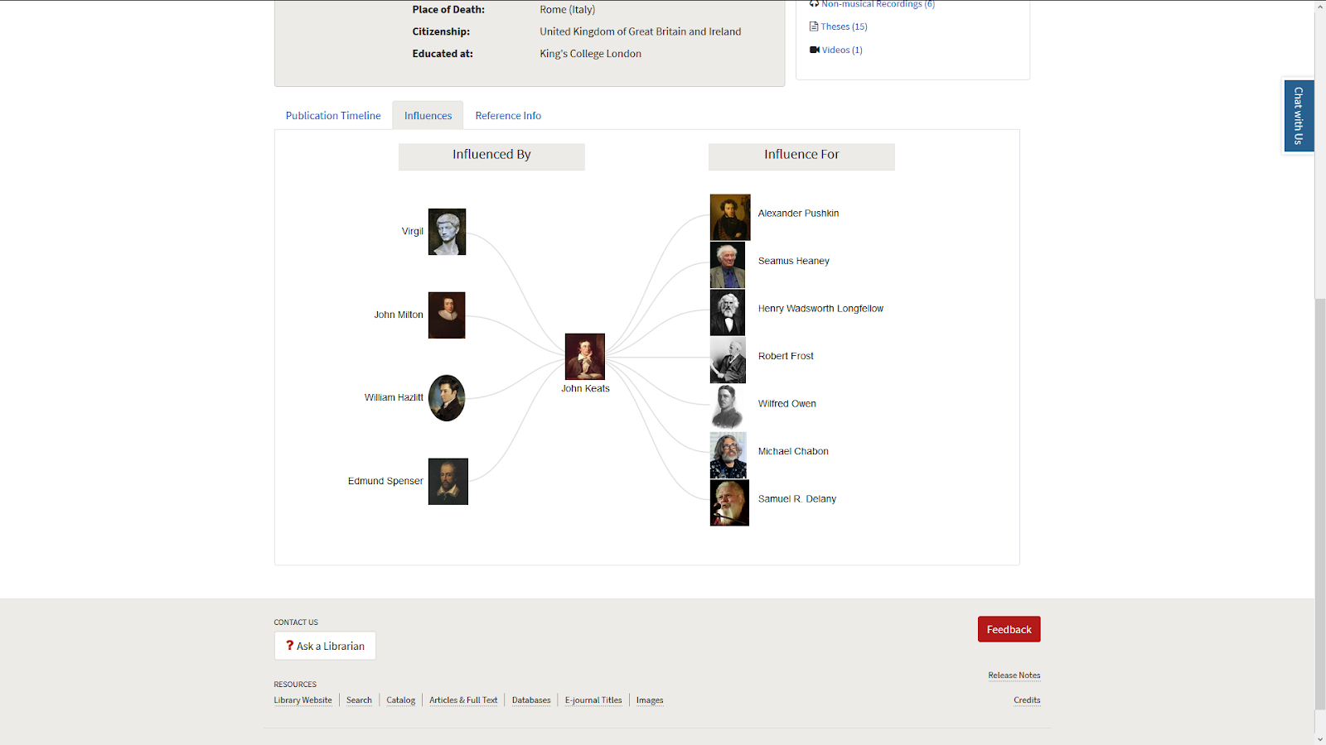
Questions to Consider
What are the points of intersection between Wikidata and your collections/information?
Can Wikidata provide possibilities for further exploration and navigation in your collections?
Do you need specific points of control over information: ways to hide/prevent display of information?

Slide 30
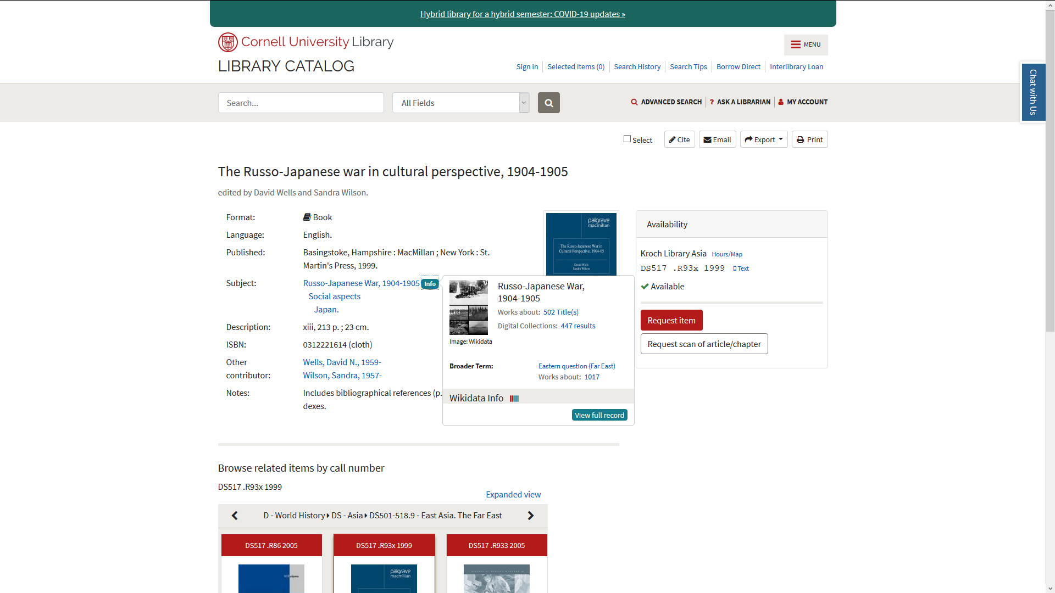

Slide 31
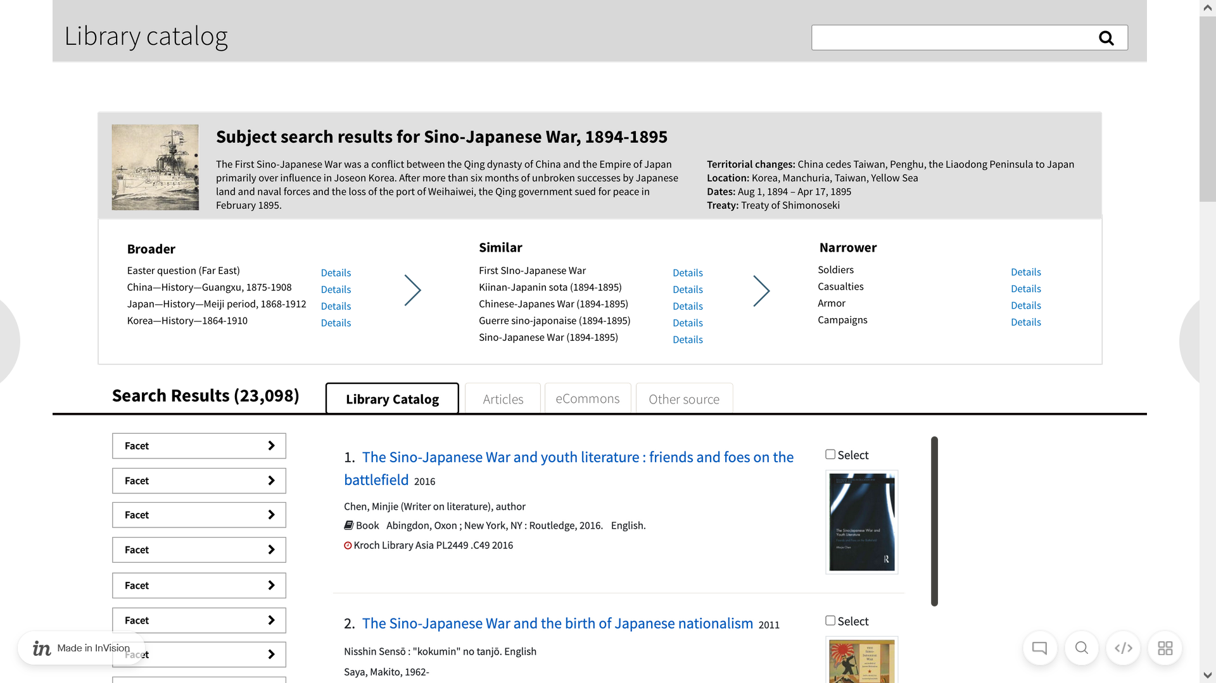

Slide 32
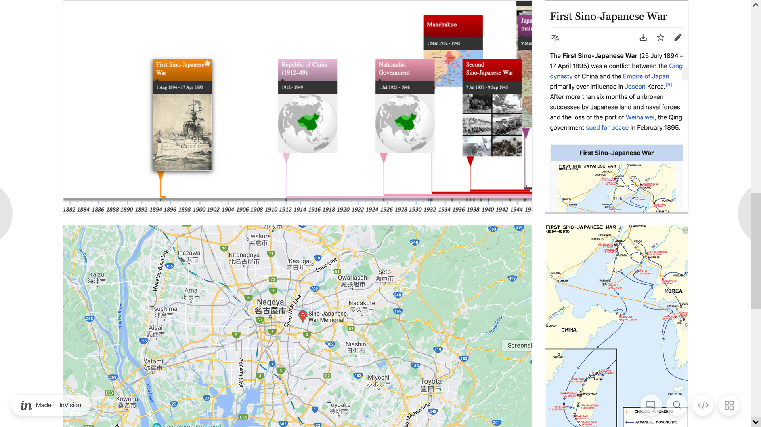

Slide 33
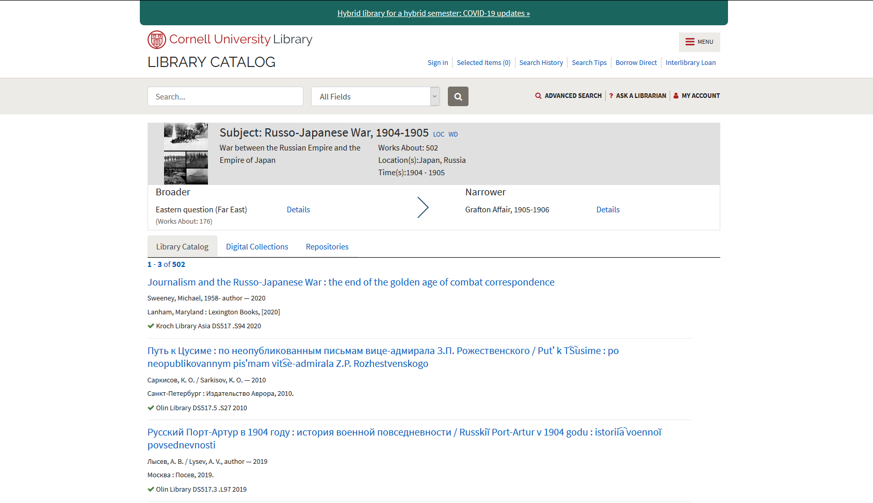

Slide 34
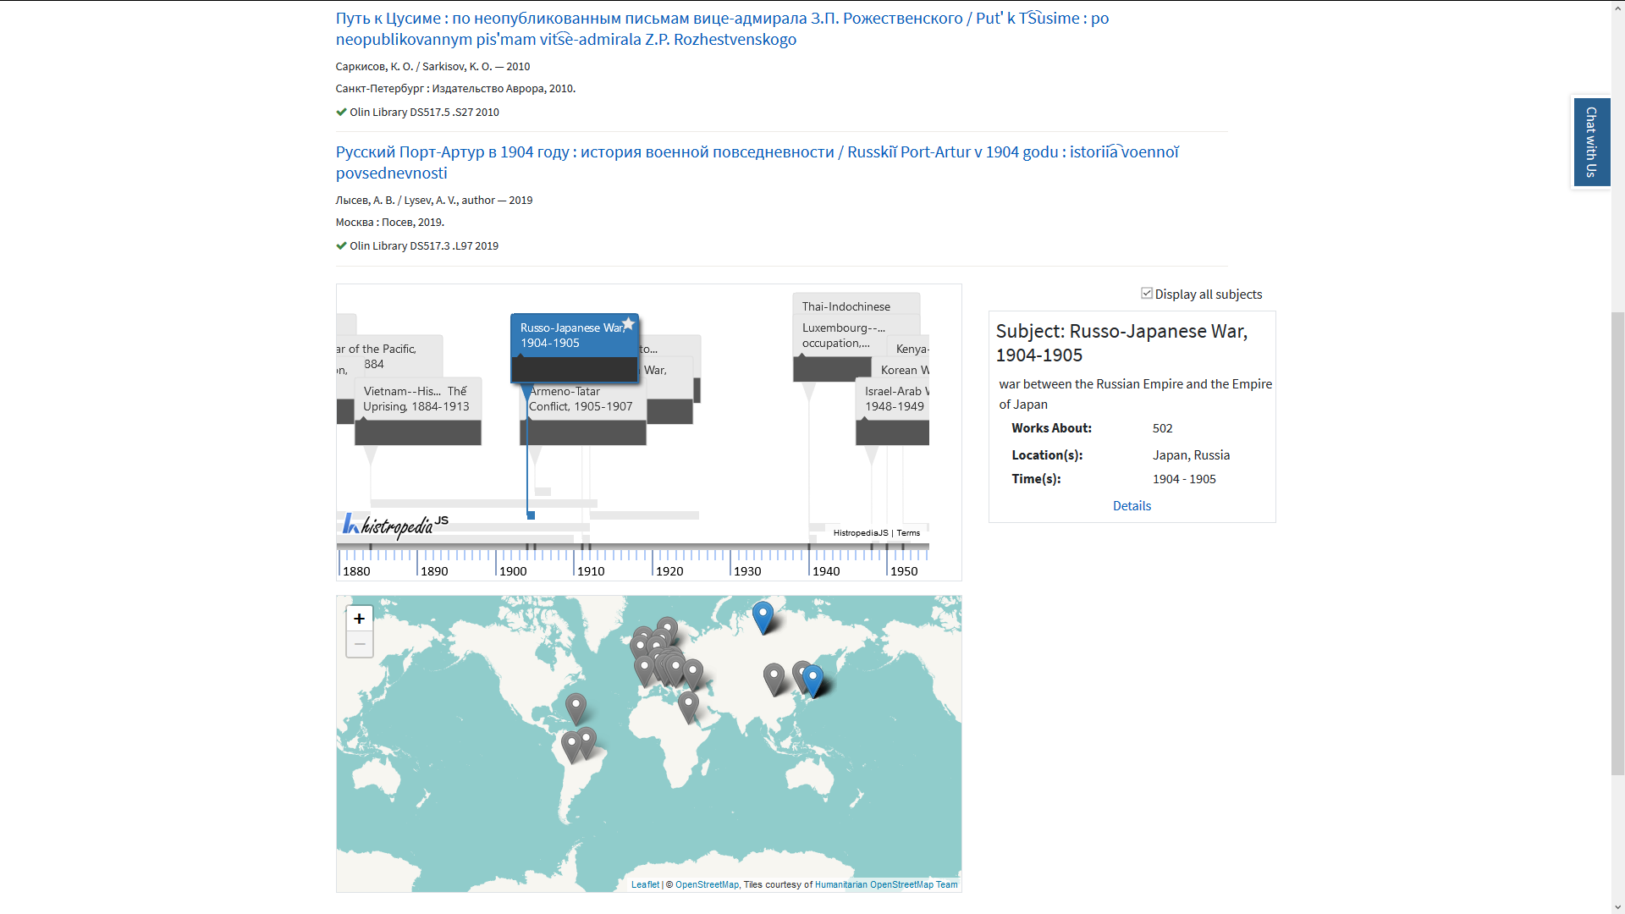

Slide 35
Timeline
Usability
Testing
Initial
Prototype
Prototype
and mockups
Feature
integration
November - December 2021
April 2021
August 2021

Slide 36
Process
Usability testing, 5 undergrads
Multiple conversations with User Representatives
Demo prototypes
Receive feedback
Update and iterate
Coordinate with Discovery and Access team (catalog implementation team)

Slide 37
Usability results
Participants: 5 undergraduates
Process: Think alouds. Tasks for finding information.
Focus: author and subject pages
High level takeaways
Info button: highlight and clarify clickability
“View full record” labeling
Timeline and map interplay
“Display all subjects” checkbox
Notes:
https://wiki.lyrasis.org/display/LD4P3/DASH%21+Usability+Results
Italicized bullets affected production design

Slide 38
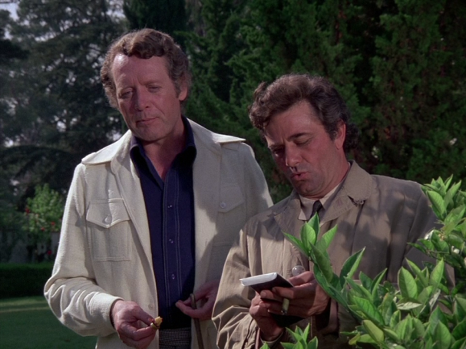
Notes:
https://i0.wp.com/columbophile.com/wp-content/uploads/2019/04/marv4801.png?resize=607%2C455&ssl=1

Slide 39
Timeline
Usability
Testing
Initial
Prototype
Prototype
and mockups
Feature
integration
November - December 2021
April 2021
August 2021

Slide 40
User representatives
First presentation
Main design features
Second presentation
Updates after user testing
Page behavior when data not available
Mockups
Possibilities for consistent design for author and subject pages
Notes:
https://wiki.lyrasis.org/display/LD4P3/DASH%21+Usability+Results
Italicized bullets affected production design

Slide 41
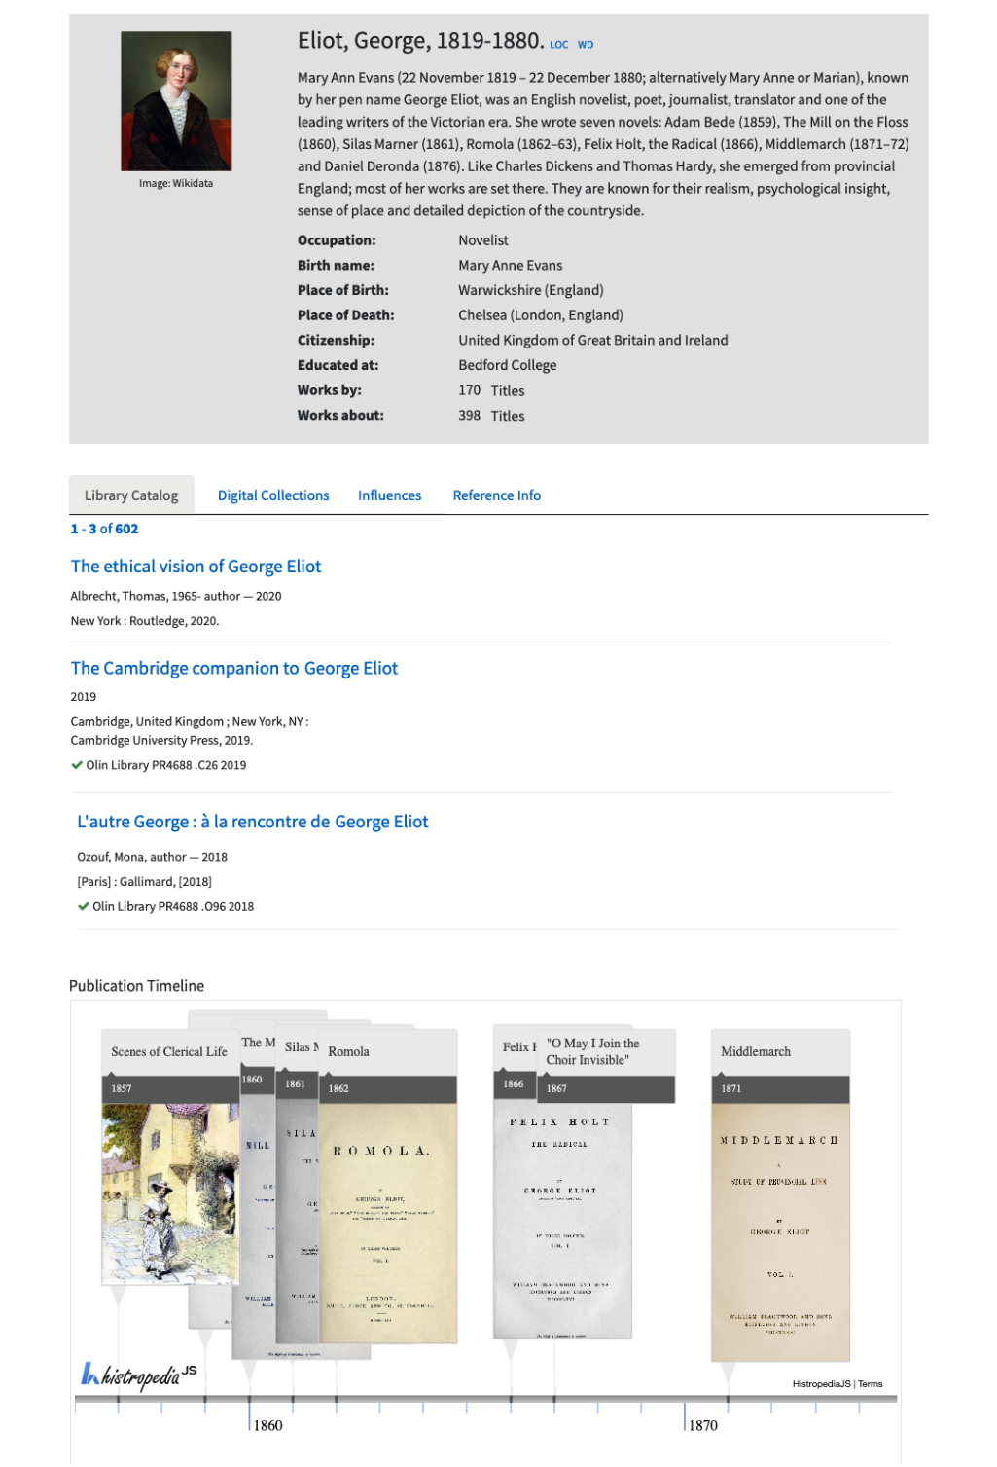
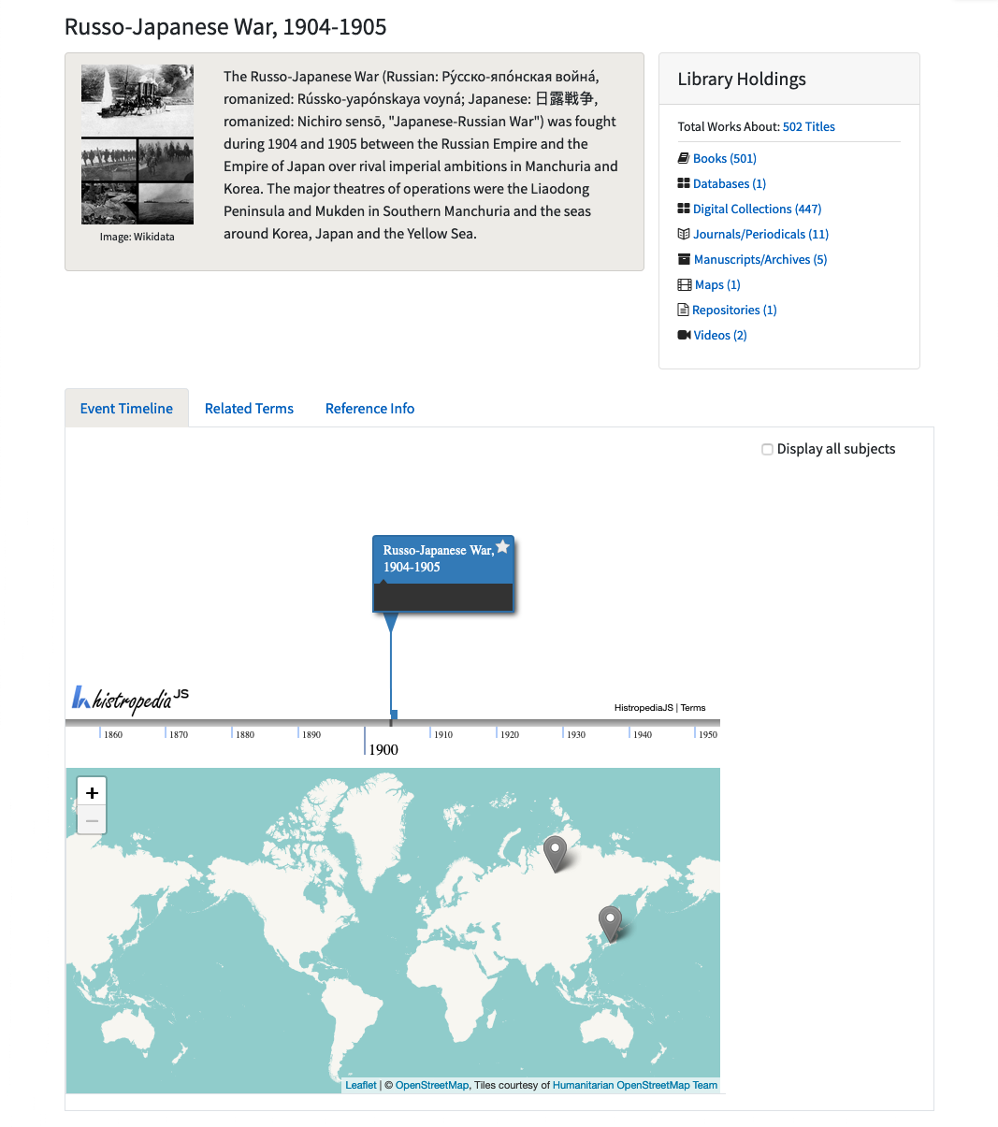
Mockups
Notes:
https://wiki.lyrasis.org/display/LD4P3/DASH%21+Mock-ups

Slide 42
Feedback
Positively received
Biographical information
Subject pages more consistent with author page design
Greater interactivity or additional design work
Publication timeline
Map and timeline interactions

Slide 43
Feedback
Influence graph
Incomplete
Arbitrary?
Didn’t indicate sources or links to articles

Slide 44
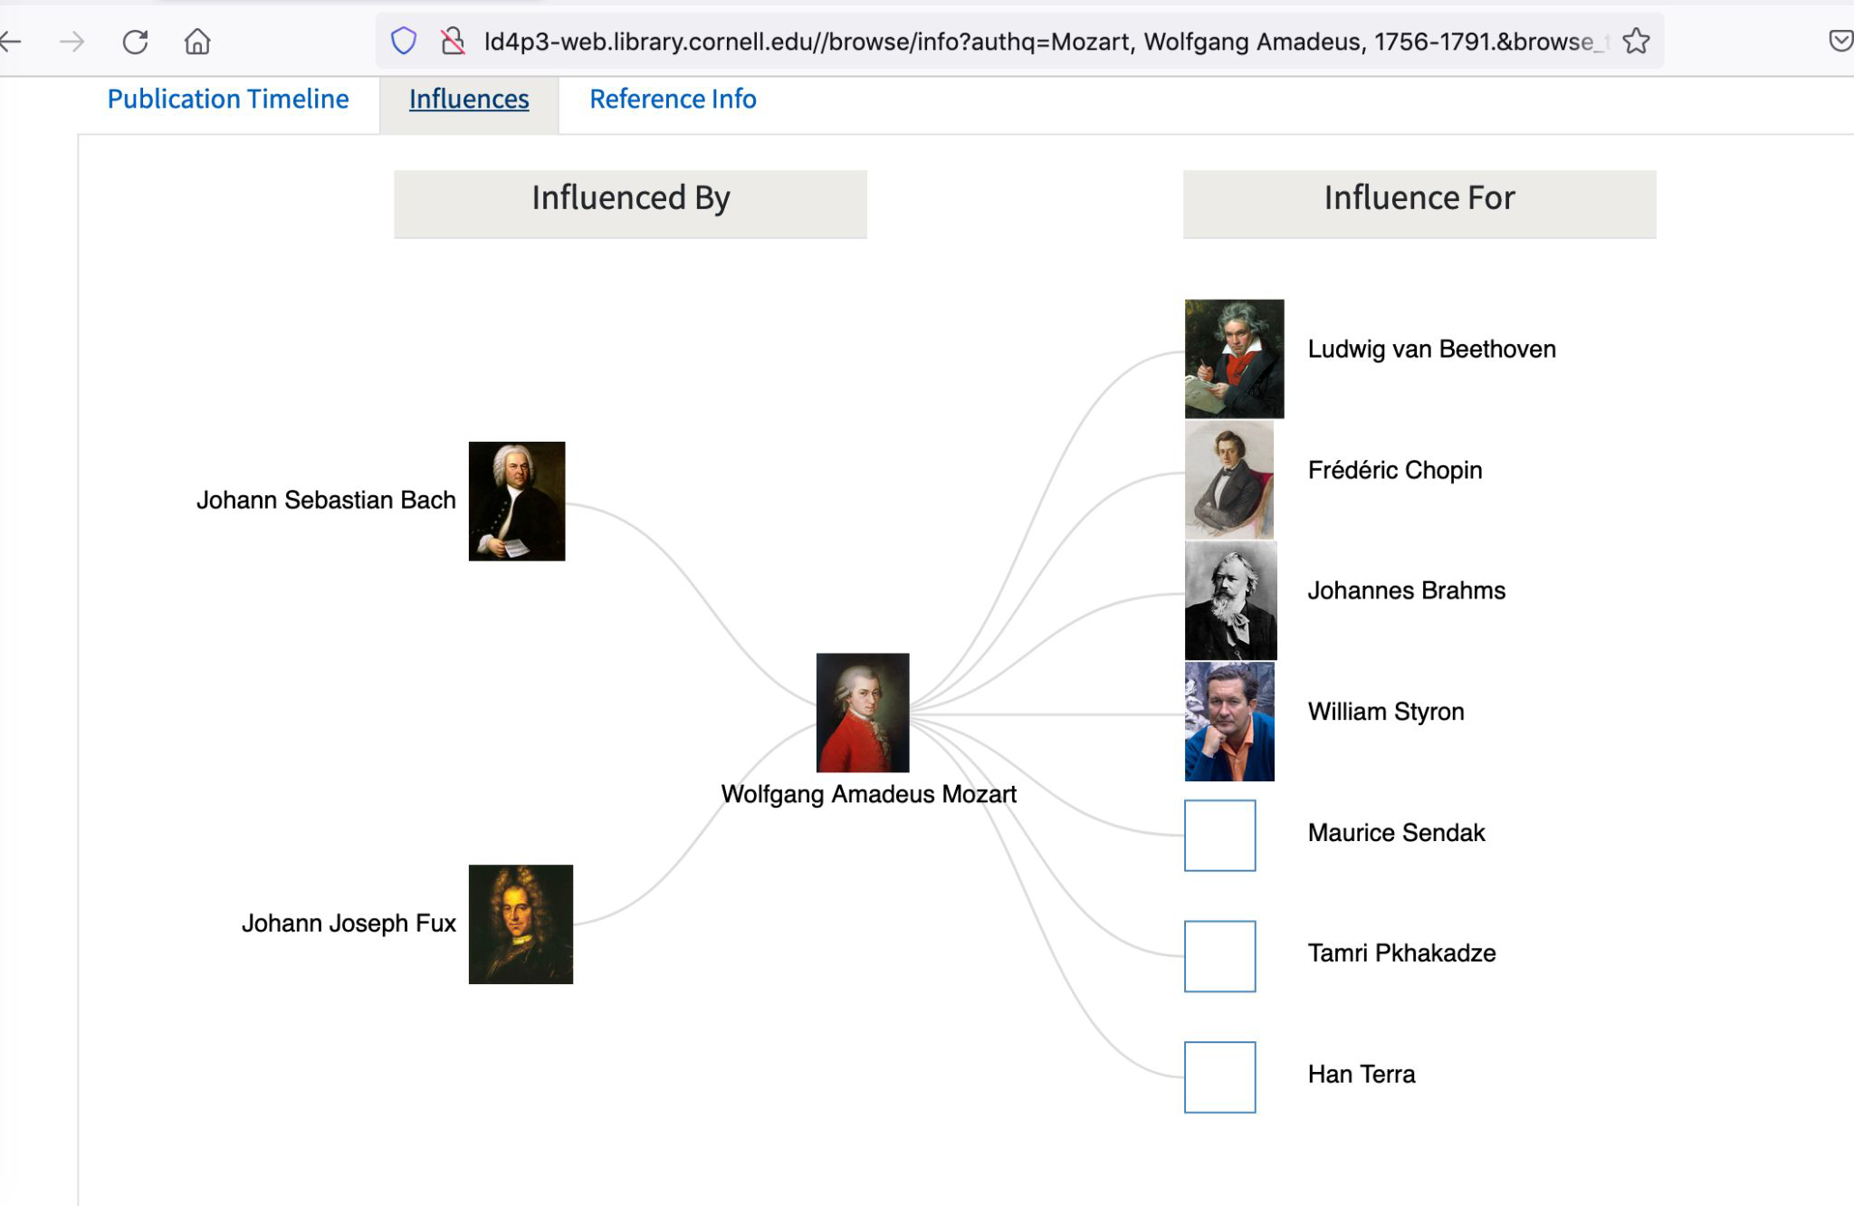
Feedback
Notes:
Original comment “Ex. 5. Another puzzling collection of people influenced by the author, and the list of “influenced by” is comparatively very skimpy.

Slide 45
Feedback
Publication timeline
Visually appealing
More interactivity? (e.g. clicking on publication)
Incomplete
Alignment with catalog?

Slide 46
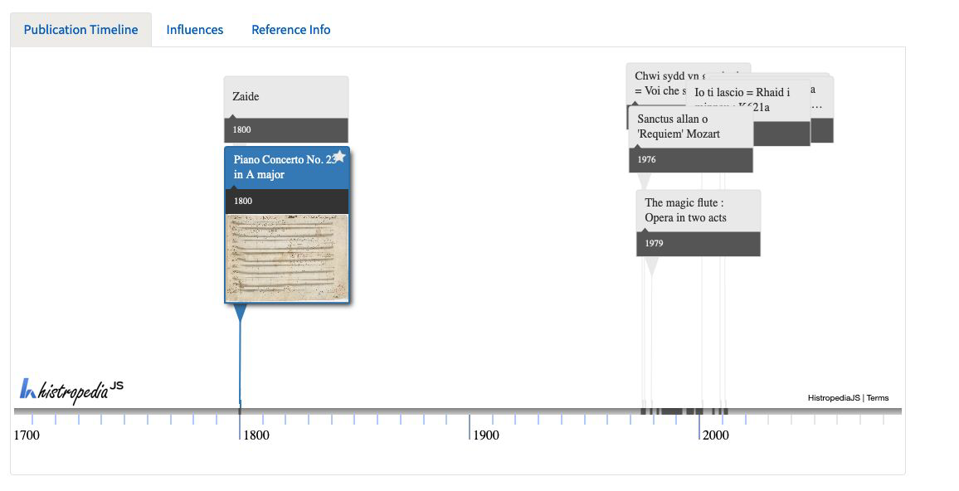
Feedback
Notes:
Original comment: “Ex. 3. Publication timeline for W.A. Mozart is wildly incomplete. Earliest editions from
1760s -1790s don’t appear. The two editions from 1800 and handful of modern
editions seem randomly selected from hundreds of possible editions.”

Slide 47
Timeline
Usability
Testing
Initial
Prototype
Prototype
and mockups
Feature
integration
November - December 2021
April 2021
August 2021

Slide 48
Feature integration
Coordinate with Discovery and Access team
Development sprint
More feedback from user representatives
Final version !
Many thanks to Tim Worrall!
Double duty on LD4P3 and Discovery and Access
“One last job”

Slide 49
Future possibilities
Include identifiers/URIs in the author and subject indices
Add knowledge panels for
Other authors/contributors
Subjects

Slide 50
Future possibilities
Integrate “Disallowing” in cataloging tools
Make URIs in MARC a central part of authority maintenance is a goal
Link directly to “non-traditional” authority sources in bibs
Consider other datasets for some relationships, e.g. ULAN for influenced/influencedBy
Consider other relationships, e.g. if influenced/influencedBy are problematic, maybe consider collaborators
Improve usage for current properties, e.g. including more than one nationality
Dream up new user interactions/display, & continue to test :)

Slide 51
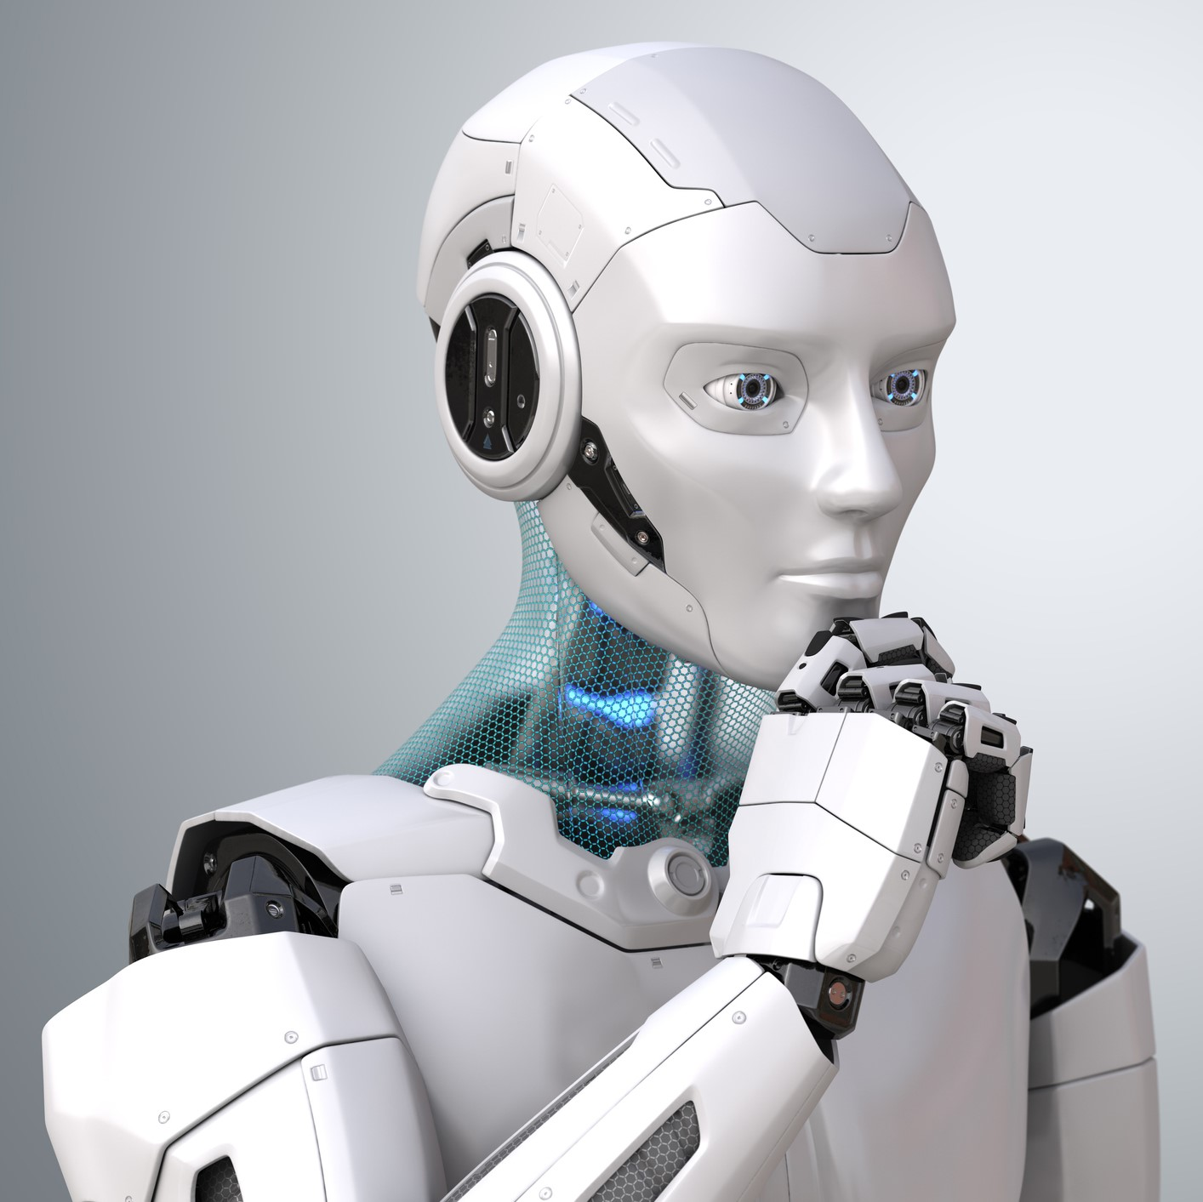
Ongoing explorations
Bringing in other versions of this work
How works are related
Translations
Editions
Adaptations
Sequels
Other Work to Work Relationships
Notes:
Tools like Sinopia have the potential to capture more detailed relationships. Not only that things are generally related, but *how* they are related.

Slide 52
Notes:
https://memegenerator.net/img/instances/400x/48499835/just-one-more-thing.jpg

Slide 53
LD4P3 Discovery Collaborators
Cornell: Greg Delisle, Steven Folsom, Huda Khan, Jason Kovari, Lynette Rayle, Simeon Warner, Tim Worrall
Stanford: Michelle Futornick, Astrid Usong, (Hilary Thorsen as special consultant)
Iowa: Dave Eichmann
Directors
Tom Cramer, Dave Eichmann, Jason Kovari, Phil Schreur, Simeon Warner

Slide 54
Cornell Discovery and Access Team
John Cline, Jenn Colt, Matt Connolly,
Caitlin Finlay, Shayla Harrington, Fred Muratori, Eisha Neely, Emma Raub, Jim Reidy, Lenora Schneller, Nina Scholtz, Adam Smith (*), Pam Stansbury, Melissa Wallace,
Frances Webb, Tim Worrall
Notes:
This list was accurate as of December and (*) indicates individuals who are no longer in the team as of February 2022

Slide 55
SPECIAL THANKS
Greg Delisle (Cornell)
Steven Folsom (Cornell)
Michelle Futornick (Stanford)
Jessie Keck (formerly at Stanford)
Jason Kovari (Cornell)
John Skiles Skinner (formerly at Cornell)
Astrid Usong (Stanford)
Tim Worrall (Cornell) (Retired)

Slide 56
Questions and discussion
Documentation/wiki
LD4P3 Discovery work

