Slide 1
Examination of Quality and Change in Subject Metadata
Dr. Oksana L. Zavalina
University of North Texas
Presentation at ALA CAMMS SAC annual meeting, 2019

Slide 2
Outline of presentation
Background: metadata quality and metadata change
Selected UNT team’s studies on metadata quality and change: research questions, study targets, and tools
Some findings relevant to subject metadata
Concluding remarks: resulting frameworks, limitations and future/concurrent research
Dr. O. Zavalina, UNT
June 24, 2019

Slide 3
1. Background
Metadata Quality and Metadata Change
Dr. O. Zavalina, UNT

Slide 4
Background: MARC 21 Subject Metadata Over Time
subject access issues related to quality of LCSH controlled vocabulary (LCSH authority records):
Pauline Cochrane (1986) and a follow-up (Cochrane,2000)
reproducing user queries in OPAC and matching user search terms with LCSH controlled vocabulary terms in MARC 21 bibliographic records:
Tina Gross and Arlene Taylor (2005) and a follow-up (Gross, Taylor, & Joudrey, 2015)
Dr. O. Zavalina, UNT
June 24, 2019
4

Slide 5
Background: metadata change
Metadata records need to be updated to keep up with changes in description standards, controlled vocabularies, etc.
Record enhancements have long been encouraged in cataloging community
Catalogers edit records in local OPACs, WorldCat and other databases
OCLC staff edits WorldCat records
Dr. O. Zavalina, UNT
June 24, 2019

Slide 6
Background: Metadata Change & Quality in Information Science
Large body of research on metadata quality:
Most common metadata quality criteria: completeness, consistency, accuracy (e.g., Bruce & Hillmann, 1998; Park & Tosaka, 2010).
Purposeful change – detecting & removing inconsistencies & significant errors – is intended to result in improved quality
Studies of digital collections suggest the link between metadata change and quality of metadata in digital collections
e.g., medical digital repository metadata that underwent change exhibits higher quality (Marc et al., 2016)
Dr. O. Zavalina, UNT
June 24, 2019
6

Slide 7
Gap in Metadata Change Research
Stvilia et al. (2004), Stvilia & Gasser (2008) emphasized the need to measure metadata change and its outcomes for the users
Lack of studies identifying and measuring metadata change
In part due to unavailability of metadata versioning
Dr. O. Zavalina, UNT
June 24, 2019

Slide 8
Challenge in Studying Metadata Change
Versioning facilitates collection of metadata change data
when versioning is supported, all versions of the record are automatically preserved and easily available for analysis
Most OPACs and digital content management systems in use do not support versioning:
whenever a record is updated, the latest version overwrites the previous version.
Dr. O. Zavalina, UNT
June 24, 2019
Notes:
Unavailability of versioning:
for MARC 21 library bibliographic (and authority) records in online catalogs (incl. WorldCat)
for digital library metadata in various standards (Dublin Core, MODS, etc., incl. locally-developed) in digital content management systems that are most widely used (DSpace, CONTENTdm)

Slide 9
Background: Computer Science on Change
Examination of change in texts, strings, files, scripts, etc.
Mechanisms for identifying change: e.g., edit distance (Bille, 2005)
File comparison tools (DIFF, COMM, PRETTY DIFF, PROMPTDIFF, etc.) for isolating differences between:
files
programs
applications
ontologies
multiple versions of the same entities.
(e.g., Cheney, 2010; Horwitz, 1990; Noy et al., 2004).
Change categories of addition, deletion, and modification
Dr. O. Zavalina, UNT
June 24, 2019
9

Slide 10
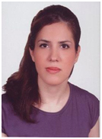
UNT metadata change research team: researchers and practicing librarians, students and faculty
Dr. Daniel Alemneh
Priya Kizhakkethil
Dr. Shawne Miksa
Mark Phillips
Dr. Shadi Shakeri
Hannah Tarver
Slava Zavalin
Dr. Oksana Zavalina
Dr. O. Zavalina, UNT
June 24, 2019
10

Slide 11
UNT research team investigates metadata change
In bibliographic metadata & authority metadata:
in digital and traditional libraries
RDA and non-RDA
MARC21 and beyond.
Quantitative studies to identify and measure change in metadata records
in digital libraries that enable metadata versioning
In WorldCat and OCLC Authorities – requires collecting the data at intervals.
A qualitative research project categorized metadata change in digital library metadata and in traditional library metadata.
Dr. O. Zavalina, UNT
June 24, 2019

Slide 12
2. SELECTED UNT team’s studies RELEVANT TO SUBJECT METADATA:
Purpose, research questions, study targets, and tools
Dr. O. Zavalina, UNT

Slide 13
Research questions:
Purpose: Understanding of Metadata Change (including in subject metadata)
How does metadata change over time?
Frequency of occurrence of metadata fields and subfields (including subject metadata) ?
Categories / types of metadata change?
Metadata fields/subfields in which metadata change occurs the most often?
Distribution of metadata change across editing events?
How is the amount/volume of metadata change related to:
record age?
total number of editing events?
fluctuations in the record length?
overall metadata quality?
Dr. O. Zavalina, UNT

Slide 14
Study Target 1: WorldCat (Zavalina et al., 2016a, 2016b, in progress 2019)
MARC 21 Bibliographic has 30 subject metadata fields: 6XX and 0XX
Study analyzed RDA-based MARC 21 records for DVD videorecordings:
931 records collected in January 2013 and April 2019: quantitative analysis
subset of 369 records collected in January 2013, April 2014, May 2015, May 2016: analyzed quantitatively & qualitatively
Listed on the next slide
Zavalina, O.L., Shakeri, S., & Kizhakkethil, P. (2016a). An empirical investigation of change in subject metadata in WorldCat. Proceedings of the International Federation of Library Associations World Library and Information Congress Satellite Conference "Subject Access: Unlimited Opportunities"
Zavalina, O.L., Zavalin, V., & Miksa, S. D. (2016b). Quality over time: A longitudinal quantitative analysis of metadata change in RDA-based MARC bibliographic records representing video resources. Proceedings of the 79th Association for Information Science and Technology Annual Meeting.
Dr. O. Zavalina, UNT

Slide 15
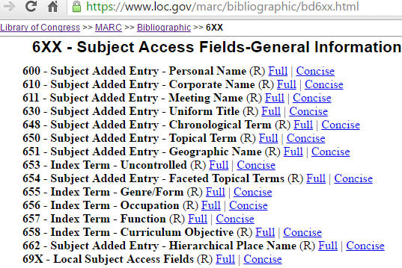
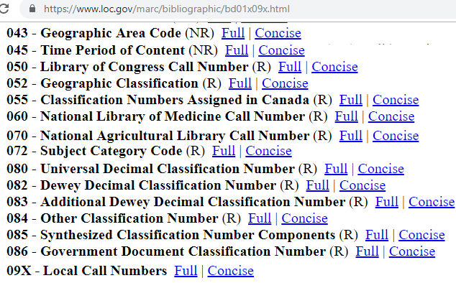
MARC21 Bibliographic: Subject Metadata Fields
15
6xx
15
0xx
Dr. O. Zavalina, UNT
June 24, 2019

Slide 16
Study Target 2: Library of Congress Name Authority File (Zavalina & Zavalin, 2017, 2018, in progress 2019)
Used in subject metadata fields 6XX of MARC bibliographic records
408.5K RDA-based MARC 21 authority records
Collected in March 2015, December 2017, April 2019:
Personal, corporate, meeting, place names
Uniform titles
Zavalina, O.L., & Zavalin, V. (2017). Implementation of Resource Description and Access standard in authority data in MARC format: An empirical investigation: Proceedings of the 13th International Conference on Knowledge Management.
Zavalina, O., L., & Zavalin V. (2018). Evaluation of metadata change in authority data over time: An effect of a standard evolution. Proceedings of the 81st Association for Information Science and Technology Annual Meeting.
Dr. O. Zavalina, UNT

Slide 17
Study Target 3: UNT Digital Library (Zavalina & Kizhakkethil, 2015)
Large regional aggregator of 400+ Texas, Oklahoma, and Arkansas digital collections; DPLA service hub
Metadata available in multiple metadata schemes, including Dublin Core
Metadata versioning enabled: end-users can only see the latest version of a record but every version is stored and available for analysis.
Compared versions of 150 Dublin Core metadata records from across the aggregation (collected May 2014)
2 subject metadata elements: Subject, Coverage.
Zavalina, O.L., & Kizhakkethil, P. (2015). Exploration of metadata change in a digital repository. Proceedings of the iConference 2015. Newport Beach, California, March 24-27, 2015. https://www.ideals.illinois.edu/handle/2142/73455
Dr. O. Zavalina, UNT
June 24, 2019

Slide 18
Study Target 4: Texas Patents Collection (Zavalina et al., 2018)
Contains 14,000 official U.S. patents issued to Texas residents in 1840-1920s
Part of The Portal to Texas History digital repository
UNTL hierarchical metadata application profile based on Dublin Core
20 descriptive metadata elements
2 subject metadata elements: Subject, Coverage.
Compared versions of 400 edited metadata records collected in May 2017
Zavalina OL, Shakeri S, Kizhakkethil P, Phillips M (2018). Uncovering Hidden insights for information management: Examination and modeling of change in digital collection metadata. In G. Chowdhury et al. (Eds.), iConference 2018, Lecture Notes in Computer Science 10766 (pp.1-7). New York: Springer.
June 24, 2019
Dr. O. Zavalina, UNT

Slide 19
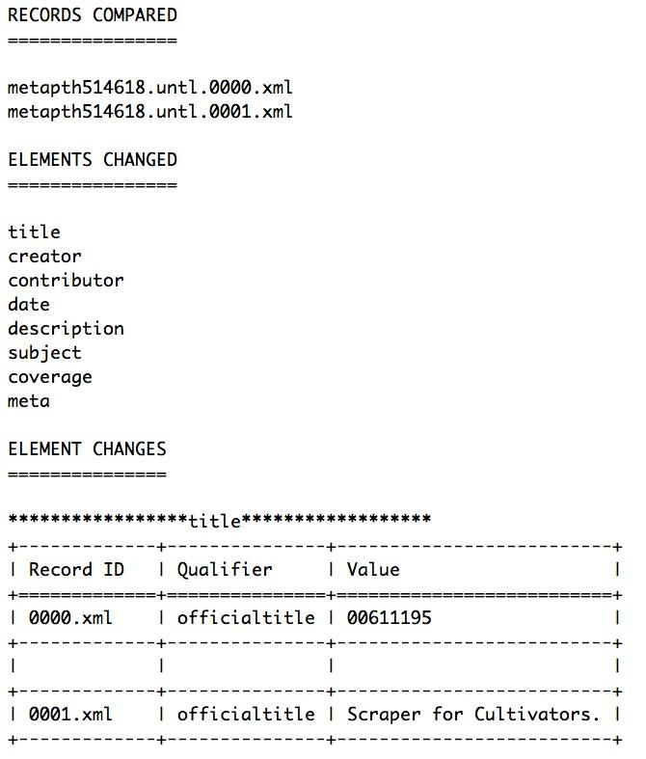
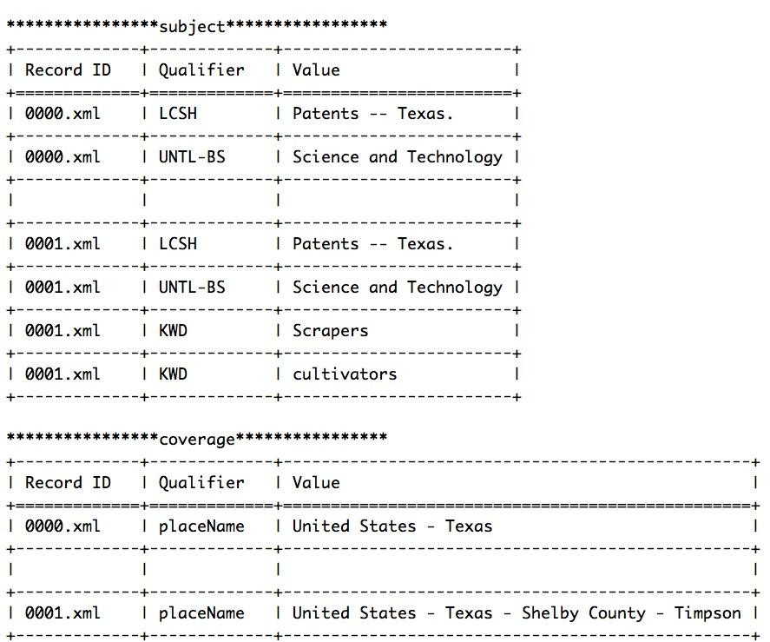
Tool to support content analysis of Texas Patents metadata change (dev. by M. Phillips)
Automatically generates summaries of metadata change from one version of metadata record to another
JSON
Python script
Zavalina OL, Shakeri S, Kizhakkethil P, Phillips M (2018). Uncovering Hidden insights for information management: Examination and modeling of change in digital collection metadata. In G. Chowdhury et al. (Eds.), iConference 2018, Lecture Notes in Computer Science 10766 (pp.1-7). New York: Springer.
Dr. O. Zavalina, UNT
June 24, 2019
19

Slide 20
3A. Some Findings of ReleVANT UNT team’s studies: MARC 21 bibliographic metadata
Dr. O. Zavalina, UNT

Slide 21
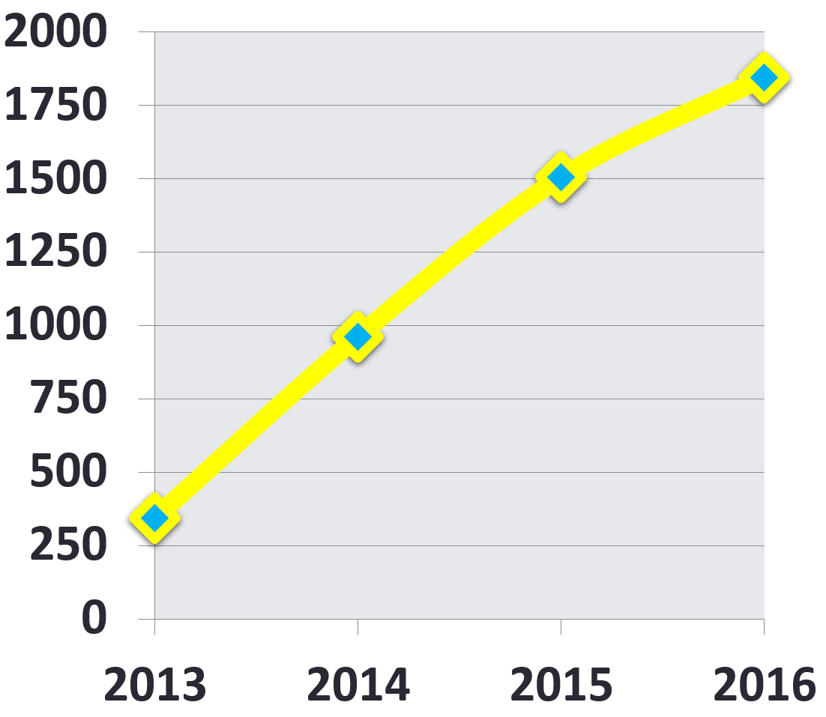
WorldCat (Zavalina, Zavalin & Miksa, 2016; n=369 bibliographic records)
Significant growth in overall volume of metadata change (no. of metadata editing events): 2013-2016
Dr. O. Zavalina, UNT
June 24, 2019

Slide 22
WorldCat (Zavalina, Zavalin & Miksa, 2016; n=369 bibliographic records)
% of records:
2013
2014
2015
2016
Dr. O. Zavalina, UNT
June 24, 2019

Slide 23
WorldCat (Zavalina, Shakeri, & Kizhakkethil, 2016; n=369 records)
All records contained 1 or more of subject metadata fields
Between 1-9 different subject fields in a record
3.64 different subject fields per record on average
Change – addition, deletion, or modification – in 1 or more subject fields observed in most records: 354 out of 369
Dr. O. Zavalina, UNT
June 24, 2019

Slide 24
WorldCat (Zavalina, Shakeri, & Kizhakkethil, 2016; n=369)
Observed 8 of 15 MARC21 0XX subject fields; growth in application for 5
MARC 21 Subject Metadata Fields (descending order by % of records with field) |  | % of records with: |  | Ave. instances per record
 |  | 2013 | 2015 | 2013 | 2015
043 | Geographic area code | 35.5% | 54.35% ↑ | 1 | 1
050 | Library of Congress call no. | 34.15% | 40.76%↑ | 1.008 | 1.013 ↑
090 | Locally-assigned LC-type call no. | 23.31% | 22.55% ↓ | 1 | 1.024 ↑
082 | Dewey Decimal classification no. | 11.92% | 14.67% ↑ | 1.022 | 1.037 ↑
086 | Government document classification no. | 0.81% | 0.81% | 1 | 1
060 | National Library of Medicine call no. | 0.54% | 0.54% | 1.5 | 1.5
070 | National Agricultural Library call no. | -- | 0.27% ↑ | -- | 1
092 | Locally-assigned Dewey-type call no. | 0.27% | 0.27% | 1 | 1
Mixed trend
Dr. O. Zavalina, UNT

Slide 25
WorldCat (2019 study in progress; n=931)
More (12 of 15) MARC21 0XX subject fields; growth for 5; decrease for 1; mixed trend for 2
MARC 21 Subject Metadata Fields (descending order by % of records in 2019) |  | % of records with: |  | Ave. instances per record
 |  | 2013 | 2019 | 2013 | 2019
050 | Library of Congress call no. | 35.52% | 67.78%↑ | 1.003 | 1.079 ↑
043 | Geographic area code | 39.6% | 57.47% ↑ | 1 | 1
090 | Locally-assigned LC-type call no. | 24.03% | 22.55% ↓ | 1 | 1.024 ↑
082 | Dewey Decimal classification no. | 11.91% | 14.67% ↑ | 1.018 | 1.037 ↑
086 | Government document classification no. | 0.32% | 0.81% ↑ | 1 | 1
070 | National Agricultural Library call no. | 0.32% | 0.43% ↑ | 1 | 1
060 | National Library of Medicine call no. | 0.21% | 0.32% ↑ | 1.5 | 1.33 ↓
092 | Locally-assigned Dewey-type call no. | 0.97% | 0.27% ↓ | 1 | 1
045 | Time period of content | 0.215% | 0.215% | 1 | 1
084 | Other classification number | -- | 0.12% | -- | 3
096 | Local call number | -- | 0.12% | -- | 1
055 | Classification numbers assigned in Canada | -- | 0.11% | -- | 1
Mixed trend
Mixed trend

Slide 26
WorldCat (Zavalina, Shakeri, & Kizhakkethil, 2016; n=369)
Observed 8 of 15 MARC21 6XX subject fields; mixed trend for 5; decrease for 2
MARC 21 Subject Metadata Fields (descending order by % of records with field) |  | % of records with: |  | Ave. instances per record
 |  | 2013 | 2015 | 2013 | 2015
650 | Topical term subject added entry | 91.33% | 91.58% ↑ | 5.038 | 4.599 ↓
655 | Genre/form index term | 86.45% | 86.14% ↓ | 1.627 | 1.662 ↑
651 | Geographic name subject added entry | 50.95% | 42.66% ↓ | 1.627 | 1.662 ↑
600 | Personal name subject added entry | 17.89% | 17.93% ↑ | 2.272 | 2.136 ↓
610 | Corporate name subject added entry | 14.09% | 14.13% ↑ | 2.326 | 1.962 ↓
648 | Chronological term subject added entry | 10.03% | 8.97% ↓ | 1 | 1
611 | Meeting name subject added entry | 5.42% | 4.62% ↓ | 1.25 | 1.25
630 | Uniform title subject added entry | 3.25% | 3.25% | 1.5 | 1.5

Slide 27
WorldCat (2019 study in progress; n=931)
Observed more (10 of 15) MARC21 6XX subject fields; growth for 7, mixed trend for 2
MARC 21 Subject Metadata Fields (descending order by % of records in 2019) |  | % of records with: |  | Ave. instances per record
 |  | 2013 | 2019 | 2013 | 2019
650 | Topical term subject added entry | 91.85% | 93.35% ↑ | 5.076 | 5.081 ↑
655 | Genre/form index term | 86.91% | 88.51% ↑ | 3.64 | 6.01 ↑
651 | Geographic name subject added entry | 53.86% | 54.24% ↑ | 1.60 | 1.64 ↑
600 | Personal name subject added entry | 15.77% | 17.4% ↑ | 2.12 | 2.3 ↑
610 | Corporate name subject added entry | 14.27% | 14.29% ↑ | 2.17 | 2.23 ↑
648 | Chronological term subject added entry | 11.27% | 11.6% ↑ | 1 | 1
611 | Meeting name subject added entry | 4.94% | 5.16% ↑ | 1.12 | 1.17 ↑
630 | Uniform title subject added entry | 2.47% | 2.79% ↑ | 1.7 | 1.62 ↓
653 | Index term -- uncontrolled | 0.12% | 0.21% ↑ | 2 | 1.5 ↓
657 | Index term -- function | 0.12% | 0.12% | 1 | 1
Mixed trend
Mixed trend

Slide 28
WorldCat (Zavalina, Shakeri, & Kizhakkethil, 2016; n=369)
Example of change in field 600: 3 more subfields in 2015;growth for 4;decrease for 4
Subfields |  | % in 150 field instances: 2013 | % in 141 field instances: 2015
a | Personal name | 100% | 100%
b | Numeration | 2.67% | 2.13% ↓
c | Titles etc. | 6.67% | 6.38% ↓
d | Dates associated with name | 64.67% | 65.25% ↑
l | Language of work | -- | 0.71% ↑
m | Medium of performance of work | -- | 0.71% ↑
q | Fuller form of name | 4.67% | 5.67% ↑
t | Title of a work | 6% | 7.09% ↑
v | Form subdivision | 16.67% | 18.44% ↑
x | General subdivision | 8% | 7.80% ↓
0 | Authority record control no. | -- | 32.32% ↑
2 | Source of heading/term | 37.33% | 32.32% ↓
Required subfield

Slide 29
WorldCat (2019 study in progress; n=931)
Example continued: more (13 of 31) field 600 subfields; decrease for 6; growth for 3
MARC21 600: Subfields |  | % in 312 field instances: 2013 | % in 373 field instances: 2019
b | Numeration | 2.56% | 2.14% ↓
c | Titles etc. | 7.69% | 16.62% ↑
d | Dates associated with name | 66.03% | 58.48% ↓
k | Form subheading | 0.32% | 0.27% ↓
l | Language of work | -- | 0.27%
m | Medium of performance of work | -- | 0.27%
q | Fuller form of name | 5.45% | 5.36% ↓
t | Title of a work | 4.81% | 4.29% ↓
v | Form subdivision | 11.54% | 15.55% ↑
x | General subdivision | 7.69% | 5.63% ↓
0 | Authority record control no. | -- | 42.90%
2 | Source of heading/term | 39.10% | 42.9% ↑

Slide 30
WorldCat (Zavalina, Shakeri, & Kizhakkethil, 2016; n=369)
Distribution of metadata change categories in subject metadata fields
Dr. O. Zavalina, UNT
June 24, 2019
Notes:
The Addition of 6XX fields, subfields, and their multiple instances were the most frequent subcategories of change
Among non-6XX, 043, and 050/090 were frequently added and less frequently modified or deleted.

Slide 31
WorldCat (Zavalina, Shakeri, & Kizhakkethil, 2016; n=369)
Change in the content of subject metadata fields: observed in 13 fields
6XX Fields (descending by change volume) |  | Change in field (% of records containing field)
650 | Topical term subject added entry | 98.53%
651 | Geographic name subject added entry | 95.85%
610 | Corporate name subject added entry | 87.50%
611 | Meeting name subject added entry | 73.91%
630 | Uniform title subject added entry | 73.33%
648 | Chronological term subject added entry | 67.50%
600 | Personal name subject added entry | 67.14%
655 | Genre/form index term | 60.19%
OXX fields (descending by metadata change volume) |  | Change in field (% of records containing field)
070 | National Agricultural Library call no. | 100.00%
043 | Geographic area code | 31.25%
082 | Dewey Decimal classification no. | 26.42%
050 | Library of Congress call no. | 14.48%
090 | Locally-assigned LC-type call no. | 7.06%
Dr. O. Zavalina, UNT
June 24, 2019

Slide 32
WorldCat (Zavalina, Shakeri, & Kizhakkethil, 2016;n=369)
Observed 5 subcategories of Addition and Deletion, 7 Modification subcategories
ANF: Add new variable field not previously in the record
ANS: Add new subfield to existing variable field
AEFI: Add an instance of existing variable field
AESI: Add an instance of existing subfield
AIF: Add an indicator to existing variable field
DF: Delete a variable field completely
DS: Delete a subfield completely
DEFI: Delete an instance of existing variable field
DESI: Delete an instance of existing subfield
DIF: Delete an indicator from existing variable field
MRIF: Replace an indicator in existing variable field with new
MRFT: Replace field tag with new for the same data value
MRD: Replace existing data value with new
MAMD: Amend existing data value
MTIF: Transpose multiple instances of the same field
MTS: Transpose subfields within a field
MTF: Transpose different fields within a record
Dr. O. Zavalina, UNT
June 24, 2019

Slide 33
3B. Some Findings of ReleVANT UNT team’s studies: MARC 21 AUTHORITY metadata
Dr. O. Zavalina, UNT

Slide 34
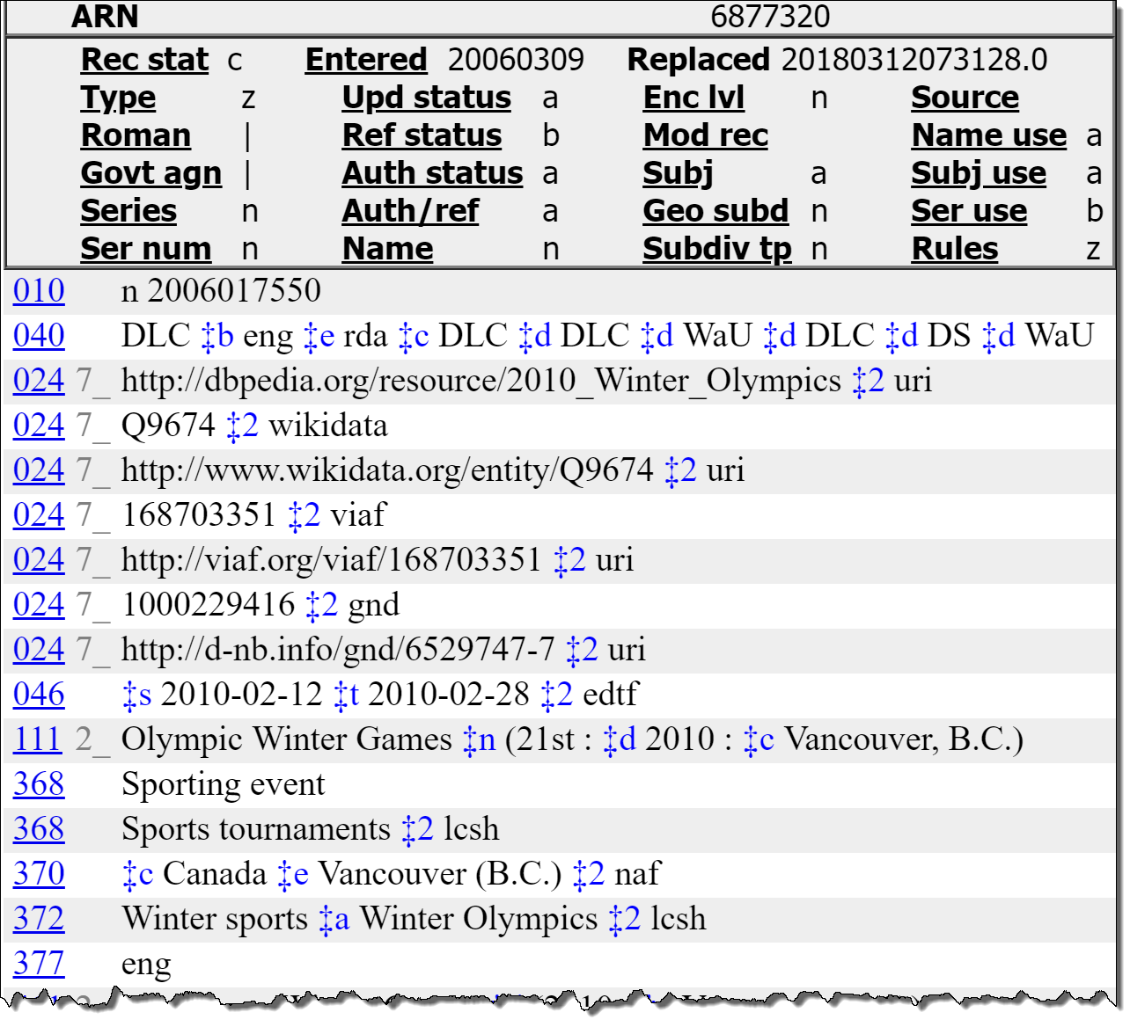
LCNAF study (Zavalina & Zavalin, 2017; 2018)
This record was originally created in AACR standard, edited later to conform to RDA
Examples of RDA-specific MARC21 subfields in RDA-specific and other fields
RDA-specific MARC21 fields
Dr. O. Zavalina, UNT

Slide 35
LCNAF study (Zavalina & Zavalin, 2017; 2018)
Changes in occurrences of RDA-specific MARC21 fields: observed for 17 of 35
Dr. O. Zavalina, UNT

Slide 36
LCNAF study (Zavalina & Zavalin, 2017; 2018)
Change for subfield-level data elements in RDA-specific MARC authority fields: top 20 of 60 observed
Dr. O. Zavalina, UNT

Slide 37
Only 1 Linked-Data-enabling MARC 21 subfield ($2 source of term) used substantially: in 7 RDA-specific MARC21 authority fields
LCNAF study (Zavalina & Zavalin, 2017; 2018)
Dr. O. Zavalina, UNT

Slide 38
3C. Some Findings of ReleVANT UNT team’s studies: NON-MARC 21 metadata in digital libraries
Dr. O. Zavalina, UNT

Slide 39
UNT Digital Library (Zavalina & Kizhakkethil, 2015) Change in the number of field instances (% of records)
Subject field is the 3rd most frequently changed by adding field instances
Dr. O. Zavalina, UNT
39

Slide 40
UNT Digital Library (Zavalina & Kizhakkethil, 2015) Metadata Change Types by Record Field (% of records)
Mostly additions in Subject; mostly deletions in Coverage
40
Dr. O. Zavalina, UNT

Slide 41
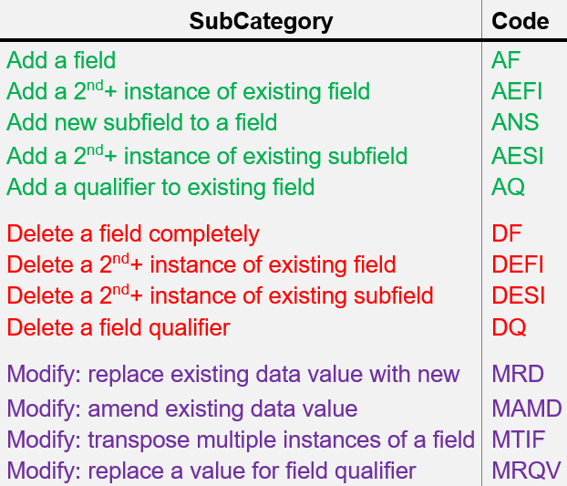
Texas Patents Collection (Zavalina, Shakeri, Kizhakkethil, & Phillips, 2018)
Change in 1st editing event):
Field | Subcategories: descending order of occurrence
Coverage | MRD, MAMD, AEFI, DESI.
Subject | AEFI, MRD, MAMD, DEFI.
Change in 2nd editing event):
Field | Subcategories: descending order of occurrence
Coverage | MAMD.
Subject | AEFI, MAMD, MRD.
Dr. O. Zavalina, UNT

Slide 42
Texas Patents Collection
(Zavalina, Shakeri, Kizhakkethil, & Phillips, 2018; n=400 records)
42
Dr. O. Zavalina, UNT

Slide 43
Texas Patents Collection
(Zavalina, Shakeri, Kizhakkethil, & Phillips, 2018; n=400 records)
Subject metadata fields are 3rd and 8th of 11 fields changed in 2nd editing event
(only 2.75%-6% of records)
43
Dr. O. Zavalina, UNT

Slide 44
4. Concluding remarks:
Resulting frameworks, limitations, future research etc.
Dr. O. Zavalina, UNT

Slide 45
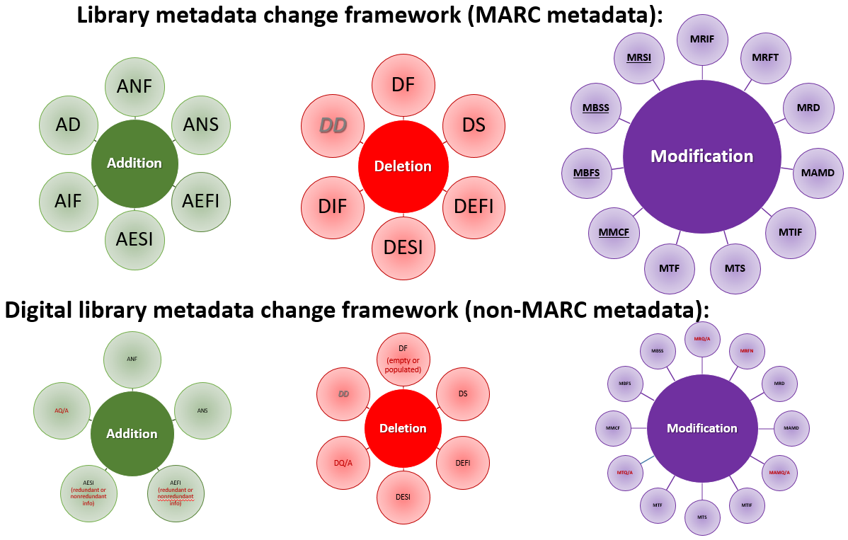
Metadata Change Framework (Zavalina et al., 2015; 2016; 2018)
Details on the next slide
Drafted and tested
For traditional library metadata (mostly bibliographic)
For digital library metadata at an aggregation level and in individual digital collection.
Zavalina OL, Kizhakkethil P, Alemneh D, Phillips M, Tarver HS (2015) Building a framework of metadata change to support knowledge management. Journal of Information and Knowledge Management 14: 1–16
Zavalina OL, Zavalin V, Shakeri S, Kizhakkethil P (2016) Developing an empirically-based framework of metadata change and exploring relation between metadata change and metadata quality in MARC library metadata. Proceedia Computer Science 99: 50–63.
Zavalina OL, Shakeri S, Kizhakkethil P, Phillips M (2018). Uncovering Hidden insights for information management: Examination and modeling of change in digital collection metadata. In G. Chowdhury et al. (Eds.), iConference 2018, Lecture Notes in Computer Science 10766 (pp.1-7). New York: Springer.
Dr. O. Zavalina, UNT

Slide 46
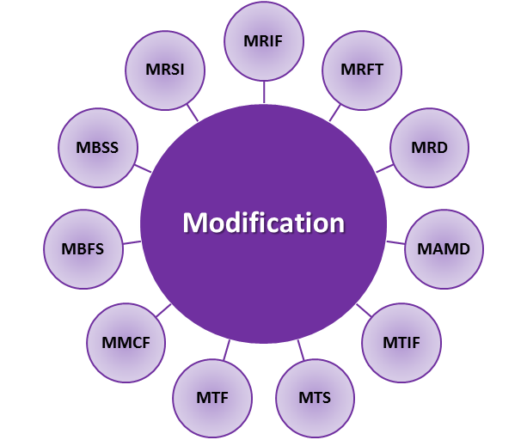
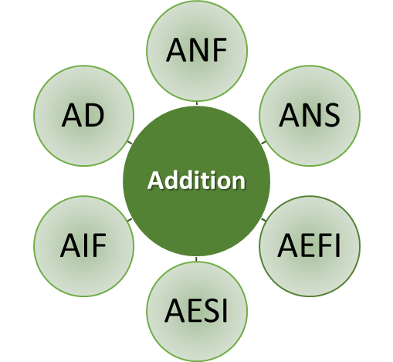
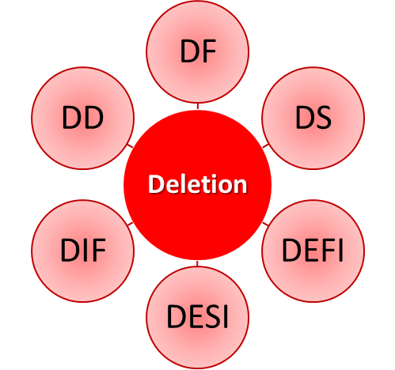
Framework of MARC21 Metadata Change
(11)
(6)
(6)
MRIF: Replace an indicator in existing field with new
MRFT: Replace field tag with new for the same data value
MRD: Replace existing data value with new
MAMD: Amend existing data value
MTIF: Transpose multiple instances of the same field
MTS: Transpose subfields within a field
MTF: Transpose different fields within a record MMCF: Merge content with another field MBFS: Break an existing field into separate fields MBSS: Break an existing subfield into separate subfields MRSI: Replace subfield indicator with new
ANF: Add new variable field not previously in the record
ANS: Add new subfield to existing variable field
AEFI: Add an instance of existing variable field
AESI: Add an instance of existing subfield
AIF: Add an indicator to existing variable field AD: Add a data value to a fixed field’s subfield
DF: Delete a field completely
DS: Delete a subfield completely
DEFI: Delete an instance of existing field
DESI: Delete an instance of existing subfield
DIF: Delete an indicator from existing field DD: Delete a data value from a fixed field’s subfield
Dr. O. Zavalina, UNT
June 24, 2019

Slide 47
Next step in framework development: Integration
Metadata quality is measured to compare against metrics of other collections or generate a quality baseline for the set of evaluated records.
Our findings provide
a baseline for evaluating metadata
a tool to help improve the quality.
to offer an integrated framework of metadata change that would be relevant to various contexts and applications.
Our concurrent research of bibliographic and authority metadata change in multiple digital and physical collections
compares level of metadata change
compares distribution of change categories.
Dr. O. Zavalina, UNT

Slide 48
Next steps in MARC 21 authority metadata change study
Quantitative evaluation
provides limited insight
More in-depth, qualitative evaluation on samples of this large dataset is needed:
Focus on data values in fields/subfields
Categorization of change beyond addition or deletion of a field/subfield instance.
Dr. O. Zavalina, UNT
June 24, 2019

Slide 49
Next steps in MARC 21 bibliographic metadata change study
Exploratory study analyzed limited group of MARC21 bibliographic records
for one type of information objects – English-language DVD video resources
catalogued by English-speaking catalogers.
Broader evaluation of subject metadata change is needed:
for various types of items
in various languages, and
catalogued by institutions from both English-speaking and non-English-speaking countries.
User study is needed !
Dr. O. Zavalina, UNT
June 24, 2019

Slide 50
THANK YOU!
Ideas?
Questions? Comments?
Oksana L. Zavalina: Oksana.Zavalina@unt.edu
Dr. O. Zavalina, UNT
June 24, 2019

Slide 51
Cited non-UNT works
Bille, P. (2005). A survey on tree edit distance and related problems. Theoretical Computer Science, 337(1-3), 217-239.
Bruce, T.R., & Hillmann, D.I. (2004). The continuum of metadata qality: defining, expressing, exploiting. In Hillman, D. and Westbrook, L. (Eds.), Metadata in Practice. Chicago: American Library Association, pp. 238-256.
Cheney, A. (2010). Pretty Diff - Documentation. Retrieved from http://prettydiff.com/documentation.php
Cochrane, P. (1986). Improving LCSH for Use in Online Catalogs. Colorado Springs, CO: Libraries Unlimited.
Cochrane, P. (2000). Improving LCSH for use in online catalogs revisited: What progress has been made? What issues still remain? Cataloging and Classification Quarterly, 29 (1/2), 73- 89.
Gross, T., & Taylor, A. (2005). What have we got to lose? The effect of controlled vocabulary on keyword searching results. College and Research Libraries, 66(3), 212-230.
Gross, T., Taylor, A., & Joudrey, D. (2015). Still a lot to lose: the role of controlled vocabulary in keyword searching. Cataloging & Classification Quarterly, 53(1), 1-39.
Horwitz, S. (1990). Identifying the semantic and textual differences between two versions of a program. ACM SIGPLAN Notices, 25(6), 234-245.
Marc, D.T., Beattie, J., Herasevich, V., Gatewood, L., & Zhang, R. (2016). Assessing metadata quality of a federally sponsored health data repository. In: American Medical Informatics Association Annual Symposium Proceedings. Vol. 2016., p 864.
Noy, N., Kunnatur, S., Klein, M., & Musen, M. (2004). Tracking changes during ontology evolution. Lecture Notes in Computer Science, 3298, 259-273.
Park, J. & Tosaka, Y. (2010). Metadata quality control in digital repositories and collections: criteria, semantics, and mechanisms. Cataloging & Classification Quarterly, 48 (8), 96-715.
Stvilia, B., Gasser, L., Twidale, M., Shreeves, S., & Cole, T. (2004). Metadata quality for federated collections. In Proceedings of the 9th International Conference on Information Quality (ICIQ04), Cambridge, MA., 111-12.
Stvilia, B., & Gasser, L. (2008). Value based metadata quality assessment. Library & Information Science Research, 30(1), 67-74..
Dr. O. Zavalina, UNT
June 24, 2019

