Slide 1
Tools and Workflows for Enhancing Discoverability of Linked Data and Other Library Resources on the Web
Crystal Clements, Science Cataloger
Theodore Gerontakos, Metadata Librarian
Benjamin Riesenberg, Linked Data Specialist
University of Washington Libraries

Slide 2
Libraries Produce Linked Data

Slide 3
Libraries Publish Linked Data
Publishing options include:
Files on a web server
RDF triple store
Data source accessed via API

Slide 4
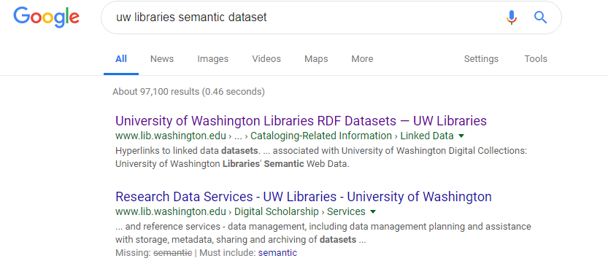
The Linked Data Becomes a Resource

Slide 5
The primary means of publishing linked data on the web is by making URIs dereferenceable, thereby enabling the follow-your-nose style of data discovery. This should be considered the minimal requirements for linked data publishing.
-Heath and Bizer, Linked Data: Evolving the Web into a Global Data Space

Slide 6
Discoverability
Providing metadata in various formats:
Schema.org
HTML
RDFa
VoID
DataCite
Site Maps
Do users want RDF datasets to appear in their search results?

Slide 7
Question Area 1
What work has your institution done to optimize discoverability of locally-produced linked data?
Are users able to discover the datasets?
How has your institution facilitated the use of that linked data?
Notes:
About what your org has done to enhance discovery

Slide 8
Question Area 2
What can libraries do moving forward to enhance discoverability of library linked data or other resources on the web?
Has your institution considered SEO practices, integration of collections with Wikimedia platforms, site maps, schema.org metadata, or other approaches?
Notes:
What have you considered doing that you haven’t done yet

Slide 9
Question Area 3
How can institutions share workflows and knowledge as we explore this new territory?
What are some ways for us to work together in order not to duplicate our efforts and to share what we learn?
Notes:
How do we pool our resources...
How do we collaborate across institutional boundaries to do this work?

Slide 10
Thanks!
Benjamin Riesenberg, Linked Data Specialist, ries07@uw.edu
Crystal Clements, Science Cataloger, cec23@uw.edu
Theodore Gerontakos, Metadata Librarian, tgis@uw.edu
University of Washington Libraries

