Slide 1
Finding religion in RDA
Elliot Williams
University of Miami Libraries
@elliot_dw
edwilliams@miami.edu
ALCTS CaMMS Cataloging & Classification Research Interest Group
ALA Midwinter 2019

Slide 2
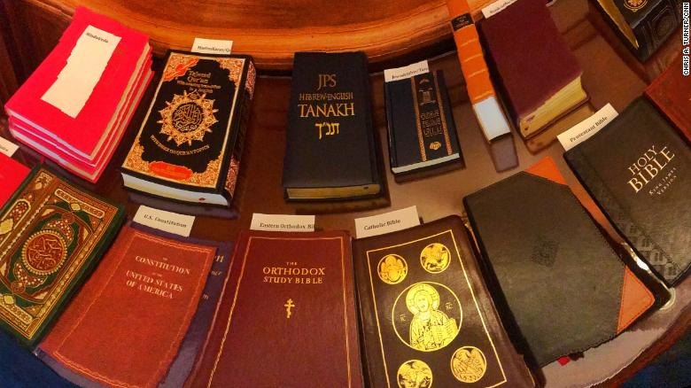
Where and how does RDA explicitly discuss religion?
What can that tell us about RDA?
Image source: Chris A. Turner/CNN
Notes:
Over the past few months, I’ve been noticing and thinking about the number of times that religion appears in RDA. So this presentation is the beginnings of my attempt to think more about that, and to try and think about what that can tell us about RDA and cataloging in general. I’m still thinking about how (and honestly, whether) this matters, but it feels to me like an interesting way of approaching RDA as a document and as a set of rules that were simultaneously designed with particular needs and audiences in mind, and intended to be all-encompassing. So today, I’m just going to talk a bit about how I’ve started looking into this topic - work-in-progress presentation, instead of final results. I should also say at the outset that I don’t have a background in comparative religions, nor do I work with religious texts very much as a cataloger - my interest in this is more in what it says about RDA’s development and structure.
I included this image of the books that congresspeople used for their swearing in this month, just because it’s not often that you use religious texts in the news, and it felt appropo to have them be so newsworthy while I was working on this talk.

Slide 3
6.2 Title of work
6.23 Title of a Religious Work
6.24 Date of Expression of a Religious Work
6.25 Other Distinguishing Characteristic of Expression of a Religious Work
6.30 Constructing Access Points to Represent Religious Works and Expressions
9.2 Name of Person
9.4 Title of Person
9.19 Constructing Access Points to Represent Persons
11.2 Name of Corporate Body
11.13 Constructing Access Points to Represent Corporate Bodies
19.2 Creator
19.3 Other Agent Associated with a Work
Appendix A: Capitalization
Appendix E: Record Syntaxes for Access Point Control
Appendix F: Additional Instructions on Names of Persons
Appendix G: Titles of Nobility, Terms of Rank, Etc.
https://tinyurl.com/rda-religion
Notes:
So the first thing I did when I got curious about this was just simply do a search in the Toolkit for the words church, religious, and religion. I absolutely can’t guarantee that I got every rule that is relevant to religion on RDA, but I think I found the majority of them.
Difficult to count number of rules (what counts as a single rule?). These are all of the sections where I found mentions of religion.
Generally, three ways in which religions is dealt with:
Describing religious texts
Describing religious people and corporate bodies
How to express religious titles, names, and words in various languages
If you want to see the full list that I compiled, it’s in a Google doc at this tinyurl link.

Slide 4
What religions appear in RDA, and where?
Chapter 6 (Identifying Works & Expressions) has rules covering a wider range of religions than Chapter 9 (Identifying People) or Chapter 11 (Identifying Corporate Bodies)
Only place (outside of appendices) where there are rules specific to Jainism or Zoroastrianism, for example
Chapter 11 (Identifying Corporate Bodies) is dominated by Christianity, especially Catholicism but Protestant churches, too
Examples, especially in Chapter 6, show a clear attempt to not only use examples from major religious traditions (e.g. Raelism, Thelema, Urantia Book)
Notes:
I had initially hoped to code that list of rules by religion/tradition to make some arguments about how different religions are represented in RDA. But… in what is no surprise to anyone, coding for religion is actually quite difficult and requires specialized knowledge about comparative religions that I don’t have. So instead of any broad claims, here are a few things I noticed as I started exploring this:

Slide 5
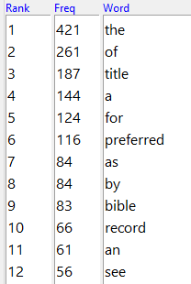
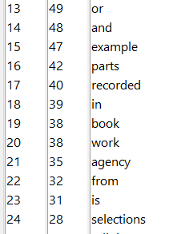
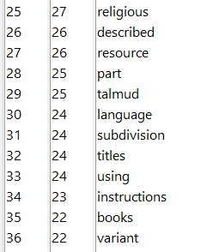
Text mining 6.23: Title of a Religious Work
Notes:
I also want to explore whether text analysis and text mining can be useful for exploring this. I started with section 6.23, Title of a Religious Work, and literally just copied and pasted from the Toolkit into a text document. Fed that into AntConc.
This list is the words that appear most frequently in 6.23. Not particularly enlightening on it’s own.

Slide 6
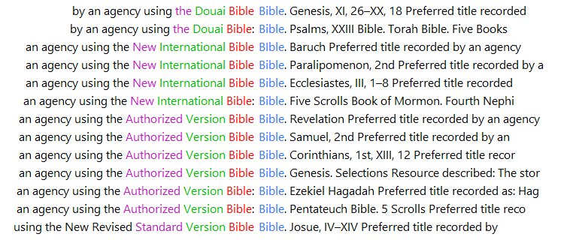
Text mining 6.23: Title of a Religious Work
Notes:
Another thing that AntConc can do is show you everywhere a word appears. This is part of the concordance for the word “Bible.” Highlights how often different versions of the Bible appear in the text (I believe most of these are examples).

Slide 7
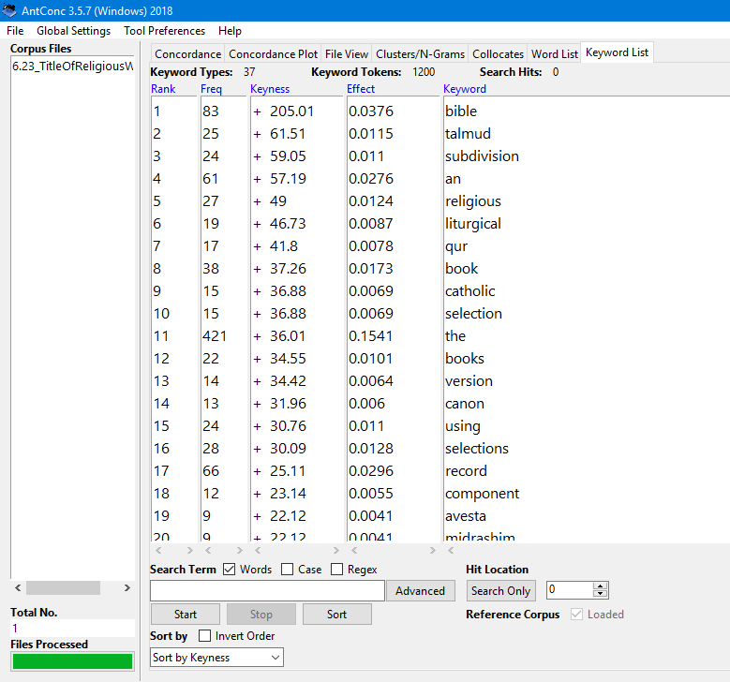
Comparing 6.23 (Title of a Religious Work) with:
6.2 Title of a Work
6.14 Title of a Musical Work
6.19 Title of a Legal Work
Notes:
I also wanted to compare section 6.23 to the other Title sections, to see if text analysis could help elucidate anything about how religious works are treated differently. On the left here is a screenshot from AntConc, showing a list of the words that are most statistically unique in 6.23 compared to 6.2, 6.14, and 6.19 - these are the words that appear in the religion section, but not the others.
Not surprisingly, words like bible, talmud, qur’an (that’s the “qur” there), liturgical, are high on the list. But subdivision is number 3 on the list. It turns out that the word “subdivision” is used 24 times in 6.23, and not once in the rules for general works, musical works, or legal works. 6.23 has multiple rules for recording titles as a subdivision of the title of a larger work, but there are no parallel rules for other types of non-religious works. Again, I’m still thinking about how and whether this is significant in the larger picture of RDA, but it illustrates the kind of things that text mining can illuminate.

Slide 8
Possible next steps
More rigorous coding by religion
Historical comparison - how does RDA compare to AACR2?
More text analysis

