Slide 1
OA Value and OA Values at the University of California
Miranda Bennett
Director of Shared Collections
CCDO Summer Meeting – June 14, 2023

Slide 2
Transformative Agreements at UC/CDL
Guidance from faculty and adminstration:
Pursue agreements which shift investments from subscriptions to OA support
Dual goal of cost containment and full transition to OA
Notes:
TAs are UC’s signature (but not sole!) approach to OA. We believe they provide value for publication-intensive institutions like UC by redirecting subscription/read-access funds to support for authors to publish open access, while giving us some level of control over the total amount of money UC spends with publishers.

Slide 3
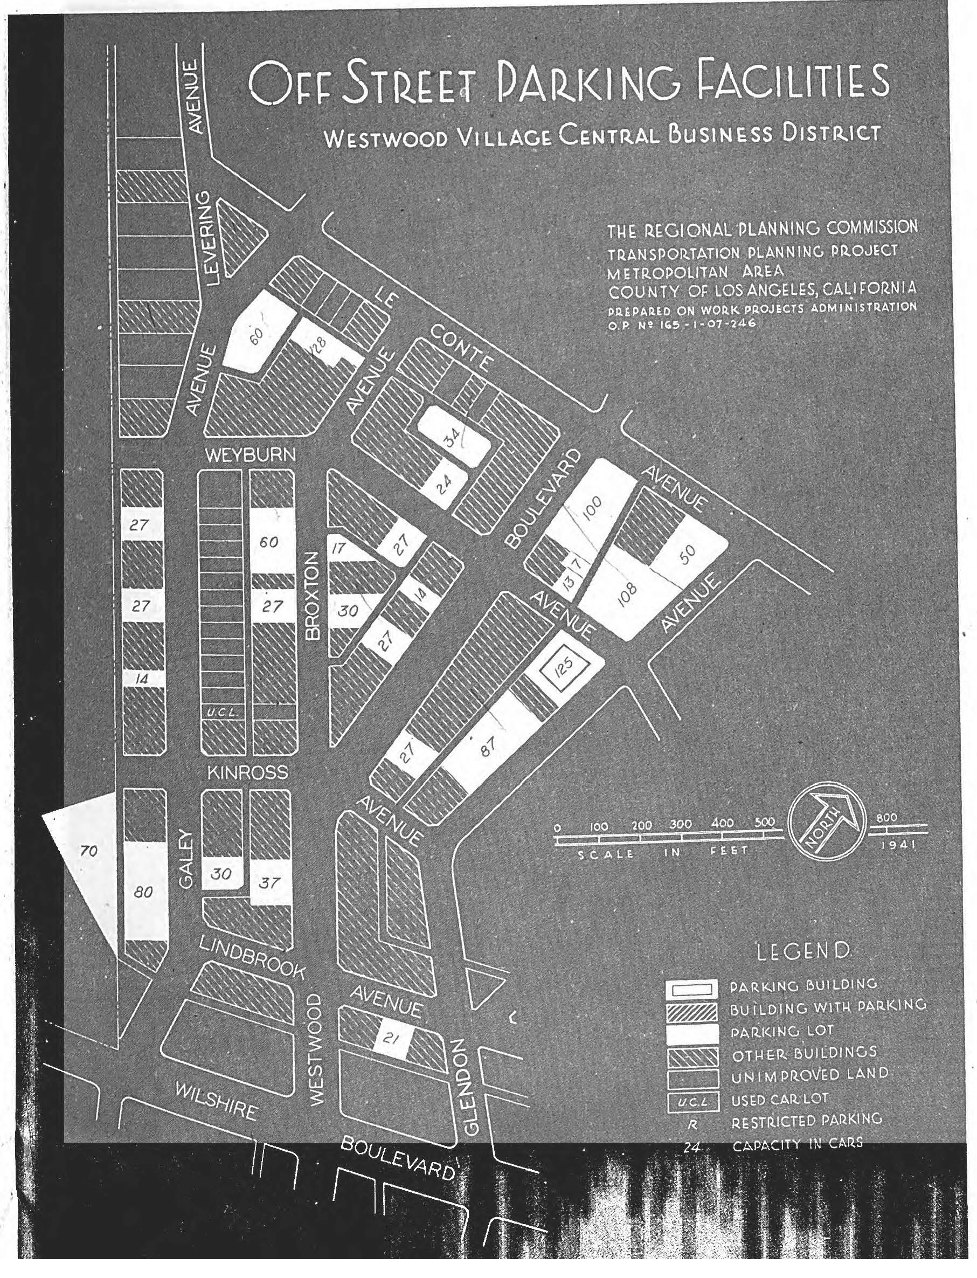
Calculating Value
Pre-negotiation analysis – informs development of financial model
Subscription spend + APCs in the wild
Determining “read value” of content (work in progress)
Usage (downloads, citations)
OA availability
Pricing

Slide 4
Multipayer model
Why multipayer?
Engage authors in economics of publishing
Distribute OA investment responsibility beyond the library
Supplement redirected library subscription funds
Encourage broad recognition of value of OA
Prompt authors to consider including publication costs in grant applications
Motivate publishers to develop flexible workflows
Notes:
Distributes OA investment responsibility beyond the library + keeps library costs (relatively) manageable. Encourages broad recognition of value of OA. Prompts authors to consider including publication funds in grant applications. Challenges publishers to develop flexible workflows.

Slide 5
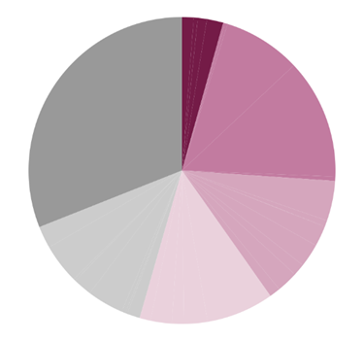
Agreement progress
As of 2023:
15 UC-wide transformative agreements (including top five by volume)
~54% of UC publications will be eligible for OA publication under an agreement
Working on negotiations with publishers covering another 15%
2020 and earlier | 4.3%
New for 2021 | 21.7%
New for 2022 | 14.1%
New for 2023 | 14.2%
Target for 2023-24 | 14.5%
For future negotiations | 31.0%

Slide 6
Agreement outcomes
Over 10,000 UC-authored articles made open access under these agreements since 2019
67% of eligible articles made OA in 2022 (preliminary assessment)
53% of eligible articles in hybrid journals made OA
Contributions from grant funds by authors:
In hybrid journals: ~30%, and increasing
In full OA journals: ~70%, and declining
Most agreements have some cost avoidance compared to status quo projections

Slide 7
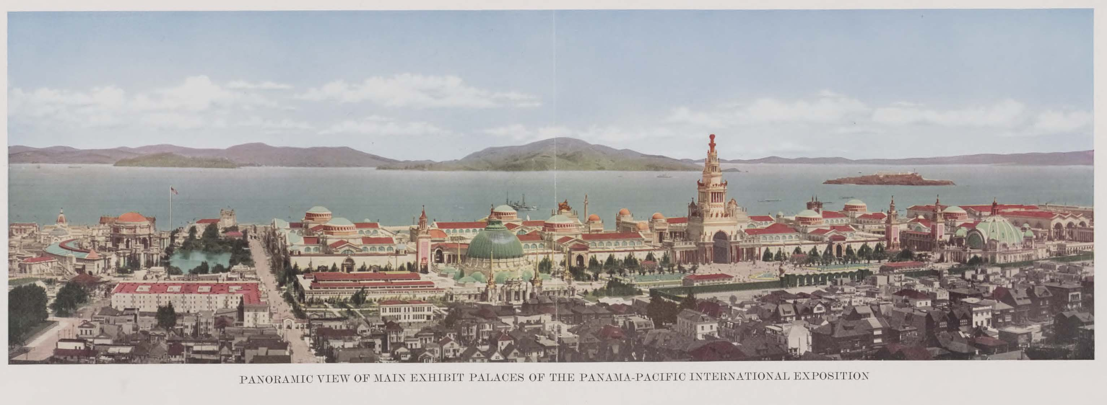
On the horizon
Transformative agreement renewals
Assessment
Author workflow improvement to encourage OA option
Greater support for OA publishing in humanities and social sciences
Collaborative, coalition-based TA negotiations
Question of “long tail” publishers and journals
Full OA publisher strategy

Slide 8
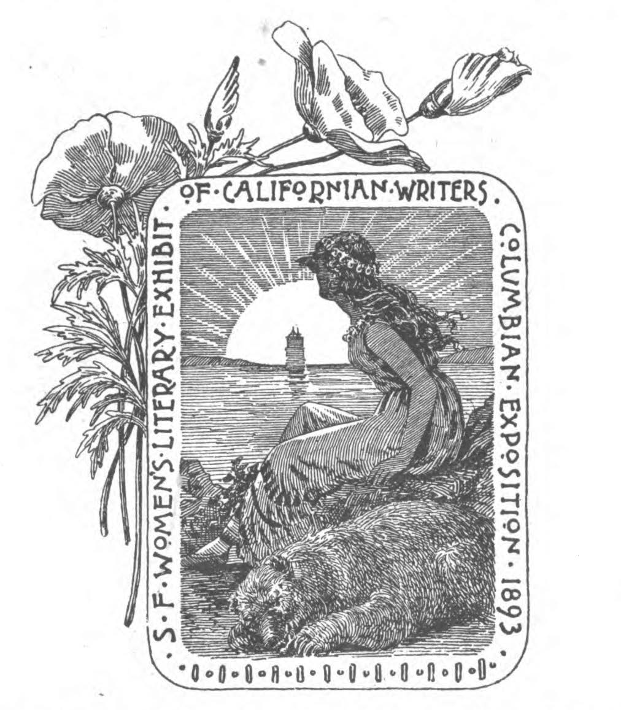
OA Values – Within TAs
Building “non-commercial” expectations into negotiations
Author rights retention
Support for federal mandate compliance (e.g., repository auto-deposit, PID requirements)
Workflow improvements
Diversity, equity, and inclusion initiatives (e.g., support for OA publishing from the Global South)

Slide 9
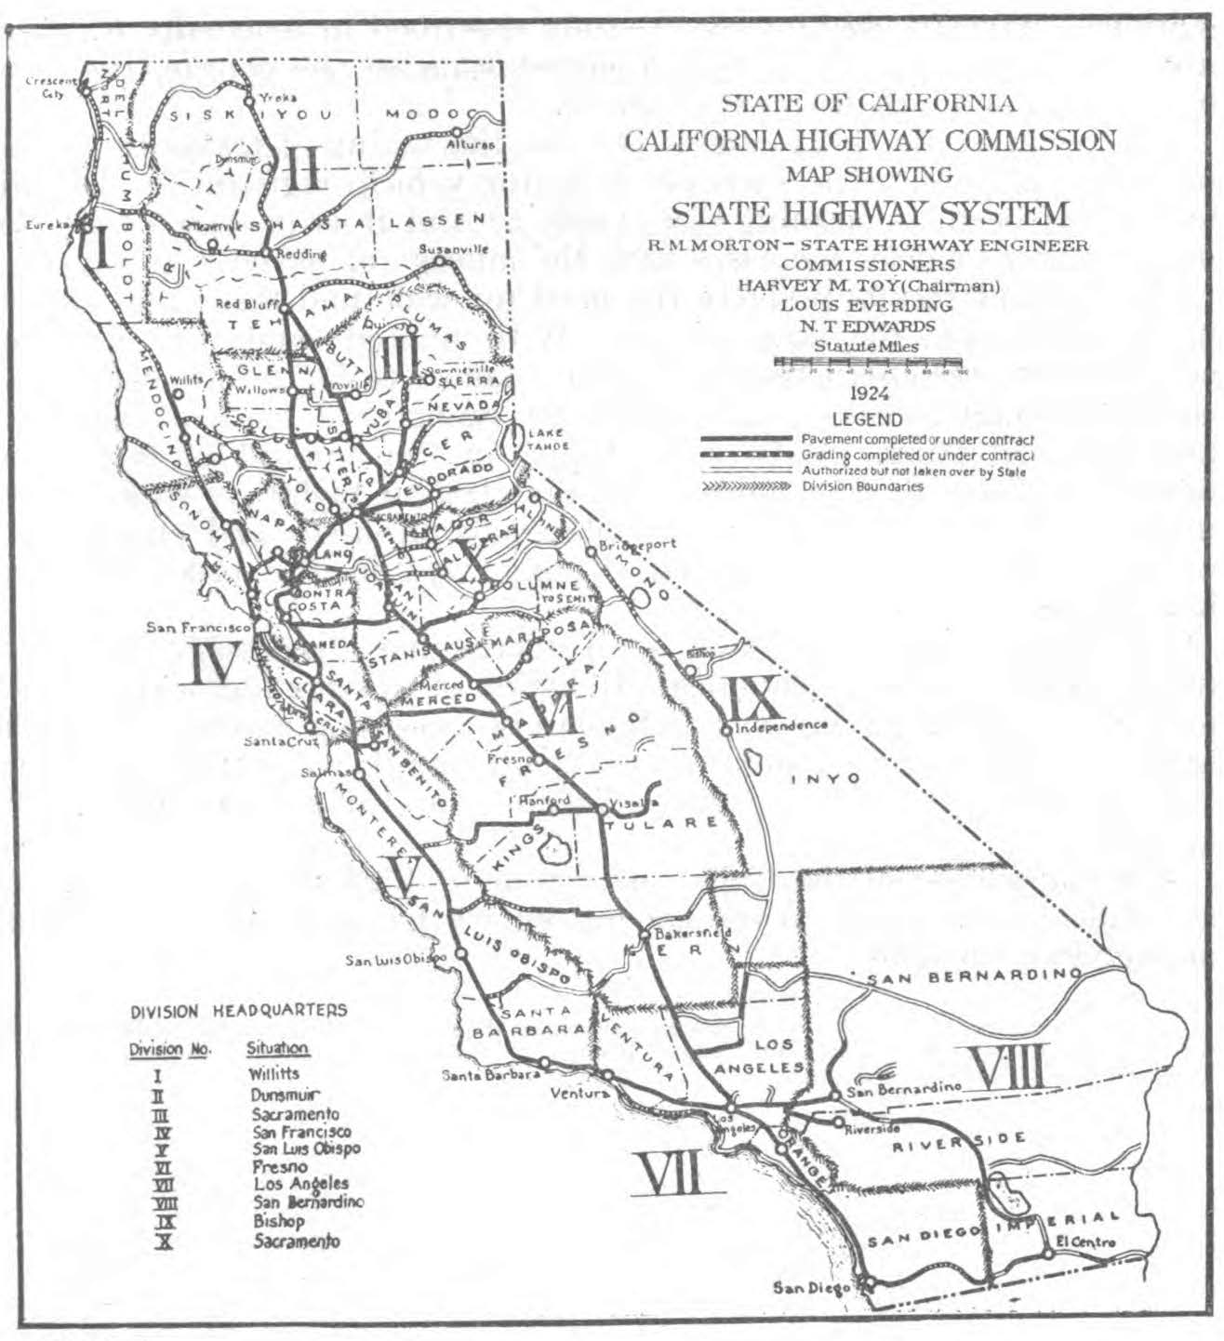
OA Values – Beyond TAs
Beyond TAs: Multiple pathways to OA
UC OA policy
Support for many approaches to OA
Institutional repository
Diamond OA (including UC eScholarship publishing program)
Preprint hosting (e.g., EcoEvoArxiv)
Subscribe to Open
OA ebook programs (e.g., MIT D2O, Opening the Future)

Slide 10
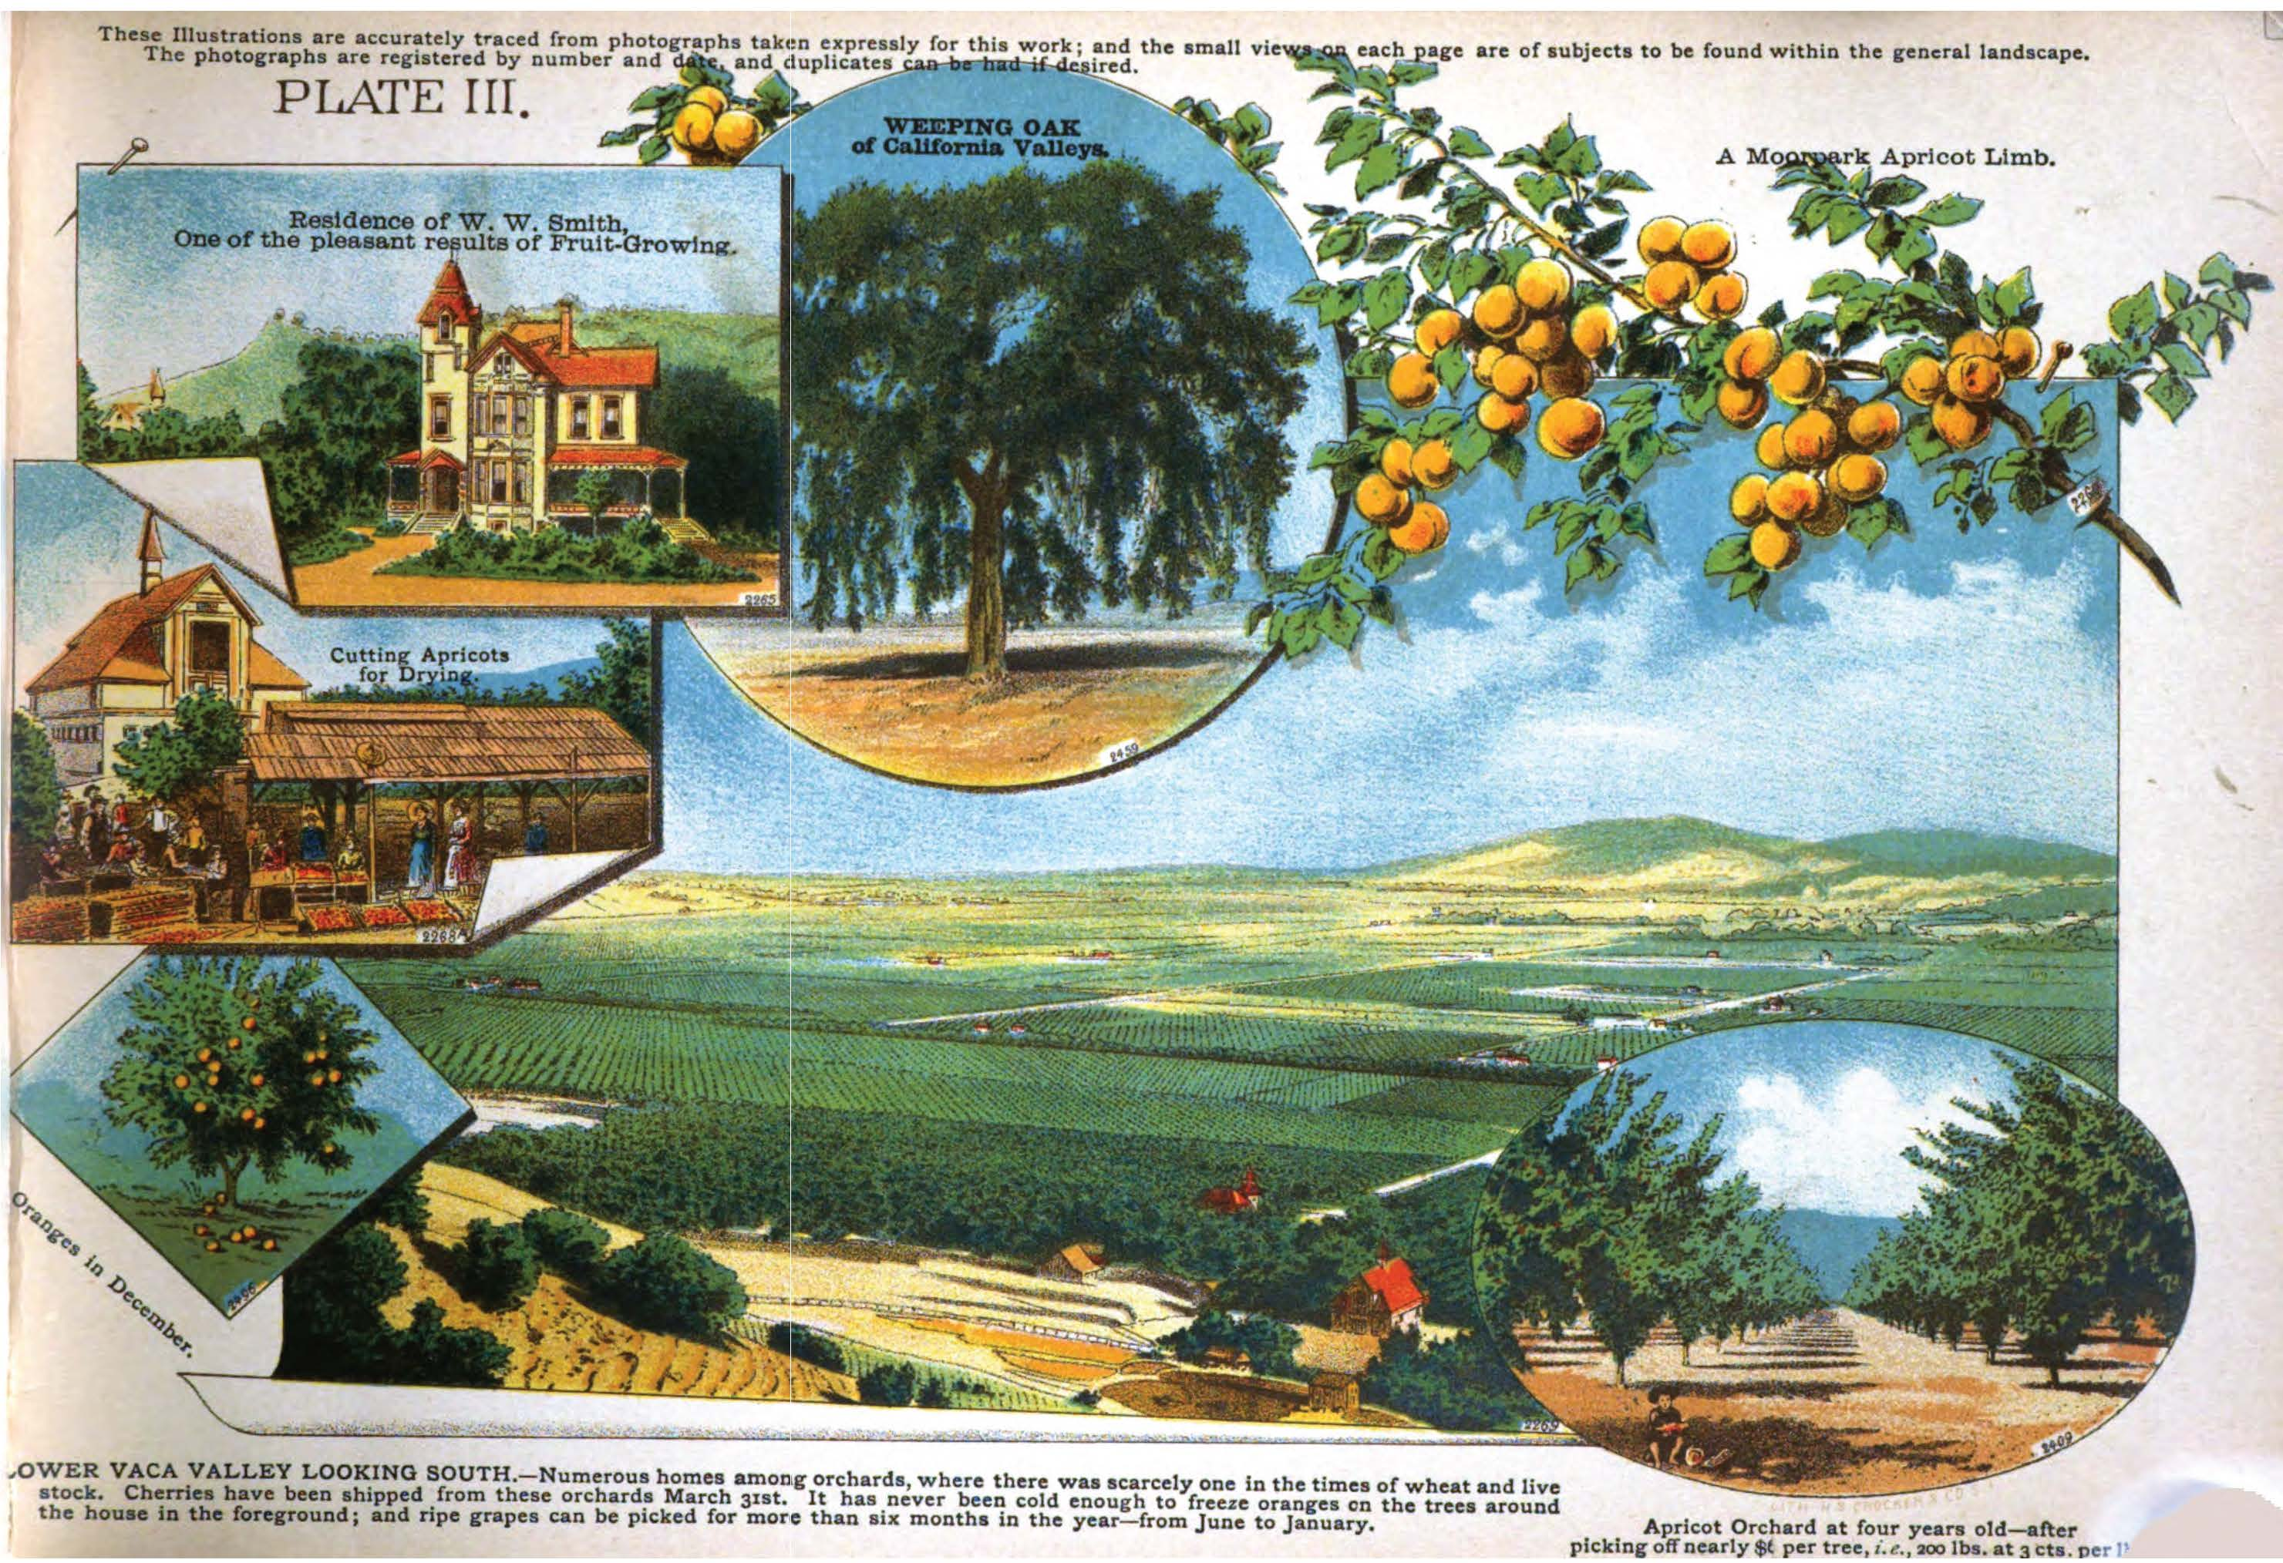
Thank you!
Miranda Bennett
miranda.bennett@ucop.edu

Slide 11
Image sources
Off-Street Parking Facilities, from Business districts, 1944. HathiTrust. https://catalog.hathitrust.org/Record/102583369.
Panoramic view of Panama-Pacific Exposition, from The great exposition: the Panama Pacific International Exposition illustrated with two sumptuous colored panoramas and 84 engravings of its principal scenes and features, 1915. HathiTrust. https://catalog.hathitrust.org/Record/009496043.
San Francisco Women’s Literary Exhibit of Californian Writers, from A list of books by California Writers, 1893. HathiTrust. https://catalog.hathitrust.org/Record/008400289.
California highway map, from A report of traffic on state highways and county roads in California 1922, 1924. HathiTrust. https://catalog.hathitrust.org/Record/001108734.
Apricot farming collage, from W. R. Nutting, California views in natural colors, 1889. HathiTrust. https://catalog.hathitrust.org/Record/102678844.

